Slide 2
OPENING PRAYER
Let us pray…..

Slide 3
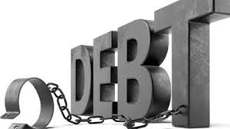
Week 4

Slide 4
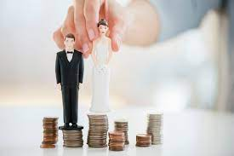
Day One (One Another & Real Love)
Homework: List Your Debts on pages 92-93
As a couple, what did you learn from completing this together ? How will this influence how you spend money? Do you have any questions about the List of Debts?

Slide 5
Day One (One Another & Real Love)
Review the “Real Love”
Which description of love did you and your spouse choose to practise in your marriage this week?
“Love is patient”
“Love is kind”
“does not envy” [is content]
“does not boast” [encourages]
“is not proud” [is humble]
“is not rude” [honors]
“is not self-seeking” [selfless]
“is not easily angered” [is gentle]
“keeps no records of wrongs” [forgives]
“Love does not delight in evil but rejoices with the truth”
“always protects”
“always trusts”
“always hopes”
“always perseveres”

Slide 6
Day Two (Debt)
Read CCC 1809
Temperance is the moral virtue that moderates the attraction of pleasures and provides balance in the use of created goods. It ensures the will's mastery over instincts and keeps desires within the limits of what is honorable. The temperate person directs the sensitive appetites toward what is good and maintains a healthy discretion: "Do not follow your inclination and strength, walking according to the desires of your heart." Temperance is often praised in the Old Testament: "Do not follow your base desires, but restrain your appetites." In the New Testament it is called "moderation" or "sobriety." We ought "to live sober, upright, and godly lives in this world."
While the Catechism does not have any direct references to debt, it does address the issue of wants versus needs that can be summarized in the virtue of temperance. The dictionary definition of temperance is “restraint”, “control” and “self-control”. We all have wants; it is the virtue of temperance that causes us to control these impulses and stay within the confines of our budget. Based on the above readings and CCC, what is the cause of getting into debt (becoming a borrower)?

Slide 7
Day Three (Debt)
Romans 13: 8 - Owe no one anything, except to love one another; for the one who loves another has fulfilled the law.
Proverbs 22: 7 - The rich rule over the poor, and the borrower is the slave of the lender.
Sharing: If you and your spouse have a strategy to get out of debt, describe it.

Slide 8
Day Four (Cosigning)
Sharing: What is your system of paying bills and/or debts efficiently? How does this work for you?
Proverbs 22: 26-27 - Do not be one of those who give pledges, who become surety for debts. If you have nothing with which to pay, why should your bed be taken from under you?
Proverbs 17: 18 - It is senseless to give a pledge, to become surety for a neighbor.
Sharing: Share your views on cosigning.

Slide 9
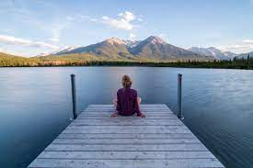
Day Five (Spending)
Read Luke 3: 14 - Soldiers also asked him, “And we, what should we do?” He said to them, “Do not extort money from anyone by threats or false accusation, and be satisfied with your wages.”
Philippians 4: 11-13 - Not that I am referring to being in need; for I have learned to be content with whatever I have. I know what it is to have little, and I know what it is to have plenty. In any and all circumstances I have learned the secret of being well-fed and of going hungry, of having plenty and of being in need. I can do all things through him who strengthens me.
Sharing: What does contentment mean to you?

Slide 10
Day Five (Spending)
Read CCC 1446
“Anytime we sin, we harm our relationship with God and need to restore it. As Catholics, we have the opportunity to “convert and recover the Grace of justification through the Sacrament of Penance.”
Are there any spending habits or lifestyle that you would like to change?

Slide 11
Day 6 - Once and for all Decision
What was the “once and for all decision” you and your spouse identified this week, and why did you choose it?

Slide 12
Closing Prayer

