Slide 1
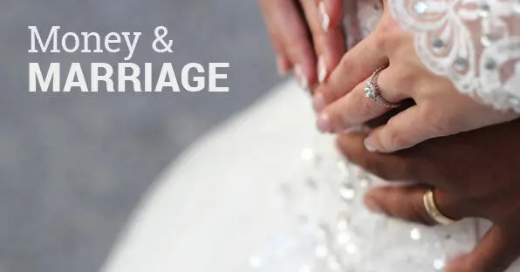

Slide 2
OPENING PRAYER
Let us pray…..

Slide 3
Week 3

Slide 4
‘One Anothers’
Which “one anothers” did you and your spouse select to apply in your marriage this week?
Our “one another” verse for this week:
“Do nothing from selfishness or empty conceit; but with humility of mind regard one another as more important than yourselves; do not merely look out for your own personal interest, but also for the interest of others” (Philippians 2:3-4)
“Be at peace with one another” (Mark 9:50)
“Live in harmony with one another” (Romans 12:16 )
“Let us stop passing judgement on one another” (Romans 14:13)
“So then let us pursue the things which make for peace the building up of one another” (Romans 14:19)
“Accept one another, then, just as Christ accepted you” (Romans 15:7)
“Serve one another in love” (Galatians 5:13)
“Carry each other’s burdens, and in this way you will fulfil the law of Christ” (Galatians 6:2)
“Be completely humble and gentle; be patient, bearing with one another in love” (Ephesians 4:2)
“Be kind and compassionate to one another, forgiving each other, just as in Christ God forgave you” (Ephesians 4:32)
“Do not lie to one another…” (Colossians 3:9)
“Comfort one another…” (1 Thessalonians 4:8)
“Make sure that nobody pays back wrong for wrong, but always try to be kind to each other” (1 Thessalonians 5:15)
“Encourage one another…” (Hebrews 10:25)
“Don’t grumble against each other… or you will be judged” (James 5:9)
“Above all, love each other deeply, because love covers a multitude of sins” (1 Peter 4:8)

Slide 5
Sharing: Which description of love did you and your mate choose to practise in your marriage this week?
“Love is patient, love is kind;
Love is not jealous or boastful;
It is not arrogant or rude.
Love does not insist on its own way, it is not irritable or resentful;
It does not rejoice at wrong,
but rejoices in the right.
Love bears all things,
believes all things,
hopes all things,
endures all things”

Slide 6
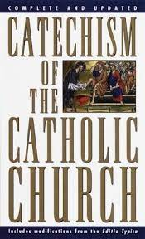
Read CCC 36
"Our holy mother, the Church, holds and teaches that God, the first principle and last end of all things, can be known with certainty from the created world by the natural light of human reason." Without this capacity, man would not be able to welcome God's revelation. Man has this capacity because he is created "in the image of God".
This is the most important section of the entire study because how we view God determines how we live. In the Bible, God calls himself by more than 250 names. What is the name that best describes God’s part in the area of money to you?

Slide 7
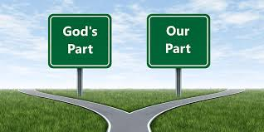
Sharing (God’s Part and Our Part)
Moreover, it is required of stewards that they be found trustworthy – 1 Corinthians 4:2
1. According to this verse, what is your requirement as a steward (manager)? How will this influence how you spend money?
Whoever is faithful in a very little is faithful also in much; and whoever is dishonest in a very little is dishonest also in much – Luke 16:10
2. Describe the principle found in this verse and how it might apply to you.

Slide 8
Differences
Sharing:
How do you and your spouse complement each other in how you handle finances?

Slide 9
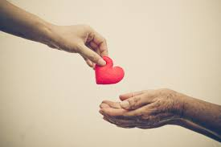
Giving
Sharing:
How would you describe your attitude to giving? Does it need to change; if so, how?

Slide 10
Saving
Four things on earth are small, yet they are exceedingly wise: the ants are a people without strength, yet they provide their food in the summer - Proverbs 30: 24-25
Sharing:
Are you satisfied with your commitment to savings? Are there any changes you intend to make as a couple?

Slide 11
Once and for all Decision
What was the “once and for all decision” you and your spouse identified this week, and why did you choose it?

Slide 12
Closing Prayer

