Slide 1
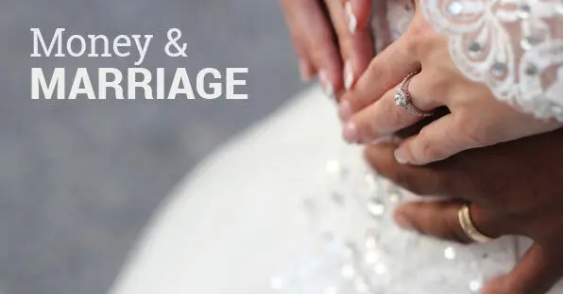
Introduction - Week 1

Slide 2
OPENING PRAYER
Let us pray…..

Slide 3
What is the Goal?
Or to grow together with a shared mission?
More money?

Slide 4
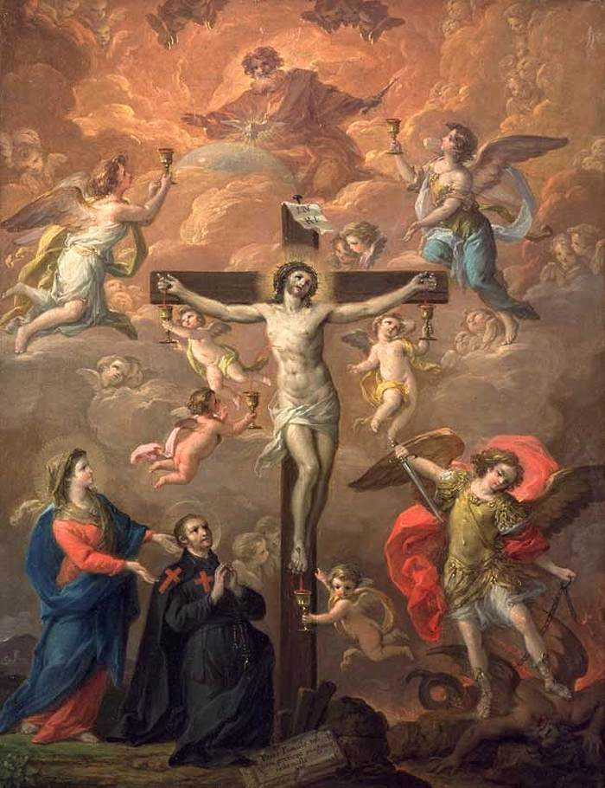
What are the four hallmarks of marriage?
The 4 Tenets of the wedding vows:
Free
Total
Faithful
Fruitful

Slide 5
Reflection
How do I live this out in my financial planning?
How do I live this out in my financial planning?

Slide 6
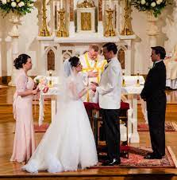
1. Free
Do we communicate freely and without fear of judgement about our spending and our financial needs/priorities?
Do we hide expenses from each other?
Do we know each other's attitudes towards money?
Are there any family-of-origin issues which affect our ability to be open to each other, to trust our spouse with our income?
How do we view money as affecting the 'balance of power' in our relationship?

Slide 7
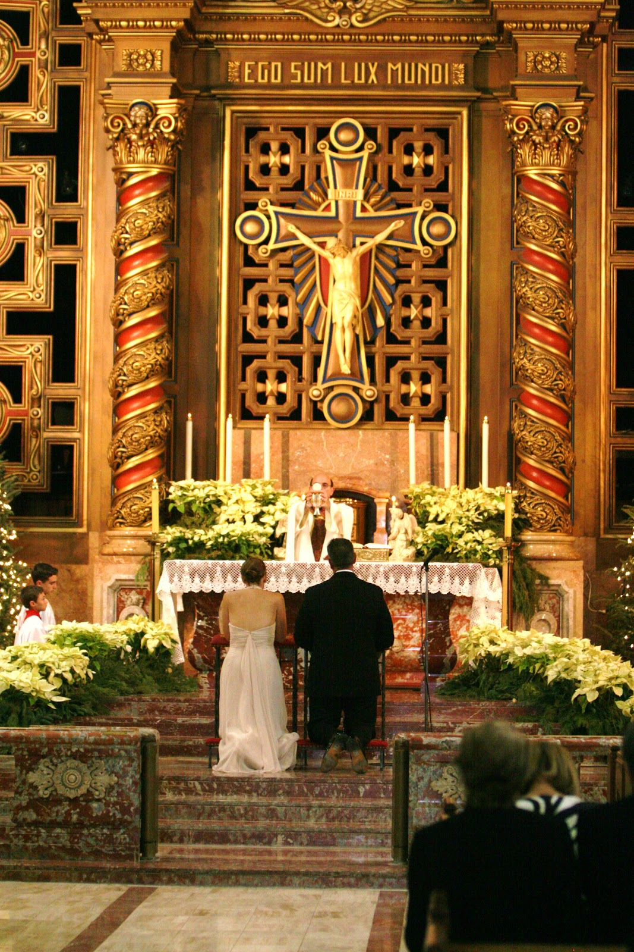
2. Total
Do we look at financial planning holistically?
Do we balance short-term needs with long-term goals?
Do we balance budgeting for the immediate family against financial commitments/responsibilities to the wider society?
How do we discern when is a good time to invest our time and treasure (e.g. in further studies, or in staying home with the kids) for the good of the family unit?

Slide 8
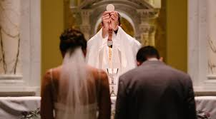
3. Faithful
Have I committed my finances fully to my spouse?
Do I see us as "one flesh" financially, e.g. shared bank account, joint responsibility?
Do I have shared investments with other relatives or friends which might endanger this financial fidelity to my spouse - especially investments which I haven't revealed to my spouse?

Slide 9
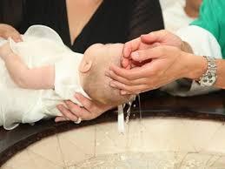
4. Fruitful
Is our spending focused purely on ourselves and short-term pleasures, or are we focused on giving life to others?
What financial plans do we need to start a family or enlarge our family, and to have our children raised by us (as far as possible)?
What are we willing to give up in order to have children?
How do we budget our allowances for parents, tithes to church and donations to charities?

Slide 10
Group Sharing
Based on this passage, do you think God’s way of having a healthy marriage and handling money will differ from how most people view marriage and money? What do you think would be the greatest differences?
From the Notes: What information especially interested you? How will you apply what you learned?
What benefits do you hope to receive from participating in this study?

Slide 11
Closing Prayer

