Slide 1
BUILDING A THRIVING MARRIAGE
Beloved Series : Session 4

Slide 2
OPENING PRAYER
“POP CORN” PRAYER
Everyone is welcomed to say a spontaneous prayer

Slide 3
Opening Prayer Pray together the following prayer from the Second Vatican Council
We stand before you, Holy Spirit, gathered in your name. Come to us, remain with us, and enlighten our hearts. Give us light and strength to know your will, to make it our own, and to live it in our lives. Guide us by your wisdom, support us by your power, for you are God, sharing the glory of Father and Son. Unite us to yourself in the bond of love, and keep us faithful to all that is true. You live and reign with the Father and the Son, one God,
for ever and ever. Amen.

Slide 4
Recap Session 3: Conflict and Communication
In Session 3, we talked about the causes of conflict as well as strategies for dealing with them. Your assignment was to draw up a “Geneva Convention” type of agreement for conflict. Would any couples like to briefly share about their experience?

Slide 5
Video - 18 mins
Beloved Series : Session 4
In this session, we’re going to talk about healing wounds, pursuing virtue, and
experiencing love as God intends.

Slide 6
Beloved Series : Session 3
We’re going to look at the common areas of conflict that most couples face. Then we’ll pull back the curtains on those areas to see what’s really behind them.
PLEASE SHARE 1 AREA THAT TOUCHED YOU

Slide 7
Outline of Video
Marriage is about mirroring God’s love
A. We must not let the ideal become the enemy of the good.
B. There are five things couples can do to pursue the ideal.
1. Be aware of yourself.
2. Do the work - Use the tools and resources and make a plan with a strategy and follow through.
3. Be together
4. Pursuing virtue -involves a learning process; occasional failures are to be expected.
5. Be patient with each other - It takes time to grow in an area of virtue.

Slide 8
Outline of Video
Woundedness can prevent us from expressing and experiencing love as God intends.
A wound is an experience of unlove.
B. The remedy for woundedness is an experience of love - an authentic blessing from God or another person

Slide 9
GROUP SHARING
What’s the most impressive thing you’ve ever accomplished? Explain.
Of the five things spouses can do to pursue God’s ideal for their relationship—
be aware of yourself, do the work, be together, pursue virtue, and be patient—
which one would you say is most difficult? Explain.
3. Describe a relationship you’ve seen struggle because of woundedness.

Slide 10
COUPLE DISCUSSION
1. What would happen to your marriage if you became more aware of yourselves,
did the work of marriage, made a point of being together more, pursued virtue more
passionately, and learned to be more patient with each other? How good could you
be together? What might be some of the results?
2. . What impact has woundedness—that is, past experiences of “unlove”—had on
your marriage?
Notes:
Marriage is the most important job we’ll ever have. It deserves at least the same amount of time, planning, strategizing, and attention to detail that we give to our career or our education. Yet the work of marriage tends to get pushed aside in
favor of more “pressing” things. Turn to the Couple’s Activity on page 66 in your Guides.

Slide 11
Couple Activity
Marriage is work—the most rewarding work we’ll ever do. And when there’s work to be done, one of the most helpful resources available to us is a to-do list. Set aside some time this week with your spouse in order to make a to-do list for your marriage. It could be your date-night activity!
Put some thought into the items you include on your list. Be specific. Don’t settle for something vague like “Spend more time together”; instead, opt for something more specific like “Take a walk around the block together every evening after dinner.
Depending on your circumstances, your list may include items such as…
• Schedule an appointment with a marriage counselor.
• Attend Mass together at 8:45 on Sunday.
• Go to Confession as a family on the 15th of every month.
• Volunteer for a ministry together.
• Plan this week’s date night.
Notes:
This week we’re going to put marriage front and center. Set aside some time this week to make a “to-do list” for your marriage—specific things you want to do in order to draw closer to your spouse. After you’ve made your list, put each item on
your calendar so that it doesn’t get lost in the busyness of daily life. Give the work of marriage the priority it deserves.

Slide 12
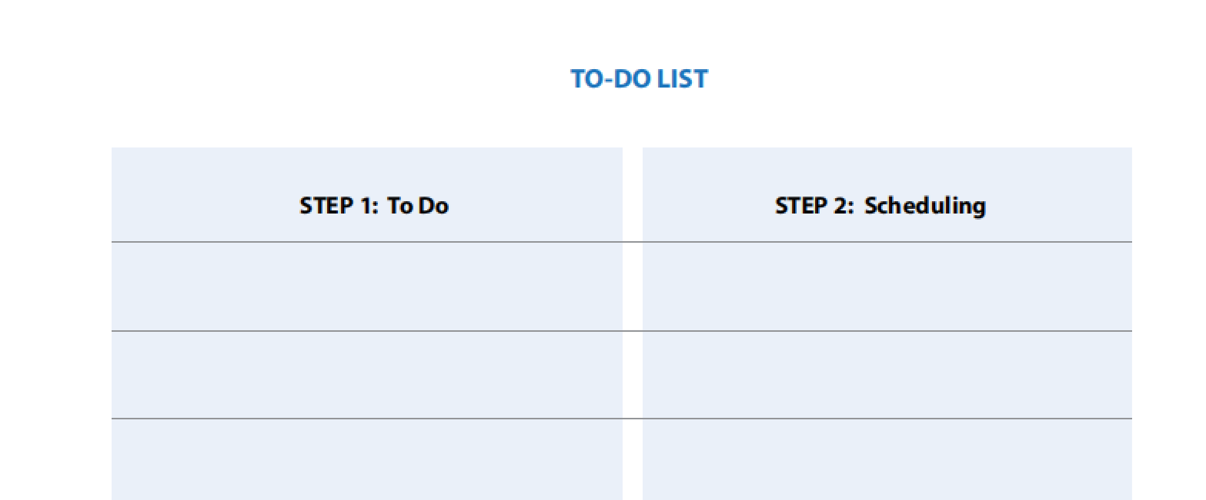
Couple Activity
Compiling your list is Step 1. Scheduling it is Step 2. Pull out your planners and set a start date for each job on your list. Honor the times you set. Don’t allow your marriage enrichment plans to be pre-empted. Give your relationship the priority it deserves.

Slide 13
“The family finds in the plan of God the Creator and Redeemer not only its identity, what it is, but also its mission, what it can and should do….Each family finds within itself a summons that cannot be ignored and that specifies both its dignity and its responsibility. Family, become what you are.”
—St. John Paul II, Familiaris Consortio 17

Slide 14
CLOSING PRAYER
Praying Husbands
Lord, I pray that You would establish in me and my wife bonds of love that cannot be broken. Show me how to love my wife in an ever-deepening way that she can clearly recognise. May we have mutual respect and admiration for each other so that we become and remain one another’s greatest friend, champion, and unwavering support.
Where love has been diminished, lost, destroyed or buried under hurt and disappointment, put it back in our hearts. Give us strength to hold on to the good in our marriage, even in those times when one of us doesn’t feel love.
Amen

Slide 15
CLOSING PRAYER
Praying Wife
Lord, I pray that You would unite my husband and me in a bond of friendship, commitment, generosity and understanding. Eliminate our immaturity, hostility or feelings of inadequacy.
Help us to make time for one another alone, to nurture and renew our marriage and remind ourselves of the reasons we were married in the first place.
I pray that my husband will be so committed to You, Lord, that his commitment to me will not waver, no matter what storms come.
I pray that our love for each other will grow stronger every day.
Amen

