Slide 1
Intellectual Intimacy
Notes:
Jn 10:10

Slide 2
Opening Prayer

Slide 3
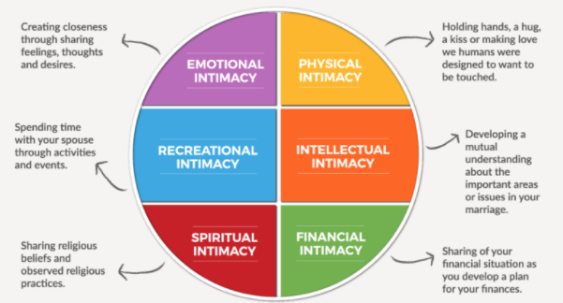
Couple Discussion (2 mins)
PART I
On a scale of 1-10, how would you measure the intellectual intimacy of your marriage right now?

Slide 4
https://www.cardinalstudios.org/epic-intimacy-challenge-intellectual-intimacy-3c9f?cid=d95eca4b-932d-4cef-a4a7-5e7e5761cae9&eoid=2147626270
Introductory video

Slide 5
Couple Discussion

Slide 6
Couple Discussion (5 mins)
PART II
Each of you name 2 strengths and 2 weaknesses in the area of intellectual intimacy for your marriage.
Share with your spouse for 5 mins before we regroup

Slide 7
https://www.cardinalstudios.org/epic-intimacy-challenge-intellectual-intimacy-3c9f?cid=d95eca4b-932d-4cef-a4a7-5e7e5761cae9&eoid=2147626270
Watch “Start by Changing Your Perspective” video (#2)

Slide 8
Couple Discussion & Group Sharing 2

Slide 9
Discuss & Share (10 mins)
PART III
1. Identify a recent/recurrent point of conflict in your marriage.
2. Each of you identify the feeling behind this conflict. Share deeply why you feel this way. (The other spouse listens intently.)
3. At the end of the dialogue, each ask the other, “What do you love about me?”
Tell your spouse: “What I love about you is _____?”
Share with your spouse for 10 mins before we regroup
Notes:
For example:
Name the conflict: Fights over long hours at the office
Name the feeling (Wife): When you work long hours, I feel WORRIED about your health. Name the feeling (Husband): When you keep mentioning my long hours at work, I feel CONTROLLED.

Slide 10
Closing Prayer

