Slide 1
Physical Intimacy
Notes:
Jn 10:10

Slide 2
Opening Prayer

Slide 3
Facilitators’ sharing
Notes:
Facilitators to share briefly with the group on what physical intimacy means to your marriage. Include any misunderstandings / misalignment of expectations that you may have had and how you worked through them.

Slide 4
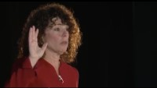
Watch video

Slide 5
Couple Discussion & Group Sharing

Slide 6
Couple Discussion (10 mins)
How do I feel when you accept my invitation to sex? How do I feel when you reject my invitation to sex?
Each time we make love, it is in essence a renewal of our marital vows. How does this make me feel?
Share with your spouse one thing you need for you to be ready for physical intimacy.
Have we asked God to bless and be a part of every area of our marriage, including our physical intimacy? Can we start (or continue) doing this?

Slide 7
What we say with our bodies in the marital embrace…
Watch video

Slide 8
Closing Prayer

