Slide 1
Emotional Intimacy
Notes:
Jn 10:10

Slide 2
Opening Prayer

Slide 3
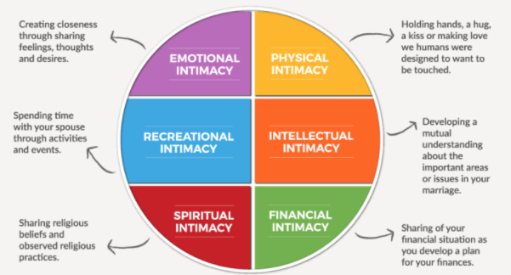
Couple Discussion (2 mins)
PART I
On a scale of 1-10, how would you each measure the quality of your emotional intimacy within your marriage right now?

Slide 4
Watch video
Notes:
please go to the section on Video Clips and play the above video

Slide 5
Couple Discussion & Group Sharing

Slide 6
Couple Discussion (10 mins)
PART II
Each of you answer: I feel least loved by you when you ____________. I feel most loved by you when you _____________. (Describe in loving detail.)
PART III
What area of improvement do I think would have the greatest impact on our marriage? Share with your spouse for 10 mins before we regroup

Slide 7
Closing Prayer

