Slide 1
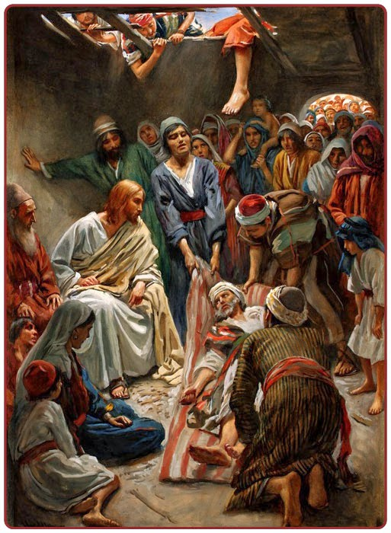
‘I order you: get up, pick up your stretcher and go off home.’
21st January 2022

Slide 2
AGENDA
Opening Hymn “Unveil My Eyes” and Prayer
Contemplate Mark 2:1-12 The Healing of the Paralytic.
Individual Reflection
Listen to meditation of the passage from Opus Dei priest.
Small Group Sharing and Discussion
Main Group Summary Reflection
Closing Hymn “In Your Truth” and Prayer

Slide 3
Unveil my eyes to see your face That I might recognise your grace And all these plans you have for me Use them to set them free
Unveil my eyes to see your face That I might recognise your grace And all these plans you have for me Use them to set them free
Unveil my eyes to see your face That I might recognise your grace And all these plans you have for me Use them to set them free Use them to set them free Use them to set them free Use them to set them free
Unveil my eyes. Salt of the sound

Slide 4
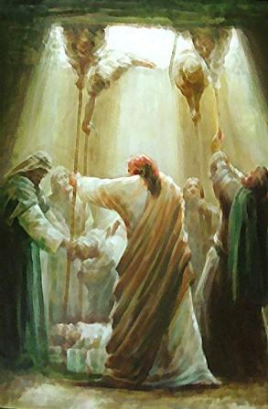
When he returned to Capernaum, some time later, word went round that he was in the house; and so many people collected that there was no room left, even in front of the door. He was preaching the word to them when some people came bringing him a paralytic carried by four men, but as they could not get the man to him through the crowd, they stripped the roof over the place where Jesus was; and when they had made an opening, they lowered the stretcher on which the paralytic lay. Seeing their faith, Jesus said to the paralytic, 'My child, your sins are forgiven.’ Now some scribes were sitting there, and they thought to themselves, 'How can this man talk like that? He is being blasphemous. Who but God can forgive sins?’ And at once, Jesus, inwardly aware that this is what they were thinking, said to them, 'Why do you have these thoughts in your hearts? Which of these is easier: to say to the paralytic, ‘Your sins are forgiven’ or to say, ‘Get up, pick up your stretcher and walk?’ But to prove to you that the Son of man has authority to forgive sins on earth he said to the paralytic: 'I order you: get up, pick up your stretcher, and go off home.’ And the man got up, and at once picked up his stretcher and walked out in front of everyone, so that they were all astonished and praised God saying, 'We have never seen anything like this.'
Mark 2: 1-12
The healing of the paralytic

Slide 5
Furnace of god’s mercy and love

Slide 6
I’ve found hope in one unchanging I’ve found a friend in the great I Am I’ve found peace in the Lord Almighty Perfect love meets me as I am In Your truth I am found In Your arms I am home In Your grace I’m restored In Your love is where I belong I’ve been saved by the King of Kingdoms I’ve found life in the Risen One I’m set free by the Lord of justice Perfect peace tеlls me who I am In Your loving arms I am safe and sеcure In Your loving arms I’m adored
In your truth. One hope project

