Slide 1
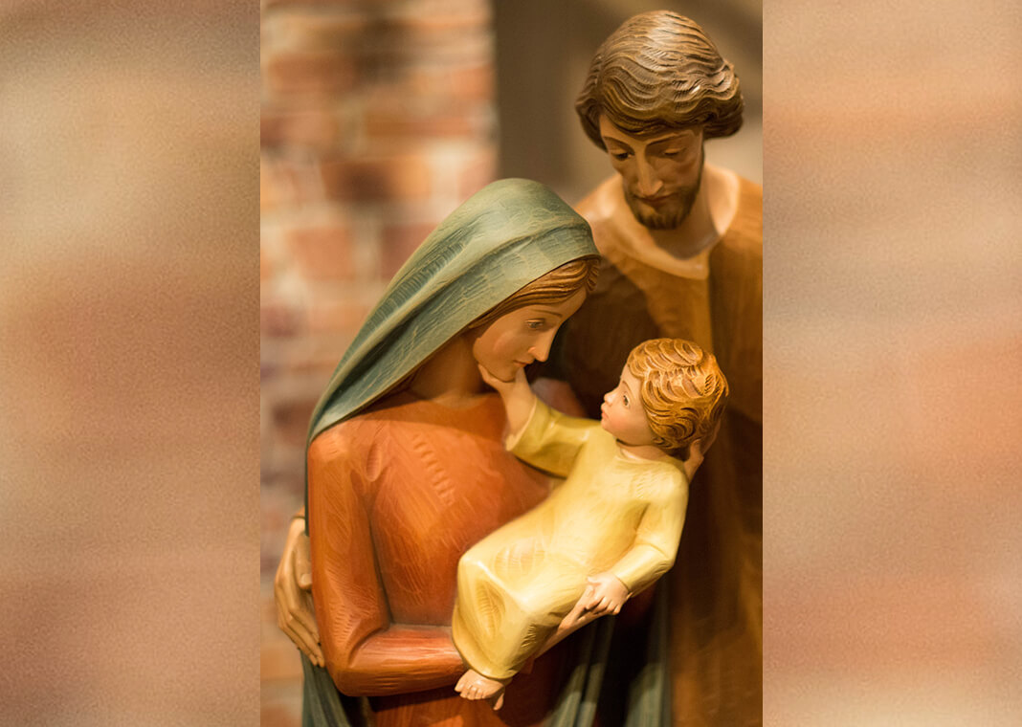
‘You are my son, the beloved; my favour rests on you’
8th January 2022

Slide 3
Lyrics
Long awaited precious promise. Son of God and son of man. Heaven's glory in a manger. Has come to us in Bethlehem.
Messiah, Messiah. A baby born to save us all. Messiah, Messiah. On our knees we fall.
All we longed for, all we needed. Shining in this child's eyes. Hope forever, death defeated. Because of this one holy night.
Messiah, Messiah. A baby born to save us all. Messiah, Messiah. On our knees we fall.
O come let us adore him, O come let us adore him, O come let us adore him, Christ the Lord.
Long awaited precious promise. Coming back again.
Messiah, Messiah. A baby born to save us all. Messiah, Messiah. On our knees we fall. On our knees we fall.
MESSIAH. Francesca Battistelli

Slide 4
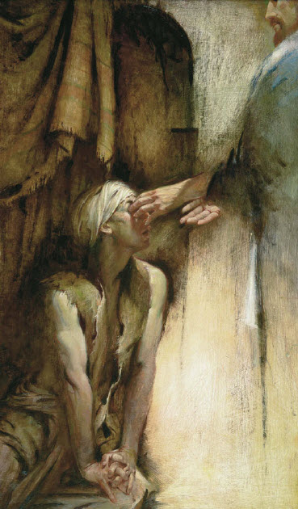
Then they came to Jericho. As Jesus and his disciples, together with a large crowd, were leaving the city, a blind man, Bartimaeus (which mean “son of Timaeus”), was sitting by the roadside begging. When he heard that it was Jesus of Nazareth, he began to shout, “Jesus, Son of David, have mercy on me!” Many rebuked him and told him to be quiet, but he shouted all the more “Son of David, have mercy on me!” Jesus stopped and said, “Call him.” So they called to the blind man, “Cheer up! On your feet! He’s calling you.” Throwing his cloak aside, he jumped to his feet and came to Jesus. “What do you want me to do for you?” Jesus asked him. The blind man said, “Rabbi, I want to see.” “Go,” said Jesus, “your faith has healed you.” Immediately he received his sight and followed Jesus along the road
Mark 10: 45-52
Bartimaeus, blind man in Jericho

Slide 5
AGENDA
Introduction – Messiah music video
Contemplate the blind man in Jericho. Mark 10:45-52
Opening Prayer – Listening
Active Listening Exercise
The first duty of love is to listen.
Listen to understand; not to respond.
Share one key impediment / obstacle you feel is affecting your marital relationship or your relationship with Jesus. The other listens and can only question to seek clarity and understanding; otherwise to paraphrase, reflect feelings being expressed and to summarise. Affirm and thank the other for sharing, recognising that sharing is a risk and a gift. Reverse role.
4. Closure – What is one thing that I can do for you? [In addressing the above]
5. Concluding Prayer

Slide 6
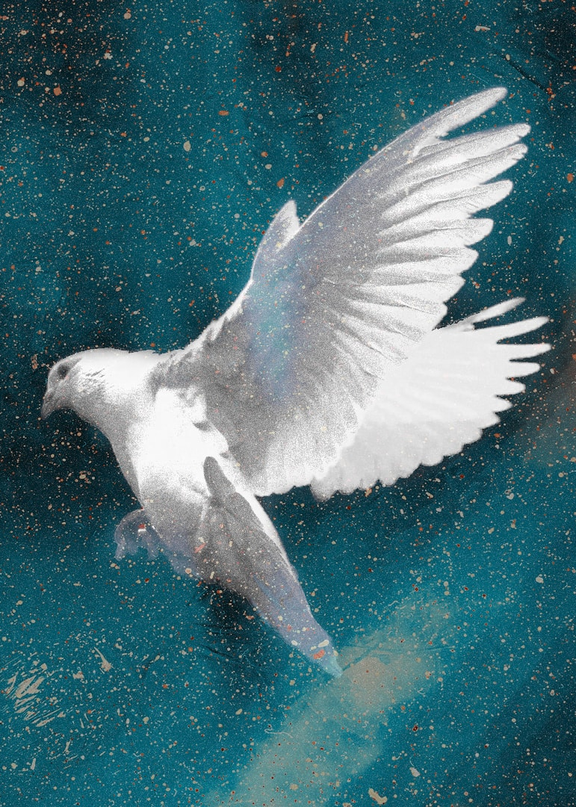
Teach me to listen, O God, to those nearest me, my spouse, my family, my friends. Help me to be aware that no matter what words I hear, the message is, “Accept the person that I am. Listen to me.”
Teach me to listen, my caring God, to those far from me – the whisper of the hopeless, the plea of the forgotten, the cry of the anguished.
Teach me to listen, O God, to myself. Help me to be less afraid to trust the voice inside — in the deepest part of me.
Teach me to listen, Holy Spirit, for your voice — in busyness and in boredom, in certainty and doubt, in noise and in silence. Teach me, Lord, to listen.
Amen.
OPENING PRAYER

