Slide 1
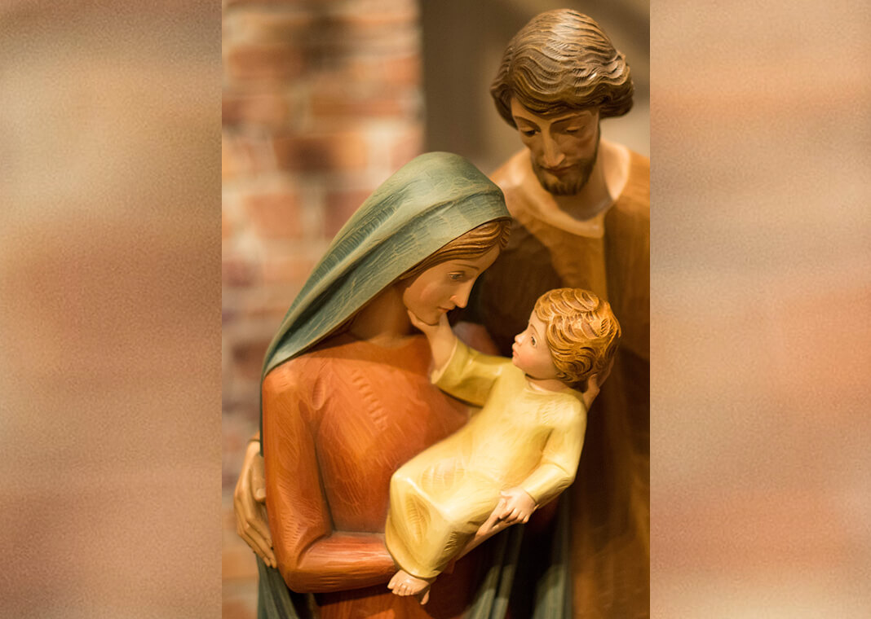
BLESSED AND HOLY CHRISTMAS TIDE
30th December 2021

Slide 3
Lyrics
Everything inside me cries for order/everything inside me wants to hide/ is this shadow an angel or a warrior?/if God is pleased with me why am I so terrified?/someone tell me I am only dreaming/somehow help me see with heaven's eyes/but before my head agrees/my heart is on its knees/Holy is he/blessed am I/ CHORUS be born/ in me/be born/ in me/ trembling heart/ somehow I believe/ that you/ chose me/I hold you in the beginning/ you will hold me in the end/every moment in the middle/ make my heart your Bethlehem/be born in me// All this time we've waited for the promise/all this time you've waited for my arms/did you wrap yourself inside the unexpected?/so we might know that love would go that far/CHORUS/I am not brave/I'll never be/ the only thing my heart can offer is a vacancy/I'm just a girl/nothing more/but I am willing/I am yours/oh woah oh oh/oh oh oh/oh oh oh oh/be born/in me/be born/in me/I hold you in the beginning/you will hold me in the end/every moment in the middle/make my heart your Bethlehem/be born in me.
BE BORN IN ME. Francesca Battistelli

Slide 4
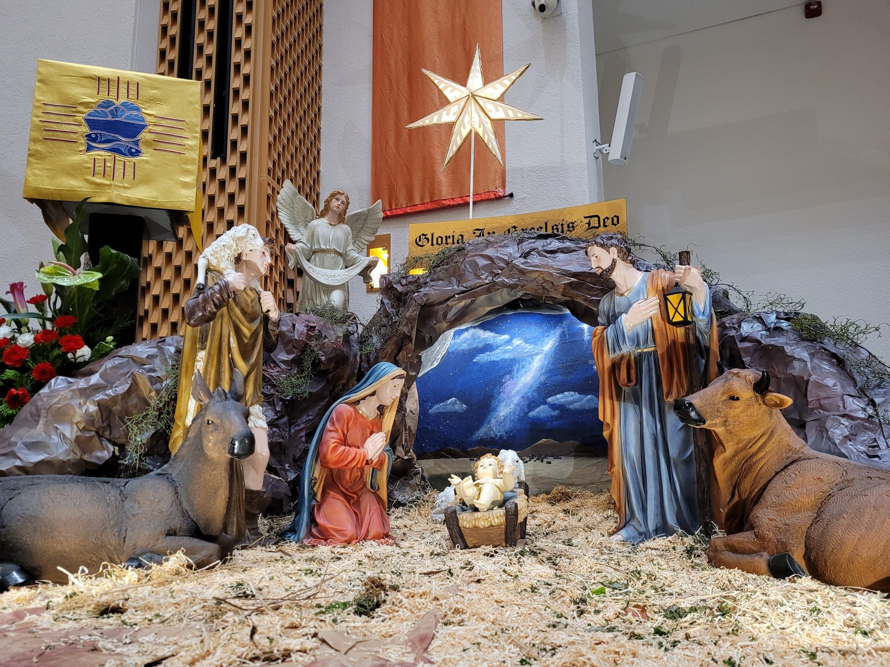
Now it happened that at this time Caesar Augustus issued a decree that a census should be made of the whole inhabited world. This census -- the first -- took place while Quirinius was governor of Syria, and everyone went to be registered, each to his own town. So Joseph set out from the town of Nazareth in Galilee for Judaea, to David's town called Bethlehem, since he was of David's House and line, in order to be registered together with Mary, his betrothed, who was with child. Now it happened that, while they were there, the time came for her to have her child, and she gave birth to a son, her first-born. She wrapped him in swaddling clothes and laid him in a manger because there was no room for them in the living-space.
LUKE 2:1-7
Contemplate the Nativity Scene

Slide 5
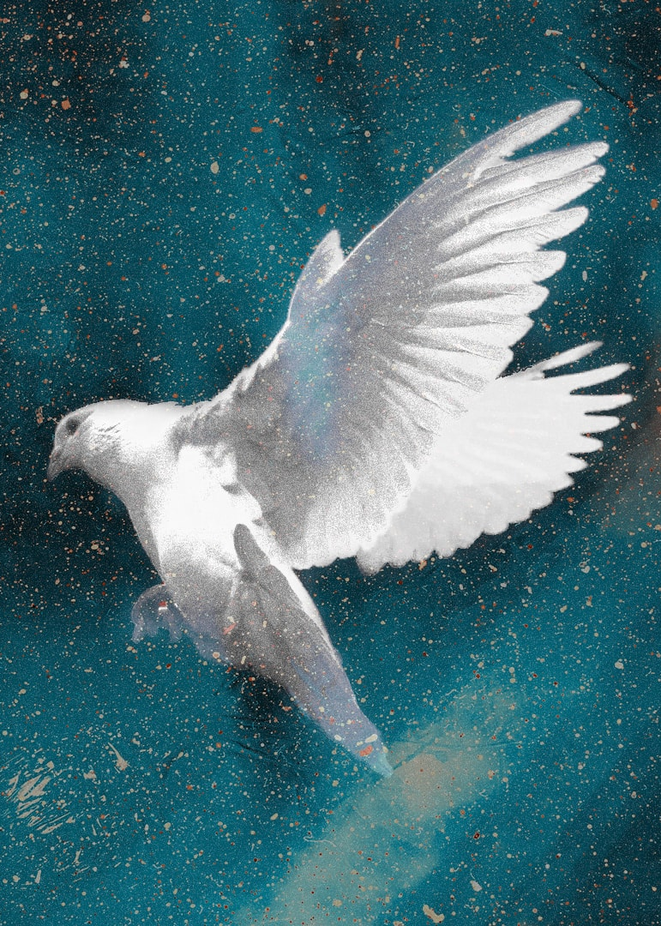
Teach me to listen, O God, to those nearest me, my spouse, my family, my friends. Help me to be aware that no matter what words I hear, the message is, “Accept the person that I am. Listen to me.”
Teach me to listen, my caring God, to those far from me – the whisper of the hopeless, the plea of the forgotten, the cry of the anguished.
Teach me to listen, O God, to myself. Help me to be less afraid to trust the voice inside — in the deepest part of me.
Teach me to listen, Holy Spirit, for your voice — in busyness and in boredom, in certainty and doubt, in noise and in silence. Teach me, Lord, to listen.
Amen.
OPENING PRAYER

Slide 6
AGENDA
Introduction – Be Born In Me music video
Contemplate the Nativity Scene. Luke 2:1-7
Opening Prayer – Listening
Active Listening Exercise
The first duty of love is to listen.
Listen to understand; not to respond.
Ground rules – Share one hurt / grievance. The other listens and can only question to seek clarity and understanding; otherwise to paraphrase, reflect feelings being expressed and to summarise. Affirm and thank the other for sharing, recognising that sharing is a risk and a gift. Reverse role.
4. Closure – next steps
5. Concluding Prayer

