Slide 1
Welcome to meeting #6
Notes:
Welcome to this , our last session before our consecration to St Joseph tomorrow.

Slide 2
Who is Saint Joseph?
Notes:
As a sum up or recap of our journey thus far, perhaps this video can refresh or reinforce our learning …

Slide 3
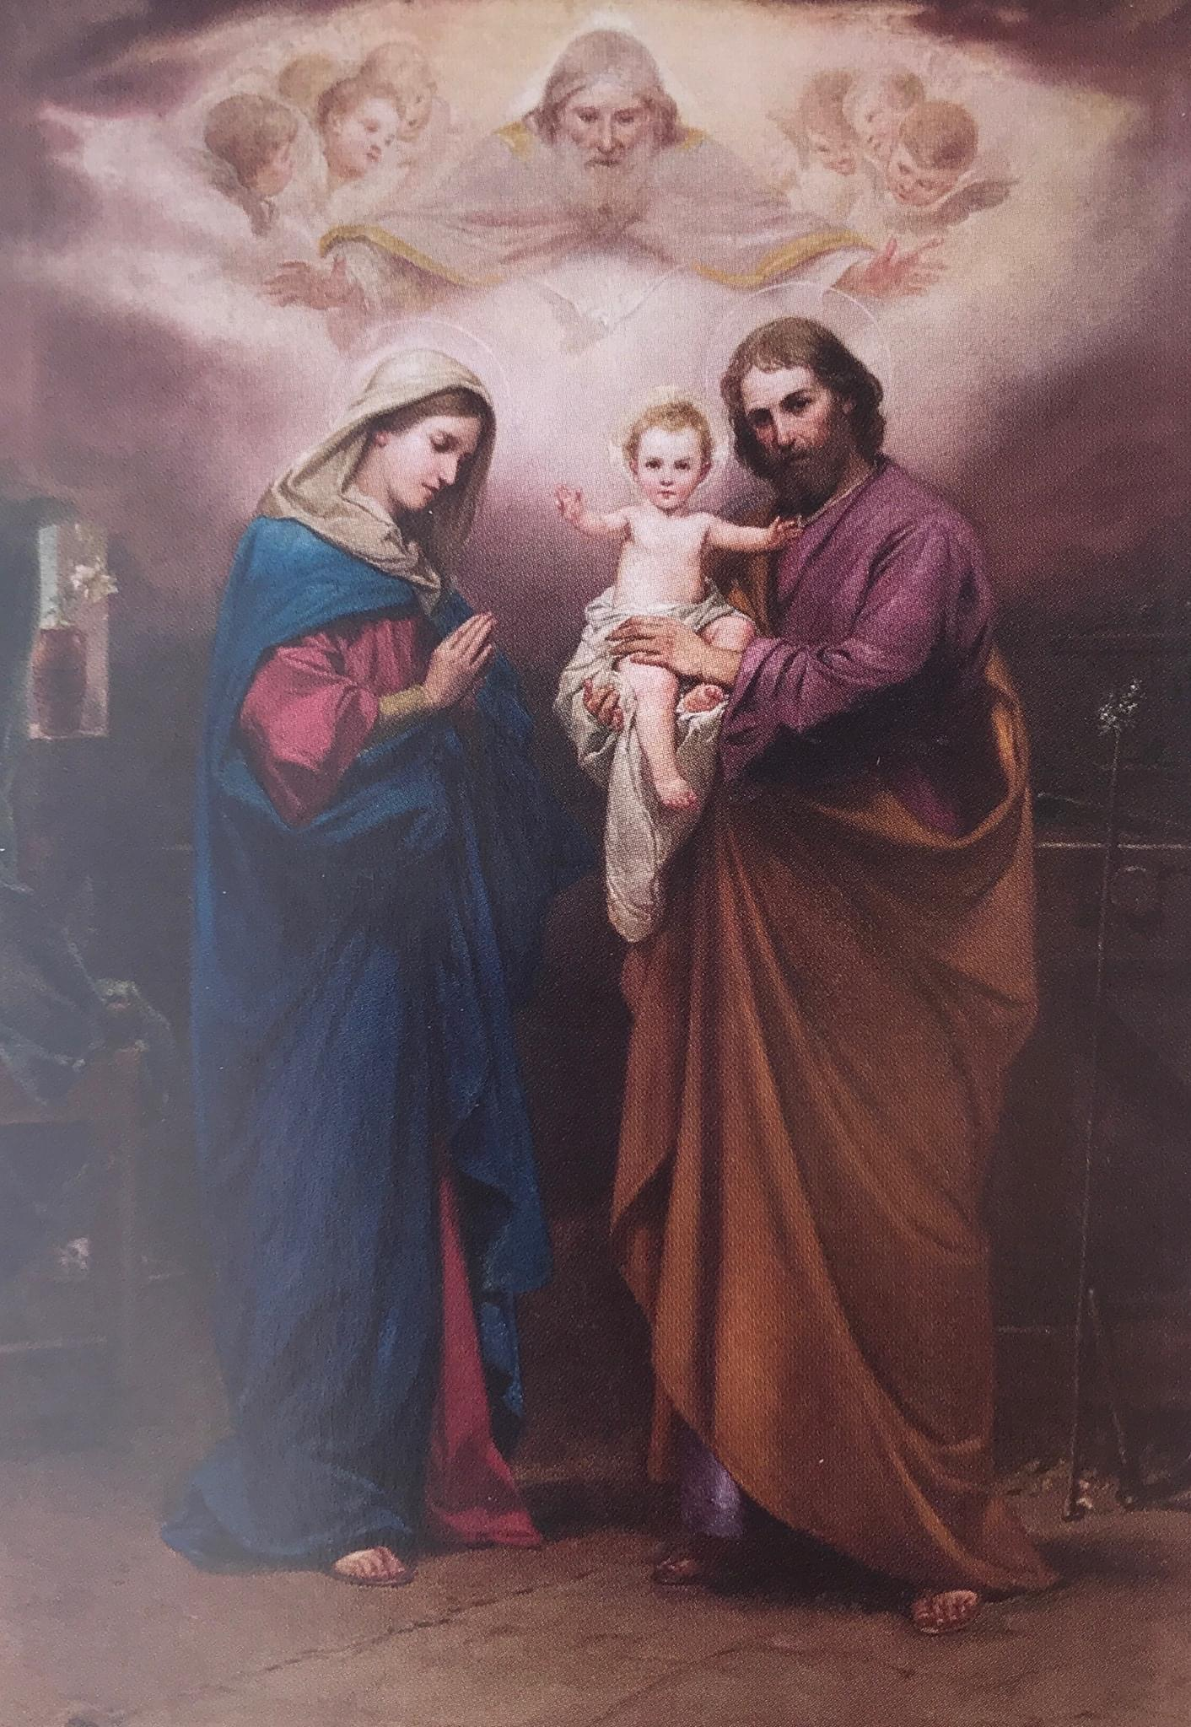
God, our Father,
We place ourselves before you;
We know you see us and you hear us;
You love us and you are never far from us.
You listen to our prayers, you attend to them,
In your time and wisdom, with your love and mercy.
At this time, we ask for your grace of faith, and understanding,
May we listen to your voice and harden not our hearts.
Let us embrace your truth and walk ever closer with you.
Protect our families with your loving care,
Especially those for whom we now pray:
[In the silence of our heart,
We pause to pray for all our family members,]
Our Beloved Mother Mary and St Joseph, intercede for us;
In Jesus name we pray,
AMEN.
Opening Prayer
Notes:
Let us pray by placing ourselves and our families before God …

Slide 4
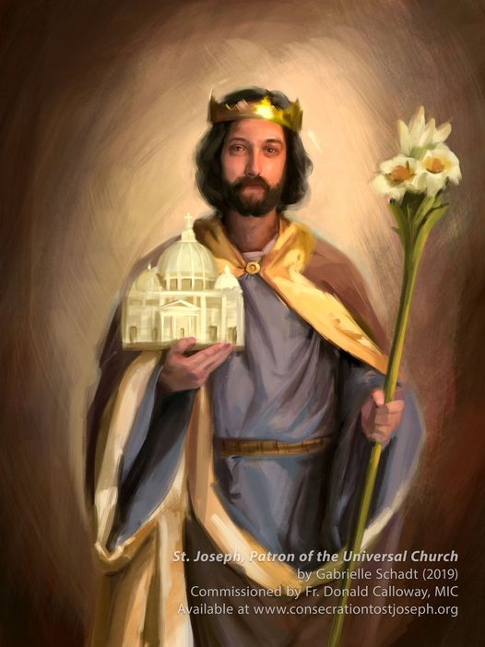
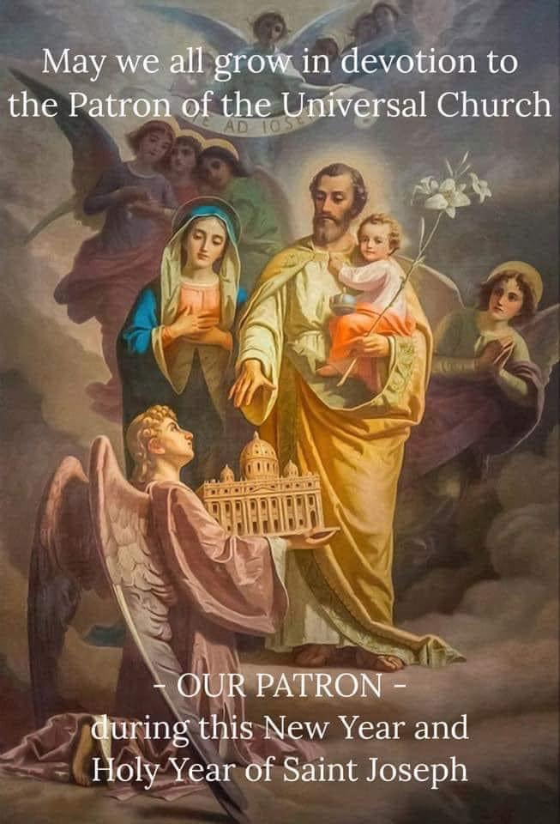
“God chose to make Joseph his most tangible image on earth.” Blessed William Joseph Chaminade
In 1870, Pope Leo XIII explained the title of St. Joseph this way, "It is thus fitting and most worthy of Joseph's dignity that, in the same way he once kept unceasing holy watch over the family of Nazareth, so now does he protect and defend with his heavenly patronage the Church of Christ."
The Church invokes St. Joseph as her Patron and Protector through her unshakable trust that he to whom Christ willed to confide the care and protection of his own frail human childhood, will continue from heaven to perform his protective task in order to guide and defend the Mystical Body of Christ himself, which is always weak, always under attack, always in a state of peril. - St. Pope Paul VI
Joseph, Protector of the Holy Church, Patron of the Universal Church; pray for us.
Notes:
As we come to the close of our 33-day study of St Joseph it bears reminding that St Joseph as Protector and Patron of the Holy Universal Church, he also presides over the Body of Christ which includes all of us. Amongst all men, God chose to make Joseph his most tangible image on earth. In 1870, Pope Leo XIII explained … read slide … Joseph, protector of the Holy Church, pray for us

Slide 5
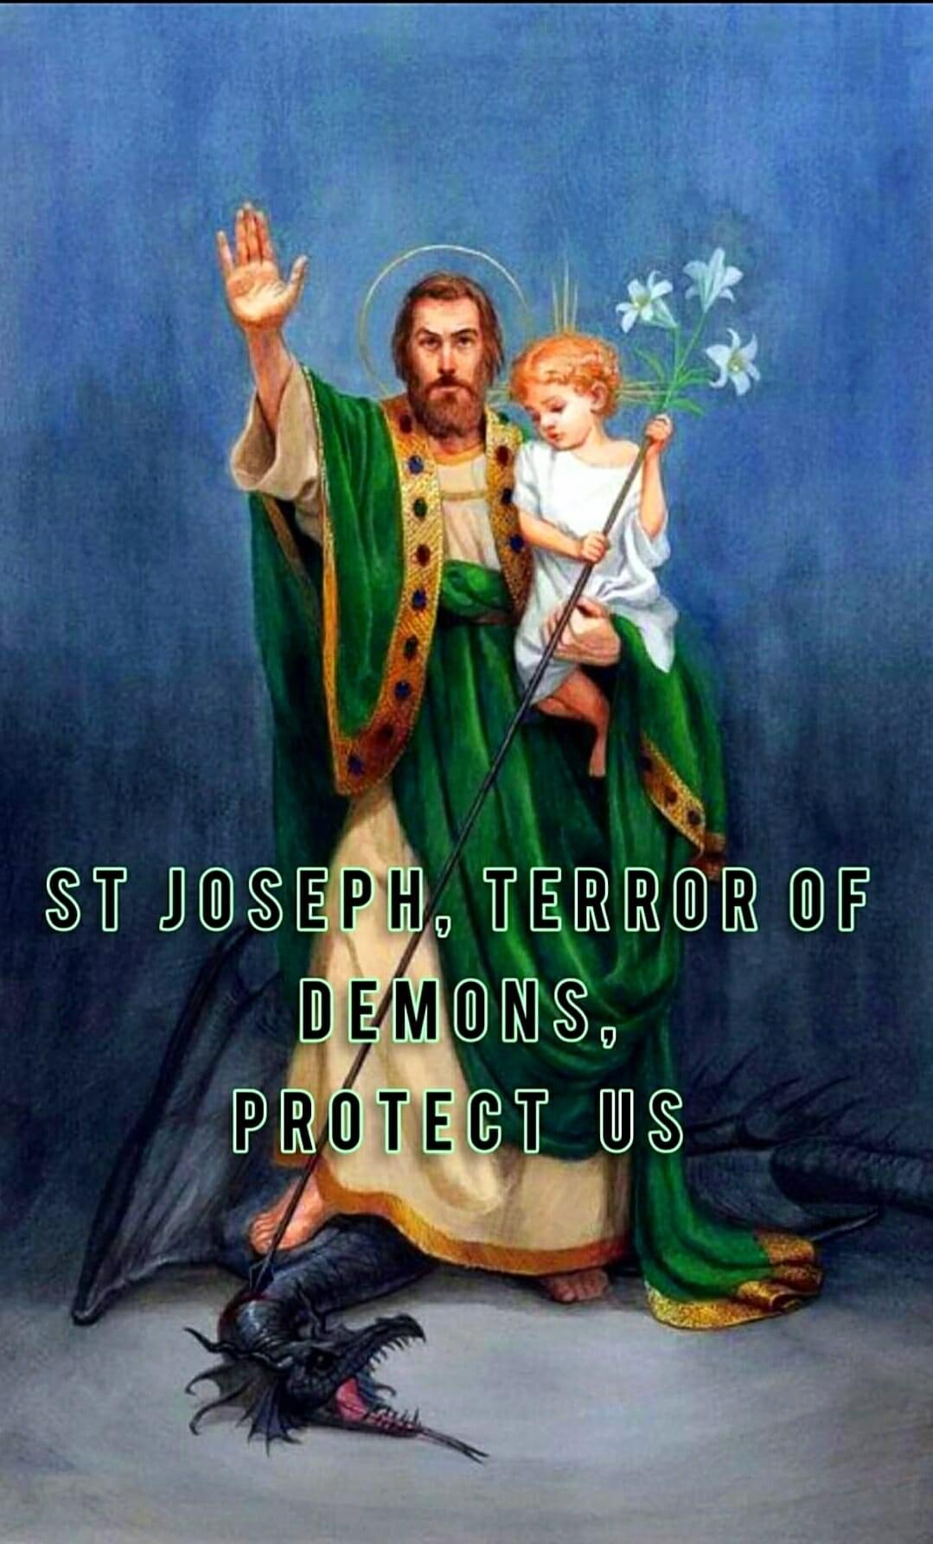
The fatherhood of St. Joseph terrorizes the devil.
Evil spirits are terrified of St Joseph because he alone is the spouse of the Immaculata and the father of Jesus Christ. St Joseph’s spirit is always at attention and ready to protect, defend and fight for Jesus, Mary and for souls.
All fatherhood is a threat to Satan. All fatherhood has its origins in God, our Heavenly Father; and finds its earthly model in St Joseph. St Joseph is not a priest nor a religious but a layperson just like us; a husband and father; a disciple.
If we pattern our fatherhood or parenthood off of St Joseph; if we imitate the virtues of St Joseph and be an apparition of St Joseph, Satan becomes powerless in his attacks against the family (the domestic church) and the Mystical Body of Christ (the Church)
“Be sober and vigilant. The devil is prowling around like a roaring lion looking for someone to devour.
1 Peter 5: 8-9
Notes:
While we are weak, and always at risk of being attacked by the Evil One, we are thankful to have St Joseph as our protector and patron for St Joseph is a terror of demons. Truly Satan and his army of demons can’t figure Joseph out. They can’t penetrate his inner most being. Like John the Baptist, Joseph was sanctified while he was in his mother’s womb. And he was blessed with supernatural grace to resist concupiscence. As God’s chosen representative of the Heavenly Father on earth and as the Patron and Protector of the Universal Church, the fatherhood of St Joseph terrorises the devil … read slide

Slide 6
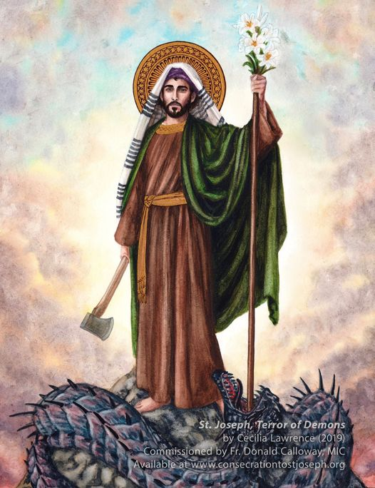
The purity of St. Joseph terrorizes the devil.
The lily St Joseph holds in his hand is a mighty spiritual weapon, a sword or spear of purity to conquer every form of filth and darkness.
The number one sin among men today is impurity. The spiritual plague of impurity leaves men spiritually impotent and they are no threat to the devil.
A filthy heart blinds a person to the countenance of God. If we want to see God and overcome darkness, we must strive to have a chaste, pure and loving heart like St Joseph.
“Blessed are the pure of heart, for they shall see God.” Matthew 5:8
Notes:
We turn to St Joseph as the purity of St Joseph terrorises the devil … read slide … Blessed are the pure of heart, for they shall see God

Slide 7
Joseph Hid the Virgin Birth from Satan
Why, when God had decided that the Saviour should be born of a virgin, he chose not a girl who was not betrothed, but precisely one who was already betrothed… St Ignatius of Antioch wrote: “Mary’s virginity escaped the notice of the ruler of this age.” It escaped his notice because of Joseph, and because of their wedding, and because Mary was thought to have a husband. If she had not been betrothed or not had (as people thought) a husband, her virginity could never have been concealed from the “ruler of this age.” Immediately, a silent thought would have occurred to the devil: “How can this woman… be pregnant? This conception must be divine. It must be something more sublime than human nature.” But the devil did not know that he (the Saviour) had taken on a body.
(Origen of Alexandria, Homilies on Luke 6:3-5)
“Mary’s virginity and giving birth… escaped the notice of the prince of this world…”
(Catechism of the Catholic Church 498)
St Joseph duped Satan!
Notes:
St Joseph completely fooled Satan. Satan couldn’t figure Joseph out. None of his schemes, his lies and trickery could tempt or side track Joseph from his mission but rather it is Joseph’s purity, fidelity, obedience, his prudence, his resoluteness, his deep interior life, his very silence that baffles and terrorises Satan and his minions instead

Slide 8
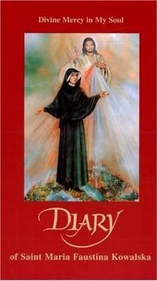
In her Diary, St. Faustina writes of terror - the terror of dying souls as well as her own brief moments of terror. Saint Faustina would eventually learn to whom she can turn in order to allay her fears and unite her to Jesus. It was none other than Jesus' foster father, St. Joseph.
The famous Litany of St. Joseph identifies him as the Terror of Demons, and it's no wonder. Surely, this man entrusted by God with the singular mission of caring for and protecting the Holy Family was endowed with graces enough to strike fear in the forces of darkness. The demons don't stand a chance against St. Joseph.
Saint Faustina writes: Saint Joseph urged me to have a constant devotion to him. ... He has promised me his special help and protection (1203).
When you find yourself feeling overcome by the trials of life, turn to St. Joseph. He was a man who, in his earthly life, never succumbed to "vain terrors." He remained ever grounded in faith, ever attuned to the will of God in his life. From Heaven, he stands as the go-to saint to help you when forces beyond your control - including demonic forces - seek to unsettle you.
Saint Joseph, Terror of Demons, protect us.
Notes:
Read off the slide

Slide 9
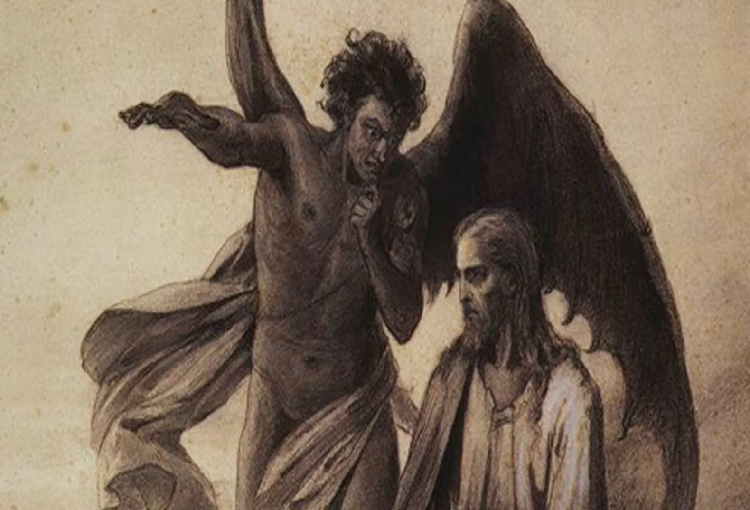
Towards the end of the 19th century [circa 1884-1886], Pope Leo XIII had a vision of Satan taunting Jesus that he will bring down his church.
In wanting to combat Satan and his evil minions Pope Leo XIII first composed the Prayer to St Michael to invoke the aid of the Archangel.
Later, Pope Leo XIII forged together two of the greatest spiritual weapons the Church has in her arsenal – the rosary and St Joseph.
Pope Leo XIII in 1889 suggested that this prayer be added to the end of the Rosary.
Notes:
Two powerful prayers at our disposal … don’t need to read this prayer; just make mention

Slide 10
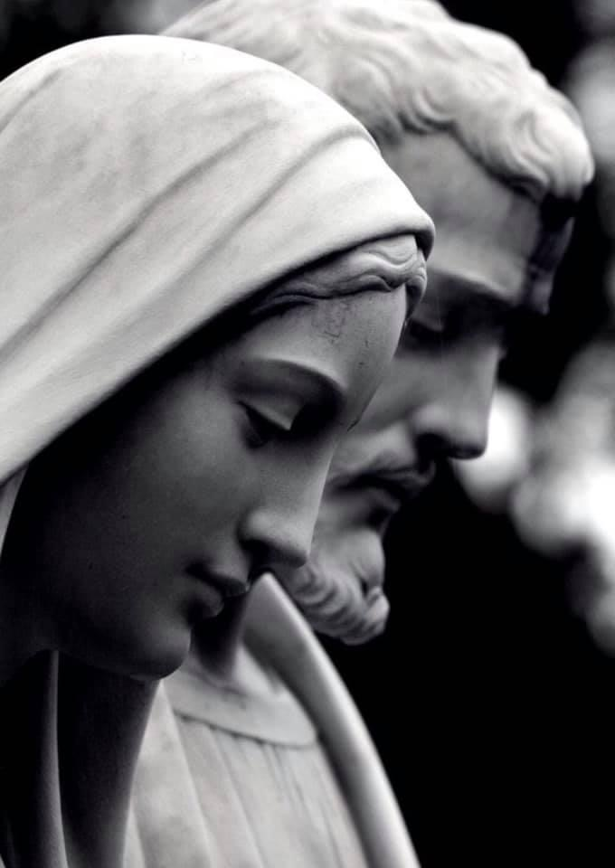
Prayer to the Blessed Virgin Mary and Saint Joseph
To you, O blessed Joseph, do we come in our tribulation, and having implored the help of your most holy Spouse, we confidently invoke your patronage also. Through that charity which bound you to the Immaculate Virgin Mother of God and through the paternal love with which you embraced the Child Jesus, we humbly beg you graciously to regard the inheritance which Jesus Christ has purchased by his Blood, and with your power and strength to aid us in our necessities.
O most watchful guardian of the Holy Family, defend the chosen children of Jesus Christ; O most loving father, ward off from us every contagion of error and corrupting influence; O our most mighty protector, be kind to us and from heaven assist us in our struggle with the power of darkness. As once you rescued the Child Jesus from deadly peril, so now protect God's Holy Church from the snares of the enemy and from all adversity; shield, too, each one of us by your constant protection, so that, supported by your example and your aid, we may be able to live piously, to die in holiness, and to obtain eternal happiness in heaven. Amen.
Pope Leo XIII in 1889 suggested that this prayer be added to the end of the Rosary.
Notes:
Two powerful prayers at our disposal … don’t need to read this prayer; just make mention

Slide 11
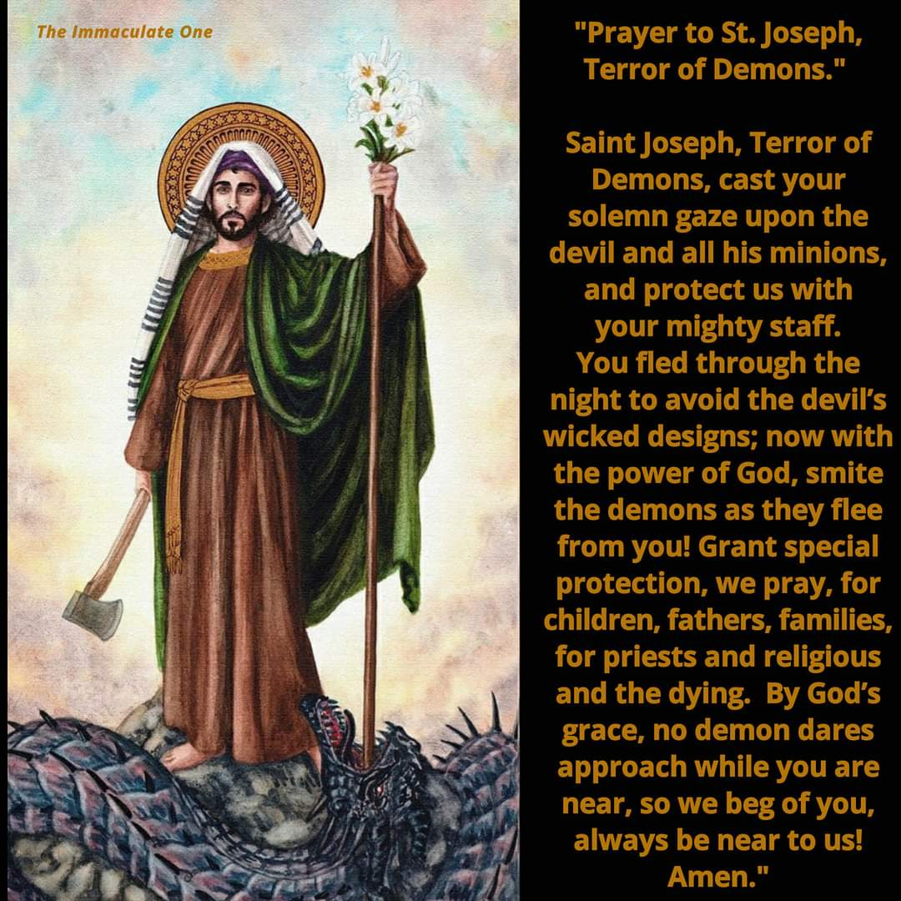
Notes:
Read this prayer

Slide 12
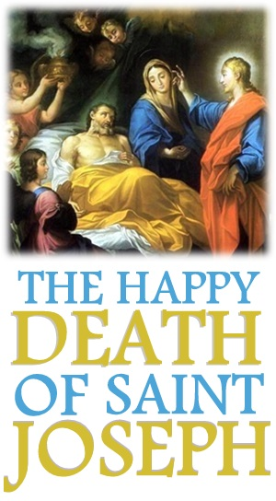
"Precious in the eyes of the Lord is the death of His faithful ones" (Ps. 115:6). After having faithfully served Jesus and Mary, St. Joseph reached the end of his life in the house at Nazareth. There, surrounded by angels, assisted by Jesus Christ the King of angels, and by Mary, his spouse, who placed themselves at each side of his poor bed, filled with the peace of paradise, he departed from this life. Who shall ever be able to understand the sweetness, the consolation, the blessed hope, the acts of resignation, the flames of charity which the words of eternal life coming alternately from the lips of Jesus and Mary, breathed into the soul of Joseph at the end of his life?
St. Alphonsus Liguori
St Joseph, Patron of the Dying; Pray for us.
Notes:
When an actor’s role is complete, he must exit from the stage; and so it was with St Joseph … After having faithfully served Jesus and Mary and accomplishing the mission assigned to him, St Joseph reached the end of his life, surrounded by angels but importantly with Jesus and Mary at his side. A happy death indeed.

Slide 13
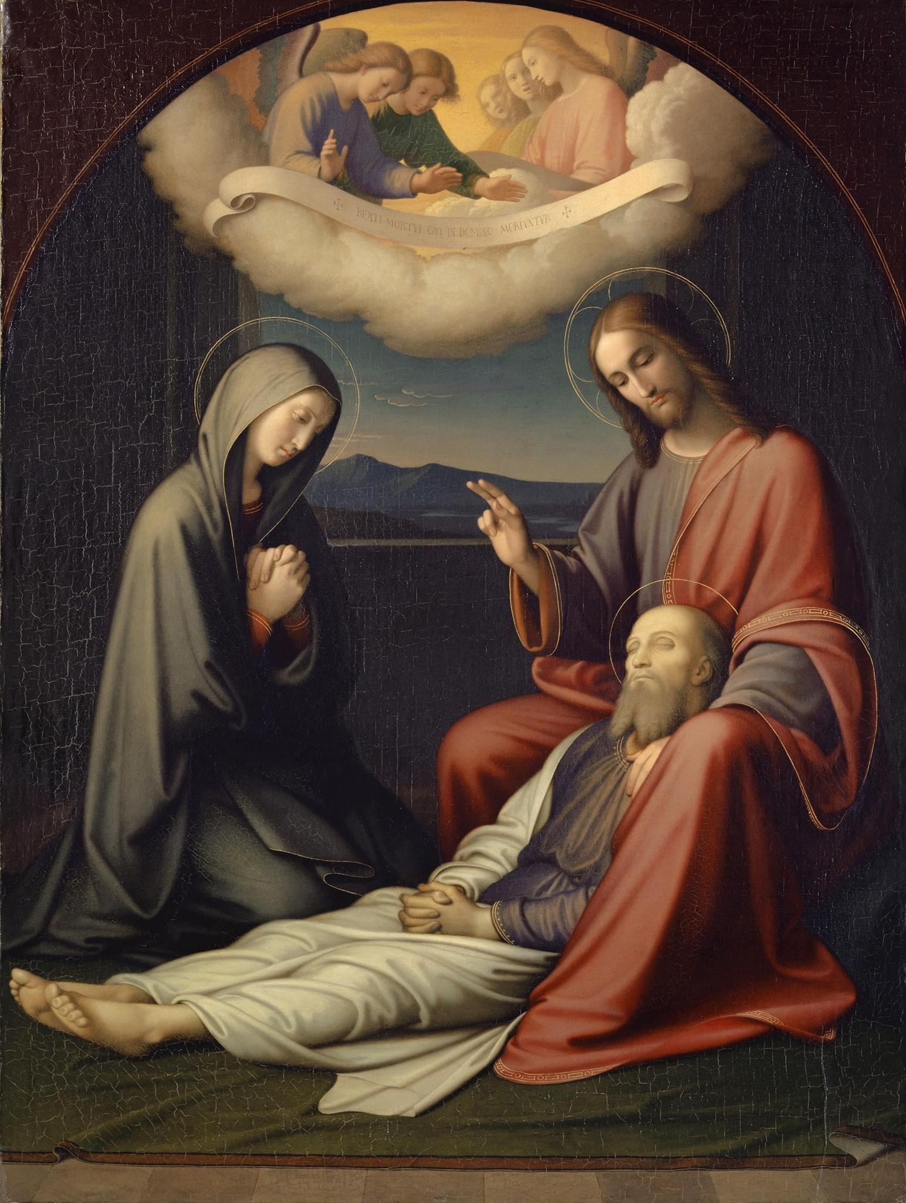
Fr Emmanuel Noel, OCD
St Joseph, Patron of the Dying; Pray for us.
Notes:
St Joseph is the Patron of the Dying; We pray to St Joseph for a happy and peaceful death. For St Joseph he did not have to die mortally in order to see God or to be in God’s bosom. Even before he died or just as he died, he was already in God’s bosom.

Slide 14
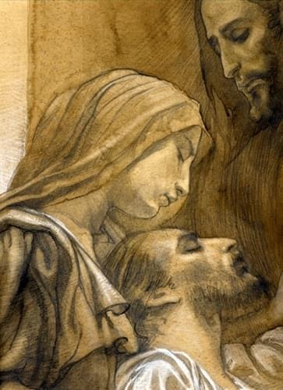
It is widely held that St. Joseph had passed away in Nazareth, while Jesus was still at home. When Jesus left home and began his public ministry, Joseph is no longer mentioned, whereas Our Lady is still mentioned during the Wedding Feast of Cana and the Crucifixion of Our Lord. If Joseph had been alive then, surely he would have been at her side during those moments.
One question that some people ask is, since Jesus had the power to resurrect the dead, such as he did for his friend Lazarus, why did he not do the same for his father on earth? Jesus did not do this for Joseph because Joseph had fulfilled his mission on earth – to guard, nurture and raise the Son of God into manhood; to prepare Jesus for his own mission. Joseph had indeed accomplished what the Lord had asked of him and fulfilled it with the utmost of love, honour, and humility.
St Joseph, Patron of the Dying; Pray for us.
Notes:
Read off slide … We are told by tradition that Joseph died out of his overwhelming love for Jesus and Mary. [optional]

Slide 15
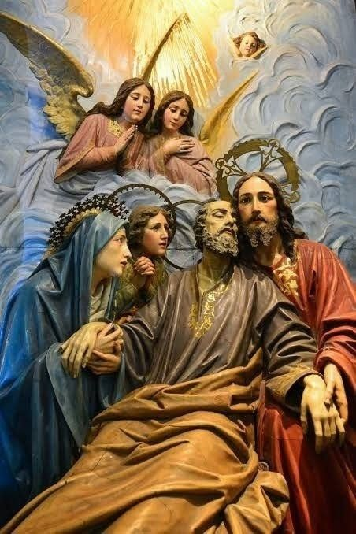
Since we all must die, we should cherish a special devotion to St. Joseph, that he may obtain for us a happy death:
Jesus Christ loved Joseph not only as a friend, but as a father, and on this account his mediation is far more efficacious than that of any other Saint.
St. Joseph had obtained special power against the evil spirits, who tempt us with redoubled vigour at the hour of death.
The assistance given St. Joseph at his death by Jesus and Mary obtained for him the right to secure a holy and peaceful death for his servants. Hence, if we invoke him at the hour of death he will not only help us, but he will also obtain for us the assistance of Jesus and Mary.
St. Alphonsus Liguori
St Joseph, Patron of the Dying; Pray for us.

Slide 16
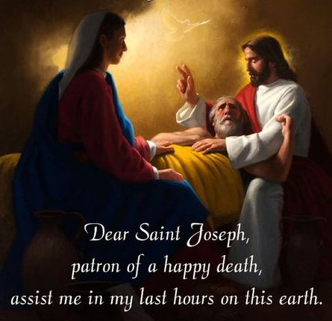
St Joseph, Patron of the Dying; Pray for us.

Slide 17
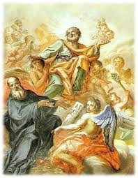
Of all the saints in Christendom, the only pair of whom we possess no first-class relics are the Blessed Virgin Mary and St. Joseph. We attribute this lack of bodily relics to the Assumption of the Virgin Mary into heaven, body and soul, which is one of the great Marian Dogmas of the Church. This tradition has been popularly believed from the earliest days of the Church but was not officially defined as dogma until November 1, 1950 by Venerable Pope Pius XII.
The same reasoning is applied to lack of bodily relics of St. Joseph, Virgin-Father of Christ and Chaste Spouse of Mary. We can feel validated in the possible belief of the Assumption of St. Joseph by looking to the apparitions of the 20th century. When St Joseph appeared at Fatima, Portugal, to bless the world on October 13, 1917 holding the Child Jesus and standing next to Our Lady, would he just have been some type of "ghost" holding the flesh and blood Jesus standing next to flesh and blood Blessed Virgin? It doesn't make sense that the Earthly Trinity: Jesus, Mary and Joseph - who were so closely united on Earth, would be hindered in their union in Heaven.
The Assumption of St Joseph Body & Soul Into Heaven

Slide 18
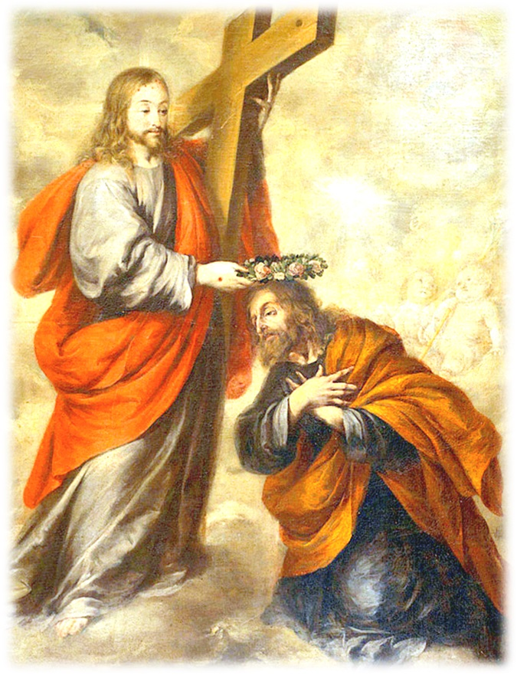
Servant of God Mother Cecilia Baij: When the Saviour of the world gloriously and victoriously arose from the dead … he thereafter proceeded to deliver and to take with him from Limbo, those souls which had been confined there. Joseph’s glorified soul was, by the power of God, again reunited to his blessed body. … Joseph made his entry into heaven together with the Saviour on the occasion of his remarkable Ascension. There the Saint now occupies, in virtue of his virginity and great purity of soul, a most distinguished throne near to the unspotted Lamb of God.
The Assumption of St Joseph Body & Soul Into Heaven
Notes:
But this is still regarded as tradition and not official church teaching. That’s why you find the Assumption of Mary in the liturgical calendar but not the Assumption of St Joseph

Slide 19
Fr Emmanuel Noel, OCD
19th March 2021 Solemnity of St Joseph, husband of the Blessed Virgin Mary
Notes:
If we were doing our consecration Mass on 19th March which is the Solemnity of St Joseph, this would be the entrance antiphon at the start of Mass

Slide 20
Fr Emmanuel Noel, OCD
19th March 2021 Solemnity of St Joseph, husband of the Blessed Virgin Mary
Notes:
So again, amongst all men, Joseph was picked to steward and manage God’s household. Only a just man can be picked to manage the Kingdom of Heaven on earth. Indeed if you’ve been to Mass today or read today’s readings; part of the responsorial psalm reads: They are happy to do what is right; who at all times do what is just.

Slide 21
Fr Emmanuel Noel, OCD
19th March 2021 Solemnity of St Joseph, husband of the Blessed Virgin Mary
Notes:
In the collective prayer that the celebrant raises on our behalf to God …

Slide 22
Fr Emmanuel Noel, OCD
Joseph kept hidden Mary’s virginity and virgin birth from the ruler of the age
Notes:
The beginnings refer to Mary and Joseph and their role in the salvation and redemption of man.

Slide 23
Fr Emmanuel Noel, OCD
19th March 2021 Solemnity of St Joseph, husband of the Blessed Virgin Mary
Notes:
In the Preface of the Eucharistic Prayer it reads …

Slide 24
Fr Emmanuel Noel, OCD
19th March 2021 Solemnity of St Joseph, husband of the Blessed Virgin Mary
Notes:
So what does all these verbiage mean? Simply that God is the author and master script-writer from which we respond and do our part and fulfil our role in His Story, His Masterplan. And His Son, Jesus, our Saviour and Redeemer, is the cornerstone, the central figure and hero in the Good News of Salvation.
For without Jesus, there wouldn’t be a need for Joseph and Mary

Slide 25
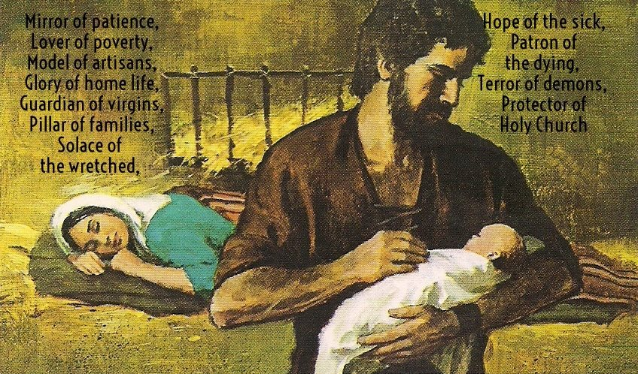
Lowly Carpenter or Hidden King of the Jews?
Elderly Widower or Chaste Spouse of Mary?
Legal Guardian or Shadow of the Heavenly Father?
who are you saint joseph?
Notes:
And so we’ve come to the end of this particular study of St Joseph; for now, that is; and hopefully we’re now in a better position to answer this question – Who is St Joseph? Is he a lowly carpenter or is he the hidden king of the Jews? … We can explore each of these questions further when we continue on with our follow-up study by viewing three video talks on St Joseph presented by Dr Brant Pitre

Slide 26
Dr Brant Pitre Professor of scripture at the Augustine institute
Notes:
Dr Pitre is Professor of Sacred Scripture at the Augustine Institute. I’ve posted an intro trailer video in the Telegram channel which you can refer. I’ll leave the details as to when all these will be taking place to Alicia and Annabelle to arrange for you. Meanwhile, …

Slide 27
Congratulations to having spent the last 33 days getting to know more about St Joseph.
How has the experience been comparing from when you first started to where you are now? Do you have a renewed understanding and appreciation of this silent saint?
Are you open to deepening your understanding and relationship with St Joseph? Is there anything that might prohibit / impede you in doing so?
As you prepare to consecrate yourself to St Joseph, is there anything in particular that you want to ask St Joseph for? Turn to him in prayer.
Group Reflection & Discussion Questions

Slide 28
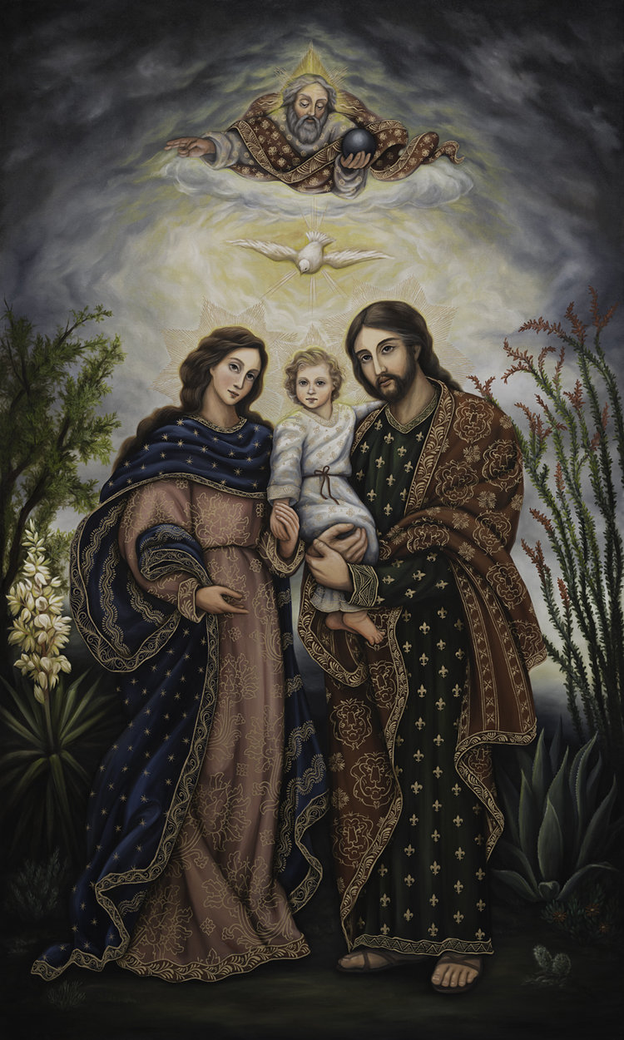
O Glorious Patriarch and Patron of the Church! O Virgin Spouse of the Virgin Mother of God! O Guardian and Virginal Father of the Word Incarnate! In the presence of Jesus and Mary, I choose you this day to be my father, my guardian, and my protector.
O great St. Joseph, whom God has made the Head of the Holy Family, accept me, I beseech you, though utterly unworthy, to be a member of your “Holy House.” Present me to your Immaculate Spouse; ask her also to adopt me as her child. With her, pray that I may constantly think of Jesus, and serve him faithfully to the end of my life. O Terror of Demons, increase in me virtue, protect me from the evil one, and help me not to offend God in any way.
O my Spiritual Father, I hereby consecrate myself to you. In faithful imitation of Jesus and Mary, I place myself and all my concerns under your care and protection. To you, after Jesus and Mary, I consecrate my body and soul, with all their faculties, my spiritual growth, my home, and all my affairs and undertakings. Forsake me not, but adopt me as a servant and child of the Holy Family. Watch over me at all times, but especially at the hour of my death. Console and strengthen me with the presence of Jesus and Mary so that, with you, I may praise and adore the Holy Trinity for all eternity. Amen.
CONSECRATION TO SAINT JOSEPH

Slide 29
For daily use.

Slide 30
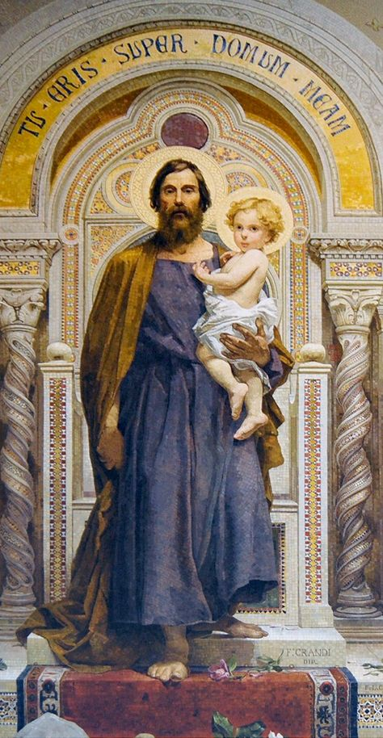
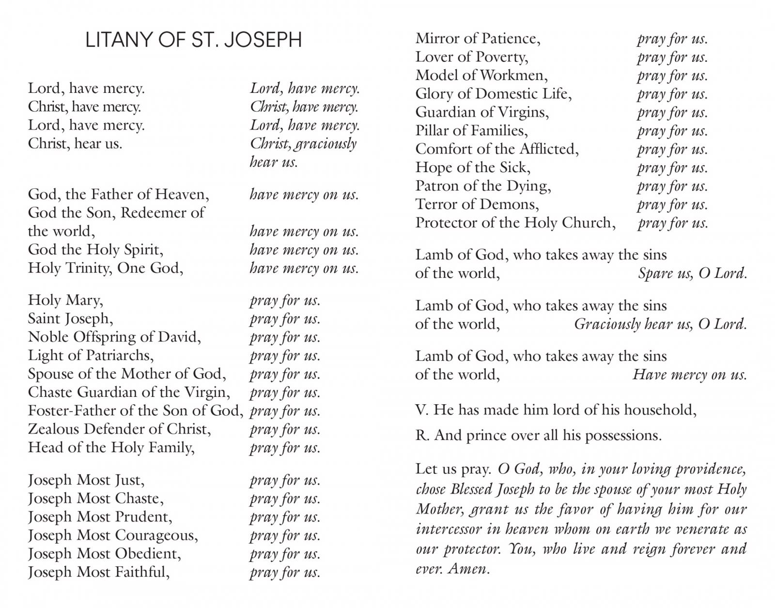
LITANY OF SAINT JOSEPH

Slide 31
LITANY OF SAINT JOSEPH

