Slide 1

Welcome to the 5th Group Meeting – We’ll be starting soon.
Notes:
Welcome to our 5th Group Session. We have just one more session to go which will be our final session this Friday 20th Aug when we’ll end with online Mass celebrated by Fr RV.

Slide 2
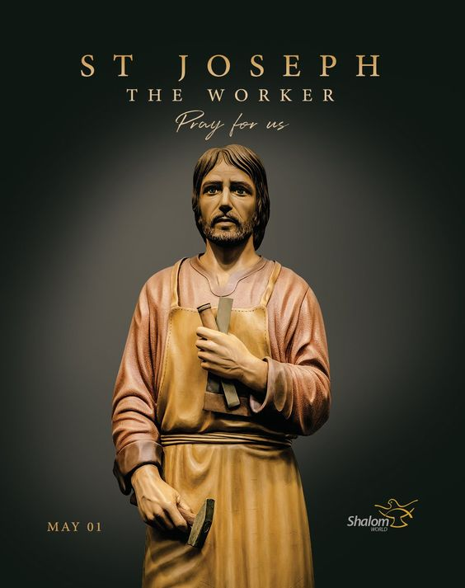
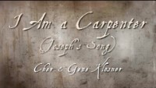
Opening Hymn
Notes:
As always , let us start with a music prayer video to put us in the mood …

Slide 3
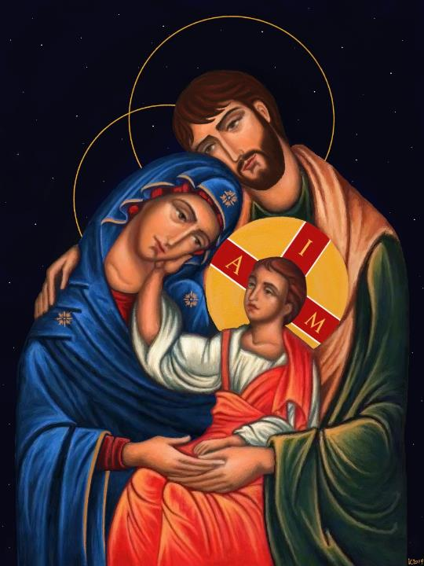
Loving Father, you showed us your mercy by sending Your Son, who out of love for us, emptied Himself to be born into a human family, the cradle of faith and love. Bless our families to live the spirituality of communion, where love, dialogue, mutual respect, acceptance and forgiveness abound. May we grow in awareness of our own brokenness and sinfulness so that, receiving Your mercy and forgiveness, we can in turn be channels of mercy to each other.
Grant all parents strength, patience and compassion so that they can be good role models and mentors of Christian faith, love and mercy to their children. Guide and shield us from anger, resentment and violence. May our families be domestic churches that are beacons of compassion and love.
Jesus, Mary and Joseph, we entrust our families to you. Pray for us and protect us. Amen.
Opening Prayer
Notes:
And we use this time to pray for our families …

Slide 4
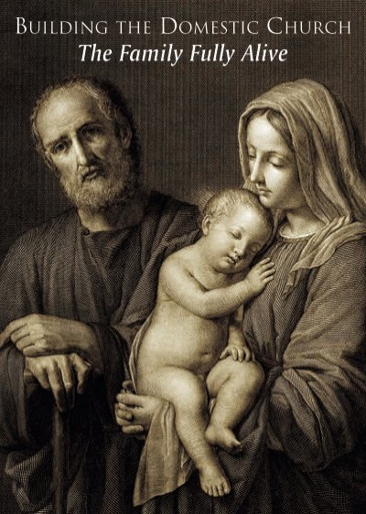
Need to re-discover the biblical vision of marriage and family.
Need to see the family as a domestic church with the same mission as the universal church.
Need to establish the family as the primary place where the faith is passed on.
Need to recognise the ecclesial nature of the family as the place where we encounter God in each other.
Need to recognise the sacred order of the Family.
“The future of humanity passes by way of the Family.” St John-Paul II
Notes:
Right; if you can recall from my first introduction session, I mentioned that in Familiaris Consortio 75, St John-Paul II said “The future of humanity passes by way of the Family.” The family is a good which society cannot do without and it ought to be protected. [Mention the 5 points as above.]
Given that marriage and family is being re-defined and re-configured in modern society today, there is the need for us to re-discover the biblical vision of marriage and family as God meant it to be from the very beginning
There is the need to see the family as a domestic church with the same mission as the universal church
We need to establish the family as the primary place where the faith is passed on [and this can be a challenge in inter-faith marriages and families; that is where one spouse is Catholic and the other is not; I mentioned in the last session that 70% of couples undergoing marriage preparation at CEE or MPC are inter-faith couples – that’s a double-edge sword in that it could be an opportunity for the non-Catholic spouse to learn more about the Catholic faith or if the Catholic spouse is not strong in the faith or is a non-practising Catholic, then the reverse can easily take place or as often is the case, the parents leave it to the catechists in church to teach the faith.
There is the need to realise and to recognise the ecclesial nature of the family as the place where we encounter God in each other.
And as I mentioned in Session 3, there is the need to recognise the sacred order of the Family.

Slide 5
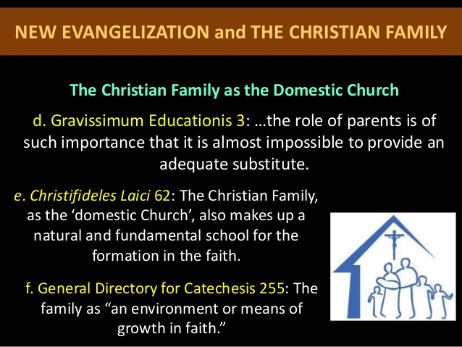


Discipleship
Family
These are what the Church teaches about Evangelising Families and Families Evangelising
Notes:
These are some examples of Church teaching relating to Evangelising Families and Families Evangelising; … parents are the first catechists at home in their domestic church

Slide 6
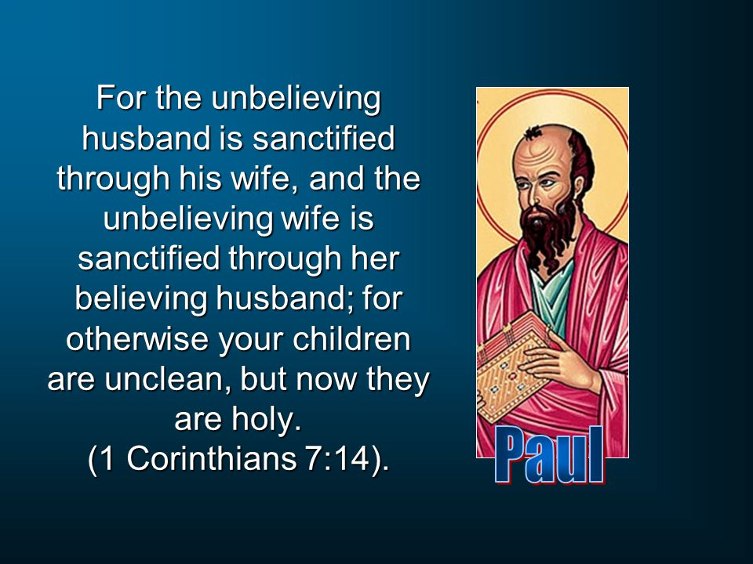

What happens if one spouse is of the faith and the other is not?
Notes:
Perhaps we can draw some lessons from St Paul’s letters to the Corinthians in chapter 7: 14-16
When I first got married, I wasn’t a Catholic but I gladly went through Catholic Engaged Encounter as a form of marriage preparation; not so much because I believed in God but because I had already been in and out of countless relationships, none of which survived a year; believe it or not - my wife is my first girlfriend whose relationship lasted more than a year; so it’s like when I met the love of my life, I better behave and learn - cannot take chances anymore. So I remembered the meeting with Msgr Ambrose Vaz who married us, he explained and took us through the pre-nuptial agreement which I had to sign – but it’s more of an acknowledgement that Allyson as the Catholic spouse has the duty and responsibility of raising our kids in the Catholic faith.

Slide 7
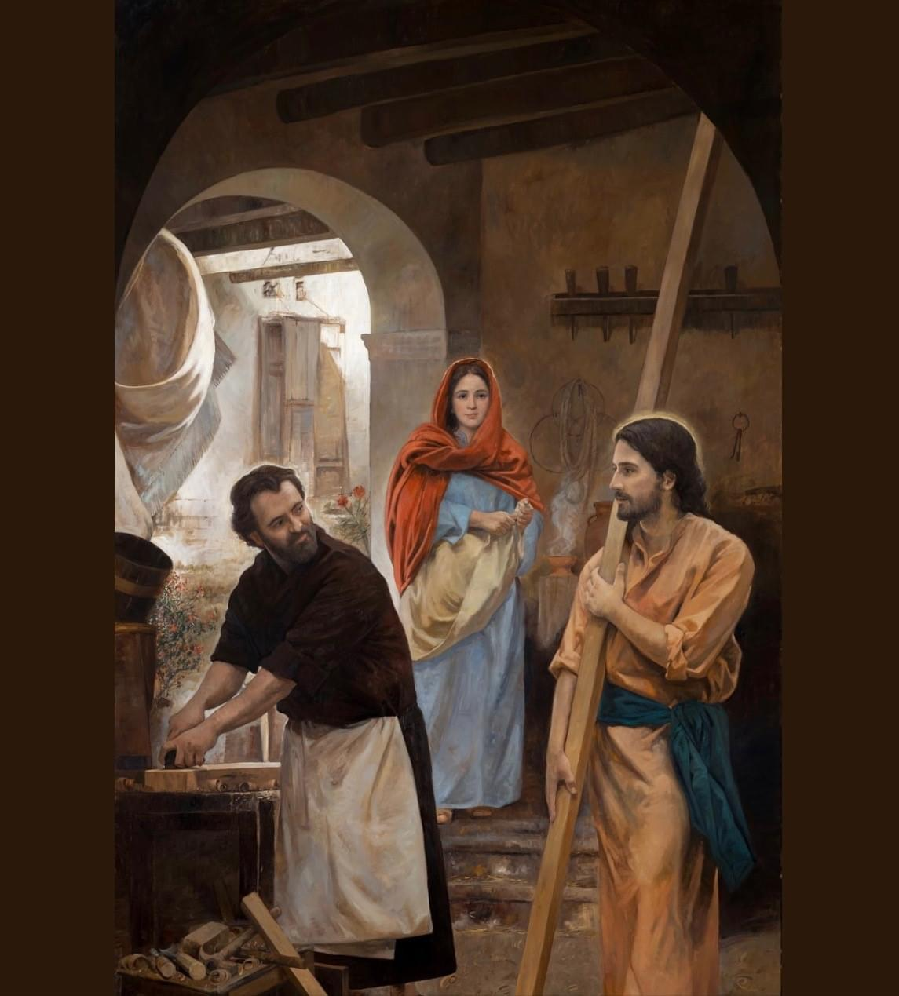
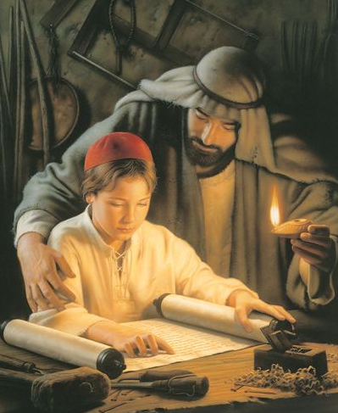
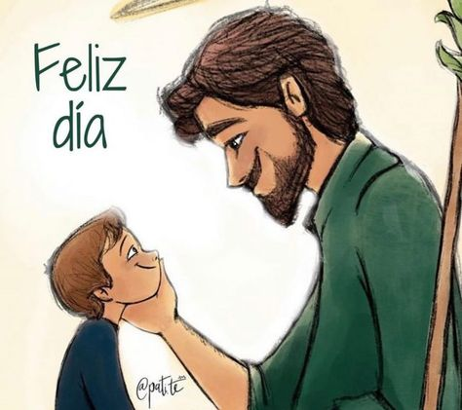
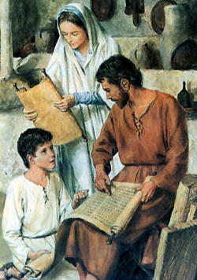
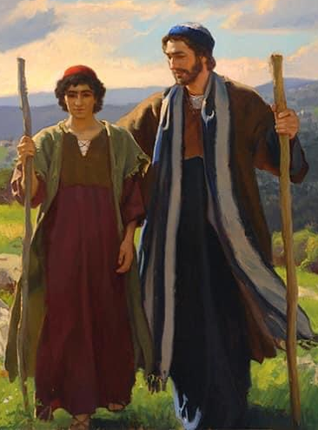
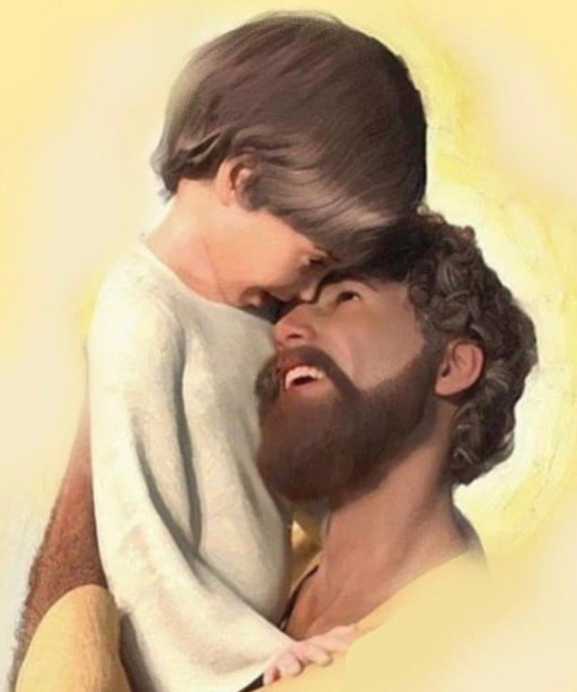
Building up the domestic church
Perpetual
Adoration
St Joseph is the Glory of Domestic Life. He loved, educated, nourished and protected his Son. He gave his entire life in loving service to Jesus and Mary.
St Joseph, Glory of Domestic Life, pray for us!
Notes:
Again coming back to our study of St Joseph, if we draw lessons from St Joseph as the Glory of Domestic Life. He loved, educated, nourished and protected his Son. He gave his entire life in loving service to Jesus and Mary.
Clearly he lovingly fulfilled all that is asked of him as a husband and father and more. [Of course in this instance we don’t have any inter-faith issues or conflict here.]

Slide 8
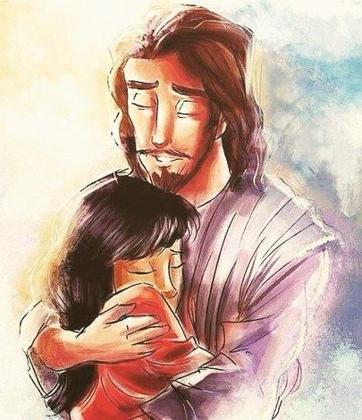
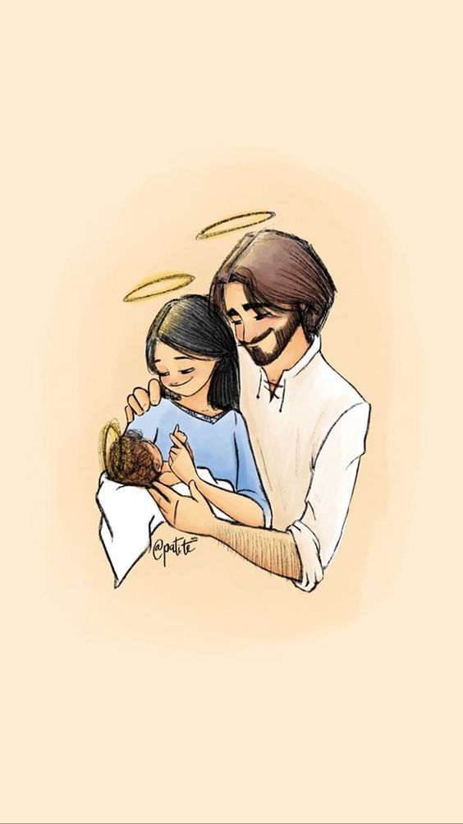
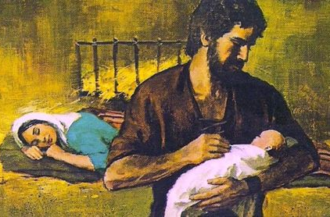
Family:
the school of love
and the cradle of life
He will teach your family the importance of prayer, mutual respect, purity, honesty, forgiveness, love and placing God above all else.
St Joseph, Head of the Holy Family; Glory of Domestic Life; Pillar of Families; Pray for us!
Notes:
In our opening prayer we mentioned that the family is the cradle of faith and love.
I suppose regardless of race, culture and religion, the question is whether that can be something that the spouses can agree on as a shared vision and mission. {even while I was not Catholic in the first 9 years of my marriage, I did have a healthy respect for the religion and my wife was an good Christian example and we did share similar ideals in terms of how we want to raise our kids.]
For us as Catholics we want to entrust our families to the Holy Family and in particular to Joseph who is the Head of the Holy Family and the Pillar of Families.
From him we learn the importance of prayer, the virtues of mutual respect, purity, honesty, forgiveness, love and placing God above all else.

Slide 9
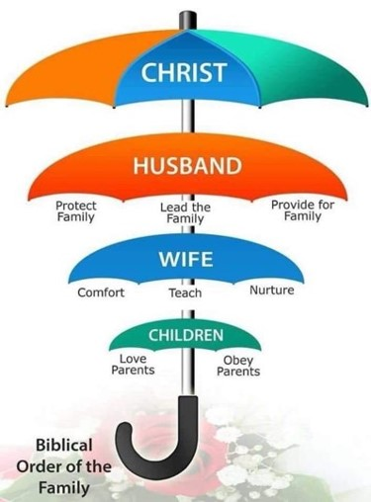




Notes:
And coming back to the sacred order of the Family; our emphasis here isn’t so much on what needs to be done to fix a faulty marriage but rather how we can work towards building a good covenantal marriage.
While we can have St Joseph as our role model to be a holier husband and father, all of the men I've spoken with since I've been running 33SJ sessions at the start of the year have told me it's a tall order. Change is hard and it requires a dying to self. Some of our guys actually make appointments with their parish priest to make confession while going thru 33SJ!
But clearly we are not the sum of our weaknesses and failures; we are the sum of the Father's love for us. And we all need to draw from the source of all love in order that we may have the capacity to be holy / perfect as our Heavenly Father is holy / perfect. We can't do it on our own. Hence, we need prayers, we need support, encouragement and affirmation. We need community.
And yes, if I’m allowed to say this on behalf of all men, we guys of the male species - we do need our space and time to grow! There is a general agreement among the guys I know that while we may never completely be like St Joseph, we will try to reach for the stars knowing that even if we don't grab hold of any stars, we won't have a handful of mud either. So to the women-folk, Let me say on behalf of the men, please be patient with us. Give us that time and space.
Last Sunday we celebrated the Feast of the Assumption of the Blessed Virgin Mary – the first reading referred to Mary as the Ark of the Covenant. To the women here – may I suggest that you too can be the ark of the covenant to your family – your spouse and your children – as the heart of the family; you have the means to be like a spiritual womb in caring, comforting and nurturing your family. Do not turn that lovely womb into a cage.
For the men, guys, let’s love and protect this spiritual womb. Let’s affirm and appreciate our wives and mothers – as head of the family you can set the thermostat within your family – be aware and tune in to her. Share her mental, emotional and physical load – typically it is the wife / mother that remembers all the details, every body’s birthdays, who likes what, when and what time are all the appointments – medical, dental, school, tuition, catechism class, what to cook, what groceries to buy and what toiletries need topping up, and if there’s no domestic help then it’s also attending to all the household chores – washing, cleaning, ironing and that’s besides the work at the office. And she has to say Yes to you when you’re in the mood for some loving! So let’s remember: Team-work! Mutual submission and Godly Submission. And God will save your family.

Slide 10
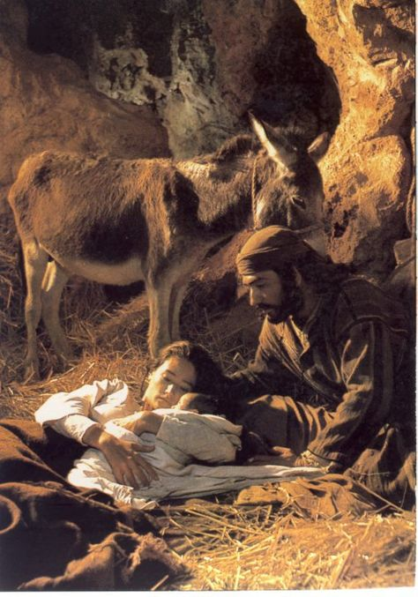
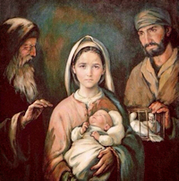
“Blessed are the poor in spirit for theirs is the kingdom of heaven.”
Matthew 2: 11
“The Lord gave and the Lord has taken away. Blessed be the name of the Lord.”
Job 1: 21
St Joseph, Lover of Poverty,
pray for us!
Joseph relied on Divine Providence for all of his needs
Notes:
Continuing on … We know that the Holy Family lived in poor circumstances … from the birth of Jesus to his presentation at the Temple forty days after his birth, Joseph and Mary could only afford two turtledoves as their offering; they couldn’t afford a lamb. Even though Joseph was of noble birth, in the royal lineage of King David, he gave all that up and chose to live an austere and low key life to escape attention and to remain hidden in order to safeguard the Holy Family. It’s been said that if the Magi didn’t come to pay homage and leaving them with gold, myrrh and frankincense, Joseph would not have the means to leave Bethlehem and settle in Egypt. Joseph relied on Divine Providence for all of his needs.

Slide 11
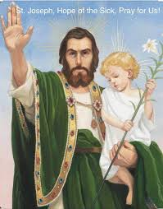
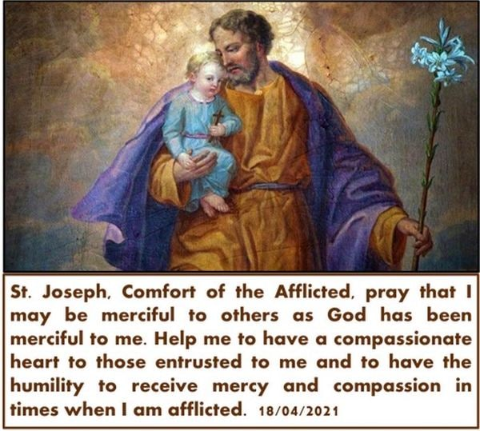
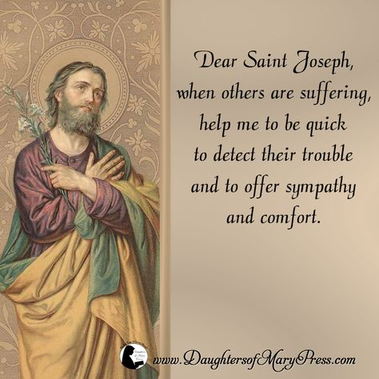
“Every poor, needy, suffering or dying person, every stranger, every prisoner, every infirm person is “the child” whom Joseph continues to protect. For this reason, Saint Joseph is invoked as protector of the unfortunate, the needy, exiles, the afflicted, the poor and the dying.” Pope Francis; Patris Corde.
Saint Joseph, Comfort of the Afflicted; Hope of the Sick; Pray for us.
Notes:
Because of the hardships he had to endure, the poor circumstances he lived under, and having to be a refugee and migrant almost overnight; St Joseph has an affinity with the poor, needy, suffering or dying person; every stranger, every prisoner, every infirm person is the child whom Joseph continues to protect. For this reason, Saint Joseph is invoked as protector of the unfortunate, the needy, the exiled, the afflicted, the poor and the dying.” Pope Francis; Patris Corde.
And we are similarly encouraged to be on the look out for the least, the lost and the last of our brothers and sisters and to be quick to offer comfort, solace and support. We pray to St Joseph, Comfort of the afflicted that we may be merciful to others as God has been merciful to us. To let us have a compassionate heart to those entrusted to us and also to have the humility to receive mercy and compassion from others in times when we ourselves are afflicted.

Slide 12
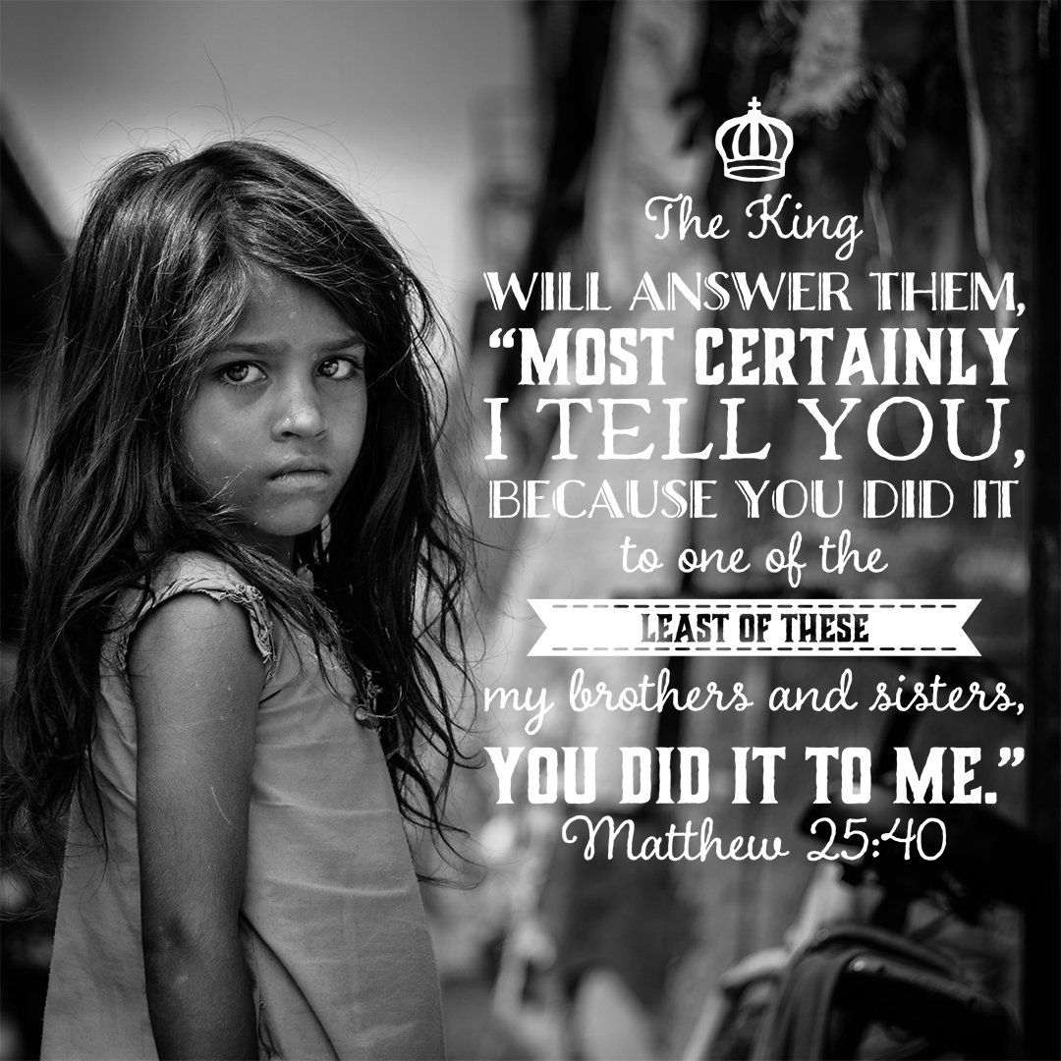
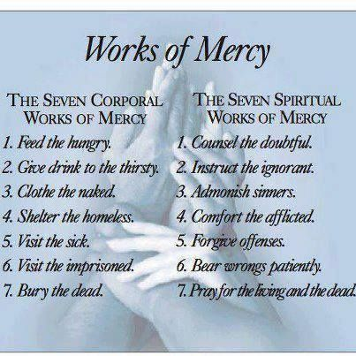
“What you do for the least of your brethren.”
Notes:
With such upbringing and influence, it is natural to find Jesus echoing such similar sentiments when he said “What you do for the least of your brethren, you do to me.” And so the Church too teaches us to practise the seven corporal works of mercy … and the seven spiritual works of mercy …

Slide 13
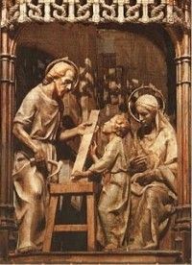
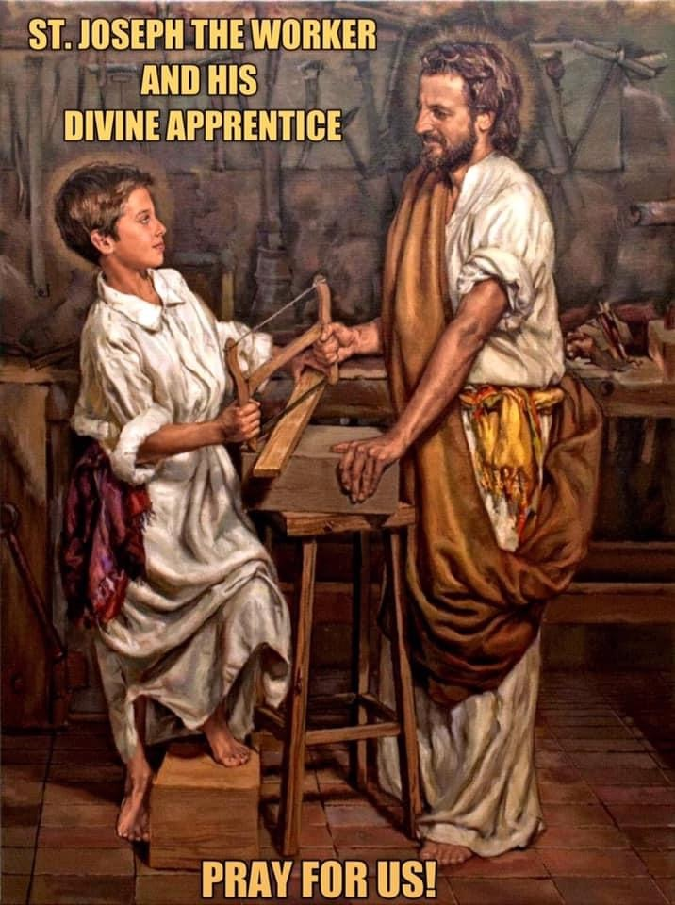
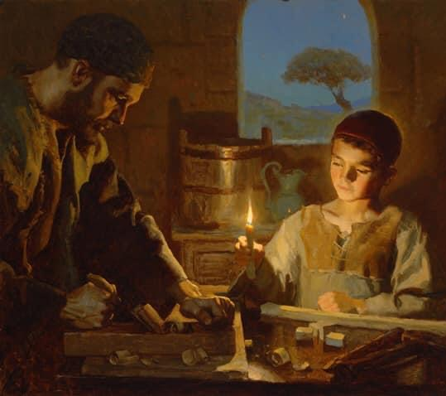
‘Saint Joseph was a carpenter who earned an honest living to provide for his family. From him, Jesus learned the value, the dignity and the joy of what it means to eat bread that is the fruit of one’s own labour.’
Pope Francis
St Joseph the Worker and his Divine Apprentice; the craftsman and the son of the craftsman.
Notes:
Clearly when Joseph was alive, Jesus was referred to as the son of the carpenter. St Joseph was a carpenter who earned an honest living to provide for his family. From him, Jesus learned the value, the dignity and the joy of what it means to eat bread that is the fruit of one’s own labour. And despite the busyness in the workshop, Joseph never stopped loving Jesus and Mary

Slide 14
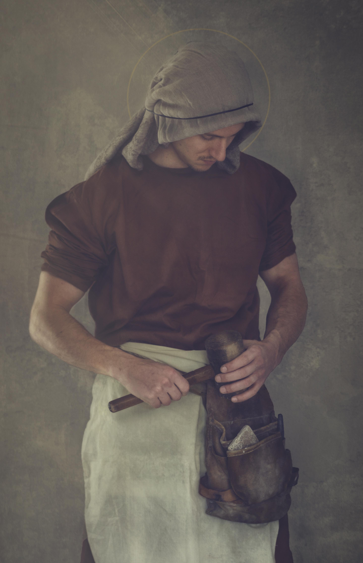
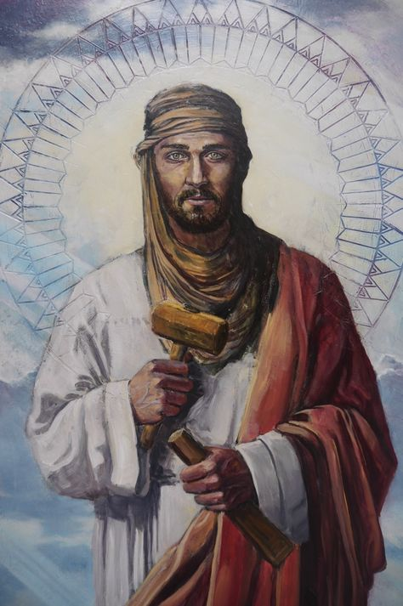
Measure Twice, Cut Once
The virtue of prudence
2. Use the Right Tool for the Job
  You can build someone up or tear one down, depending on the tools you use and how you use them.
3. Take Care of Your Tools and They’ll Take Care of You
We also have tools of prayer, fasting, meditating on the Word of God, reconciliation, Eucharist
Pass on the faith [Be blessed and be a blessing]
Lessons from St Joseph, the Model of Workmen
Notes:
What are some lessons we can learn from St Joseph the Model of Workmen? In previous lessons we had talked about the virtue of prudence where like St Joseph we seek to do what’s right by God. While it is not that we are risk averse, cautious or that we procrastinate; but rather we take time to wait upon the Lord, to spend time in prayer and to discern the Will of God, But once we know we act decisively. Read off the slide … so as a carpenter Joseph has to be very precise; … he measures twice, but cuts just once so there be no wastage … And he always uses the right tool for the specific task at hand. We are gifted by God in various different ways, how do we use our talents and gifts; you may have the gift of eloquence but if that is used to demean or put someone down, are we using our gifts as God intended? We also need to take care of our tools in order that they serve us well when we need them. In addition, as Catholics, we also have at our disposal the tools of prayer, fasting, meditating on the Word of God, the sacrament of reconciliation and the Eucharist. Lastly we are blessed so we in turn can be a blessing to others. And to share our faith and the goodness we have received.

Slide 15
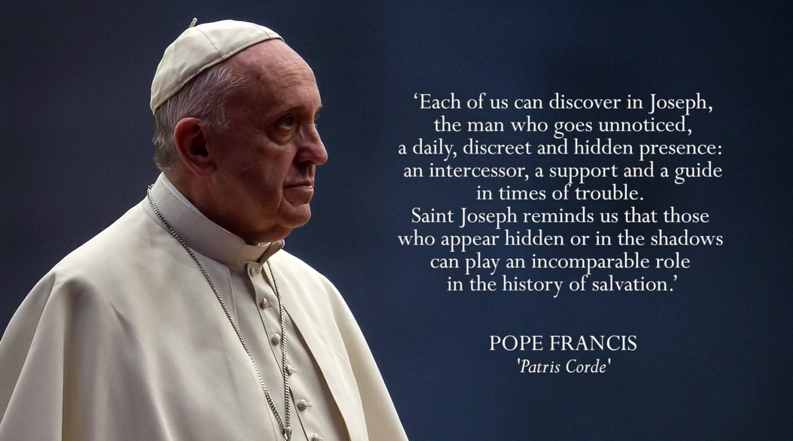
The Dignity of Work
Notes:
All work is holy … work is fundamental to the dignity of a person. Work anoints us with dignity, makes us similar to God, who has worked and still works, who always acts to quote Pope Francis and Pope Francis in his apostolic letter Patris Corde paid tribute to the hidden and unsung heroes who go about their work diligently, efficiently and without fanfare who reminds him of St Joseph … when he said; quote from slide

Slide 16
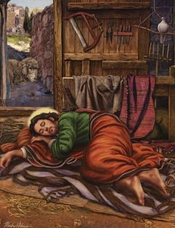
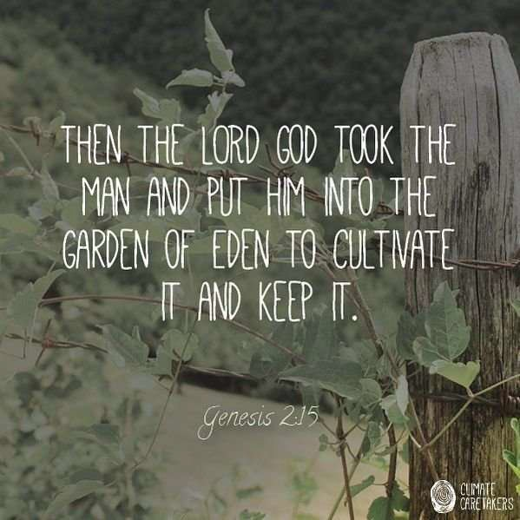
Jesus spent many years in Joseph’s workshop diligently working. It was preparation for his re-entering man’s original workshop – a garden; the Garden of Gethsemane and accomplishing the work of our redemption.
Through the loving example of St Joseph, Jesus learnt the holiness of work and its proper place in life; for St Joseph also strived to make time for God, family, community, recreation and rest.
Lessons from St Joseph, the Model of Workmen
Notes:
Read off the slide … Jesus spent many years in Joseph’s workshop … As Christ Himself looked to Joseph, carrying heavy loads of wood on his shoulders from forest to workshop; let us look to the man who showed the Child Jesus how to carry His forthcoming Cross, for inspiration to carry ours.
Through the loving example of St Joseph, let us also like Jesus learn the holiness of work and its proper place in life; for St Joseph also strived to make time for God, family, community, recreation and rest.

Slide 17
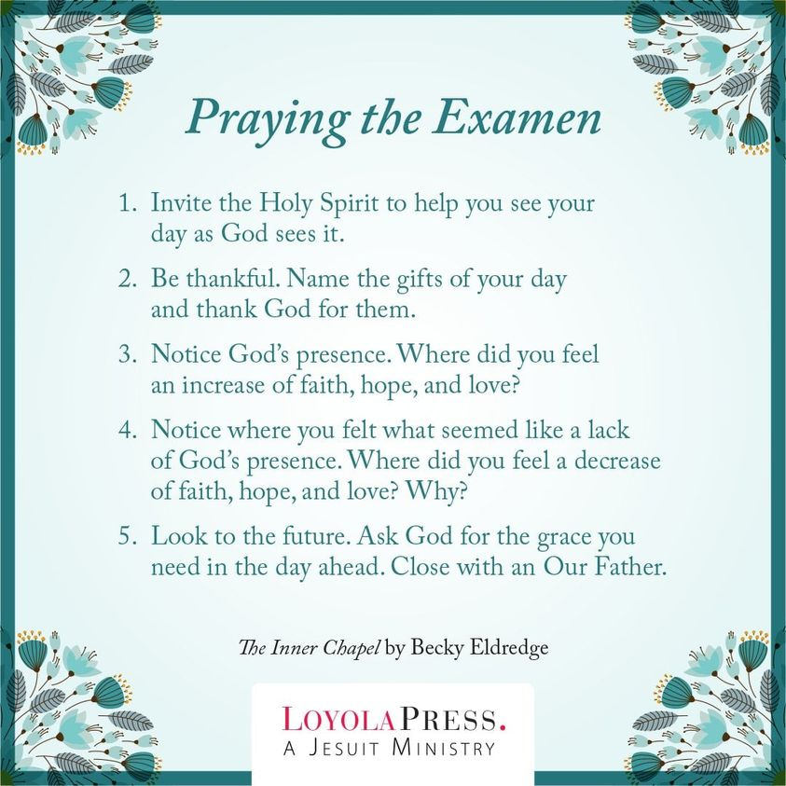

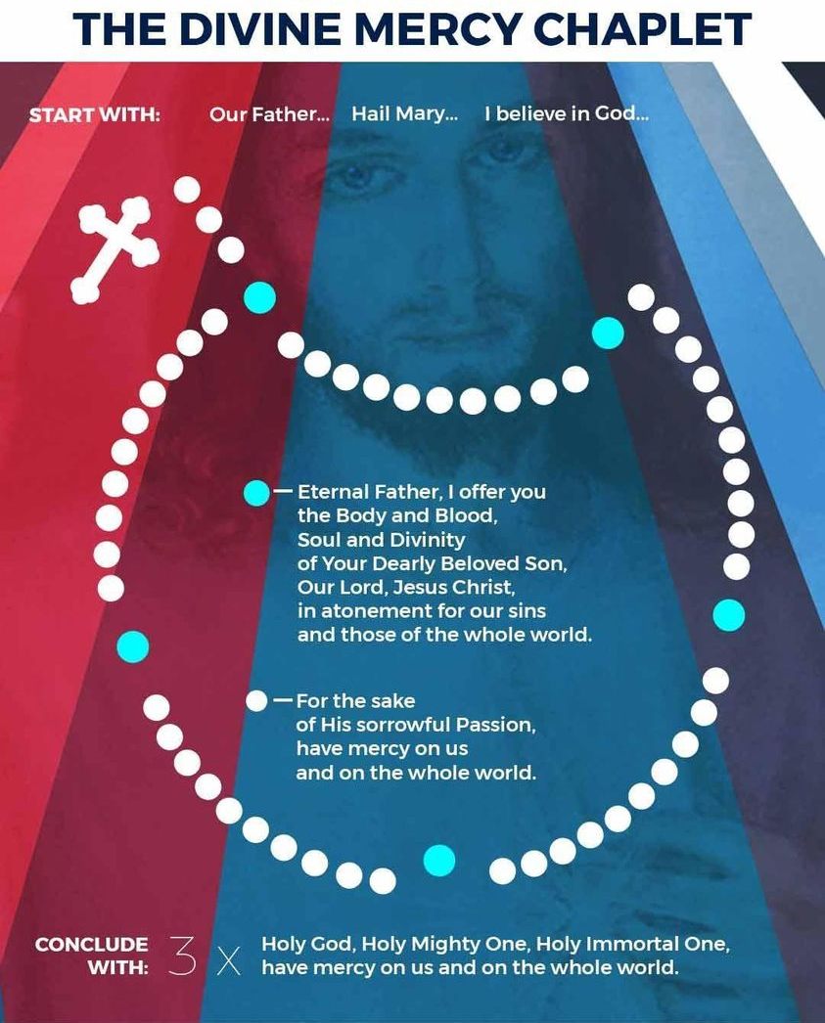
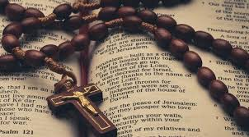
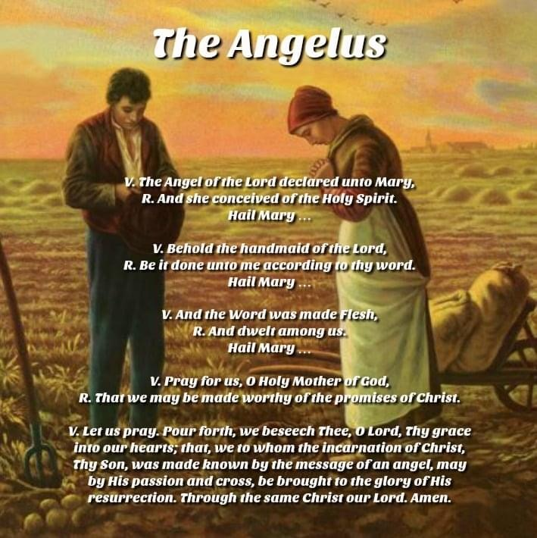

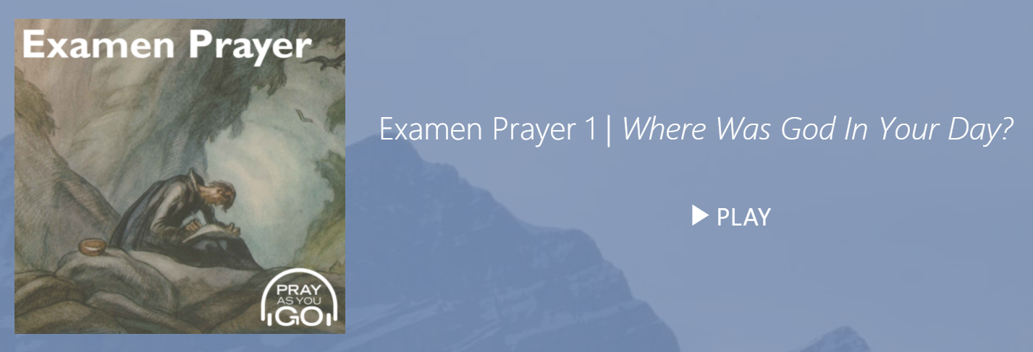
Let us turn our daily work
and life into a living prayer.
Lessons from St Joseph, the Model of Workmen
Let us turn our daily work and life into a living prayer.
Notes:
St Paul tells us we are always to be grateful and to pray unceasingly. But how are we to do this when we lead such busy lives? Can we turn our daily work and life into a living prayer. How do we start our day? During the Pre-Covid days, I used to enjoy going for Morning Mass first thing in the morning. Do we make our Morning offering; thanking God we are awake and alive; surrendering and dedicating the day unto the Lord? Do we take a break mid-day at noon time, to stop whatever we are doing, to pray the Angelus to recall the incarnation of Christ and how He shed His Divinity to be among us in order to bring us home to our Heavenly Father? And continue on to seek the Lord’s inexhaustible grace and mercy thru the recitation of the Divine Mercy chaplet at 3pm, At St Max where I work we’ve started evening online community rosary prayers at 6pm, and before we turn in for the night, do we do a daily examen of conscience?

Slide 18

Imagine yourself in a place where you feel at peace. It might be your own room at home.
There are two chairs there and you sit on one of these. There is a knock on the door and you open it. It is Jesus.
You invite him to sit down. What is it like to have him there? He has brought a book with him and you realise that it is a photograph album of the week... He has taken pictures of you throughout the week.
You and Jesus look through the photos talking about them. If one in particular catches your eye, for which you are grateful, spend some time with it and talk to Jesus about it . . .
Is there a particular picture Jesus wants you to look at? What do you feel about his choice? What do you say to him about it?
Is there a picture there which you wish wasn’t there? Talk to him about that too.
When you are ready the album is closed. What do you ask of Jesus before he departs, to help you for the week ahead? How do you take leave of each other?
How do you feel now?
A photo album of your week. https://pray-as-you-go.org/p/o/3282
Notes:
David: If you can’t do the daily examen, there is an Ignatian spiritual exercise you can try at the end of a busy week – It’s called photo album of the week. Imagine Jesus knocking at your door and you invite him into your home. He’s having coffee with you and the both of you flip through a photo album of your life for the past week. You review with Jesus the great photos taken during the week and you rejoice with him. You also look at those photos you’d rather they were not taken and you speak with Jesus about them. Try it, it’s good fun though it can also be rather unpleasant at times, but what can you hide from Jesus, huh?

Slide 19
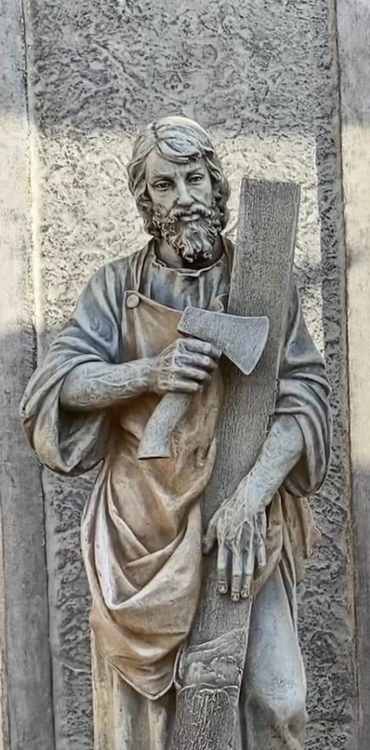
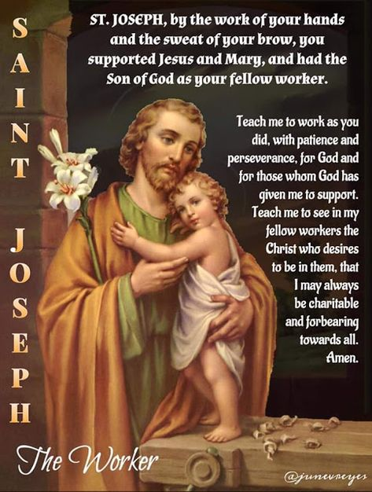
St Joseph the Model of Workmen; Pray for us.
Notes:
I think most of you know that 1st May: Memorial of St Joseph the Worker. Read the prayer

Slide 20
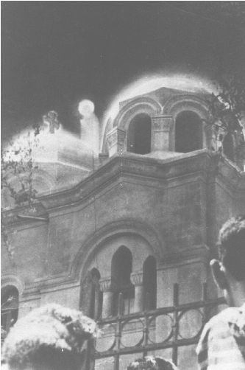
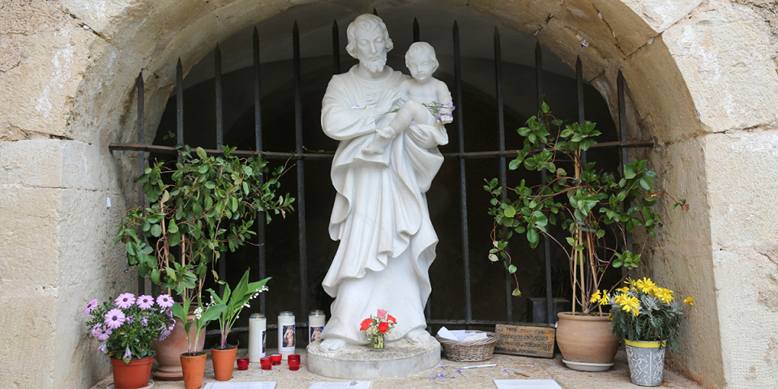
St Joseph – Silent Witness
7 June 1660, Cotignac, France
2nd April 1968, Zeitoun, Cairo, Egypt
Unveiling of St Joseph
Notes:
While St Joseph may be silent in sacred scripture, he has been visible as evidenced in the following apparitions …

Slide 21
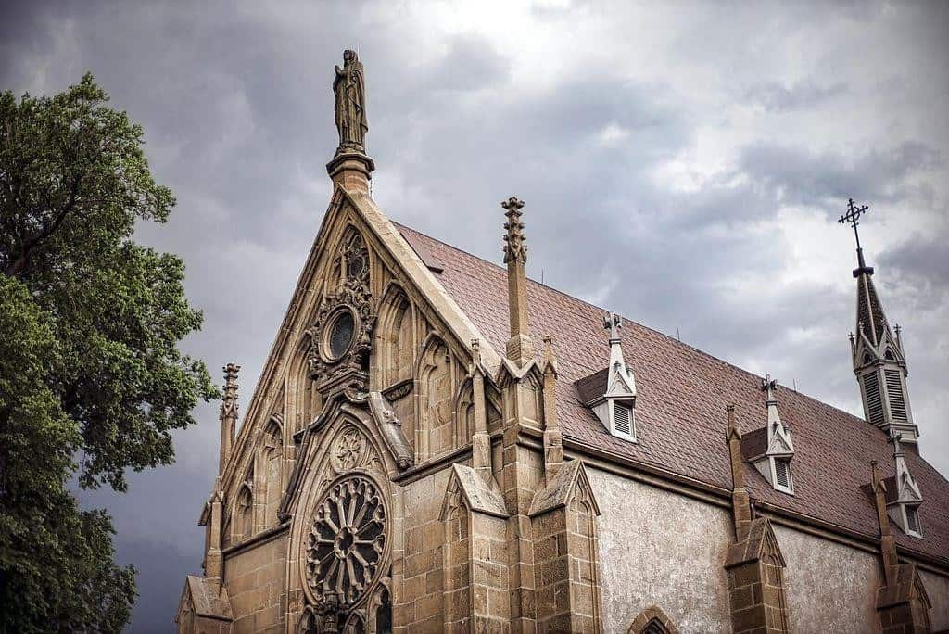
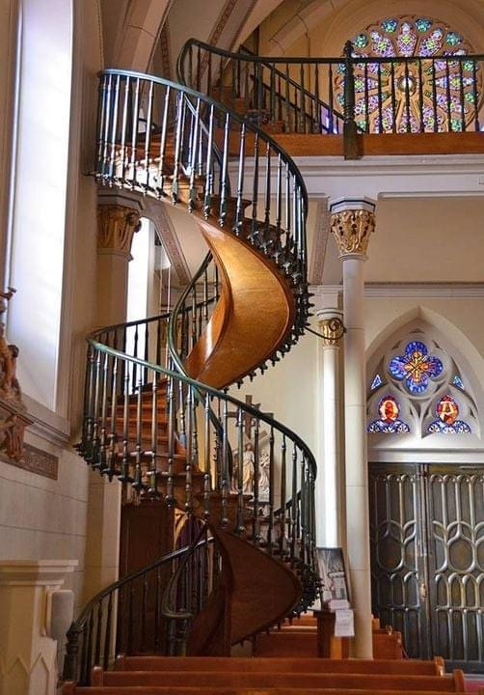
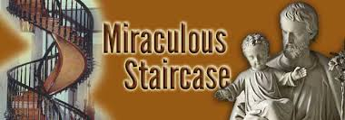
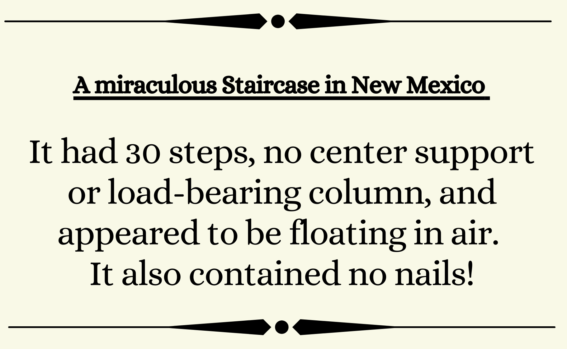
St Joseph – Silent Witness
In 1878, the Sisters of Loretto operated a girl’s academy in Santa Fe, New Mexico. The sisters prayed to St. Joseph for help for their chapel that was built for 5 years only to find out that a staircase to the choir loft is missing. They began a novena to St. Joseph asking him to send a carpenter to help them. Remarkably, on the final day of the novena, a mysterious man arrived at the convent.
3
Unveiling of St Joseph
Notes:
You would have read this amazing story …

Slide 22
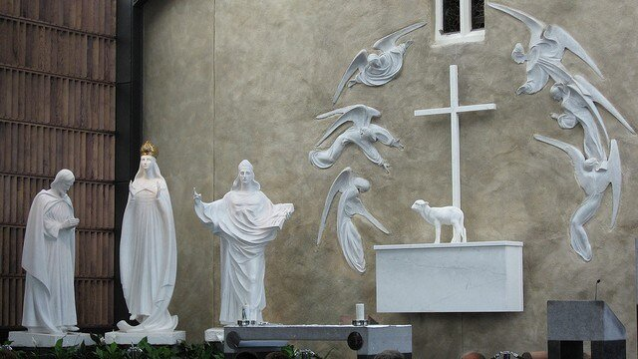
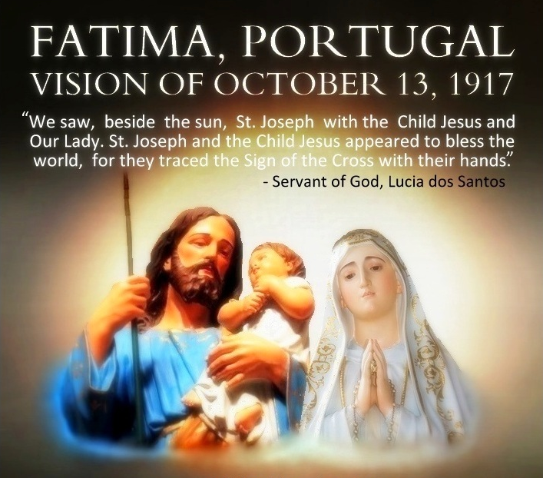
St Joseph – Silent Witness
We honour Saint Joseph as the man who taught Jesus how to speak yet the Gospel does not record a single word from him apart from the naming of Jesus; his language is silence. Saint Joseph’s silence and humility are the foundation of his greatness.
21 August 1879, Knock, Ireland
Unveiling of St Joseph
Notes:
St Joseph appeared at Fatima to remind us of the strength fathers and families need. St Joseph was Head of the Holy Family and the Pillar of Families not because he was the holiest member which obviously he was not. He was Head of the Holy Family and Pillar of Families because he was the father of the family. As father of the family, he represented God the Father. His task being to establish and build up the ecclesia domestica – the domestic church to be a stronghold, a fortress on solid foundations to withstand the evil of our times.

Slide 23
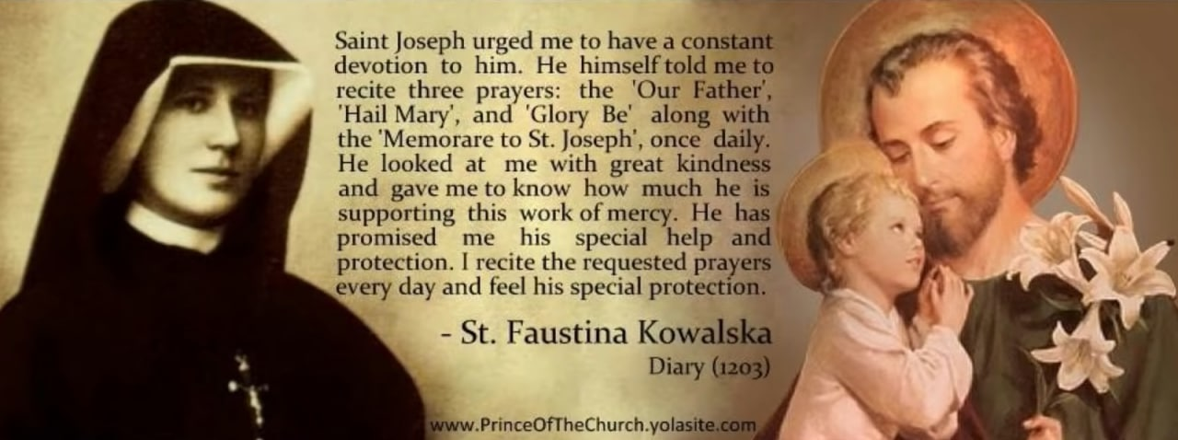

St Joseph – Silent Witness
What our Lady revealed to St Brigid of Sweden: “St Joseph was so reserved and careful in his speech that not one word ever issued from his mouth that was not good and holy, nor did he ever indulge in unnecessary or less than charitable conversation. He was most patient and diligent in bearing fatigue; he practised extreme poverty; he was most meek in bearing injuries; he was strong and constant against enemies; he was the faithful witness of the wonders of heaven.”
Unveiling of St Joseph
Notes:
Our Lady shared with St Brigid of Sweden that not only is St Joseph a man of few words but the words he spoke are kind and affirming …
St Faustina had visions of St Joseph in which he urged her to … read from slide

Slide 24
Through the loving example of St Joseph, Jesus learnt the holiness of work and its proper place in life; for St Joseph also strived to make time for God, family, community, recreation and rest. In the past week, besides being the Model of Workmen, we’ve seen him as the Glory of Domestic Life, the Pillar of Families, and the Comfort of the Afflicted.
Given the many roles in my life, how can I achieve a good balance, ensuring I am able to prioritise and focus on that which truly matters? What challenges do I face? What help do I need?
What would I like to turn to St Joseph in prayer?
Group Reflection & Discussion Questions

Slide 25
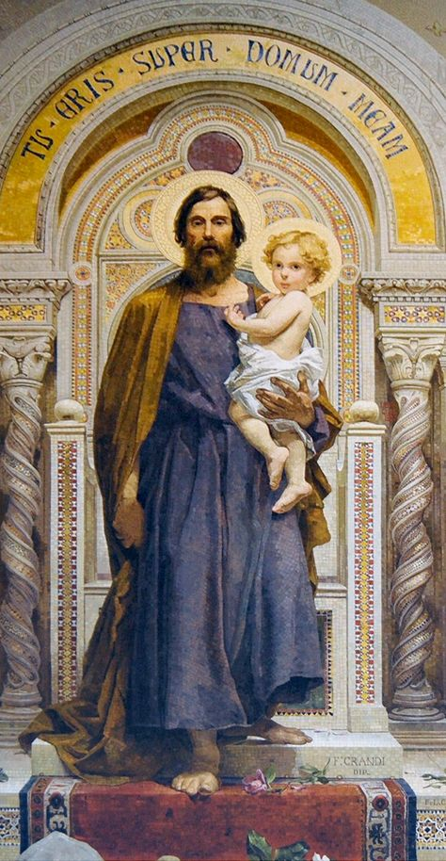

LITANY OF SAINT JOSEPH

Slide 26
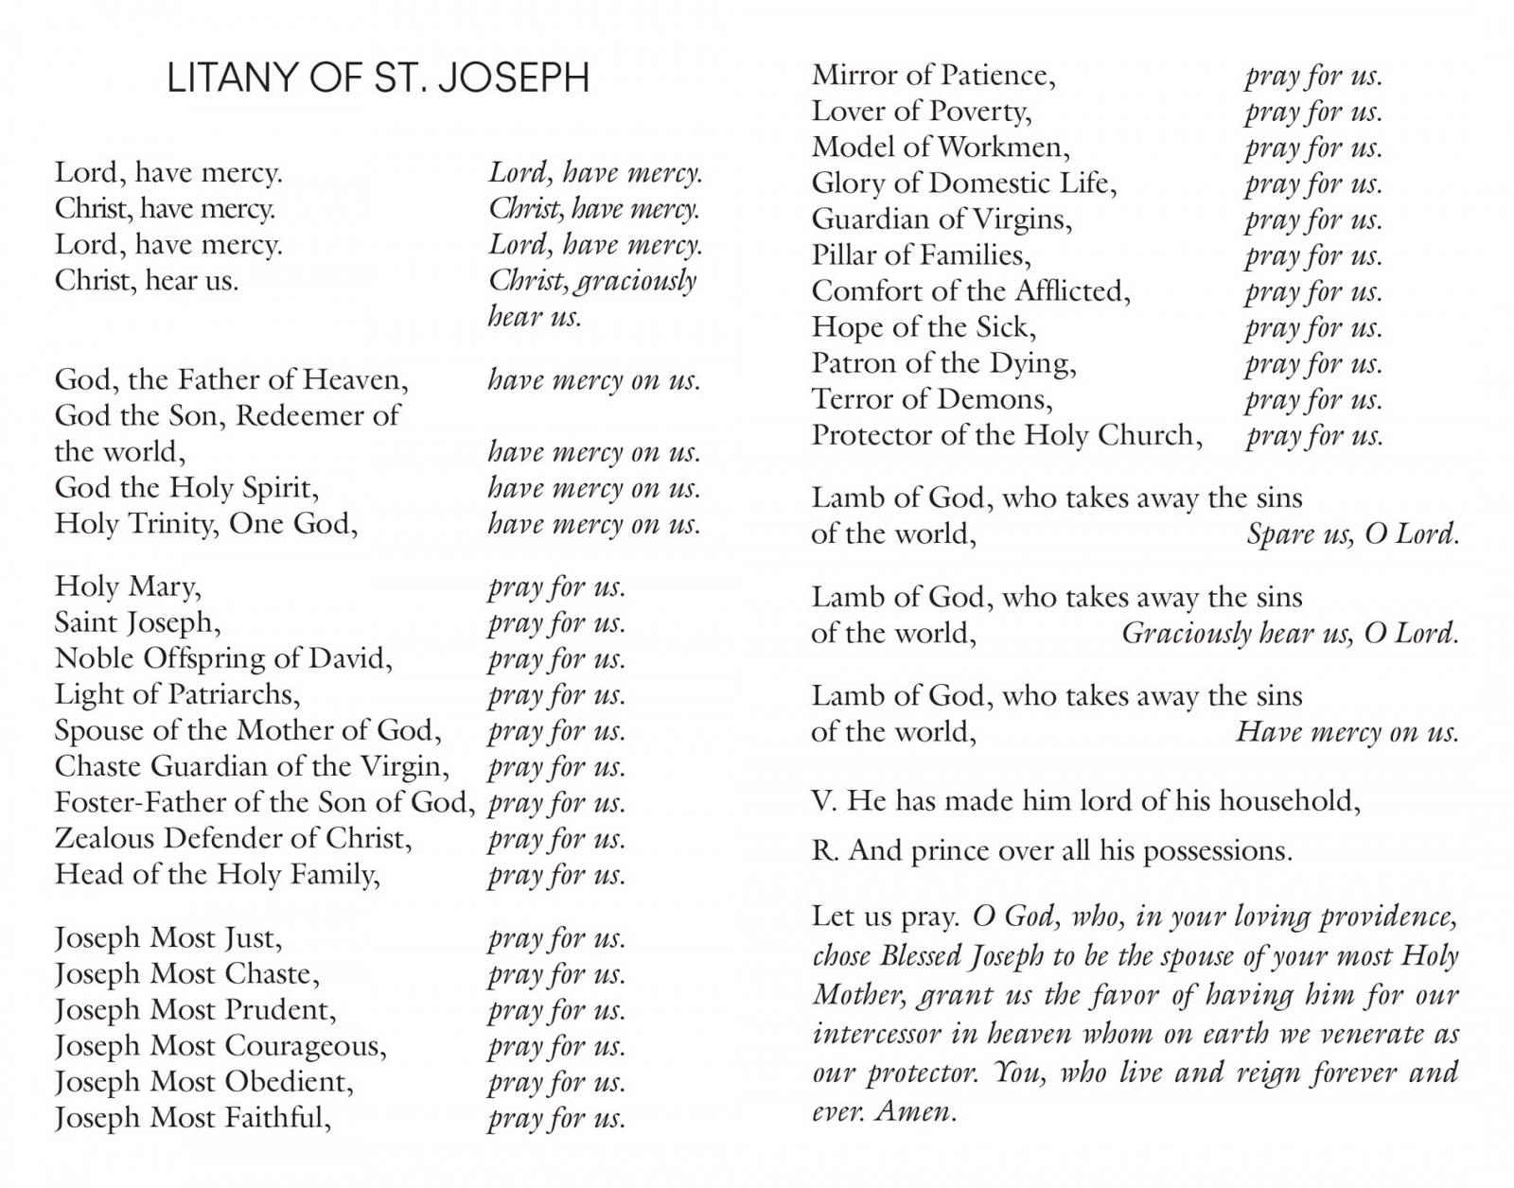
LITANY OF SAINT JOSEPH

