Slide 1
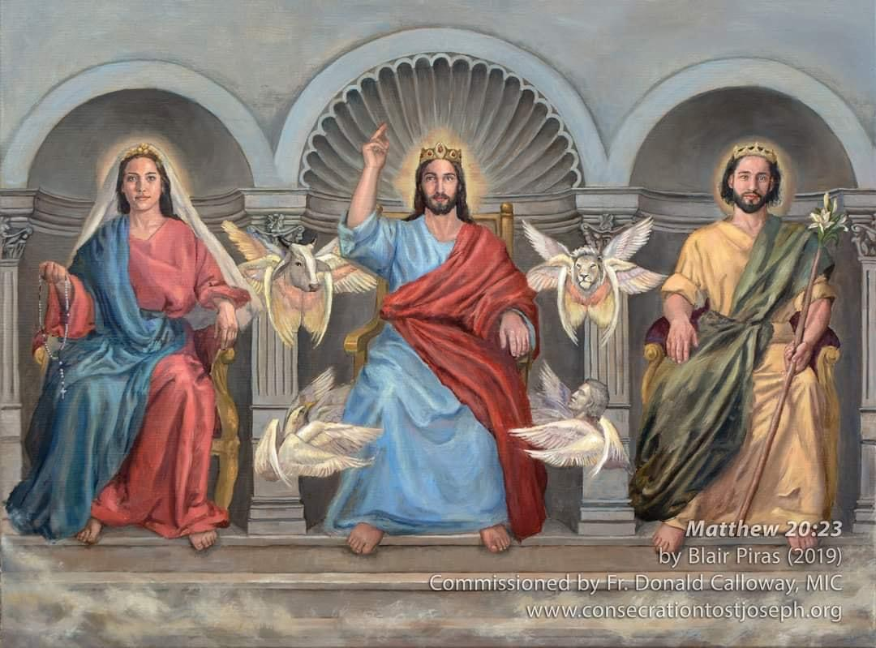
Welcome to the 4th Group Meeting
Notes:
Welcome to our 4th session. We have 2 more to go before Consecration Day.

Slide 2
https://www.youtube.com/watch?v=f5RLChQZz-M
Joseph's Song - Michael Card
Notes:
To get us going, let me share with you another music prayer video; trust you will enjoy this one as well

Slide 3
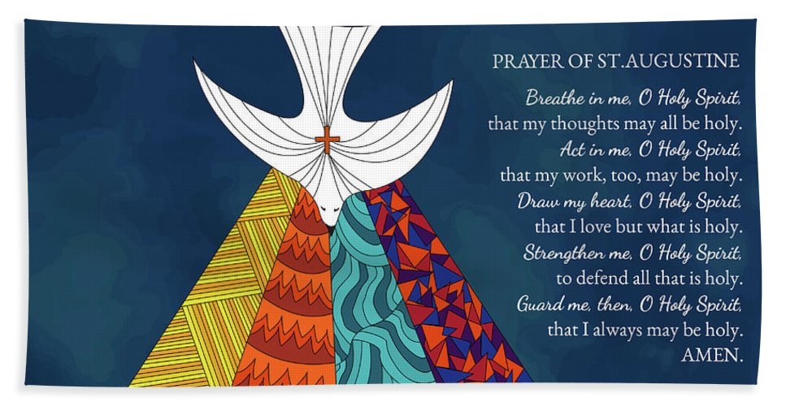
Opening Prayer
Notes:
And again, we call upon the Holy Spirit to fill us with what we need as we continue on with our journey to holiness; …

Slide 4
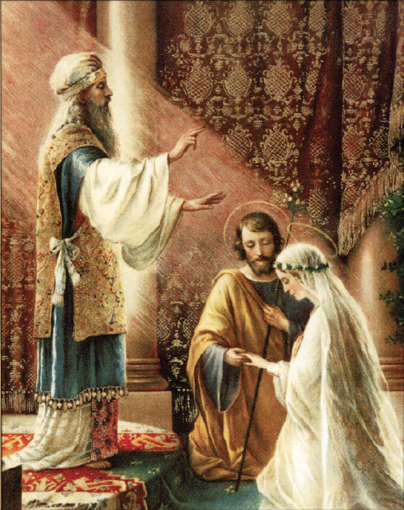
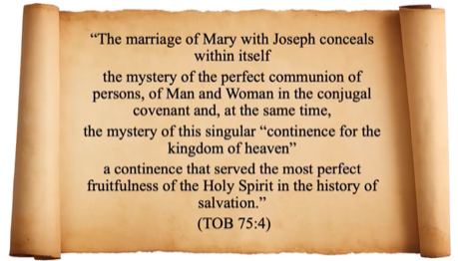
Joseph and Mary lived in what is often called a “Josephite marriage.” They were truly husband and wife, with an inseparable union of souls; but they never engaged in sexual relations. They were both consecrated to God and sacrificed a natural good for a greater good: the salvation of souls.
Josephite Marriage
Fr David Garcia, OP
Mary and Joseph safeguarded each other’s virtue for the sake of the mission of their virginal Son.
Notes:
Quick recap – In the last session we established that Joseph and Mary lived a Josephite Marriage. Read off the slide

Slide 5
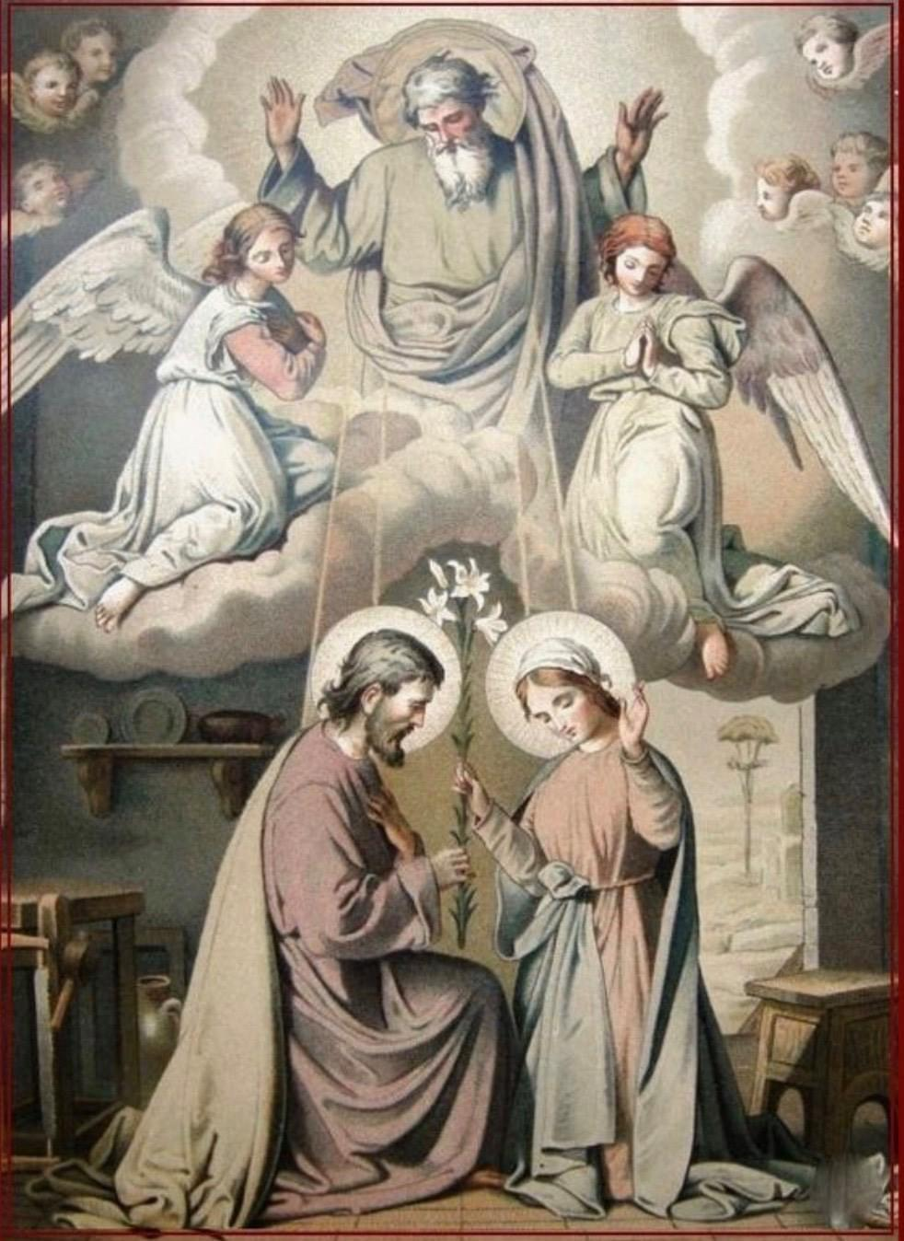
Mary was not an unwed woman when the Angel came to her. Our Lady was already married to Joseph when the Annunciation took place. Joseph was not present when the angel came to her because ancient Jewish weddings had 2 phases. The first phase was the betrothal (which established a valid marriage and is not the same thing as what we call an engagement today). The second phase of the marriage was when the couple started to live together. The second phase could take up to a year. This is very important because it shows that God waited until Mary and Joseph were married to send his Son into the world to save us. The mystery of salvation has marriage and family at its core. The Saviour came into the world through the marriage of Mary and Joseph.
God waited until Mary and Joseph were married to send his Son into the world to save us.
Notes:
Read off the slide

Slide 6
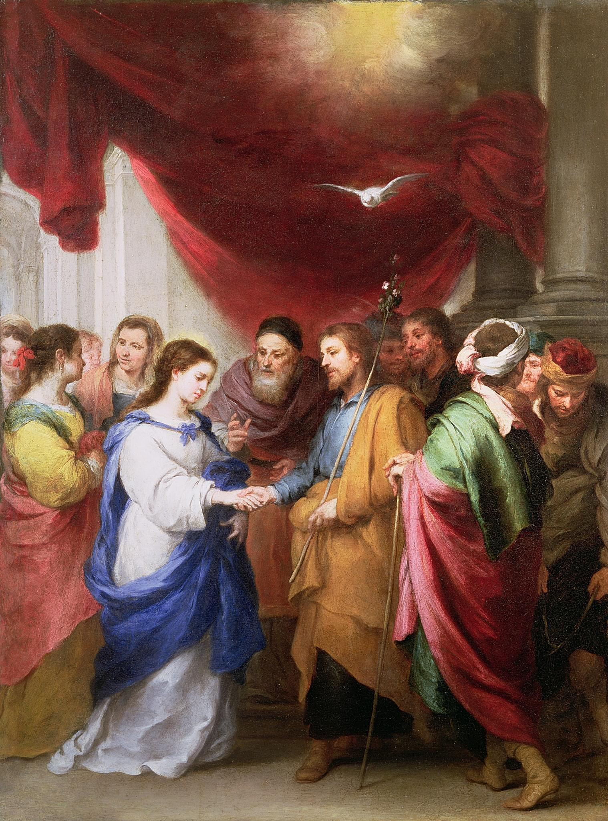
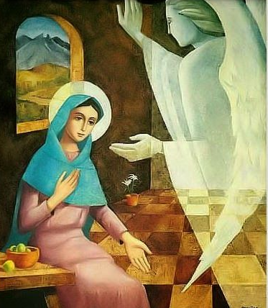
Joseph had made and kept the vow of chastity and was known for the utmost purity of his life, holy and irreprehensible in the eyes of God and of men.
M Agreda, 1912, p.576
But Mary said to the angel, “How can this be, since I have no relations with a man?”
God waited until Mary and Joseph were married to send his Son into the world to save us.
Notes:
What Mary meant by that response to the Archangel Gabriel is that given she had made a vow of perpetual virginity long before the angel showed up, she was puzzled by what he said because she had already pledged / consecrated herself to God - so she will not have relations with any man, never ever, not before, during nor after her marriage. And God saw to that by choosing Joseph to be her spouse.
Joseph who himself had made a vow of chastity.
And I think it would be safe and logical to assume that they would have talked about this subject matter even as they prepare to be betrothed like any couple although I don’t think they have CEE or MPC then.

Slide 7
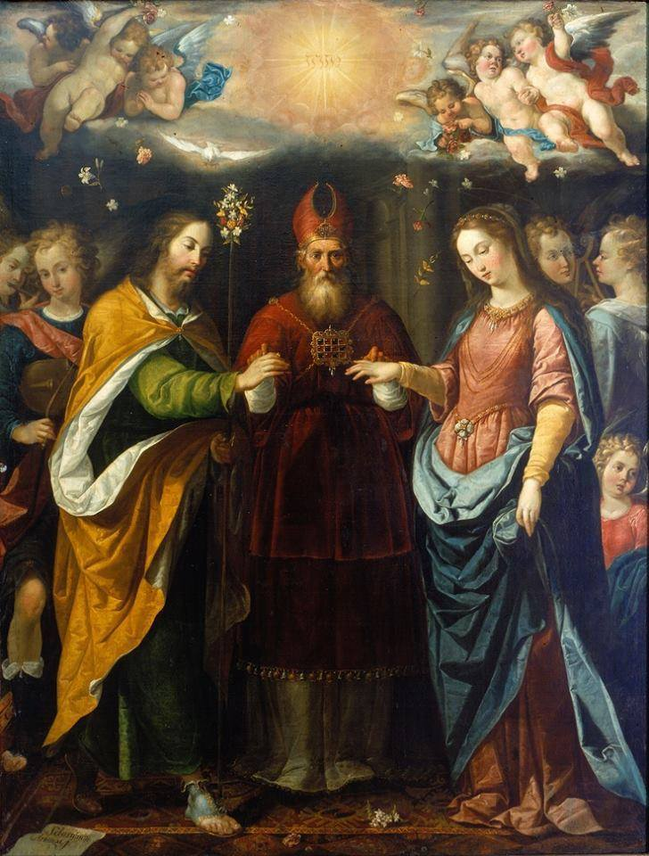
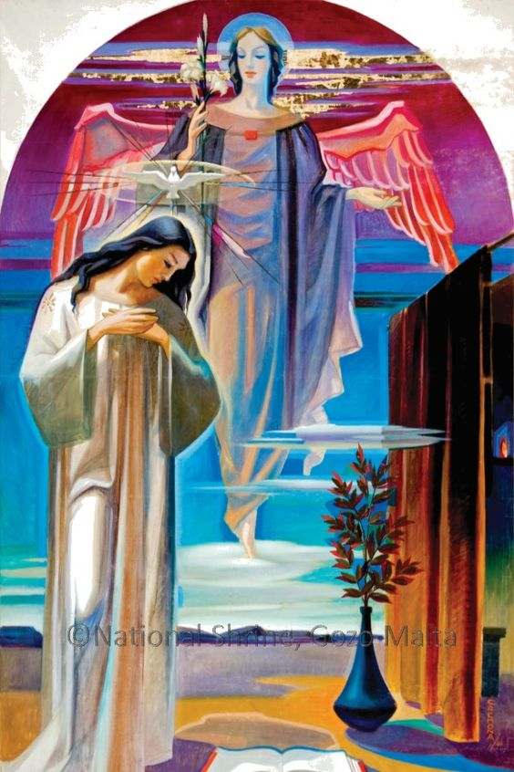
Espousal
Annunciation
Notes:
So here’s the chronological order of events …

Slide 8
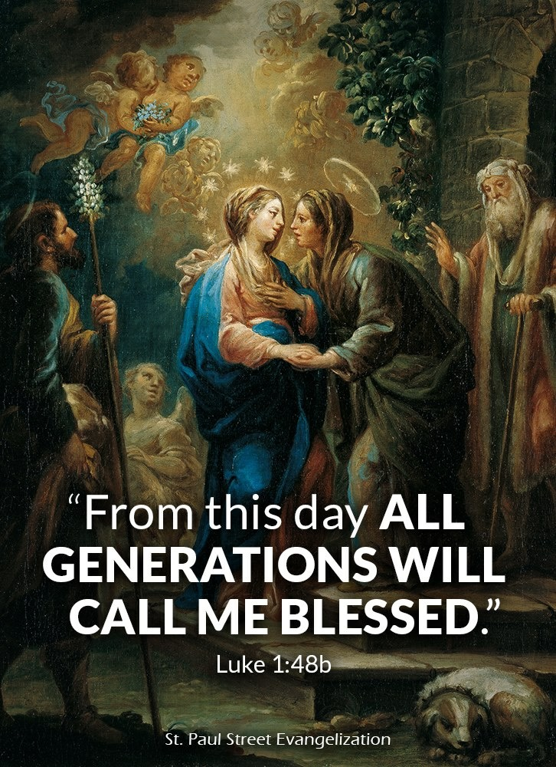
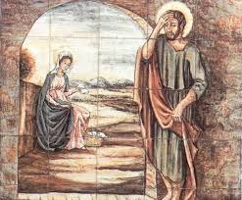
It was when Mary returned to Nazareth that Joseph found out that his virgin bride was with child.
Visitation
Joseph’s Headache
Notes:
Shortly after Mary was overshadowed by the Holy Spirit and she was with child, she set out to visit her cousin Elizabeth as the angel had told her that Elizabeth too was with child.
Now I think that given all that we now know and understand about St Joseph, I think it is safe to surmise that Joseph had actually accompanied Mary to visit Elizabeth. Elizabeth lived in the Judean Hill Country in Ein Karem which is even further than Nazareth and Bethlehem. Joseph would not have let Mary (a teenager) to travel on her own. Either Mary went along with a caravan of relatives and/or Joseph would have escorted her there. Even if he did not stay on but would come back three months later to bring her home.
So in most images and paintings of the visitation you will actually noticed Joseph being present.
It was only after Mary got back from her visit of Elizabeth that Joseph discovered his virgin bride was with child.

Slide 9
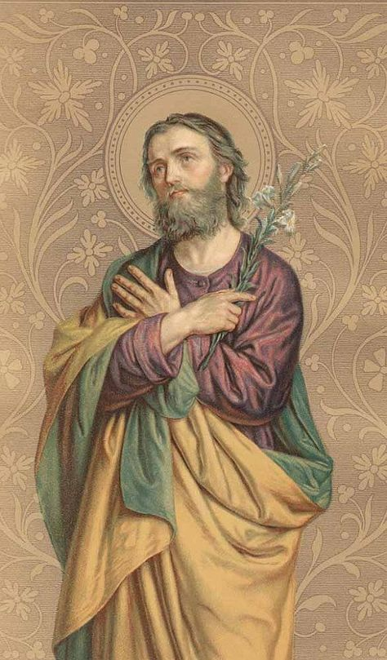
The divine pregnancy of Mary had advanced to its fifth month when the most chaste Joseph commenced to notice the condition of the Virgin …
The man of God was wounded to his inmost heart by an arrow of grief …
The principal cause of his grievous affliction was the intense love with which he cherished his most faithful spouse … and the dread of being obliged to deliver over his spouse to the authorities to be stoned.
He argued with himself: “I do not find a better way out of these difficulties than to absent myself. I confess that my spouse is most perfect and exhibits nothing but what shows her a saint; but after all she is pregnant and I cannot fathom the mystery. I do not wish to injure her reputation of holiness by involving her in the punishment of the law; yet at the same time I cannot stand by and witness the consequences of her pregnancy. I will leave her now, and commit myself to the providence of the Lord, who governs me.”
The Blessed Virgin Mary was heartbroken to see Joseph so wounded by this. She prayed to God to take pity on Joseph to enlighten him.
The private revelations of Venerable Maria de Agreda and Blessed Ann Emmerich
Notes:
According to the private revelations of Venerable Maria de Agreda and Blessed Ann Emmerich, the divine pregnancy of Mary …

Slide 10
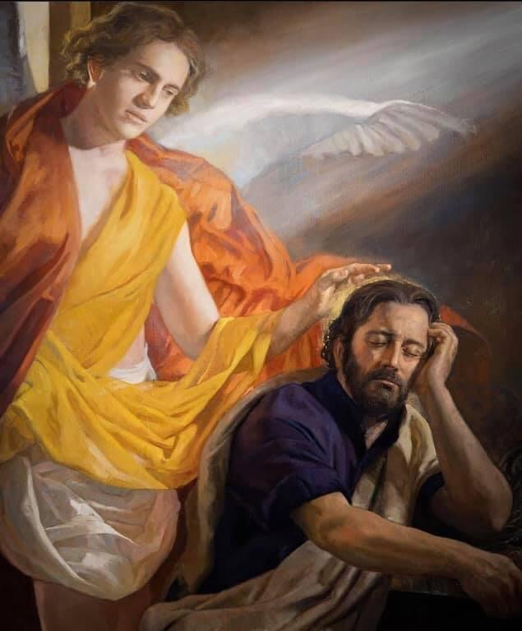
Now the birth of Jesus Christ took place in this way. When his mother Mary had
been betrothed to Joseph, before they came together she was found to be with child of the Holy Spirit; and her husband Joseph, being a just man and unwilling to put her to shame, resolved to send her away quietly. But as he considered this, behold, an angel of the Lord appeared to him in a dream, saying, “Joseph, son of David, do not fear to take Mary as your wife, for that which is conceived in her is of the Holy Spirit; she will bear a son and you shall call his name Jesus, for he will save his people from their sins.” All this took place to fulfil what the Lord had spoken by the prophet: “Behold, a virgin shall conceive and bear a son, and his name shall be called Emmanuel” (which means, God with us). When Joseph woke from his sleep, he did as the angel of the Lord commanded him; he took his wife.
Matthew 1: 18-24
Revised Standard Version Catholic Edition.
Notes:
Using the Revised Standard Version Catholic Edition we read …

Slide 11
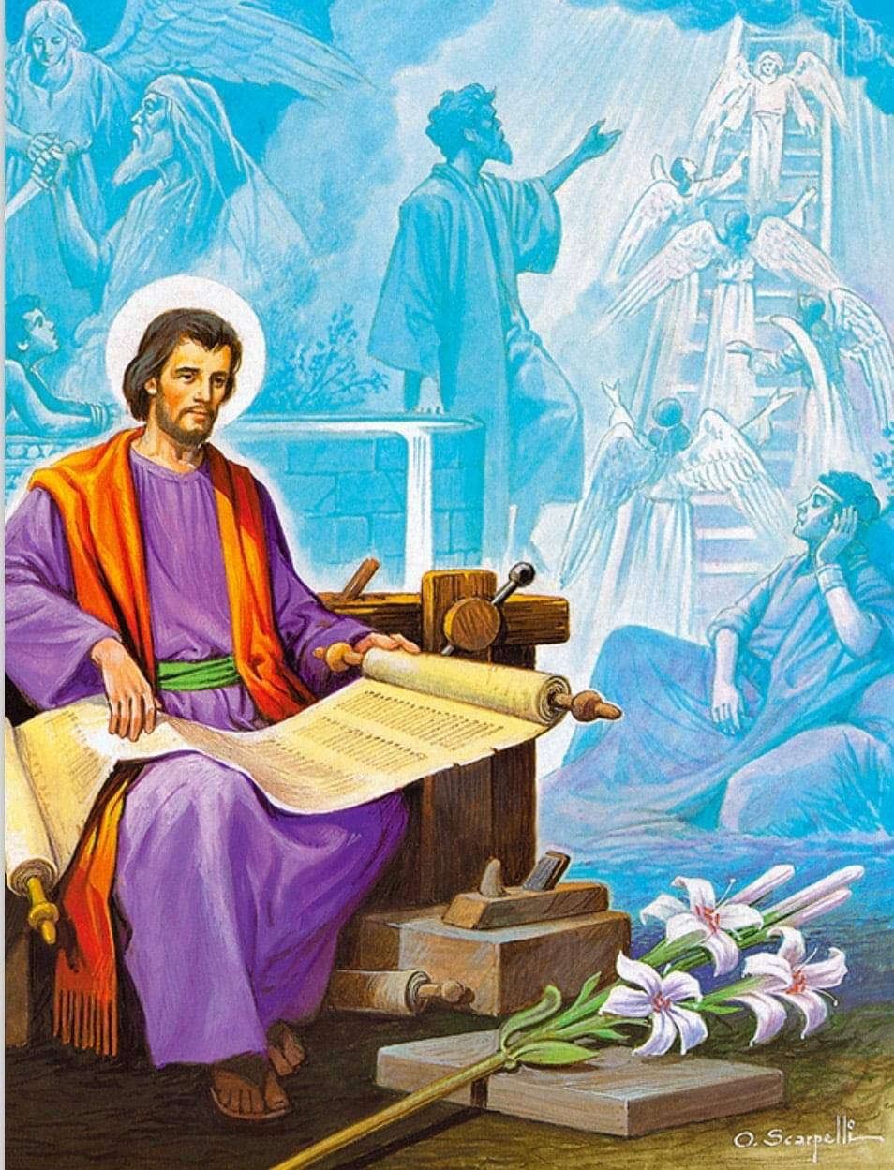
The Church teaches that St Joseph, most just, always acted in accord with the Divine Will and gave God and others their due.
He does not doubt her purity and innocence. Instead he doubts his worthiness and ability to take care of Mary and the child. A just man, he knows that Mary belongs to God and he considers himself unworthy of living with her. He decides to separate himself from her quietly out of justice to God and out of love and reverence for Mary. He was willing to step out of the picture.
“Because he would not suspect evil but remembered the words of the prophet who foretold that the Son of God would be born of a virgin, he reputed himself unworthy to serve such a mother, until the angel in a dream commanded him not to fear but to minister to me with charity.” [Our Lady’s revelation to St Brigid of Sweden.]
Joseph Most Just, pray for us.
Notes:
The Church teaches that St Joseph, most just, always acted in accord with the Divine Will and gave God and others their due… He was willing to step out of the picture.
Saint Joseph was a very devout Jew. He was not ignorant of the scriptures. He knew the prophesy of Isaiah that said a virgin would give birth. He also knew that the heavenly child had to be of the Davidic lineage. Thus, he never doubted Mary or suspected her of adultery. He doubted his own worthiness to fulfill such a lofty vocation of being the husband of the Virgin and the earthly father of the Messiah.
We are talking extreme humility, only outdone by the Virgin Mary and Jesus Christ.
And that is exactly why God chose him.
As Our Lady revealed to St Brigid of Sweden; she said … Because he would not suspect evil …

Slide 12
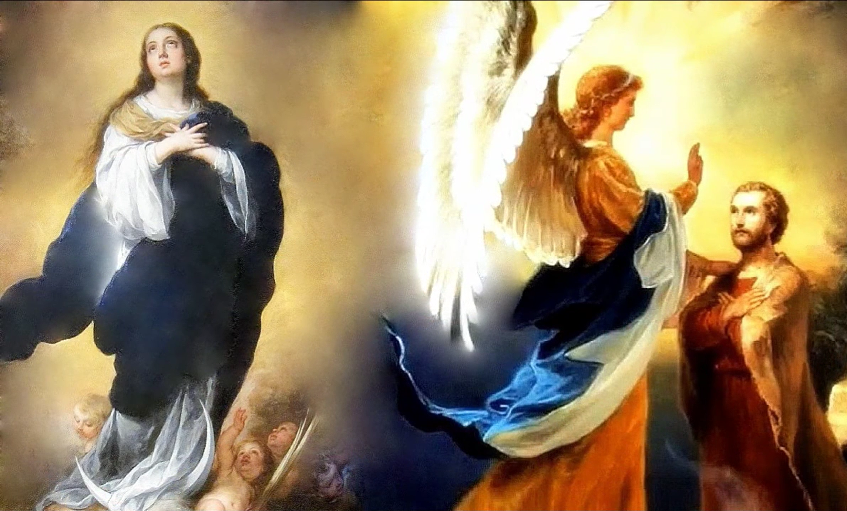
“My God and my Supreme Good! I recognise that I am unworthy to be the one to receive from you so eminent a gift as this Most Holy Virgin Mary, as a spouse and companion. I realise that I have no right to expect it. I am going to this meeting only because it has been so ordered. I beg you to give to this most Holy Virgin a bridegroom who will be worthy of her, and who is fully in accord with Your own heart. But to me, kindly grant an increase of Your grace and love. I place myself entirely in Your hands, May whatever pleases you be always done to me. I desire nothing else than Your holy will be done in me.
Mother Cecilia Baij, 1977, pg. 75, 76
Notes:
This is the testimony from Mother Cecilia Baij … This was St Joseph’s prayer / plea to God as he was making his way to the Temple as summoned
Just like the centurion who said Lord I’m not worthy to have you come under my roof, but only say the word … or like Peter who said to Jesus – away from me, I’m a sinful man … such is the humility of Joseph

Slide 13
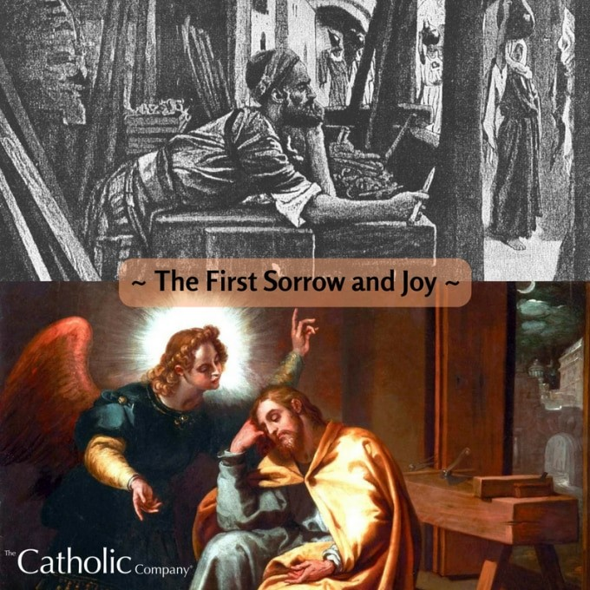
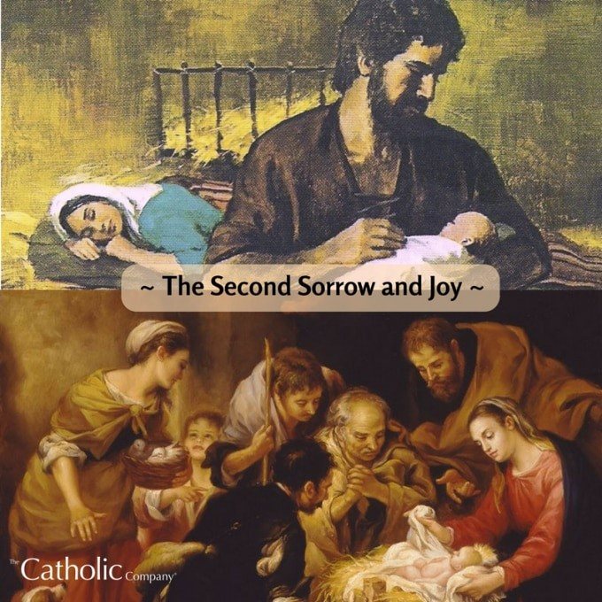
1st Sorrow – Joseph Resolves to Leave Mary (Matt 1:18-19)
1st Joy – The Annunciation to St. Joseph (Matt1:20-21)
2nd Sorrow – The Poverty of Jesus’ Birth (Luke 2:6-7)
2nd Joy – The Birth of the Saviour of Mankind (Luke 2:10-19)
Devotion of the Seven Sorrows and Seven Joys of Saint Joseph
Notes:
Next I want to quickly cover what the 7 Sorrows and 7 Joys of St Joseph are about. They are all scripture-based
We can actually spend time to dive deeper into each Sorrow / Joy and reflect upon what meaning and lessons we can derive for ourselves. This is another way of contemplating and reflecting upon the virtues of St Joseph. [Practice of Opus Dei] As a follow up after this 33-day consecration we can arrange like what we did previously spending 7 consecutive Wednesdays / Sundays diving into each Sorrow / joy leading to the Solemnity of St Joseph on March 19. [Go through quickly what each Sorrow / Joy is about what are its implications as we apply to our daily living.] Through it all St Joseph’s virtues were clearly on display.

Slide 14
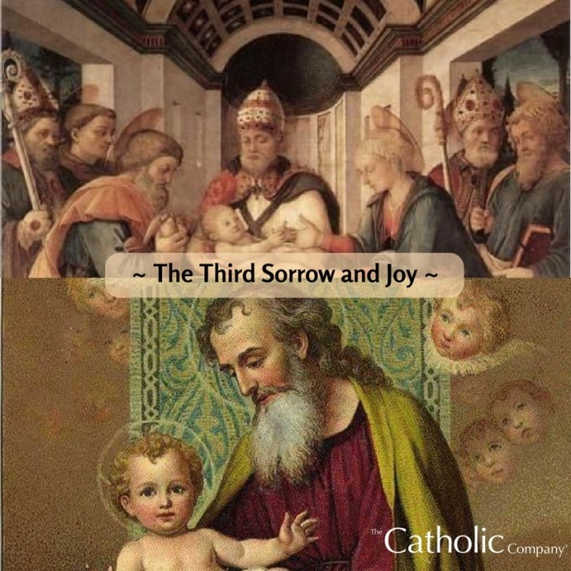
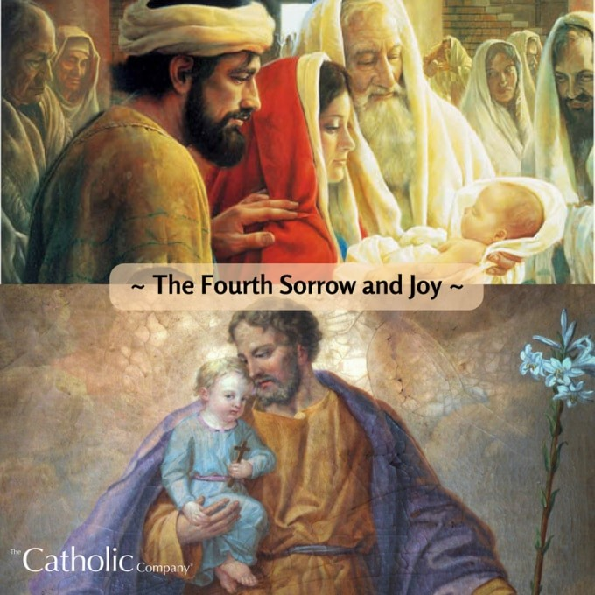
3rd Sorrow – The Circumcision of Christ (Luke 2:21)
3rd Joy – The Holy Name of Jesus (Matt 1:24-25)
4th Sorrow – Simeon’s Prophecy (Luke 2:34-35)
4th Joy – The Salvation of Mankind (Luke 2:29-33)
Devotion of the Seven Sorrows and Seven Joys of Saint Joseph

Slide 15
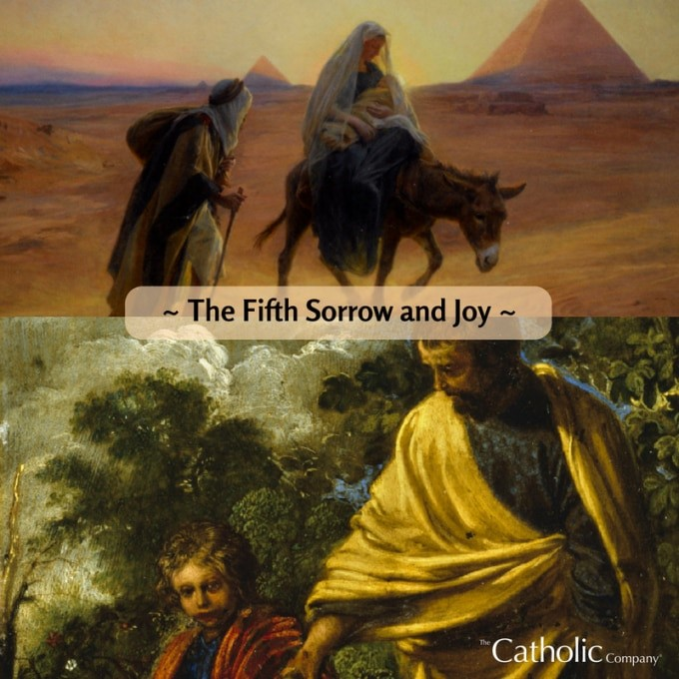
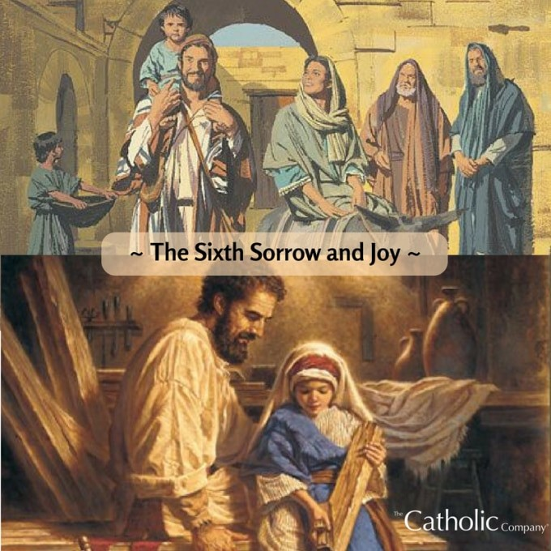
5th Sorrow – The Flight into Egypt (Matt 2:13-14)
5th Joy – The Toppling of the Idols (Isaiah 19:1)
6th Sorrow – The Perilous Return from Exile (Matt 2:19-22)
6th Joy – Family Life at Nazareth
(Luke 2:39-40)
Devotion of the Seven Sorrows and Seven Joys of Saint Joseph

Slide 16
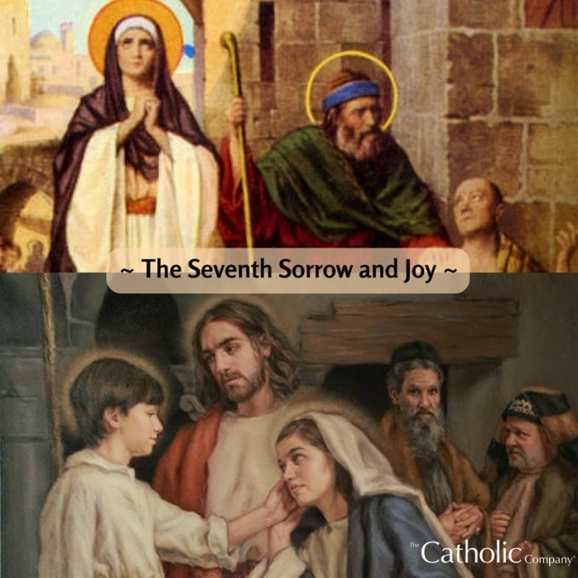
Seven Sorrows & Seven Joys
Through the ebb and flow of his life, loving and protecting Mary & Jesus; through the trials and tribulations, in good and troubled times, Joseph kept faith and stayed strong and was true to his mission, remaining always obedient to God’s will.
All his blessed virtues were evident – his supernatural prudence in always making the decisions that are right by God; his creative courage and ingenuity in having to improvise and make the best of every situation.
And you can believe he prayed unceasingly!
7th Sorrow – The Loss of Jesus in Jerusalem (Luke 2:42-45)
7th Joy – The Finding of Jesus in the Temple (Luke 2:46-52)
Devotion of the Seven Sorrows and Seven Joys of Saint Joseph
Notes:
Story of the horse that strayed into a farm …

Slide 17
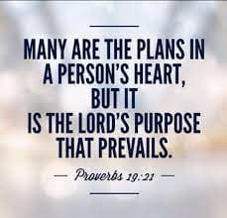
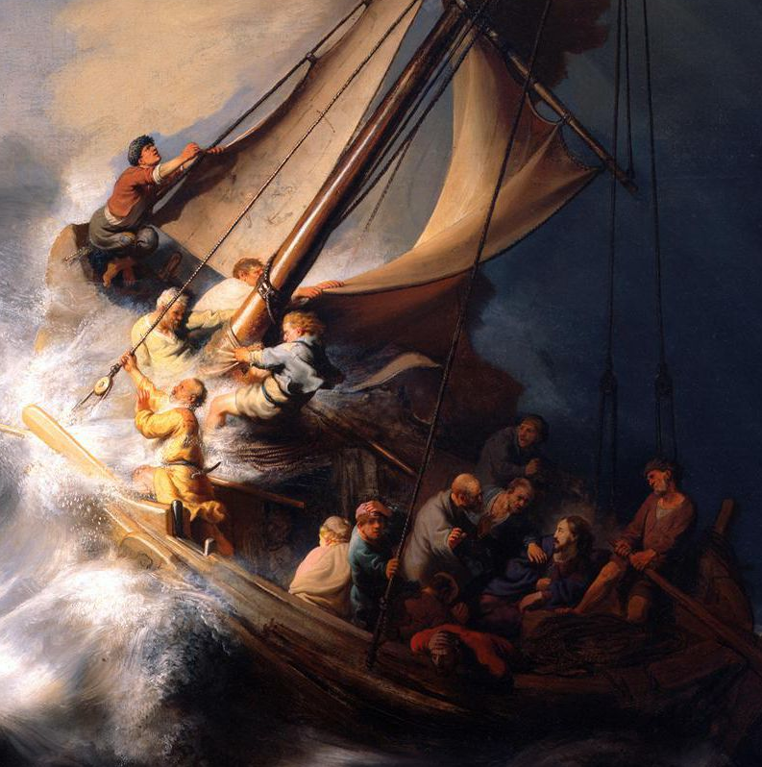
The Lord is with you.
Notes:
“Even through Joseph’s fears, God’s will, his history and his plan were at work. Joseph, then, teaches us that faith in God includes believing that he can work even through our fears, our frailties and our weaknesses. He also teaches us that amid the tempests of life, we must never be afraid to let the Lord steer our course. At times, we want to be in complete control, yet God always sees the bigger picture.”
It’s been said that love and fear cannot co-exist. . Love overcomes fear. That’s what gives any young couple the courage to get married in the face of so much unknown. Joseph had much to fear. But he let his great love of Abba Father, of Jesus and of Mary overcome his fear. What about us?

Slide 18
Justice: The virtue of justice involves “giving to another his due.” Joseph did exactly what the Lord wanted him to do, in each and every event that went to make up his life.
Challenge: Resolve to be completely truthful and just in every interaction.
Prayer: St. Joseph, Most Just, pray that I may grow in the virtue of justice. Help me to examine my life to see if I am really open to all that God wants of me. Amen.
Daily Challenge & Prayer
Notes:
So the past week we had the chance to examine each of Joseph’s virtue and try to relate it to our daily living and our life situation. I had posted a daily challenge along with a prayer …

Slide 19
2. Chastity: Purity comes from love. A love that does not seek to possess nor dominate but takes responsibility for the other; loving the other more than oneself.
Challenge: Honestly and prayerfully confront and expose any lustful thoughts and actions that you entertain or engage in this day, however seemingly harmless, or insignificant, or habitual. Resolve to bring these to the Sacrament of Reconciliation.
Prayer: St. Joseph, Most Chaste, pray that I may grow in the virtue of chastity. Help me to be victorious against lust and be triumphant over sin. Fight for me against the wickedness and snares of the devil and help me to take refuge in you. Amen.
Daily Challenge & Prayer

Slide 20
3. Prudence: Wisdom and prudence go hand in hand. Wisdom is knowledge combined with the practical experience necessary to use it effectively at the right time or in the right situation. Prudence is the ability to act in accordance with knowledge and wisdom.
Challenge: Are there situations in my life right now that require great wisdom and prudence to know the right thing to do? If so, identify these and resolve to seek Godly wisdom through counsel and prayer to be prepared to act with prudence.
Prayer: St. Joseph, help me to increase in the virtue of prudence. Guide me to do what is right no matter how much I have to suffer for it. Amen.
Daily Challenge & Prayer

Slide 21
4. Courage: To be courageous is to love the good more than you fear evil and suffering
Challenge: Identify a circumstance in your life where you need greater courage. Ask for the gift of courage and the help of St. Joseph to take the next steps needed to confront your challenge as beloved sons and daughters of God the Father.
Prayer: St. Joseph, help me to imitate you and to be courageous, especially in times filled with difficulty and sorrow. Give me the courage to be a good and faithful witness to Jesus Christ in word and in deed. Amen.
Daily Challenge & Prayer

Slide 22
5. Obedience: Obedience requires trust. Obedience is the road to the Father. Obedience is listening deeply to God.
Challenge: Identify an area of your life where you resist obedience to God’s will. Pray to St. Joseph for an increase of trust so you may experience the true freedom that comes through obedience to God.
Prayer: St. Joseph, help me to examine my life to discover what holds me back from trusting and obeying God more fully. Pray for me so that I may have a humble heart and yield to God at all times. Amen.
Daily Challenge & Prayer

Slide 23
6. Faith: When a person has faith, he or she is in possession of something invaluable, something that acts as a shield against life’s suffering and trials. St Joseph’s faith never wavered through all the uncertainty and trials of the life of the Holy Family.
Challenge: Compose a simple prayer to your guardian angel and ask God to help you be aware of their presence, their spiritual weapons and heavenly aid. Reflect on Ephesians 6: 10-17, ”Put on the Armor of God”
Prayer: St. Joseph, Most Faithful, pray for us and for our families! Amen.
Daily Challenge & Prayer

Slide 24
7. Patience: Being patient is a vital part of trusting in God as our life circumstances are not always what we would prefer. And we tend to want things to happen here and now. Then there is also patience with regards to difficult people.
Challenge: Ask the Holy Spirit to suggest a person or situation where you can exhibit greater patience. Ask St Joseph, Mirror of Patience, to teach you how to practically do so.
Prayer: St. Joseph, pray for an increase in the virtue of patience in me. Teach me to love the difficult people in my life, help me to be still in the midst of the storms that come my way, and to trust that your timing is always perfect. Amen.
Daily Challenge & Prayer

Slide 25
God allows trials in order that we may grow in virtue
Notes:
Like Joseph, our lives also comprise its share of ups and downs … in terms of patience, there are two aspects; … are we patient with God and the other dimension is are we patient with our neighbour?
As mentioned we tend to want things here and now; instant gratification instead of waiting upon the Lord

Slide 26
God allows trials in order that we may grow in virtue
Notes:
There’s also patience with our spouse, our children, our family members as well as patience with others at work or in our community. Which I think is more akin to forebearance, tolerance and perseverance.
But in any case, God allows trials in order that we may grow in virtue.

Slide 27
Of the various virtues exemplified by Saint Joseph and highlighted in Fr Calloway’s book this past week – justice, chastity, prudence, courage / fortitude, obedience, fidelity and patience; which do I struggle with the most? … is there one particular virtue I most want to seek the intercession of St Joseph for help and guidance?
Let’s intercede for one another; praying with and for each other; for the grace of these virtue(s) before re-joining the main group.
Group Reflection & Discussion Questions
Notes:
So then, …

Slide 28
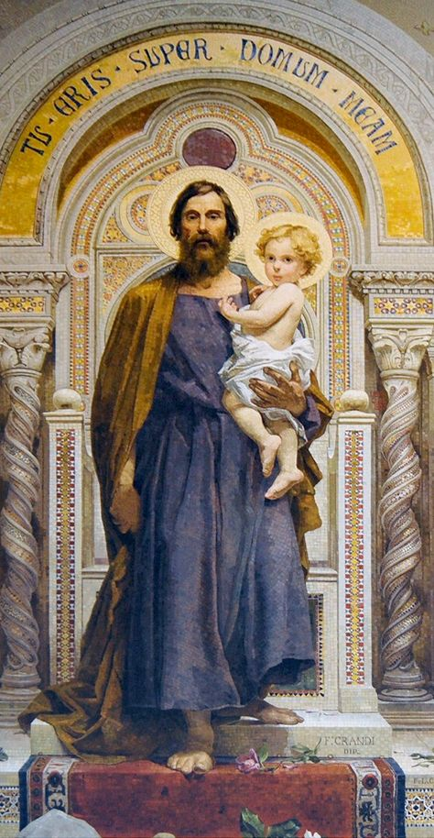
LITANY OF SAINT JOSEPH

Slide 29
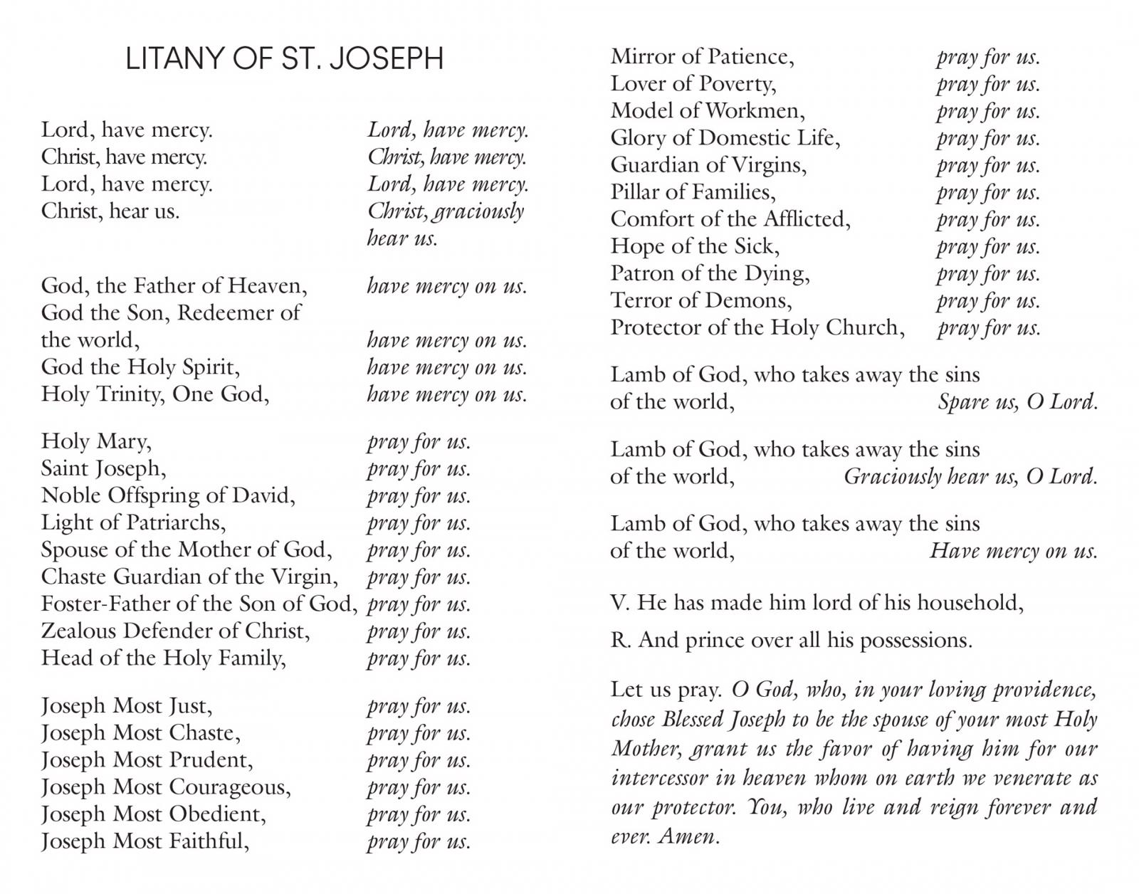
LITANY OF SAINT JOSEPH

