Slide 1
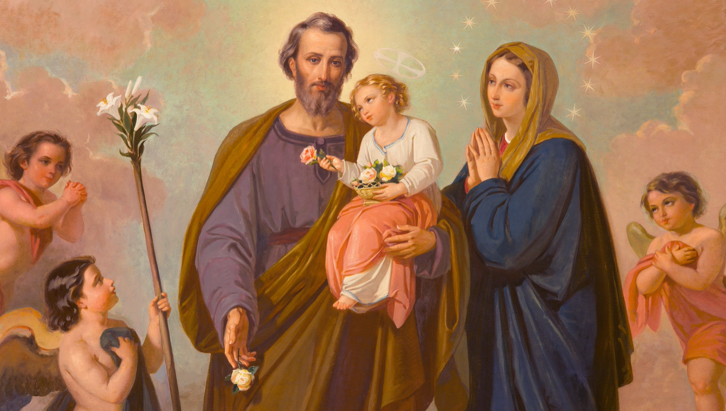
Welcome to our third group meeting
Notes:
Welcome back; we’re on to our third session and we’re half way along our 33-day journey.

Slide 2

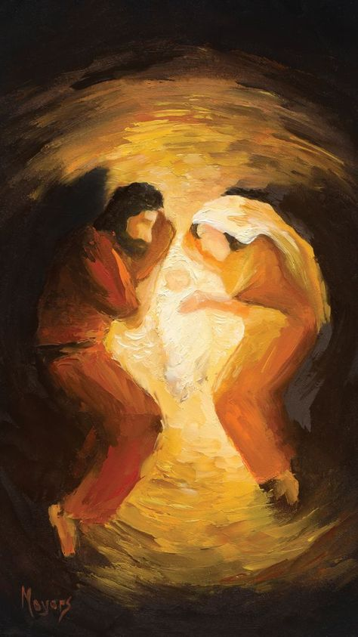
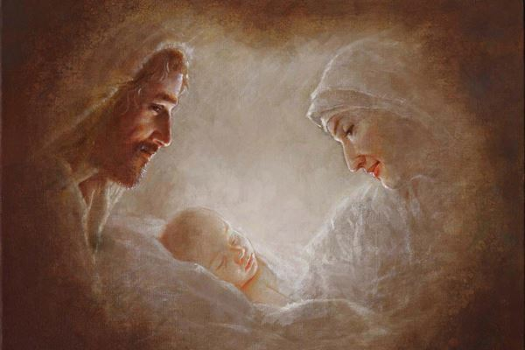
JOSEPH’S LULLABY
Notes:
Here to get us going, is a music prayer video, entitled Joseph’s Lullaby, trust you will like it …

Slide 3
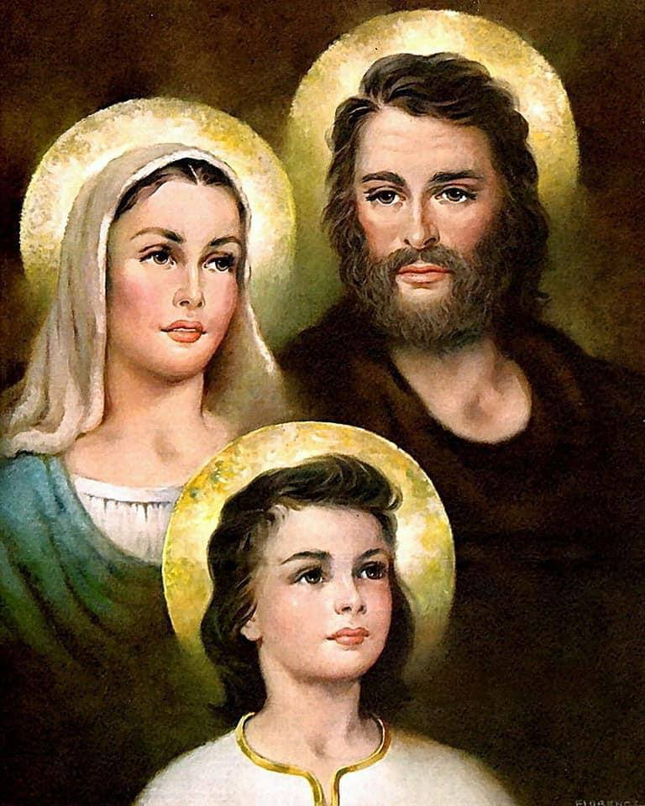
Dear Lord, bless our family. Be so kind as to give us the unity, peace, and mutual love that You found in Your own family in the little town of Nazareth.
Saint Joseph, bless the head of our family. Obtain for him the strength, the wisdom, and the prudence he needs to support and direct those under his care.
Mother Mary, bless the mother of our family. Help her to be pure and kind, gentle and self-sacrificing. For the more she resembles you, the better will our family be.
Lord Jesus, bless the children of our family. Help them to be obedient and devoted to their parents. Make them more and more like You. Let them grow, as You did, in wisdom and age and grace before God and man.
Holy Family of Nazareth, make our family and home more and more like Yours, until we are all one family, happy and at peace in our true home with You. Amen.
Notes:
Let us pray …

Slide 4
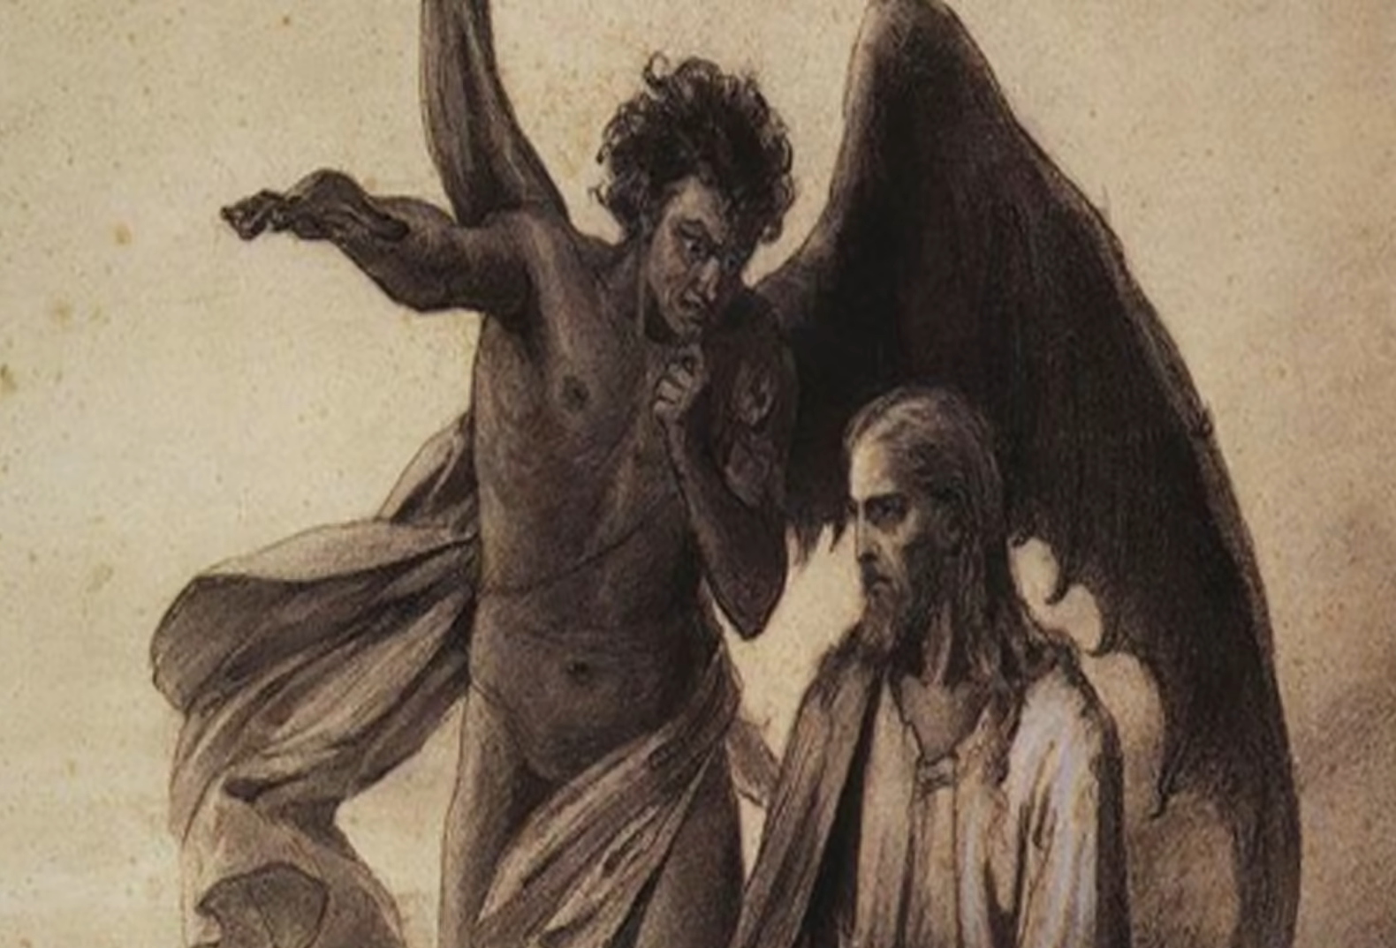
Towards the end of the 19th century [circa 1884-1886], Pope Leo XIII had a vision of Satan taunting Jesus that he will bring down his church.
In wanting to combat Satan and his evil minions Pope Leo XIII first composed the Prayer to St Michael to invoke the aid of the Archangel.
Later, Pope Leo XIII forged together two of the greatest spiritual weapons the Church has in her arsenal – the rosary and St Joseph.
Pope Leo XIII in 1889 suggested that this prayer be added to the end of the Rosary.
Notes:
Very quickly before we dive deeper into understanding more of St Joseph, I’d like to introduce you to a prayer that you can include in your rosary prayers, particularly on Wednesdays – a day Mother Church has dedicated for the devotion to St Joseph … towards the end of the 19th century; …read off the slide

Slide 5
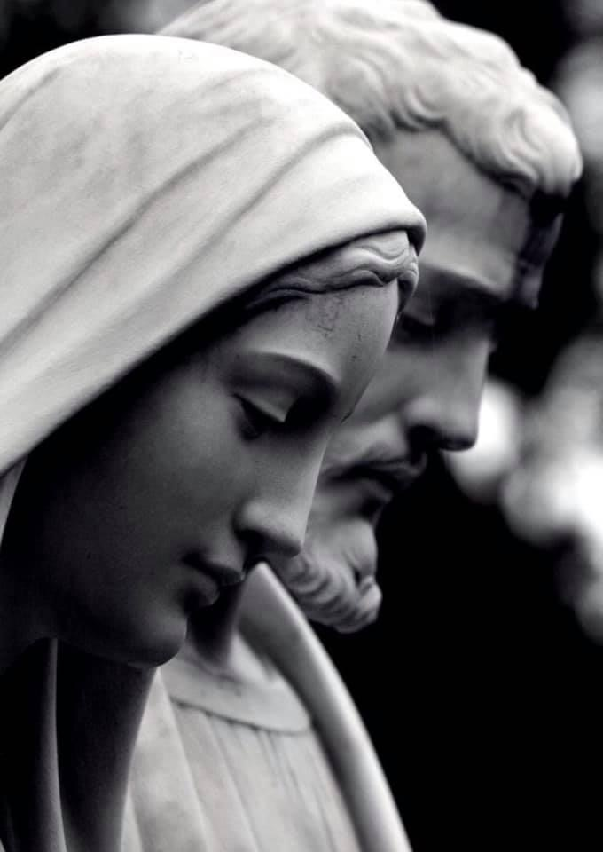
Prayer to Saint Joseph towards the end of the rosary
To you, O blessed Joseph, do we come in our tribulation, and having implored the help of your most holy Spouse, we confidently invoke your patronage also.
Through that charity which bound you to the Immaculate Virgin Mother of God
and through the paternal love with which you embraced the Child Jesus,
we humbly beg you graciously to regard the inheritance which Jesus Christ has purchased by his Blood, and with your power and strength to aid us in our necessities.
O most watchful guardian of the Holy Family, defend the chosen children of Jesus Christ;
O most loving father, ward off from us every contagion of error and corrupting influence;
O our most mighty protector, be kind to us and from heaven assist us in our struggle
with the power of darkness.
As once you rescued the Child Jesus from deadly peril,
so now protect God's Holy Church from the snares of the enemy and from all adversity;
shield, too, each one of us by your constant protection, so that, supported by your example and your aid, we may be able to live piously, to die in holiness, and to obtain eternal happiness in heaven. Amen.
This can be added to your rosary prayers on Wednesdays, a day Mother Church dedicates to St Joseph.
Notes:
The prayer reads …

Slide 6
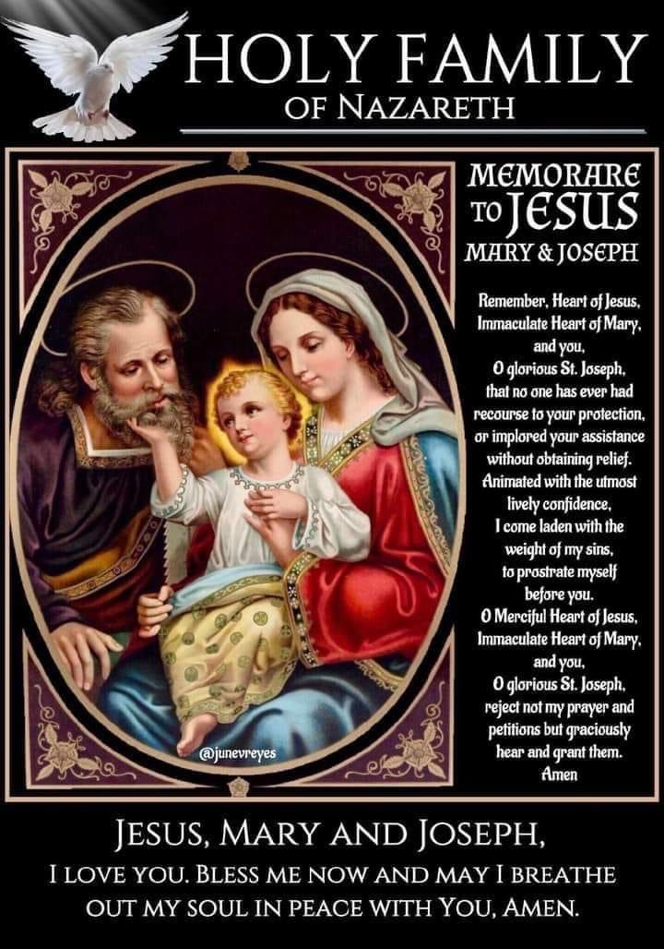
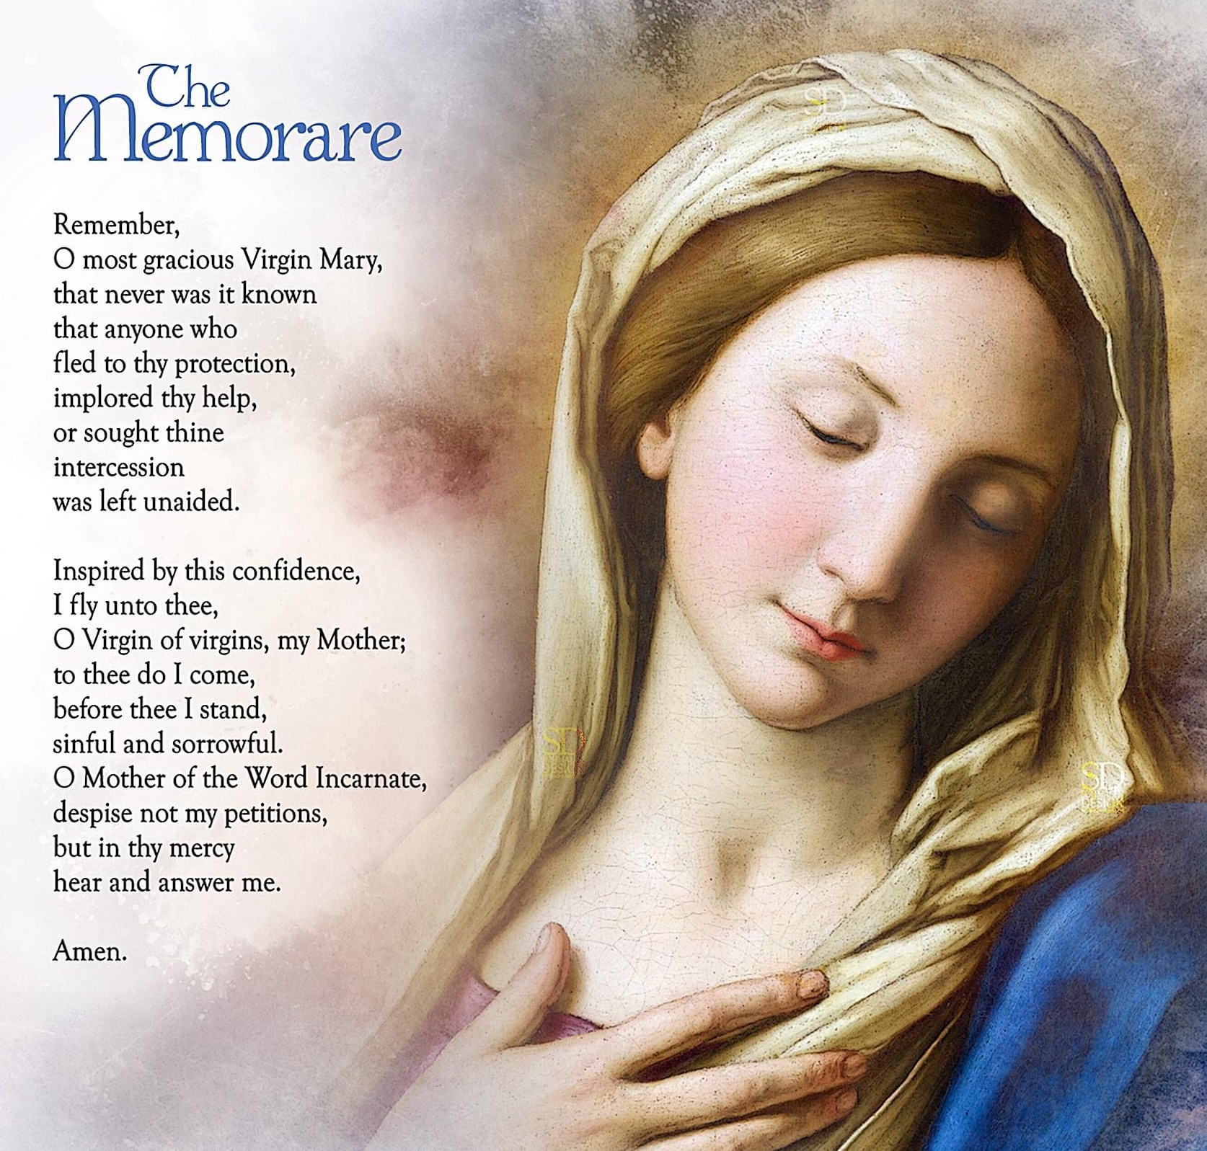
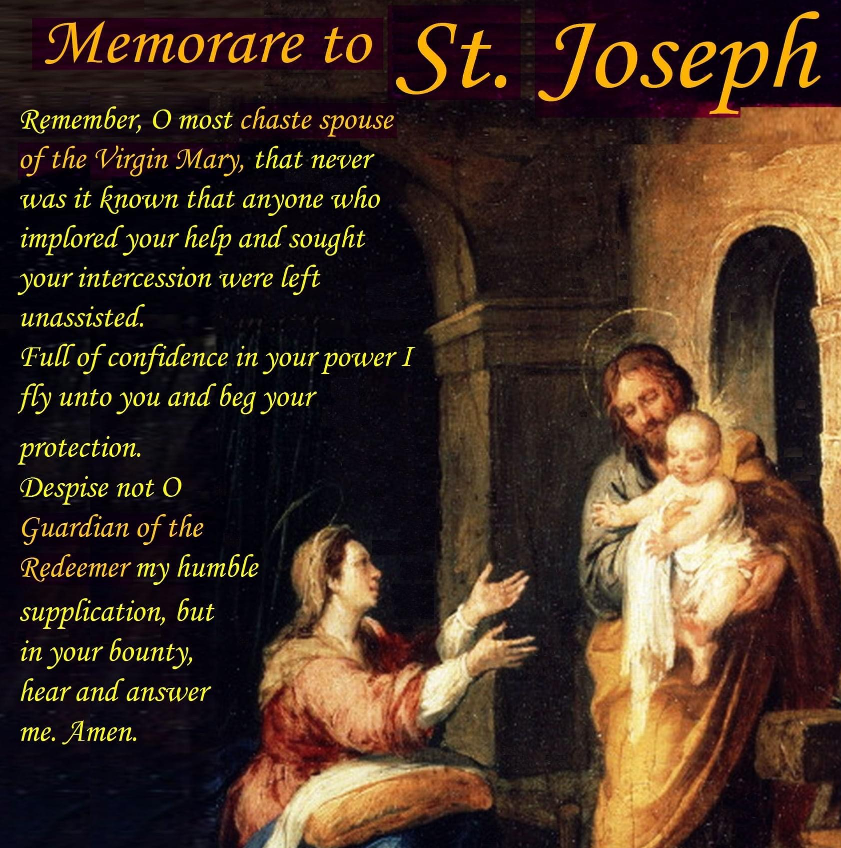
Notes:
So that is to be prayed right after the Prayer ie when you say: Let us pray; O God whose only begotten Son, by his life, death and resurrection, … just before the Memorare.
And instead of the regular Memorare, we can perhaps substitute with the Memorare to St Joseph or you might want to consider using the Memorare to Jesus, Mary & Joseph instead?

Slide 7
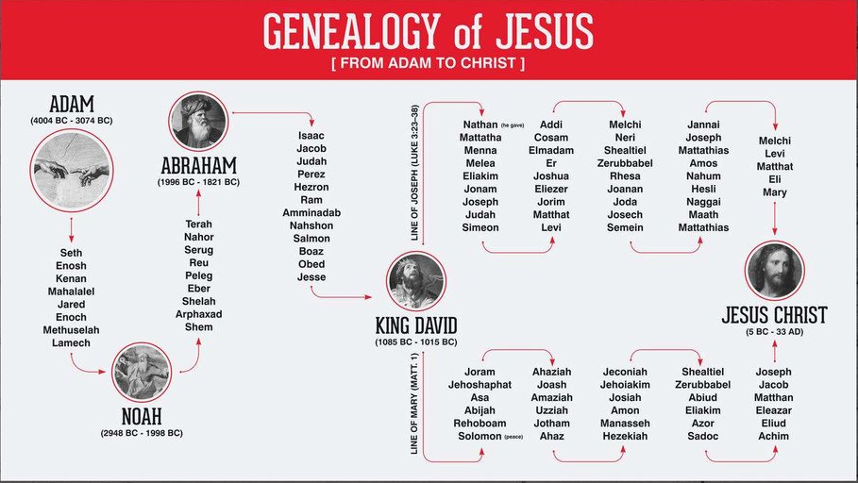
Saint Joseph, Noble Offspring of David
By the time of the birth of Christ. Judea had been lost to the Romans and the descendants of King David had lost their royal birth-right and their place in line for the throne. Herod the Great, who was appointed king of the Jews by the Roman senate, had usurped the throne. Joseph of Nazareth, the earthly father of Jesus (though not according to the flesh), was a part of this Davidic lineage and remained the rightful heir of the kings of Judea.
MARY
JOSEPH
The blood of David, of Solomon, and all the kings of Judah flows in Joseph’s veins. St. Peter Julian Eymard
Notes:
Alright, continuing on with getting to know more about St Joseph, for those of you who missed the 1st intro session, I had mentioned that “By the time of the birth of Christ, … read off the slide …
The blood of David, of Solomon, and all the kings of Judah flows in Joseph’s veins.
But like Dr Brant Pitre in his presentation on The Hidden King. The Jewish Roots of St Joseph, he commented that St Joseph in fulfilment of his mission gave up pursuing his right to the throne. Because if he did so, that would have drawn too much attention onto him. The Romans would be after him and more so the power hungry King Herod who did not hesitate to murder his wife and two of his sons whom he loved because he thought they were undermining his rule. Slaughtering innocent children is nothing to Herod. St Joseph would not take such risks to bring danger to his wife and child. He chose to remain hidden and lived as a lowly carpenter but whose reward is to be with the Mother of God and the real King of all Kings and Lord of Lords.

Slide 8

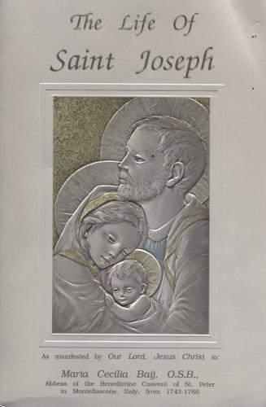
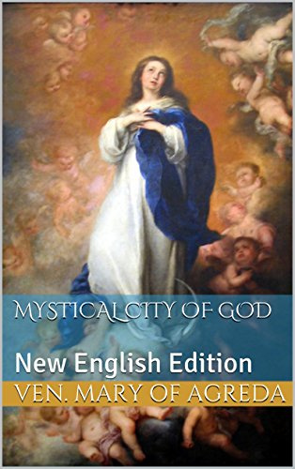
German mystic Blessed Anne
Emmerich (1774 – 1824)
Servant of God mystic Mother Cecilia Baij
(1694 – 1766) Abbess of the Benedictine
Convent of St Peter in Montefiascone, Italy.
Spanish mystic Venerable
Maria de Agreda (1602 – 1665)
Private visions / revelations
Notes:
You will find in the Fr Calloway’s book references to the private visions of Servant of God Mother Cecilia Baij, Blessed Anne Emmerich and the Venerable Maria de Agreda and what our Blessed Mother revealed to them; where it relates to St Joseph … All their books have nihil obstat (nothing stands in the way) and imprimatur (let it be printed) status – The Church allows their books to be published indicating that they are not contrary to the Church’s teachings on faith and morals, and free of doctrinal error. But they are not official Church documents. So we take them for they are – private visions that help to some extent to give us a closer glimpse or back story to St Joseph since there isn’t much written about him.

Slide 9
Saint Joseph, Noble Offspring of David
St. Joseph’s father’s name was Jacob and his mother’s name was Rachel. Both distinguished themselves by leading very holy lives; they had in common nobility of birth (both were of the family of David)
(C. Baij, 1997, pg. 1).
Joseph was to be a miracle of holiness. He was sanctified in the womb of his mother seven months after his conception, and the leaven of sin was destroyed in him for the whole course of life.
(M. Agreda, 1912, p. 163)
Through the Servant of God, Mother Cecilia Baij, whose writings were given both the Imprimatur and Nihil Obstat, the circumstances of St. Joseph’s conception and birth are known. These events mirror those of the prophet Jeremiah (Jeremiah 1:5) and St. John the Baptist (Luke 1:5-19, 41-44) who were sanctified in the womb, and were blessings to their families. They were freed from the stain of original sin by the grace of God after their conception, not to be confused with the Immaculate conception of the Blessed Virgin Mary.
The private revelations of Blessed Anne Emmerich, Servant of God Cecilia Baij and Venerable Maria de Agreda
Notes:
So from their accounts, we learn that St Joseph’s father’s name was Jacob and his mother’s name was Rachel much like the Joseph of the Old Testament … summarise from about slides … He was sanctified in the womb of his mother seven months after his conception … basically St Joseph like Jeremiah and John the Baptist; all these characters were sanctified in their mother’s womb some time after their conception and were freed from the stain of original sin. This is different and not to be confused with the Immaculate Conception of the BVM who was conceived without sin.

Slide 10
Saint Joseph, Noble Offspring of David
Joseph was a child obtained through prayerful entreaty. To this purpose, his parents generously bestowed alms upon the poor and for the temple in Jerusalem. They also made many pilgrimages to beg God for the desired offspring.
(C. Baij, 1997, pg. 1).
An angel came to them and revealed certain mysterious and secret facts concerning this child. And the angel said to them:
“This child resting beneath his mother’s heart will have the happy privilege of seeing the promised Messiah and associating with Him. You are to rear him with special foresight and diligence; training and instructing him in the Sacred Scriptures.
You shall call his name ‘Joseph’ and he will be great in the sight of God.”
(C. Baij, 1997, pg. 1,2)
The private revelations of Blessed Anne Emmerich, Servant of God Cecilia Baij and Venerable Maria de Agreda
Notes:
Like many of the Old Testament stories, Joseph’s mother was barren for some time but after much prayer and entreaty, with almsgiving and pilgrimages, Joseph was conceived. And a familiar theme of the appearance of God’s messenger telling the parents that the child is special … he will have the happy privilege of seeing the promised Messiah and associating with Him. You are to rear him with special foresight and diligence; training and instructing him in the Sacred Scriptures.
You shall call his name ‘Joseph’ and he will be great in the sight of God.”

Slide 11
Saint Joseph, Noble Offspring of David
As the child Joseph grew, he matured quickly in intelligence, in awareness of God, and in angelic virtues. As revealed by Venerable Maria de Agreda, Servant of God Cecilia Baij and Blessed Anne Catherine Emmerich, this was the result of God’s sanctification and blessing him with early use of reason, and the teaching of Scripture especially the Davidic Psalms by his father Jacob.
Joseph had a great veneration for the patriarchs, Abraham, Isaac and Jacob as well as the prophet King David. Joseph had the desire to imitate them when he saw how they were loved and specially privileged by God. By the age of seven, Joseph had acquired a true appreciation of all the virtues that the patriarchs had practiced.
(C Baij, 1997, pg 17).
The private revelations of Blessed Anne Emmerich, Servant of God Cecilia Baij and Venerable Maria de Agreda

Slide 12
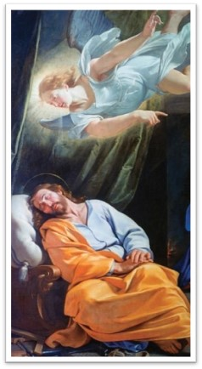
Saint Joseph, Noble Offspring of David
Joseph was in the grace and friendship of God, having been previously freed of the stain of original sin. His soul’s growth was derived from the graces he obtained from the divine bounty and generosity. God fashioned him according to His own heart and spirit, in order to eventually make him a worthy bridegroom for the Mother of the Divine Word.
(C. Baij, 1997, pg. 4, 5).
The devil, that hellish fiend, was aware of the light that abided in Joseph and he feared that this child would arouse others to take up struggle against him. He attempted several times to take the child’s life, but his plans always went awry, for Joseph was protected by the almighty arm of God. Joseph was guarded by two angels … and the angel who had been assigned to speak to him in his dreams continually advised him on what to do to overcome the infernal demon … Joseph never failed to carry out the admonitions of the angel.
(C. Baij, 1997, 10,11)
The private revelations of Blessed Anne Emmerich, Servant of God Cecilia Baij and Venerable Maria de Agreda
Notes:
God’s providence was clearly evident as according to Mother Baij, God fashioned him according to His own heart and spirit, in order to eventually make him a worthy bridegroom for the Mother of the Divine Word. Unbeknown to Joseph, God’s plan was already in motion.
And with no surprise the devil comes after Joseph but he is guarded by two angels, one of whom has been assigned to continually come into St Joseph’s dreams to warn or advise him what to do
So even while he was much younger, Joseph was already pre-disposed to God communicating with him through his dreams

Slide 13
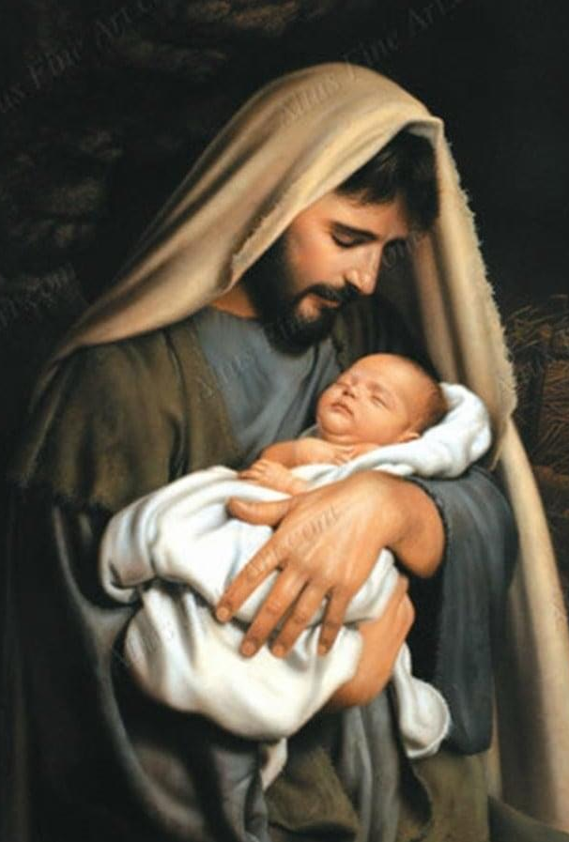
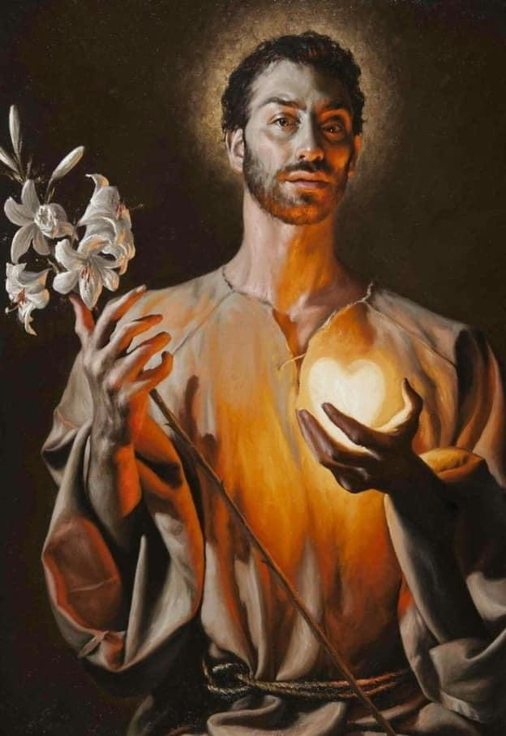
Saint Joseph, Light of Patriarchs
The paternal light of God shines through the fatherhood of St Joseph.
“… he is more faithful than Abraham, more obedient than Isaac, more generous than David, wiser than Solomon, in a word, as superior in grace as he is close to the source, Jesus sleeping in his arms.”
Blessed William Joseph Chaminade
Joseph is so close to his Son he reflects the light of Jesus to us.
“Saint Joseph is a bearer of light. He brings Jesus, the true Light of the World, to us."
Notes:
Saint Joseph is also known as the Light of Patriarchs; … as the earthly representative of the Heavenly Father, the paternal light of God shines through the fatherhood of St Joseph. And having been so enamoured with all the Patriarchs before him, Blessed William Joseph Chaminade said that Joseph is more faithful than … read off the slide. And his reward for being so close to Jesus is that he ends up reflecting the light of Christ to us. Saint Joseph is a bearer of light. He brings Jesus, the true Light of the World, to us

Slide 14
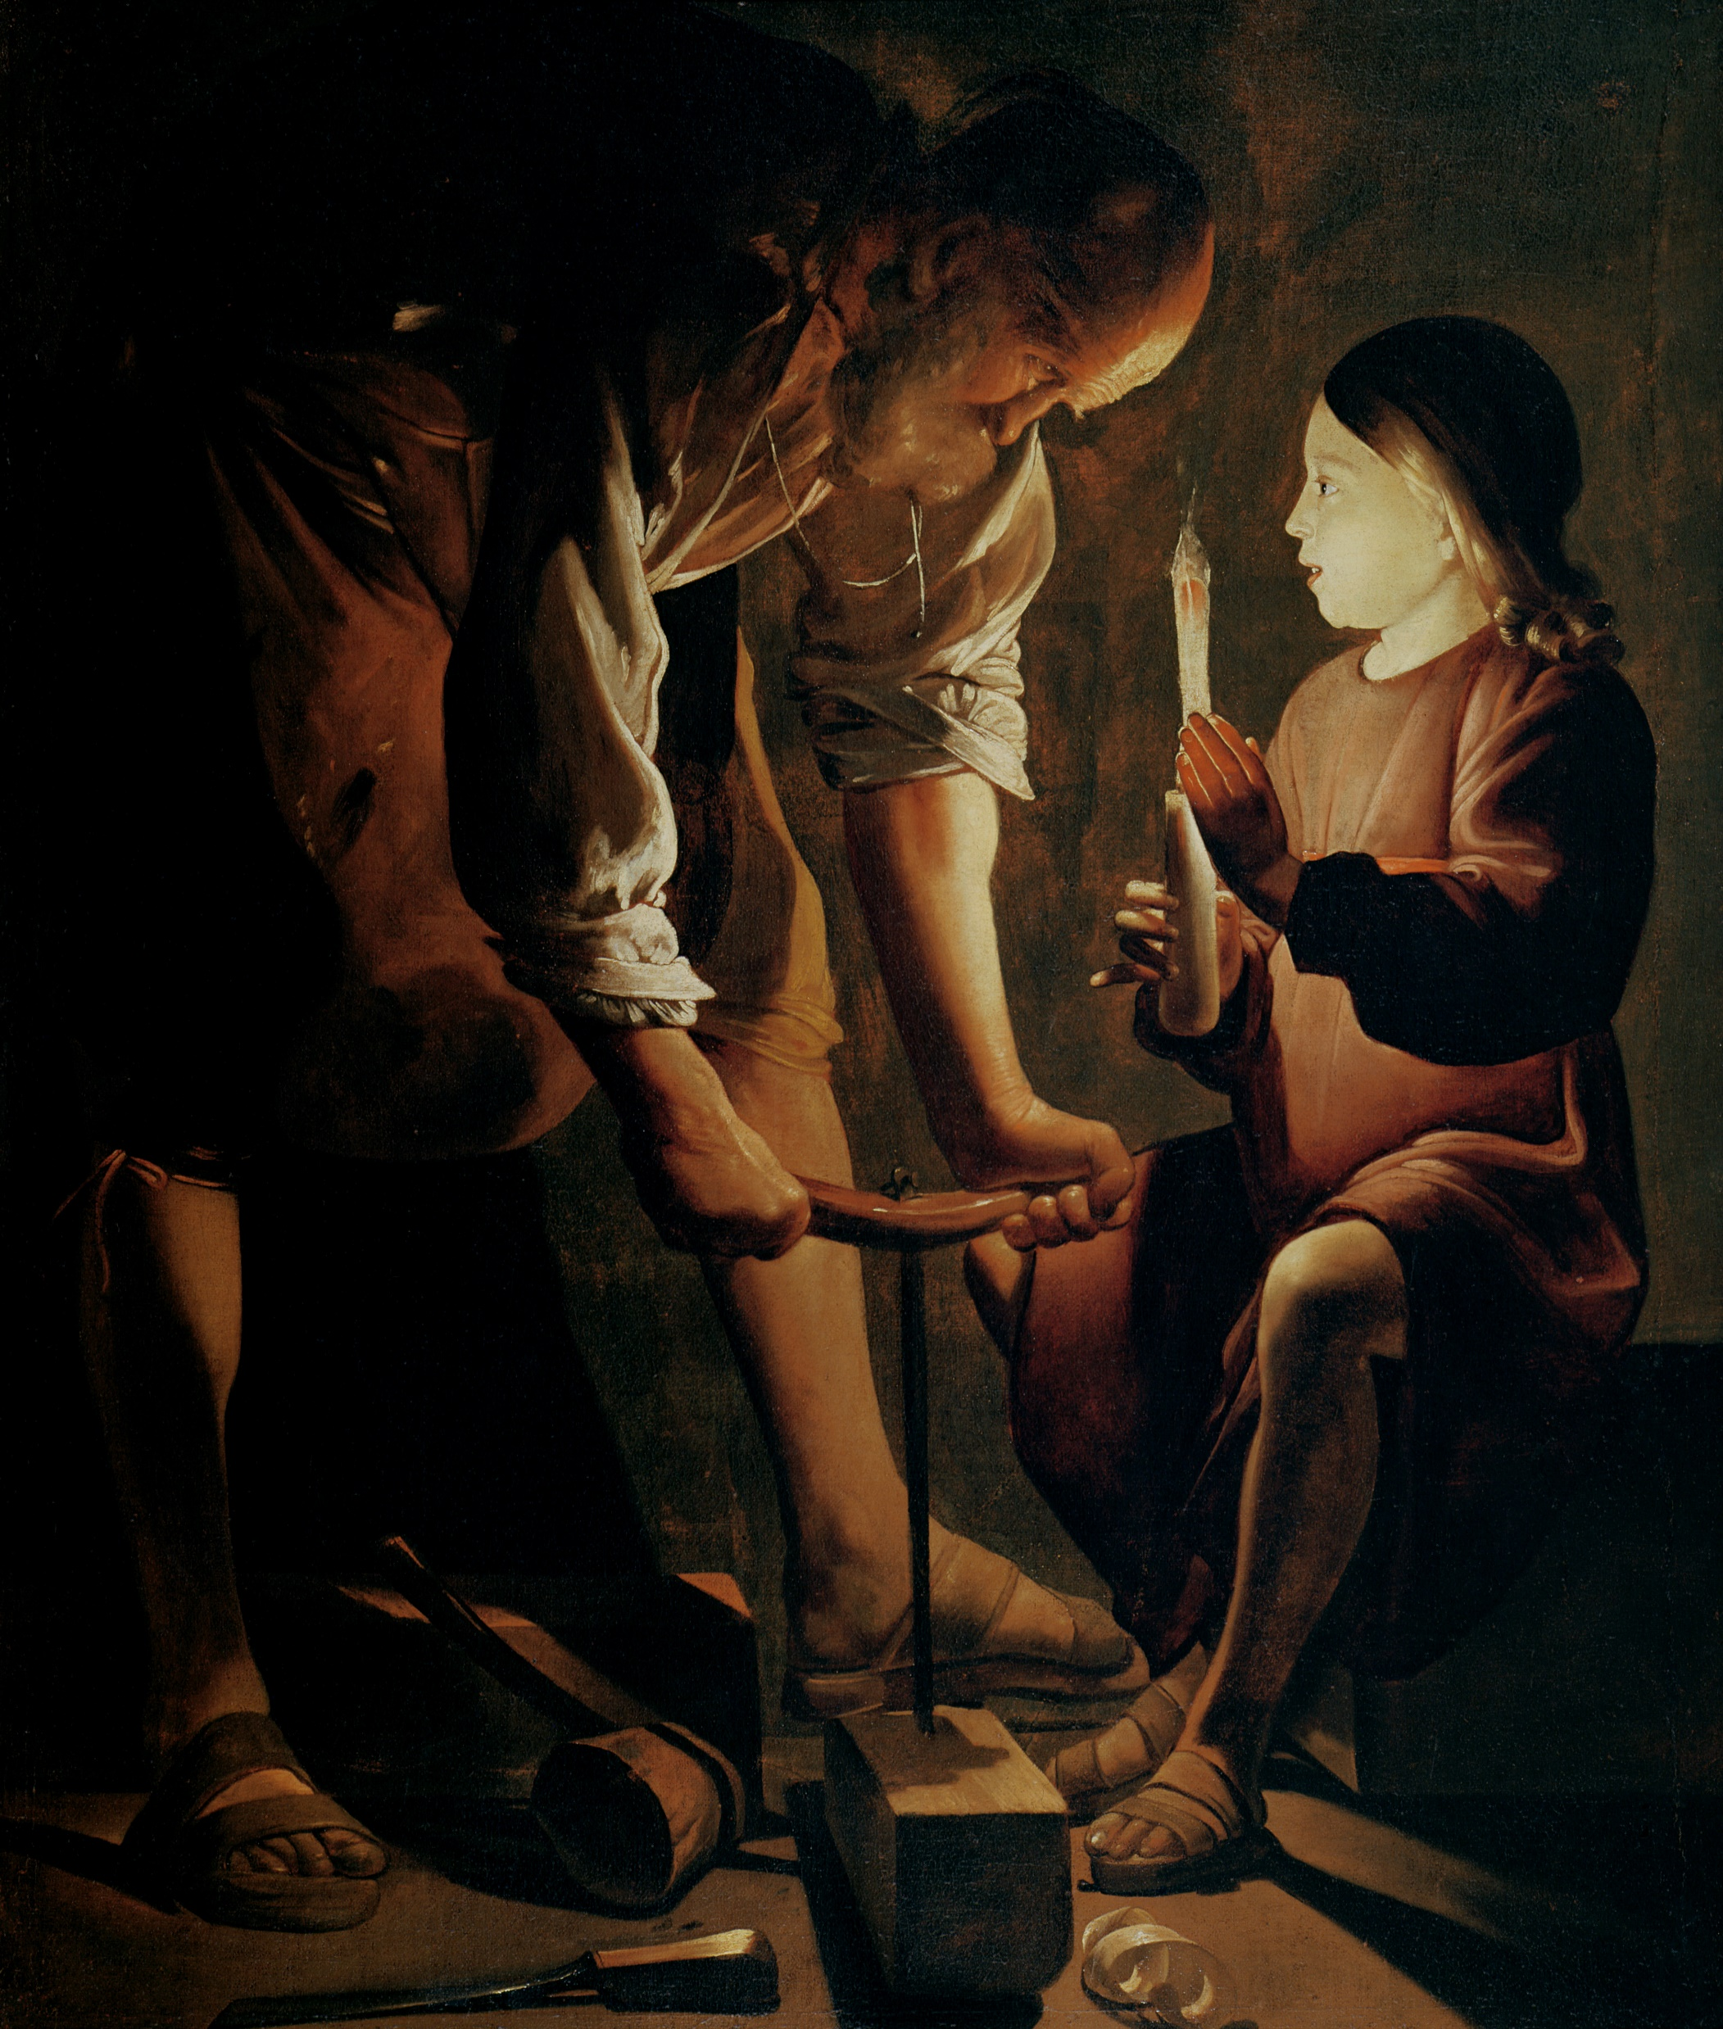
Saint Joseph, Light of Patriarchs
An oil canvas painting depicting the child Jesus holding a candle to give light to his father at work in his workshop in the night. Jesus seems to be telling Joseph something while he looks intently at his son who he sees as the true Light of the World. Joseph knew the superiority of his adopted child. And it is within this knowledge that his profound humility lies.
By giving Him the name of Jesus, by spilling the first drops of Jesus' blood during His circumcision, as a prelude to His Passion and by saving the Author of Salvation from Herod's wrath by fleeing to Egypt, Joseph providentially initiated his adoptive Son to His redemptive mission, to His sacrificial and priestly vocation. But he always carried out this prophetic mission quietly behind the scenes, until, like John the Baptist, he disappeared completely from the Gospel, as Jesus entered His public ministry.
Joseph the Carpenter
By Georges de La Tour
Public Domain
“Stay close to St Joseph; He has the Light of Christ. Walk in the Light!"
Notes:
Read off the slide; conclude with Stay close to St Joseph; He has the Light of Christ. Let us walk in the Light!

Slide 15
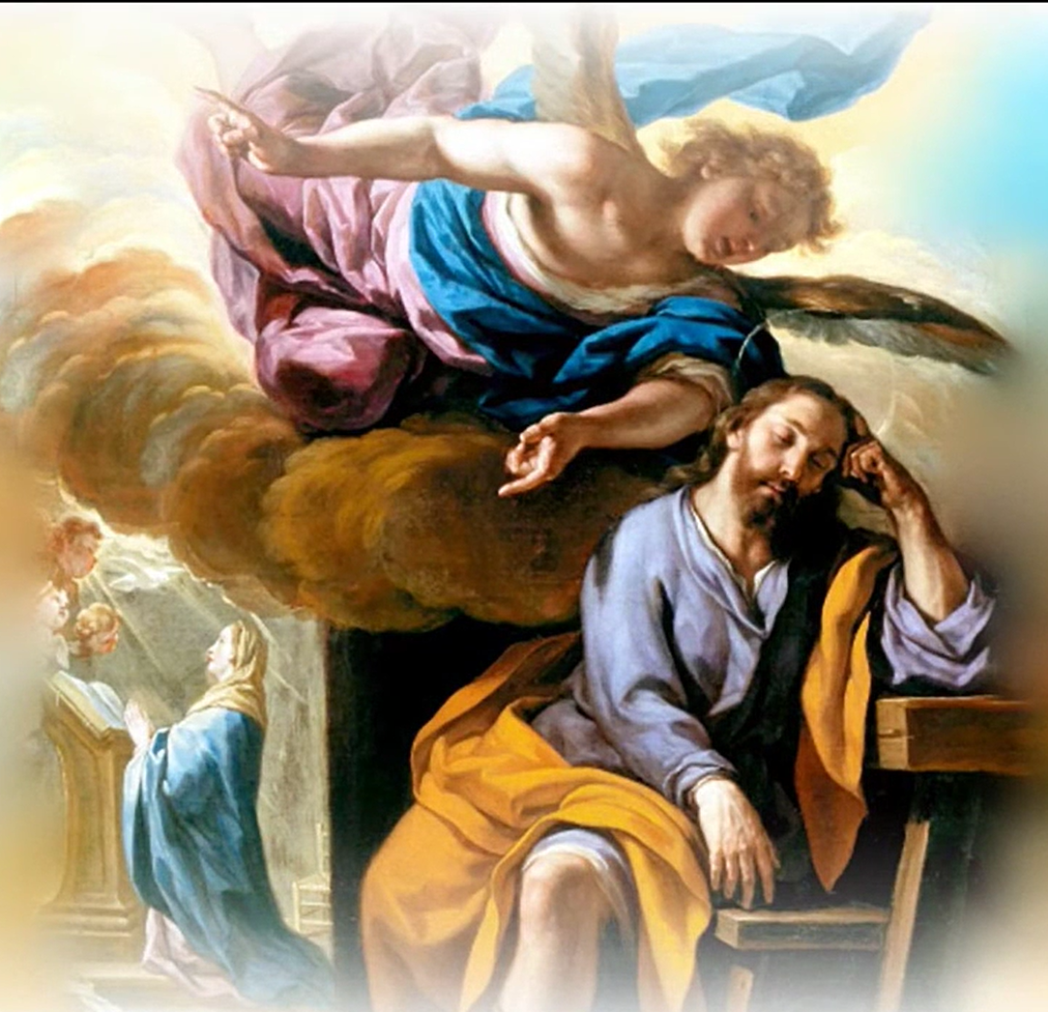
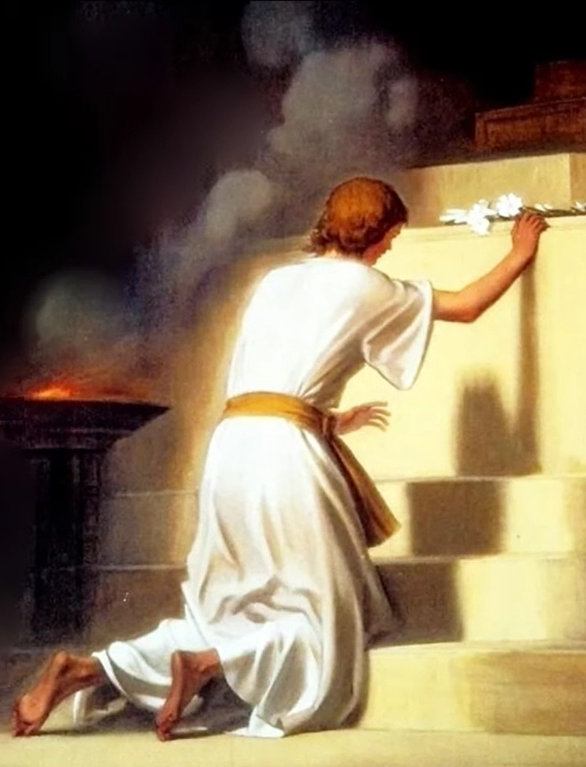
Saint Joseph, Chaste Guardian of the Virgin
The angel appeared to Joseph and advised him to go to Jerusalem … where at the Temple there was a maiden who was most dear to God and for whom God had a special love. This Temple virgin was Mary, the daughter of Joachim and Anna … He was told that Mary had dedicated herself entirely to God and had vowed her virginity.
Joseph felt the desire to do the same, and he dedicated his virginity to God by means of a vow. As he made his promise of perpetual virginity to God, Joseph’s heart was filled with an inexpressible joy.
Mother Cecelia Baij
Joseph had made and kept the vow of chastity and was known for the utmost purity of his life, holy and irreprehensible in the eyes of God and of men.
M Agreda, 1912, p.576
Led by the Holy Spirit, Joseph gave his gift of virginity to God as a selfless act of love
Notes:
Not surprising again, an angel appeared to Joseph and advised him to go to Jerusalem …
Joseph was inspired to do the same …
Joseph made and kept the vow of chastity and was known …
Led by the Holy Spirit, Joseph gave his gift of virginity to God as a selfless act of love

Slide 16
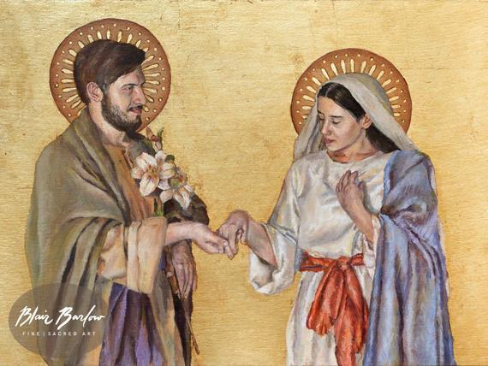
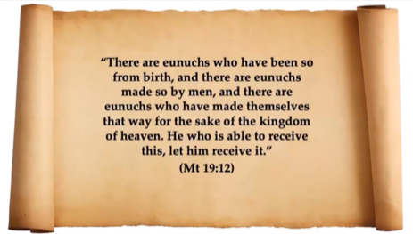
Saint Joseph, Chaste Guardian of the Virgin
Marriage exists ‘from the beginning’ to point us to the Marriage of the Lamb.
[Rev 19:7-9]
Human marriages are only ‘pointers’ to the real ultimate marriage of Christ and the Church.
Continence for the Kingdom is not a rejection of marriage but an affirmation of it.
Marriage and virginity are two ways of expressing and living the one mystery of the Covenant of God with his people, the Covenant which is a communion of love between God and human beings.
[JPII 1989]
Fr David Garcia, OP
Both Mary & Joseph gave their gift of virginity to God as a selfless act of love
Notes:
[ In Mt 19:12 … Read the scripture passage] While some of us are called to consecrated celibacy, most of us are called to marriage; embracing both the unitive and procreative dimensions. Both vocations are necessary. Without marriage, there will be no children. Without priests, there are no Sacraments.
Marriage exists ‘from the beginning’ to point us to the Marriage of the Lamb.
Human marriages are only ‘pointers’ to the real ultimate marriage of Christ and the Church.
Those who are celibate “for the sake of the kingdom” (Mt 19:12) are choosing to live the heavenly marriage on earth. Not surprising you’ll find our priests, nuns / religious sisters wearing a wedding ring because they consider themselves married to Christ.
Continence for the Kingdom is not a rejection of marriage but an affirmation of it.
So to quote JPII: Marriage and virginity are two ways of expressing and living the one mystery of the Covenant of God with his people, the Covenant which is a communion of love between God and human beings.
We are called to be chaste in our marriage; just as priests and bishops need to be chaste in their priesthood as with the religious in their consecrated life.
Both Mary & Joseph gave their gift of virginity to God as a selfless act of love

Slide 17
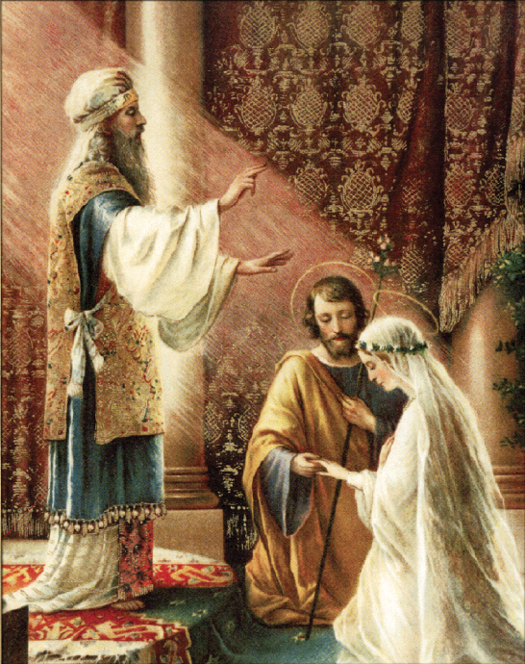
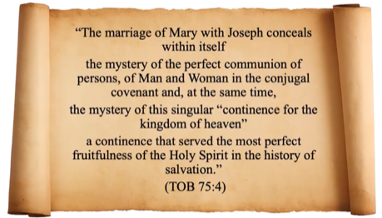
Saint Joseph, Spouse of the Mother of God; Chaste Guardian of the Virgin
Joseph and Mary lived in what is often called a “Josephite marriage.” They were truly husband and wife, with an inseparable union of souls; but they never engaged in sexual relations. They were both consecrated to God and sacrificed a natural good for a greater good: the salvation of souls.
Josephite Marriage
Fr David Garcia, OP
Mary and Joseph safeguarded each other’s virtue for the sake of the mission of their virginal Son.
Notes:
Mary and Joseph, with free will, fair knowledge and mutual consent, safeguarded each other’s virtue for the sake of the mission of their virginal Son.

Slide 18
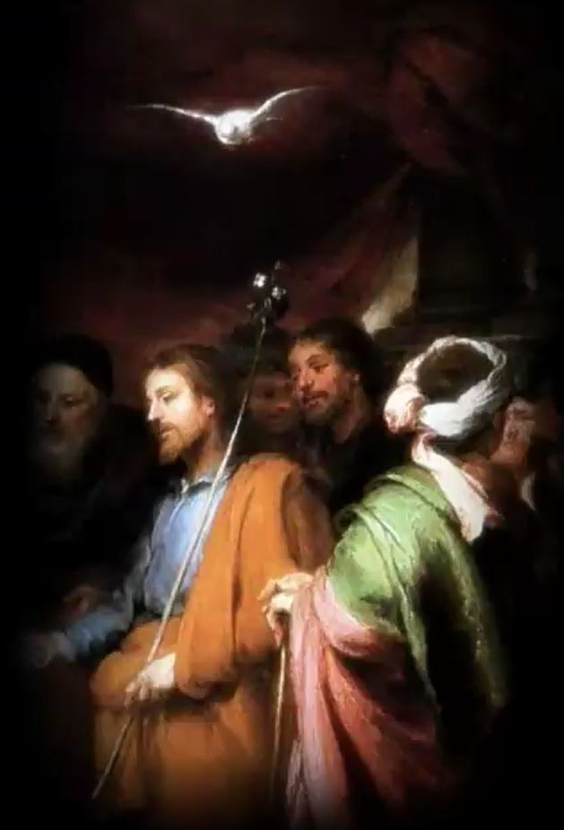
Saint Joseph, Spouse of the Mother of God; Chaste Guardian of the Virgin
He was then thirty-three years of age, handsome and of pleasing countenance … while they were thus engaged in prayer the staff which Joseph held was seen to blossom and at the same time a dove of purest white and resplendent with admirable light, was seen to descend and rest upon the head of the saint. [Maria de Agreda, 1912, pg 576]
As Joseph was about to lay his staff on the altar before the Holy of Holies, a white lily blossomed out of the top … I saw over him an appearance of light like the Holy Ghost. [Anne Emmerich, 1953, pg 83]
Suddenly Joseph saw his branch begin to sprout and become bedecked with snow white blossoms. Everyone around him was soon staring at this miraculous sign … All present now saw a snow-white dove descend from Heaven and settle on the head of Joseph. It was now quite certain that of all the candidates, Joseph was the man of God’s choice. [C. Baij, 1977, pg 77]
It was necessary that divine providence should commit her to the charge and guardianship of a man absolutely pure.
St Francis de Sales.
Notes:
You may be familiar with the story of Aaron’s staff … when Moses wanted to make Aaron the chief priest, the other priests challenged Moses’ decision and only Aaron’s staff budded or flowered to make clear that he was God’s choice. Similar in the case of Joseph … all the men who were in the Davidic lineage were summoned to gather in the Temple as they needed to pick a husband for Mary; … All the men were randomly given a staff and told to inscribe their names on it. Then they were all to surrender their staff and lay it on the altar before the Holy of Holies. As this was taking place, the High Priest and the other priests in the Temple began to pray. According to all three mystics, Joseph’s staff sprouted white lilies and a dove descended upon him. It was clear to everyone present that Joseph was God’s choice to be the husband of Mary. And to quote St Francis de Sales: It was necessary that divine providence should commit her to the charge and guardianship of a man absolutely pure [you can see from the back story and now this incident - how the Hand of God is behind all of this]

Slide 19
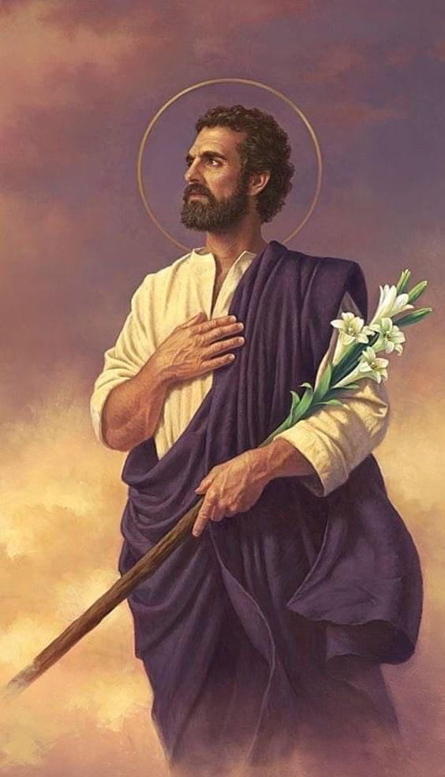
A lily is a symbol of purity, so St. Joseph holds a lily to represent his holiness and his celibate marriage to the Blessed Virgin.
Three White Flowers or Lilies
Joseph was virtuous, pure and obedient to God. He had the difficult large task of caring for and protecting the Holy Family, and he did so always listening to the voice of God. He also remained chaste while loving and caring for his wife, Mary ever virgin. Even though they were married they remained celibate, “he had no relations with her”
“Both Mary and Joseph had made a vow to remain virgins all the days of their lives; And God wished them to be united in the bonds of marriage, not because they repented of the vow already made, but to be confirmed in it and to encourage each other to continue in this holy relation.”
Saint Francis de Sales
“Joseph is chaste and pure by virtue and not by age.” Venerable Fulton Sheen
Notes:
Read off the slide

Slide 20
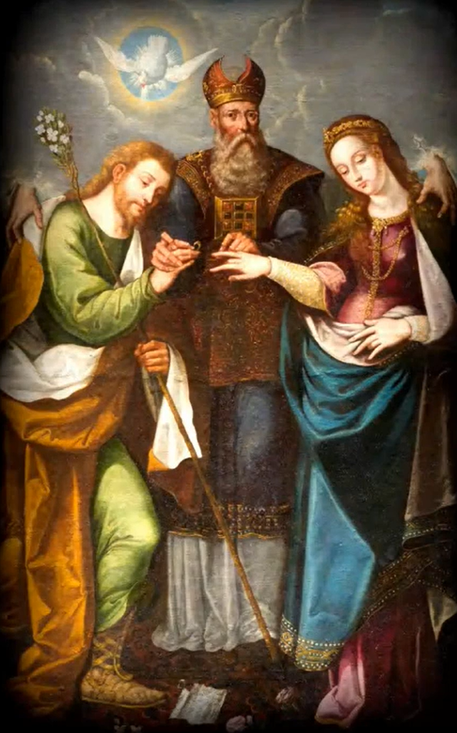
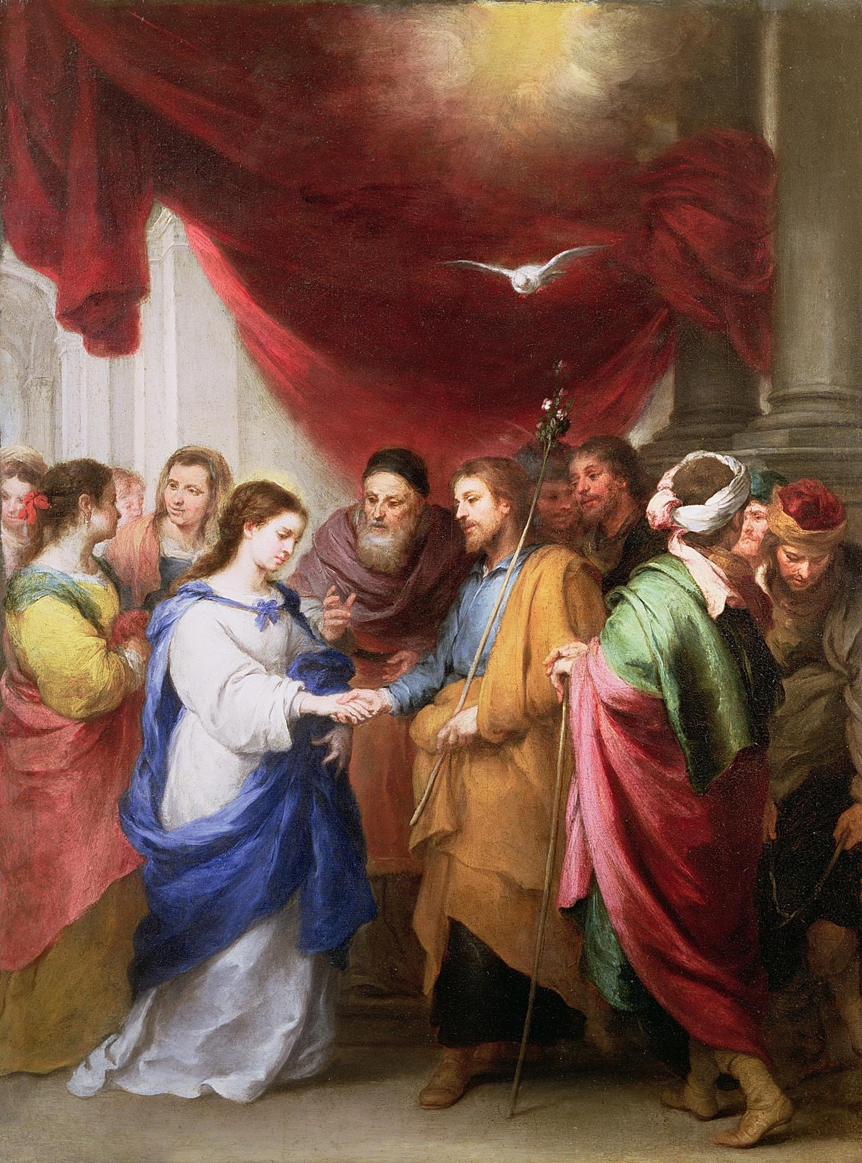
Saint Joseph, Spouse of the Mother of God; Chaste Guardian of the Virgin
The espousals between Joseph and Mary are an episode of great importance. Joseph was of the royal line of David and by virtue of his marriage to Mary, would confer on the Son of the Virgin – on God’s Son – the legal title of “Son of David”, thus fulfilling the prophecies. The espousals of Joseph and Mary are, because of this, a human event, but determinant in the history of humanity’s salvation, in the realisation of the promises of God; because of this, it also has a supernatural connotation, which the two protagonists accept with humility and trust.
Benedict XVI, 2010
Notes:
Read up to highlighted portion

Slide 21
Hidden King of the Jews
The Jewish Roots of St Joseph
Dr Brant Pitre
How old was Joseph when he married Mary?
Notes:
The exact age does not matter other than to counter an apocryphal account of Joseph being a widow with 4 sons and 2 daughters from a previous marriage and that Joseph was almost 90 when he married Mary. That was meant to protect Mary’s perpetual virginity because it was thought that Joseph at aged 90 would already be impotent.

Slide 22
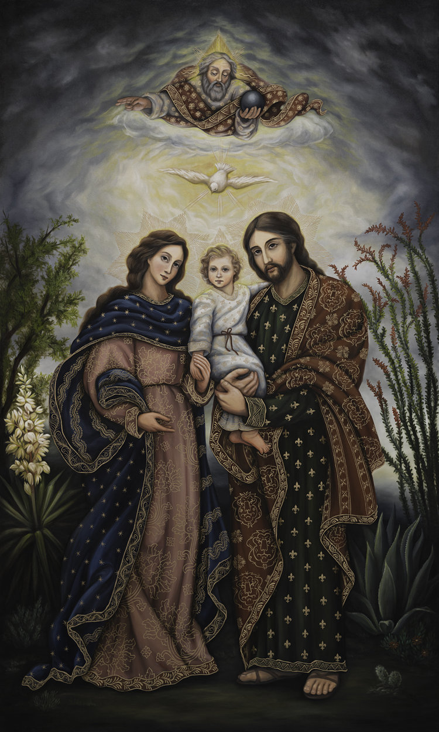
Virginal Trinity
God the Father is a virgin who generates the Son in all His goodness. God the Son is a virgin who existed in Heaven without a mother; God the Holy Spirit is a virgin, who proceeds gloriously from the Father and the Son. As the Heavenly Trinity is the first and altogether virgin, so is the second Trinity, on earth. The Earthly Trinity of Jesus, Mary and Joseph mirror the Heavenly Trinity of the Father, Son and Holy Spirit – Jesus (God the Son) connecting the two Trinities. If Jesus is a virgin, and Mary is a virgin, why couldn’t Joseph, who would complete this virginal Trinity, be one as they are?
“It is perfectly in accordance with the faith and spirit of the Church, to honour as a virgin not only the Mother of God, but likewise Joseph.”
Saint Peter Damian
Joseph Most Chaste and Virginal Spouse of the Mother of God, pray for us.

Slide 23
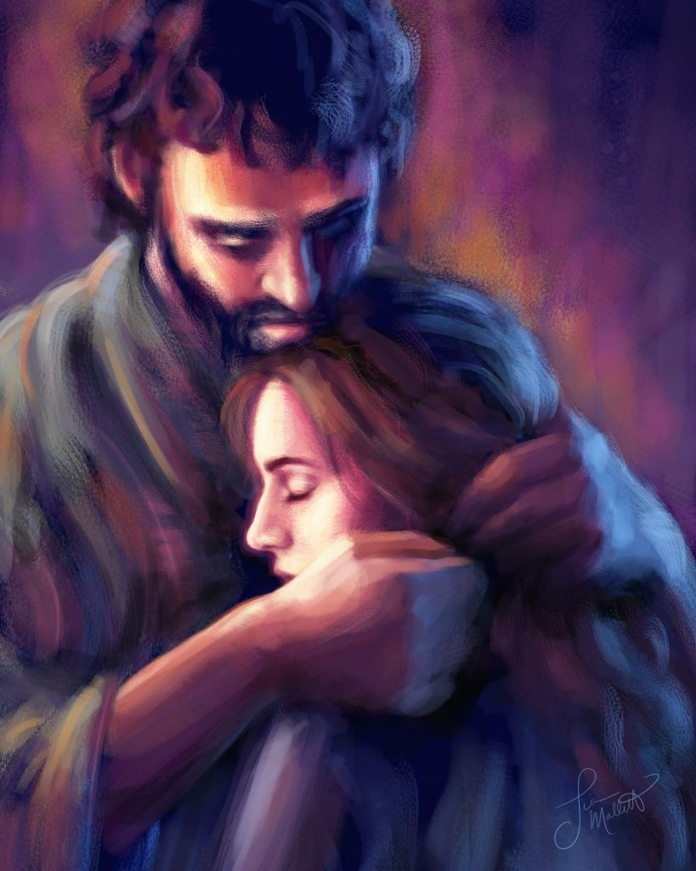
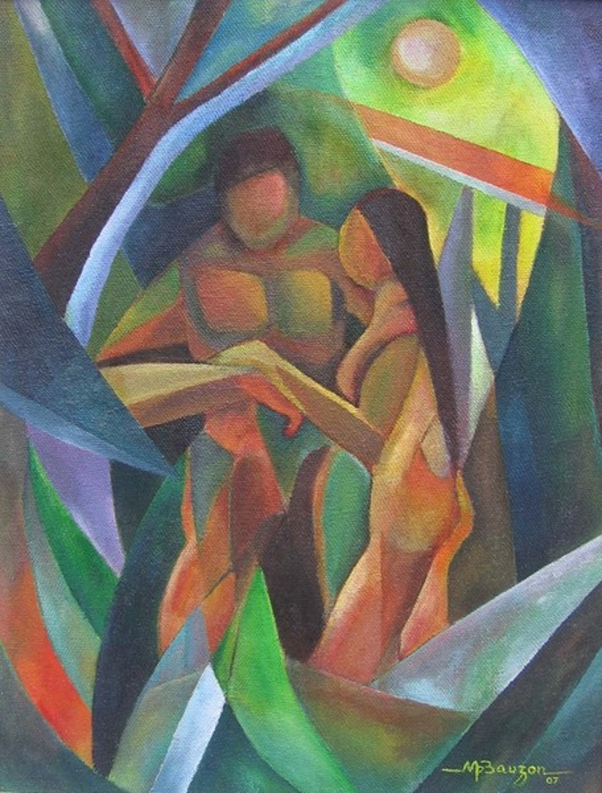
Saint Joseph, Spouse of the Mother of God; Chaste Guardian of the Virgin
Love trusts. It sets free. It does not try to control, possess and dominate everything.
Pope Francis
Amoris Laetitia (No. 115)
Free, Total, Faithful & Fruitful.
A person to love;
not an object of use.
This is the measure of love; the amount of responsibility one takes for the beloved.
St John Paul II
“The man and his wife were both naked yet they felt no shame.” Genesis 2:25
Loving the other as another self; Loving the other more than yourself.
Notes:
Joseph and Mary embraced a love that is free, total, faithful and fruitful [which as you know isn’t just about having lots of children]
Both man and wife can stand naked before the other and not feel ashamed, wary nor afraid that of being used. They do not seek to control, possess nor dominate the other but as St JPII puts it – they take responsibility for their beloved, loving the other as another self; loving the other more than oneself.

Slide 24
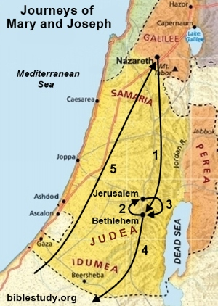
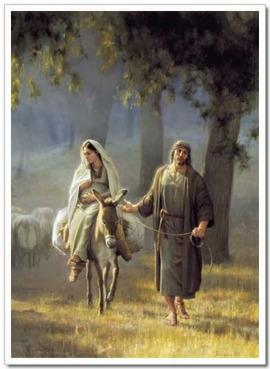
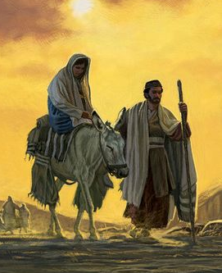
Saint Joseph, Chaste Guardian of the Virgin; Zealous Defender of Christ
A Holy Procession
“Joseph spoke so comfortingly to the Blessed Virgin, and so sorry that the journey is difficult.”
Blessed Anne Emmerich, 1953, pg 106
“Even though I walk through the valley of the shadow of death, I will fear no evil, for you are with me, your rod and your staff; they comfort me.”
Psalm 23:4
“I don’t agree with the traditional picture of St Joseph as an old man.” St Josemaria Escriva
Notes:
Distance from Nazareth to Bethlehem: 80+miles. [120+km]
That’s going by the Jordan River, traversing through the Jordon Valley.
The shorter route is if they go past Samaria but in those days the Jews and the Samarians aren’t the best of friends so it’s safer to take the longer route which is equivalent to going from Changi to Tuas and back to Changi and on to Tuas again. [38km one way]
“So Joseph travelled up from the town of Nazareth in Galilee, to Bethlehem the town of David…” (Luke 2:4) [his ancestral home to complete the census]
Going “up” to Bethlehem is an important clue about the terrain, meaning more Judean mountains. Probably taken them about a week of walking across rough terrain, having to brave the weather and with all sorts of dangers along the way – wild animals, robbers and even dark spiritual forces.
In pictures Mary is always depicted riding on the donkey with Joseph on foot.
A donkey actually slows you down – it’s a beast of burden, useful for carrying things but you cannot ride on a donkey for long; you heard the saying stubborn as a mule? A donkey will let you lead for some distances but it pretty much has a mind of its own. It will stop when it wants to stop.
So imagine a holy procession … The priest of the Holy Family processed his Wife and unborn Son, like a priest holding up the monstrance with the blessed sacrament inside through the Jordan Valley going enroute past Jericho (notorious place for bandits) and the Dead Sea [Psalm 23] before climbing up towards Bethlehem.
Bethlehem – Alexandria = 480km / 300 miles

Slide 25
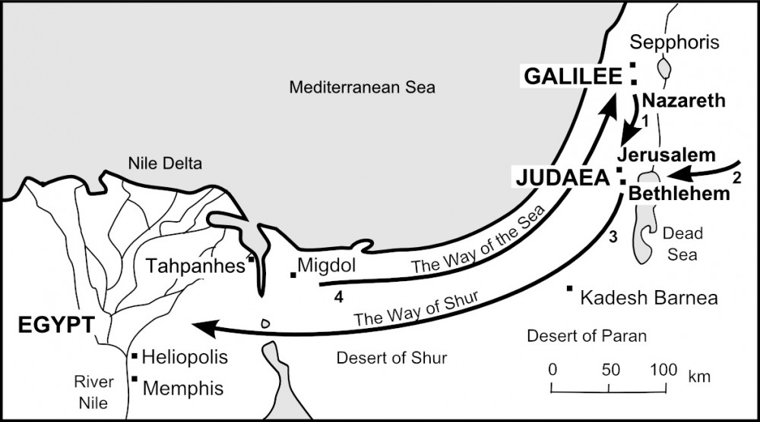
Saint Joseph, Chaste Guardian of the Virgin; Zealous Defender of Christ
A Holy Procession
Now at this time Caesar Augustus issued a decree for a census to be taken. This census took place
while Quirinius was governor of Syria and everyone went to his own town to be registered. So Joseph
set out from the town of Nazareth in Galilee and travelled up to Judaea to the town of David called
Bethlehem, since he was of David’s House and line in order to be registered together with Mary, his
Betrothed, who was with child.
Luke 2: 1-5
Notes:
Distance from Nazareth to Bethlehem: 80+miles. [120+km]
That’s going by the Jordan River, traversing through the Jordon Valley.
The shorter route is if they go past Samaria but in those days the Jews and the Samarians aren’t the best of friends so it’s safer to take the longer route which is equivalent to going from Changi to Tuas and back to Changi and on to Tuas again. [38km one way]
“So Joseph travelled up from the town of Nazareth in Galilee, to Bethlehem the town of David…” (Luke 2:4) [his ancestral home to complete the census]
Going “up” to Bethlehem is an important clue about the terrain, meaning more Judean mountains. Probably taken them about a week of walking across rough terrain, having to brave the weather and with all sorts of dangers along the way – wild animals, robbers and even dark spiritual forces.
In pictures Mary is always depicted riding on the donkey with Joseph on foot.
A donkey actually slows you down – it’s a beast of burden, useful for carrying things but you cannot ride on a donkey for long; you heard the saying stubborn as a mule? A donkey will let you lead for some distances but it pretty much has a mind of its own. It will stop when it wants to stop.
So imagine a holy procession … The priest of the Holy Family processed his Wife and unborn Son, like a priest holding up the monstrance with the blessed sacrament inside through the Jordan Valley going enroute past Jericho (notorious place for bandits) and the Dead Sea [Psalm 23] before climbing up towards Bethlehem.
Bethlehem – Alexandria = 480km / 300 miles

Slide 26

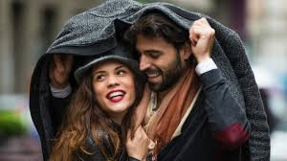


"The vocation of men is to be at the service of those entrusted to their love and care. Men like St Joseph are willing to fight for what they love, what is good, true and beautiful.” Is chivalry still accepted and appreciated in today’s modern society?
Chivalry or Chauvinism?
Notes:
Ok, I posted last week this question … So is chivalry dead or alive?
You can discuss this in your group and report back your answer after we all come back.
But I guess the question remains as:
What is our understanding of masculinity? Or perhaps I should be more specific to Catholic masculinity?
The vocation of men is …

Slide 27


Saint Joseph, Head of the Holy Family
Herein lies the fullness of masculinity; each Catholic man must be prepared to give himself completely, to charge into the breach, to engage in spiritual combat, to defend women, children and others against the wickedness and snares of the devil.
While the Husband is the Head of the Family, the Wife is the Heart of the Family
Notes:
Do we agree that a real (Catholic) man (like St Joseph) is one who lives by the Word and Will of God, who loves his wife and who teaches his children to pray, to study the Word of God, to have manly virtues, …
To give himself completely, to charge into the breach, notwithstanding if he can fight or not; it’s like if an intruder comes into the home, he will confront the intruder head-on, he will never push his wife and children to the fore even if they hold a black belt in taekwondo.
Can we agree that a real man of the house is a non-anxious, non-narcissistic leader who leaves his ego and pride at the door when as the Head of the Family, he leads by loving and trusting his wife to let her love by leading since she has the heart of the family.
I had posted in our Telegram chat an interview with Scott Hahn in which he refers to Pope Pius XI’s encyclical Casti Connubii on how the husband is to be the head of the household but the wife is the heart of the family and how the head should defer to the heart because authority is not a end in itself but a means to an end, which is love. He spoke about non-anxious leadership and how the men are meant to lead in the dance but to showcase the wife. If you’ve not viewed the video, I’d encourage you to find time to do so.

Slide 28
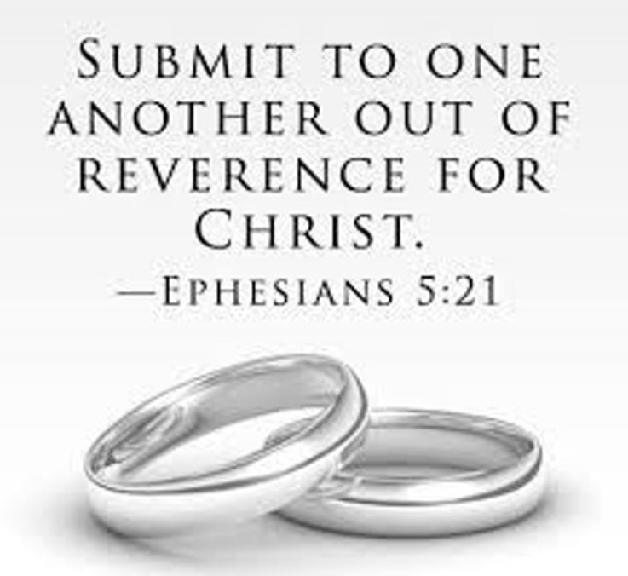
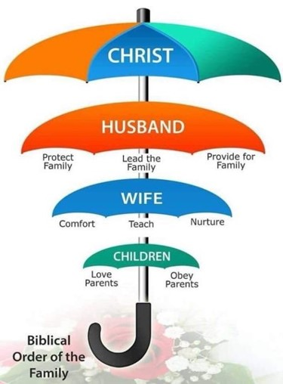
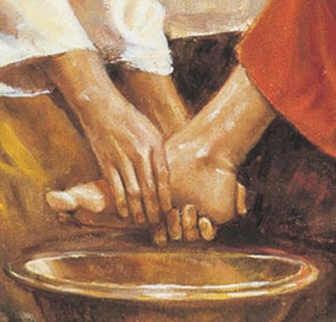
Saint Joseph, Head of the Holy Family
“Jesus and Mary not only bent their wills to Joseph’s for he was head of the Holy Family, but they lovingly surrendered their hearts to him as well.”
St Peter Julian Eymard
“He then went down with them and came to Nazareth and lived under their authority.”
Luke 2: 51
“Submit to one another out of reverence for Christ.” Ephesians 5:21
Notes:
Put it in another context, it’s about servant leadership. The man dies to self and prioritizes his family’s needs over his own. Christ demonstrated this vividly at the Last Supper when he as master washed the feet of his disciples and asked that we do likewise. And we submit to one another out of reverence for Christ.
Just as God created the heaven and the earth in a very methodical and orderly manner – when he first formed it and then he filled it; here we see the biblical order of the family with Christ as the Head.
The Holy Catholic Church teaches, through Scripture and Tradition, that the husband is the head of his family and has God-given authority over his wife and children. This gift of authority does not give a husband any greater dignity than his wife. Both are equal members of the marital covenant. This order of authority reflects the divine order between God, Christ and man. The Sacred Scriptures clearly affirm that God has assigned the responsibility of spiritual leadership in the home to husbands:
St Paul in Ephesians 5 provides the blue-print on how to live out this order.

Slide 29
Ephesians 5
21-24
25-28
29-30
31-33
²¹ Submit to one another out of reverence for Christ.
²² Wives, submit yourselves to your own husbands as you do to the Lord.
²³ For the husband is the head of the wife as Christ is the head of the church, his body, of which he is the Savior.
²⁴ Now as the church submits to Christ, so also wives should submit to their husbands in everything.
²⁵ Husbands, love your wives, just as Christ loved the church and gave himself up for her
²⁶ to make her holy, cleansing her by the washing with water through the word,
²⁷ and to present her to himself as a radiant church, without stain or wrinkle or any other blemish, but holy and blameless.
²⁸ In this same way, husbands ought to love their wives as their own bodies. He who loves his wife loves himself.
²⁹ After all, no one ever hated their own body, but they feed and care for their body, just as Christ does the church—
³⁰ for we are members of his body.
³¹ “For this reason a man will leave his father and mother and be united to his wife, and the two will become one flesh.”
³² This is a profound mystery—but I am talking about Christ and the church.
³³ However, each one of you also must love his wife as he loves himself, and the wife must respect her husband
Slides and reflections courtesy of Marcus & Selina
Notes:
This is a passage we should all be familiar with; if not I would suggest we read it again when we have the time; Or listen to the podcast by Kimberly Hahn I shared in our Telegram channel – she has many excellent tips on how husbands and wives can live out Ephesians 5 … next slide

Slide 30
Reflections
Scripture shows what a marriage should be - a relationship that mirrors the love between Christ and His Church.
The Covenantal Marriage is compared to the connection between Christ and the Church. The relationship isn’t of master to servant; it’s of lover and beloved.
When a husband submits to the Lord, leading his wife with a servant’s heart and nurturing her God-given talents, she can confidently submit to him — lean on him and trust his covering.
“For the husband is the head of the wife even as Christ is the head of the church, his body, and is himself its Saviour” (Ep 5:23).
Slides and reflections courtesy of Marcus & Selina
Notes:
Sacred scripture shows the full picture of a marriage: a relationship that mirrors the love between Christ and His Church. When a husband submits to the Lord, leading his wife with a servant’s heart and nurturing her God-given talents, she can confidently submit to him — lean on him and trust his covering.
[Mary felt safe in Joseph’s love]
St Paul compares marriage to the connection between Christ and the Church. The relationship isn’t of master to servant; it’s of lover and beloved.
As Lord of the Church, Jesus has given up His life in exchange for the life of His Bride. This is what Paul has in mind when he says, “For the husband is the head of the wife even as Christ is the head of the church, his body, and is himself its Saviour” (Ephesians 5:23, ESV).

Slide 31
Reflections cont’d
Different sexes have different needs for love and respect: Men need to feel respected by their wives, and women need to feel loved by their husbands.
This explains why Paul specifically tells husbands to “love” their wives and wives to “respect” their husbands (Ephesians 5:33). A lot simply has to do with the unique natures of male and female
Of course, God wants both husbands and wives to treat their spouses with love and respect. When the Bible says that wives should respect their husbands, it assumes such respect will be based on love.
Scripture is clear about God’s design for marriage in the fact that men and women have different roles. Yet it never suggests that one spouse is more important than the other.
When a Christian husband and wife learn how God has wired them to complement each other in mutual submission, they reflect the love that exists between Christ and His Bride.
Slides and reflections courtesy of Marcus & Selina
Notes:
When it comes to submission, generally speaking, the sexes have different needs for love and respect: Men need to feel respected by their wives, and women need to feel loved by their husbands.
This explains why Paul specifically tells husbands to “love” their wives and wives to “respect” their husbands (Ephesians 5:33). A lot simply has to do with the unique natures of male and female. They are made not to compete against one another but to complement and complete each other
Of course, God wants both husbands and wives to treat their spouses with love and respect. When the Bible says that wives should respect their husbands, it assumes such respect will be based on love.
Scripture is clear about God’s design for marriage in the fact that men and women have different roles. Yet it never suggests that one spouse is more important than the other.
Instead, when a Christian husband and wife learn how God has wired them to complement each other in mutual submission, they reflect the love that exists between Christ and His Bride.
Ally: I’m a house proud person. I like our house to be clean and tidy at all times. When I’m out and I return, I expect the house to be in the same condition as I had left it. When I come home to a messy house I get upset and I start to grumble because I’ve to put things in order. David gets the brunt of it as I feel that with him being home, he should have done something about the mess or at least get our girls to clean up.
David: As scripture says in Isaiah 55: My thoughts are not your thoughts; my ways are not your ways … so I don’t see the mess that she sees! That’s why I didn’t do anything about it. This used to be a constant source of tension and friction. But now we’ve learnt to use the team approach.
Firstly I don’t take her comments / outburst as a personal attack. I take a step back and I’ve come to see and understand that she means well. From young she has been brought up strictly to keep house well. It is an ingrained trait or value. It’s not just about keeping a clean house; it goes far beyond that – from cooking different, tasty and nutritional meals each day, having clean fresh linen to sleep on, having a home we love to return to; It is her love for me and ours girls, how she takes pride in being a good wife, mother and home-maker. It is important that I honour and respect her for that. She is God’s gift to me. Keeping the home is her gift to me [Remember Love / Fondness & Respect / Admiration] With that; I’m now more pro-active in helping with the upkeep of the home. [Even though I still don’t see the mess in the house!]

Slide 32
Saint Joseph, Head of the Holy Family
“Jesus and Mary not only bent their wills to Joseph’s for he was head of the Holy Family, but they lovingly surrendered their hearts to him as well.”
St Peter Julian Eymard
“He then went down with them and came to Nazareth and lived under their authority.”
Luke 2: 51
“Submit to one another out of reverence for Christ.” Ephesians 5:21
Notes:
Coming back to this umbrella diagram, may I also offer you another perspective or another way of looking at the word “Submission”. Break that word up into “Sub” and “Mission” and if you refer to the biblical order of the family again, then a husband’s mission is a sub-mission of Jesus’ larger umbrella mission of redemption and salvation. The wife’s mission is a Sub – Mission or a sub-set of the husband’s mission which essentially is about bringing heaven into the home so we can bring all at home to Heaven to join Christ for the Wedding Banquet of the Lamb in the New Jerusalem
Now relating back to the Holy Family; then the top umbrella would be God the Father who entrusted the care of the Holy Family to St Joseph as his earthly representative. For thirty years Jesus and Mary paid him homage and obedience. Jesus and Mary not only bent their wills to Joseph as the Head of the Holy Family but they lovingly surrendered their hearts to him as well. How’s that for submission? What can we learn from this?

Slide 33


A Catholic Family is called to be a point of light, a safe haven and an island
of Christian living to other families struggling in times of strife and darkness
Notes:
Before I go further, let me quickly flash this slide up again from the last session. All this while we’ve been largely referring to intact families but I want to be empathetic to the situation that not all families are intact, for whatever the reason. In ancient times and even now the Israelites are often at war so they always watch out to make sure the widows and orphans are not neglected. I mentioned about Levirate marriage the last time. We as Catholic families are called to be points of light and to support other families we know in our community who may be struggling. The example I gave here is about how this teacher became a sort of a surrogate father figure to these boys with no fathers at home.

Slide 34
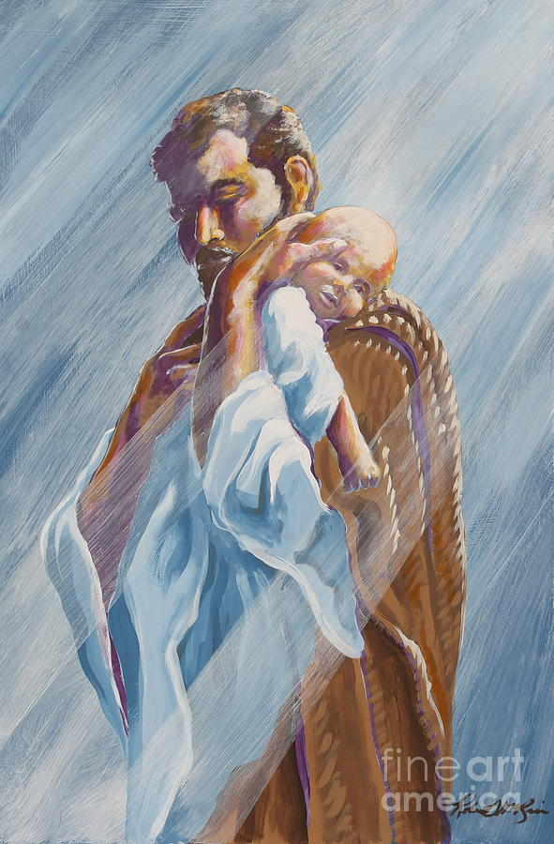
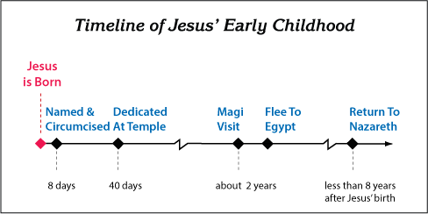
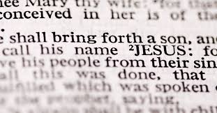
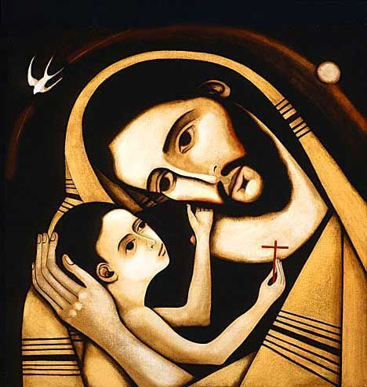
Joseph, Filii Dei Nutricie; Nurturer of the Son of God; pray for us.
Jewish Custom: The Father Named the Child
Notes:
Last week too, I mentioned that I would cover Jewish laws, customs and traditions that prescribes how Jewish fathers are to bring up their children. One of their first task is to name the child.
Recall what the angel said to Joseph: Joseph, son of David, do not fear to take Mary as your wife, for that which is conceived in her is of the Holy Spirit; she will bear a son, and you shall call his name Jesus [Aramaic
ye-shua’ = “the LORD saves”], for he will save [Hebrew yasha’] his people from their sins. (Matthew 1:20-21)
And at the end of eight days, when he was circumcised, he was called Jesus, the name given
by the angel before he was conceived in the womb. (Luke 2:21)
So Joseph the Silent One actually did say at least one word in scripture and what is that word – the name of “JESUS”

Slide 35
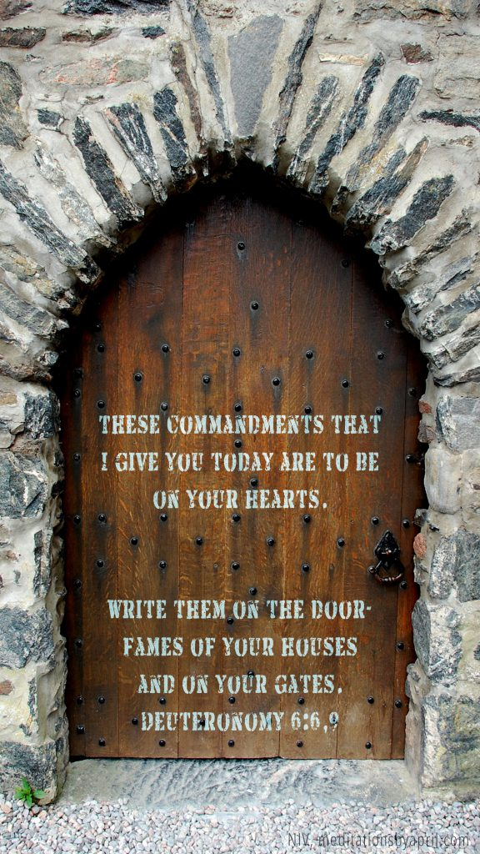
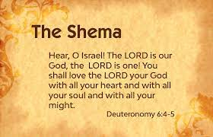
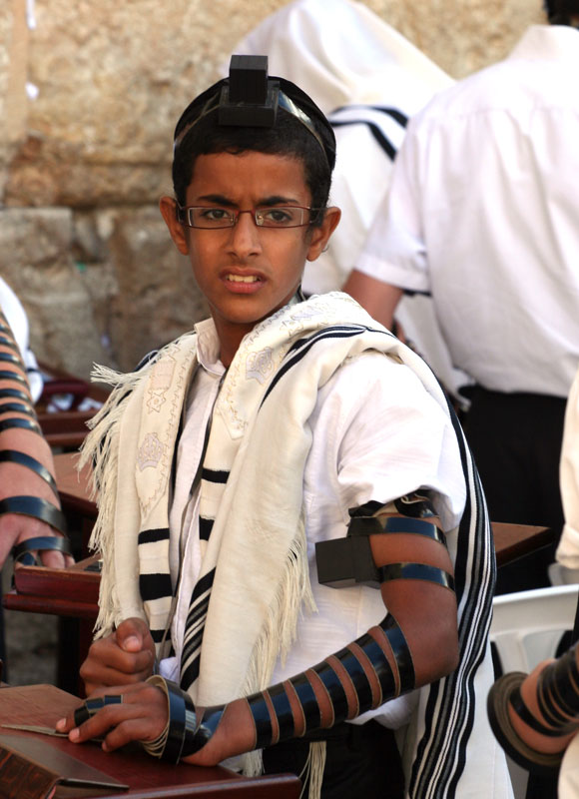
Joseph, Filii Dei Nutricie; Nurturer of the Son of God; pray for us.
“Take to heart these words which I enjoin on you today. Drill them into your children. Speak to them at home and abroad, whether you are busy or at rest. Bind them at your wrist as a sign and let them be as a pendant on your forehead. Write them on the doorposts of your houses and on your gates.” Deuteronomy 6: 6-9
Jewish Law: Fathers Teach Children the Shema
Notes:
Jewish fathers are to instruct their children in the faith.
Read off the verse in Deuteronomy 6:6-9
Their faith and religion is a way of life.

Slide 36
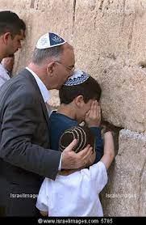
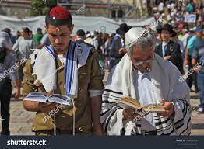
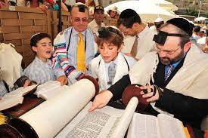
Joseph, Filii Dei Nutricie; Nurturer of the Son of God; pray for us.
All are subject to the command to appear [before the Lord] excepting a deaf-mute, an imbecile, a child…, women…, a man that is lame or blind or sick or aged... Who is deemed a child? Any that cannot ride on his father’s shoulders and go up from Jerusalem to the Temple Mount. So the School of Shammai. And the School of Hillel say: Any that cannot hold his father’s hand and go up [on foot] from Jerusalem to the Temple Mount…
(Mishnah, Hagigah 1:1)
Jewish Tradition: Fathers Taking their Sons to Jerusalem for Worship
Notes:
It is Jewish tradition that the fathers take their sons to Jerusalem for worship at the major feasts.
All are subject to the command to appear before the Lord except …

Slide 37
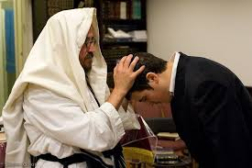
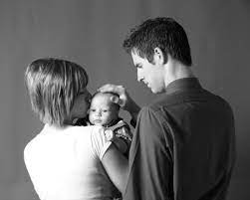


Joseph, Filii Dei Nutricie; Nurturer of the Son of God; pray for us.
I shall never forget the devotion and heartfelt care with which my father and mother made the sign of the Cross on the forehead, mouth, and breast of us children when we went away from home, especially when the parting was a long one. This blessing was like an escort that we knew would guide us on our way. It made visible the prayer of our parents, which went with us, and it gave us the assurance that this prayer was supported by the blessing of the Saviour.
Joseph Cardinal Ratzinger, The Spirit of the Liturgy, 184
May the Lord bless you and keep you.
Notes:
The book of Genesis emphasizes the blessing of a father to his sons. The patriarchs Abraham, Isaac, and Jacob all gave formal blessings to their children— In those times, receiving a blessing from one’s father was a high honor, and losing a blessing was tantamount to a curse.
Are we in a habit of blessing our children?
God told Moses to instruct Aaron to teach the people of Israel how to bless one another …
This is a reminder for us parents, particularly the fathers to exercise our priesthood within our domestic church.
Joseph Ratzinger [Emeritus Pope Benedict] shared this …

Slide 38
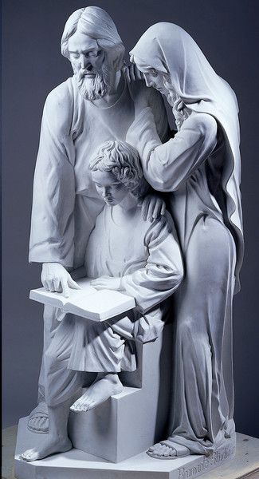

Joseph fulfilled every aspect of his paternal role. He must certainly have taught Jesus to
pray, together with Mary. In particular, Joseph himself must have taken Jesus to the
Synagogue for the rites of the Sabbath, as well as to Jerusalem for the great feasts of the people of Israel. Joseph, in accordance with the Jewish tradition, would have led the
prayers at home both every day — in the morning, in the evening, at meals — and on the principal religious feasts. In the rhythm of the days he spent at Nazareth, in the simple
home and in Joseph’s workshop, Jesus learned to alternate prayer and work…
Benedict XVI, General Audience, December 28, 2011.
Joseph, Filii Dei Nutricie; Nurturer of the Son of God; pray for us.

Slide 39

In nurturing and protecting my children:
What do I do, on a daily and weekly basis, to make sure I am physically and emotionally present to my children? Does this need improvement?
How vigilant am I in keeping morally and spiritually harmful things out of my home?
What concrete steps am I taking to protect the purity of my children?
Am I aware of what my children are reading? watching? music they listen to? games they play?
Do I know what my children are doing on the Internet, social media, and smart phones? Am I limiting their use of technology to reasonable and healthy levels?
How well do I know my children’s friends?
How am I leading my family in developing a life of prayer?
Joseph, Filii Dei Nutricie; Nurturer of the Son of God; pray for us.
Notes:
So how do we nurture and protect our children – I had posted these questions in our Telegram channel so you can refer back to these questions any time.

Slide 40
The husband is the head of the family whereas the wife is the heart of the family. What do you think of this statement?
The vocation of men is to be at the service of those entrusted to their love and care. Men like St Joseph are willing to fight for what they love, what is good, true and beautiful. Is chivalry still accepted and appreciated in today’s modern society?
St Joseph brings Jesus, the true Light of the World, to us, so we can be a light to others. How can we be the light of Christ to those we encounter? How can we respect the dignity of others and treat them as persons to love rather than objects of use? [Including our spouse and family members]
What would you like to bring to St Joseph in prayer now?
Group Reflection & Discussion Questions
Notes:
For the small group discussion, these are the suggested questions. Just pick any 2 of the first 3 questions leaving yourselves with the last 5 minutes to pray with and for each other.

Slide 41

S | SHARE AUTHENTICALLY Let love be without pretence. – Romans 12:9
A | ACCEPT ONE ANOTHER Therefore accept one another just as Christ also accepted us to the glory of God. – Romans 15:7
F | FIX NOT THY BROTHER
E | ENCOURAGE ONE ANOTHER Therefore encourage one another and build up one another just as you are doing – 1 Thessalonian 5:11
Group Reflection & Discussion Questions

Slide 42


LITANY OF SAINT JOSEPH

