Slide 1
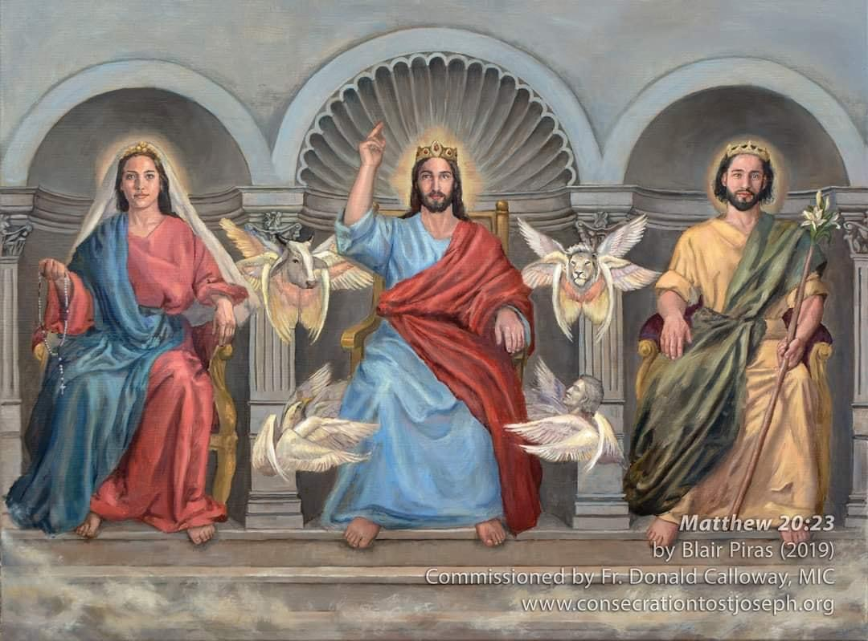
WELCOME TO 2ND GROUP MEETING OF THE 33-DAY CONSECRATION TO SAINT JOSEPH
Notes:
Welcome back everyone. Thank you for continuing on with this 33-day consecration to St Joseph. I assure you it will go by quickly. We’re already into Day 8 of our journey. And we’re just warming up. To get us going, allow me to play us another music prayer: Veni Sancte Spiritus … we call upon the Holy Spirit to guide us in our readings!

Slide 2
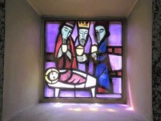
Come, Holy Spirit, from heaven shine forth with your glorious light. Veni Sancte Spiritus
Come, Father of the poor, come, generous Spirit, come, light of our hearts. Veni Sancte Spiritus
Come from the four winds, O Spirit, come breathe of God; disperse the shadows over us, renew and strengthen your people. Veni Sancte Spiritus
Most kindly warming light! Enter the inmost depths of our hearts, for we are faithful to you. Without your presence we have nothing worthy, nothing pure. Veni Sancte Spiritus
You are the only comforter, Peace of the soul. In the heat you shade us; in our labour you refresh us, and in trouble you are our strength. Veni Sancte Spiritus
On all who put their trust in you and receive you in faith, shower all your gifts. Grant that they may grow in you and persevere to the end. Give them lasting joy! Veni Sancte Spiritus
OPENING PRAYER: VENI SANCTE SPIRITUS
Notes:
We call forth the Holy Spirit to come upon us; Come Holy Spirit; guide us in gaining a deeper understanding of St Joseph as our Spiritual Father; that he may show us the way to Jesus, the path to life everlasting. Breathe unto us O Holy Spirit; cleanse us, revitalise us, teach us to resemble the virtues of St Joseph. Amen.

Slide 3
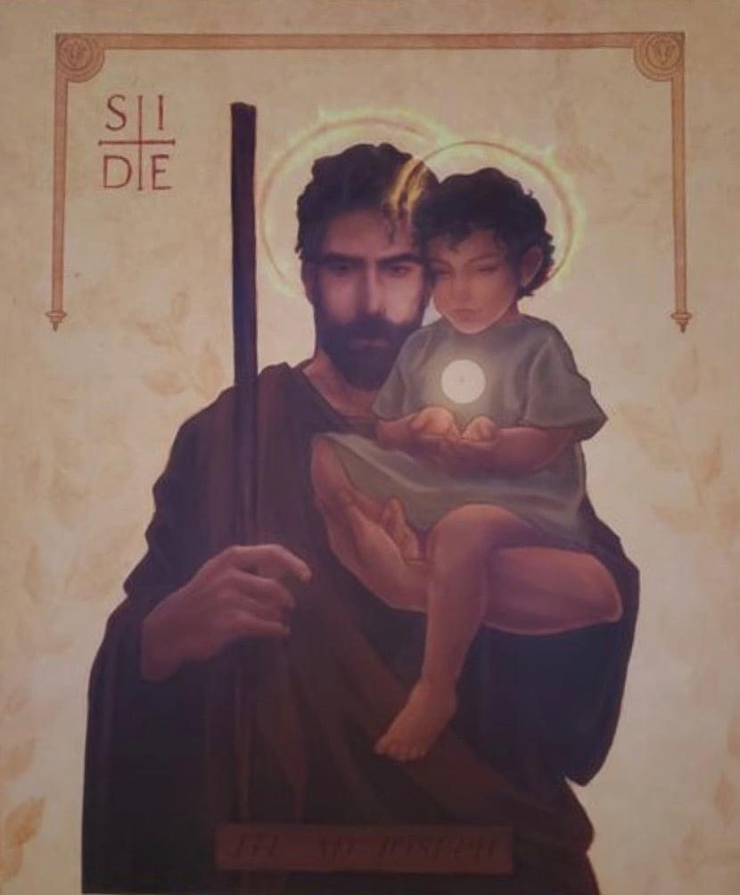
As Almighty God appointed Joseph, son of the patriarch Jacob, over all the land of Egypt to save grain for the people, so when the fullness of time was come and he was about to send on earth his only begotten Son, the Saviour of the world, he chose another Joseph of whom the first had been a type, and made him the lord and chief of his household and possessions, the guardian of his choicest treasures.
Blessed Pope Pius IX
This icon is titled "St. Joseph, Defender of the Eucharist." It is at the Cathedral of Our Lady of Perpetual Help in Rapid City, South Dakota.
Today, there is a worldwide spiritual and moral famine on the earth.
Ite ad loseph! “Go to Joseph and do whatever he tells you!” Genesis 41: 55
Notes:
A quick recap from the first introductory session – to quote Blessed Pope Pius IX: “As Almighty God appointed Joseph, … guardian of his choicest treasures.”
God the Father chose Joseph to stand in for Himself as the father of Jesus. Being all-knowing and all-powerful, God the Father could have fashioned anyone to be the earthly father of Jesus. Anyone! And God chose Joseph.
Today we face a spiritual and moral famine in our world. It is time to go to Joseph and do whatever he tells us.

Slide 4
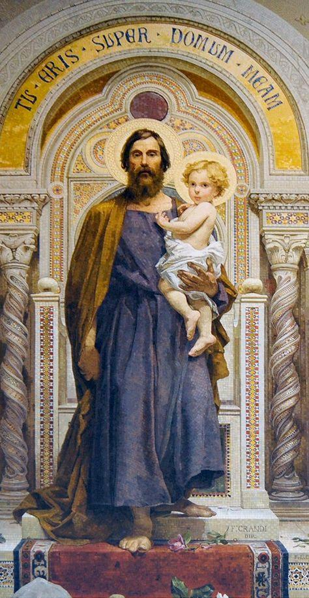
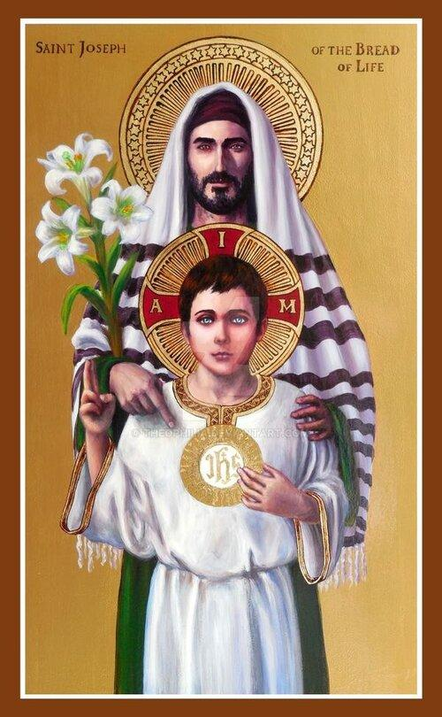
"tu eris super domum meam" - "You shall take charge of my home and family"
Litany of St Joseph
He has made him lord of his household.
And prince over all his possession
Saint Joseph – Lord, Chief & Guardian of the Treasures of Heaven
Notes:
On the left is a mosaic fresco inside St Peter's Basilica, The Vatican, Rome. There is the latin inscription on the picture: "tu eris super domum meam" which loosely translated means "You shall take charge of my home and family" similar to the last portion of the Litany of St Joseph "He has made him lord of his household. And prince over all his possession." It is inspired by Genesis 41:40 when Pharaoh made Joseph his Chancellor - the #2 position in Pharaoh's court; to take charge of all the grain as Egypt and in those days Egypt was the Bread Capital of the world. The Old Testament Joseph pre-figures the New Testament Joseph who took care of and protected the true Bread of Life from Heaven, the eucharist that we can partake to this day.

Slide 5
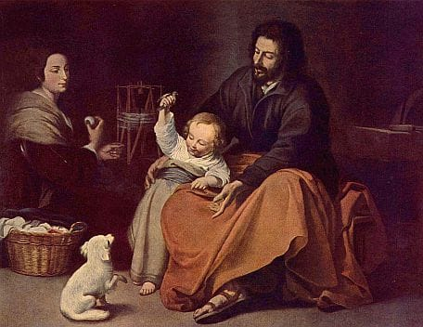
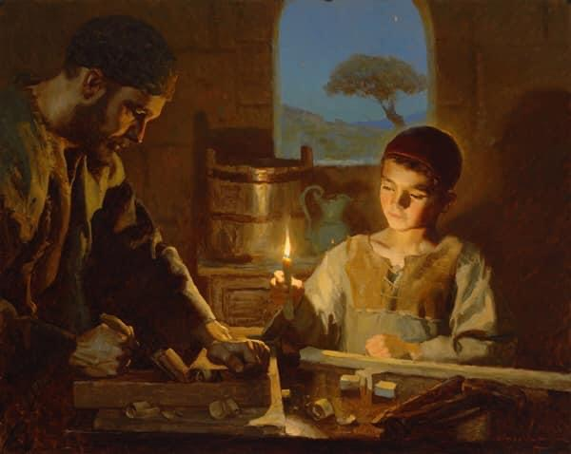
Particularly when Jesus was most vulnerable. One can argue that if God wanted to, he could easily send many legions of angels to protect his son. Just as he could have done so when Jesus was being tried and crucified. But such is not the plan of God. Such is not his way. No raw display of power nor conquering through fear and intimidation but rather gentle persuasion through freedom of choice and love. And we know that love never imposes.
In Fr Calloway’s book and video, he had explained the dual nature of Jesus - the divine and the human nature. St Joseph was chosen to stand in the place of the Heavenly Father according to the demands of Jesus’ human nature. God the Father doesn’t have a human nature. Every time Jesus saw St Joseph, heard him speak, watched him work, or witnessed his chaste love for Mary, the humanity of Jesus witnessed a perfect reflection of the Heavenly Father. Saint Joseph is the shadow of the Heavenly Father; the earthly image of his Heavenly Father.
Why did God entrust into Joseph’s custody ‘his most precious treasure’?
Notes:
Someone asked “Why did God entrust into Joseph’s custody His most precious treasure?”
Read the text from the slide … “Particularly when Jesus was most vulnerable … But such is not the plan of God. Well He doesn’t think and act like we do … No raw display of power … Among all the men in existence then, St Joseph was chosen to stand in the place of the Heavenly Father …

Slide 6
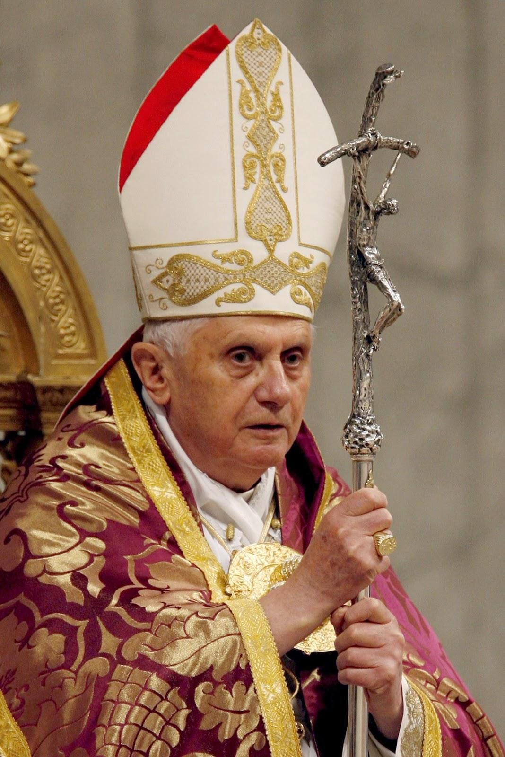
Pope Benedict XVI, Yaoundé, Cameroon, 18 March 2009
There is but one fatherhood, that of God the Father, the one Creator of the world, “of all that is seen and unseen”. Yet man, created in the image of God, has been granted a share in this one paternity of God (cf. Eph 3:15). Saint Joseph is a striking case of this, since he is a father, without fatherhood according to the flesh. He is not the biological father of Jesus, whose Father is God alone, and yet he lives his fatherhood fully and completely. To be a father means above all to be at the service of life and growth. Saint Joseph, in this sense, gave proof of great devotion. For the sake of Christ he experienced persecution, exile and the poverty which this entails. He had to settle far from his native town. His only reward was to be with Christ. His readiness to do all these things illustrates the words of Saint Paul: “It is Christ the Lord whom you serve” (Col 3:24).
Why do I need St Joseph as my spiritual father when I already have God “Abba Father”?
Notes:
Another question often asked is “Why do I need St Joseph as my spiritual father when I already have God “Abba Father”?
True; There is but one fatherhood, … read off the slide …
As parents we are co-creators and we too are given the opportunity to show the face of God to our children.

Slide 7
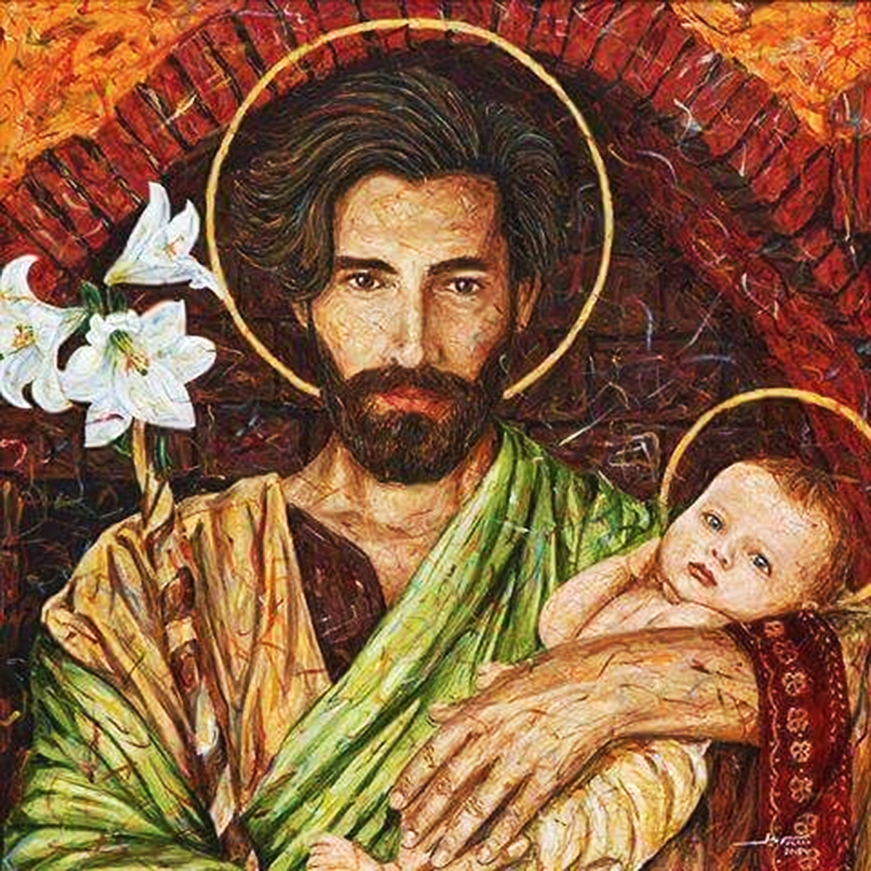
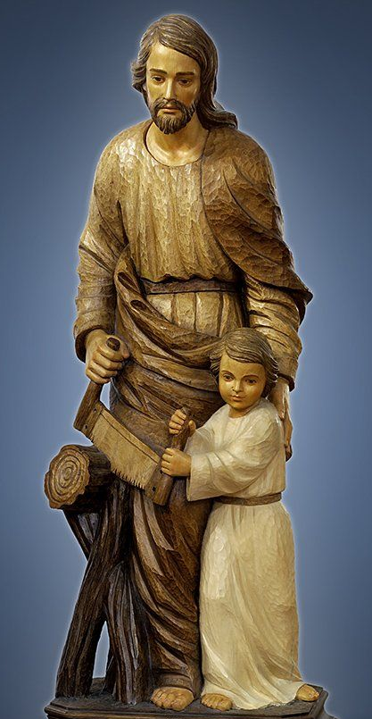
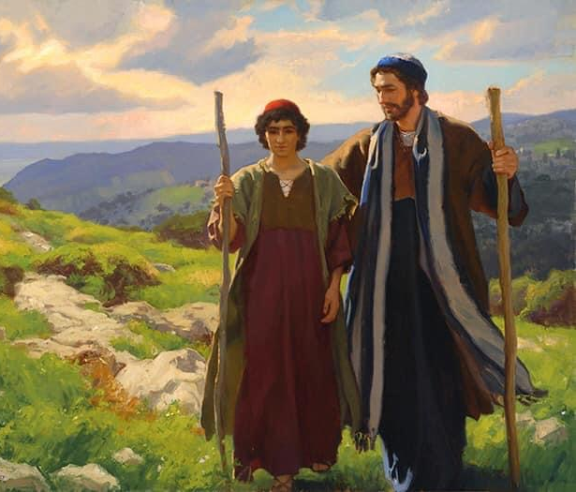
"Our heavenly Father has had only one saint to represent him on earth. Hence he bestowed everything he could on that favoured saint, and equipped him with all that he needed to be his worthy representative."
St Peter Julian Eymard.
We can be confident that God will similarly equip us for whatever He calls us forth to do.
The Will of God will not take you where the Grace of God will not protect you
Notes:
Read from the slide. Again emphasise the last point – Take courage! The Will of God will not take you where the Grace of God will not protect you.

Slide 8
“A man does not become a father simply by bringing a child into the world but by taking up the responsibility to care for that child.”
Pope Francis. Patris Corde With a Father’s Heart
‘SHOW YOUR SELF A FATHER AND GUIDE US IN THE PATH OF LIFE’
Notes:
Read St Josemaria Escriva quote and the extract from Patris Corde. IT IS LOVE THAT MAKES A FATHER AND A MOTHER.
Looking at the example of Joseph and how he loved and brought Jesus up, knowing precisely his place and role even as ‘foster-father’ to the Son of God; I'm reminded that we as parents are God's entrusted stewards and care-givers of our children.
God is the Father of us all.
But certainly God has entrusted Joseph as his earthly representative not just to Jesus but also as a Spiritual Father to all of us.

Slide 9
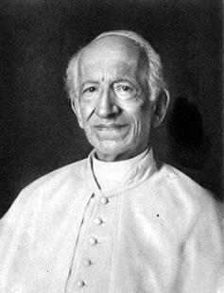
St. Joseph: Your Spiritual Father
The divine household which Joseph governed with paternal authority contained the beginnings of the new Church... The Virgin most holy is the mother of all Christians since she is the mother of Jesus… Jesus is, as it were, the firstborn of Christians, who are his brothers by adoption and redemption. From these considerations we conclude that the blessed Patriarch must regard all the multitude of Christians who constitute the Church as confided to his care in a certain special manner. This is his numberless family, scattered throughout all lands, over which he rules with a sort of paternal authority because he is the husband of Mary and the father of Jesus Christ.
(Leo XIII, Quamquam Pluries no. 3)
St Leonard
of Port Maurice
Notes:
To quote Pope Leo XIII … and St Leonard of Porto Maurizio, an Italian Franciscan preacher said …

Slide 10
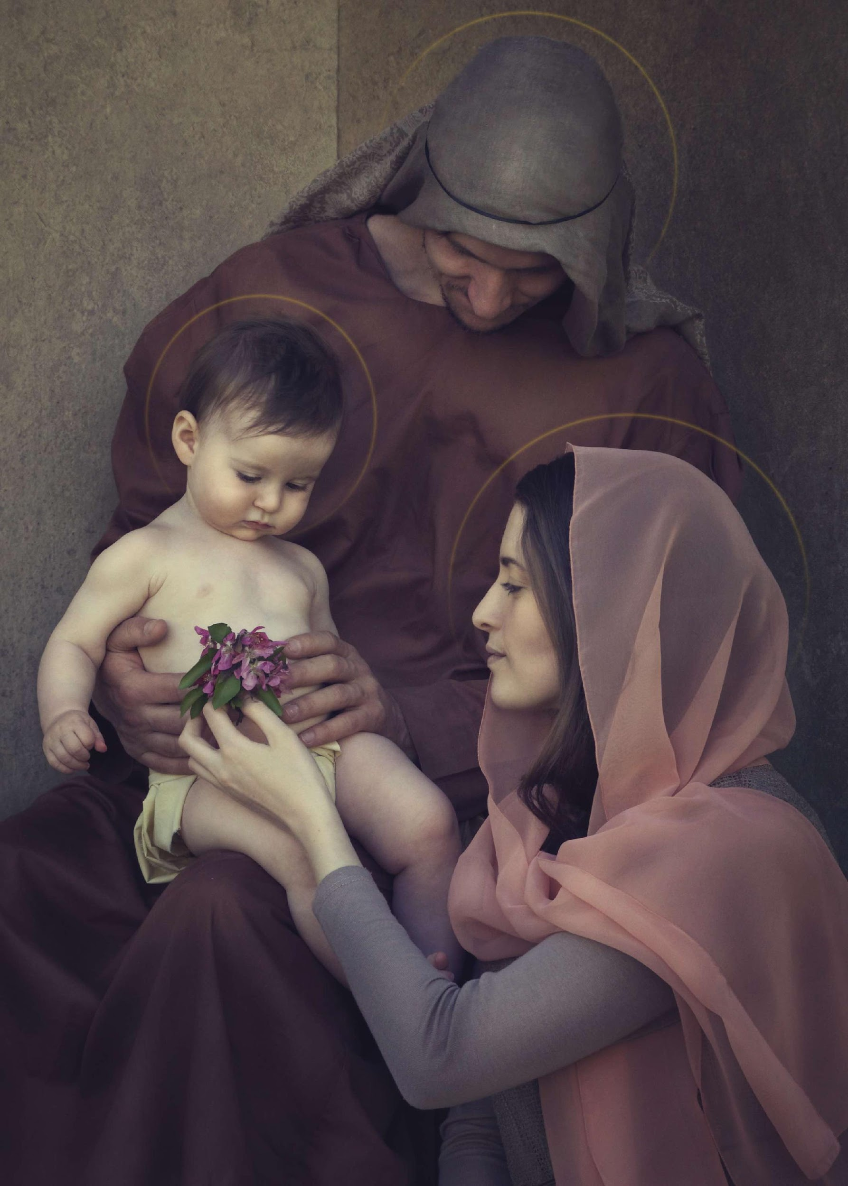
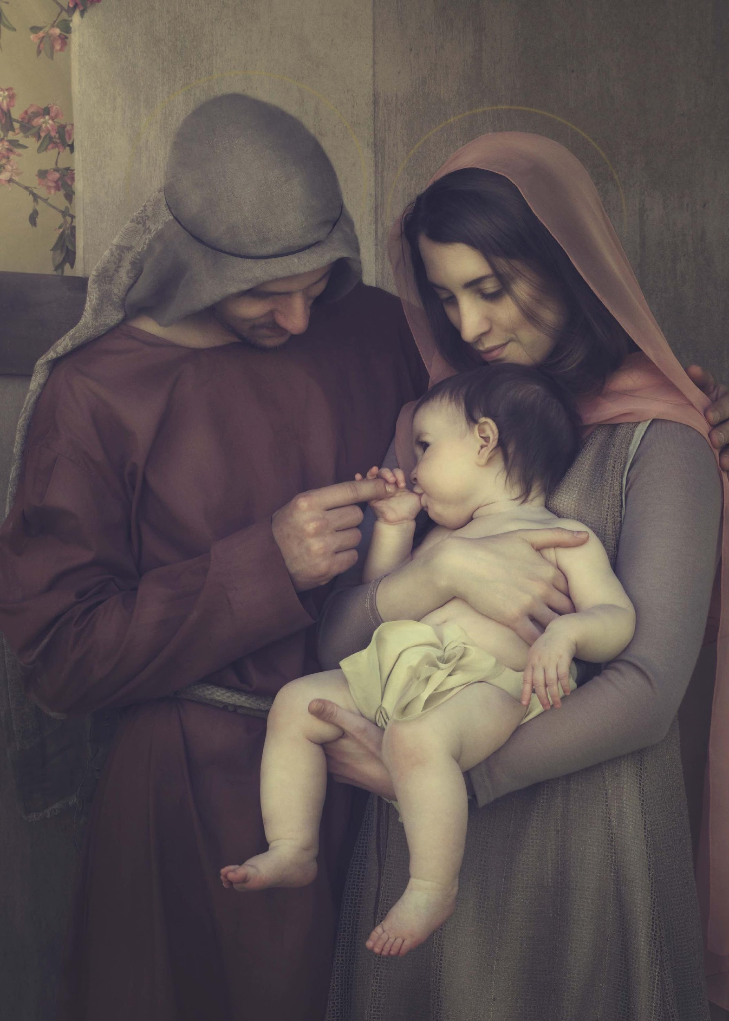
“The growth of Jesus ‘in wisdom and stature, and in favour with God and man’ (Luke 2:52) took place within the Holy Family under the eyes of Joseph, who had the important task of ‘raising’ Jesus, that is, feeding, clothing, and educating him in the Law and in a trade, in keeping with the duties of a father.”
St. John Paul II.
In Joseph, Jesus saw the tender love of God.
Notes:
And so in Joseph, Jesus saw the tender love of God
The growth of Jesus in wisdom and stature … [read off the slide]
When we next come to cover Day 13 on Joseph as the Foster-Father of the Son of God, and Day 15 Head of the Holy Family, I will elaborate further on the Jewish law, customs and practices relating to how Jewish fathers are to raise their children. So come join us again next Tuesday.

Slide 11
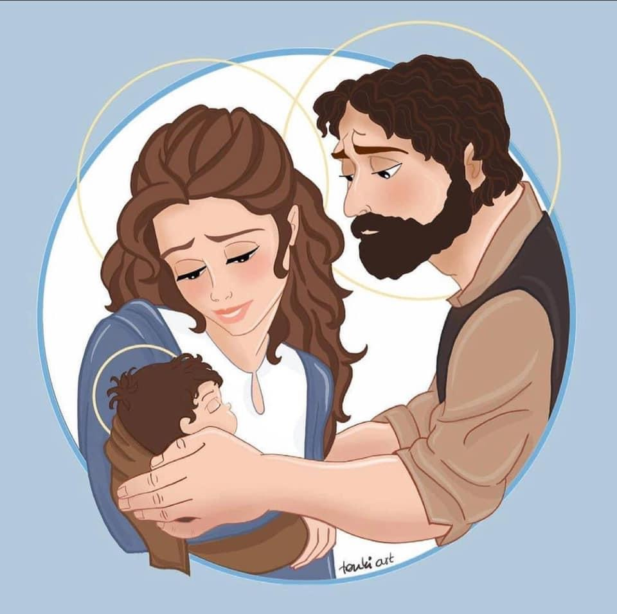
Pope Francis, Audience, 1 May 2013:
In the silence of his daily activity, St. Joseph shared with Mary a single, common focal point of attention: Jesus. They both accompany and guard, with dedication and tenderness, the growth of the Son of God made man for us.
Mary gave life. Joseph saved it!
Notes:
Pope Francis shared that In the silence of his daily activity, St Joseph … So while Mary gave birth to the Son of God, Joseph protected and saved him.

Slide 12
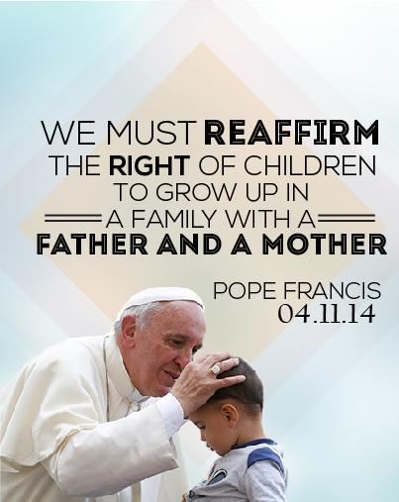
In order to grow into the fullness of his manhood Jesus required a mother, a father and time. All children require this.
The spiritual parentage of St Joseph and Mary is meant to supplement the witness and love of our earthly parents, helping us to grow in the spiritual life, especially in virtue and holiness.
We live in a fallen world and the majority of people have seen and experienced the flaws and imperfections of their parents. However, with St Joseph and Mary as our spiritual parents we are blessed with perfect parents and perfect role models.
Joseph and Mary, guide us in the path of life
Notes:
Read off the slide … 1st and 2nd para … We live in a fallen world and the majority of people have seen and experienced the flaws and imperfections of their parents. I shared the example of my father. But seriously he didn’t know any better. Neither did his father. I’m not a perfect parent. I wish I could turn back time. I wished I had known what I now know 28 years ago when my first child was born. But we have to move forward. With St Joseph and Mary as our spiritual parents we now have great role models to emulate. Yet God knows we are all a work-in-progress. And we can choose, with God’s grace, to change, to learn a new script and to break the cycle of life that we had been caught up with in the past. Indeed, dear Joseph and Mary, please do guide us in the path of life.

Slide 13
A Catholic Family is called to be a point of light, a safe haven and an island
of Christian living to other families struggling in times of strife and darkness
Notes:
I’m sure you would have heard the saying … It takes a village / a kampung to raise a child. In the old Jewish society, they practice something called a Levirate marriage which is a type of marriage in which the brother of a deceased man is obliged to marry his brother's widow. Levirate marriage has been practiced by societies with a strong clan structure in which exogamous marriage (i.e. marriage outside the clan) is forbidden. This is to protect the widows and orphans within the clan. Within our faith, a Catholic Family is called to be a point of light …

Slide 14
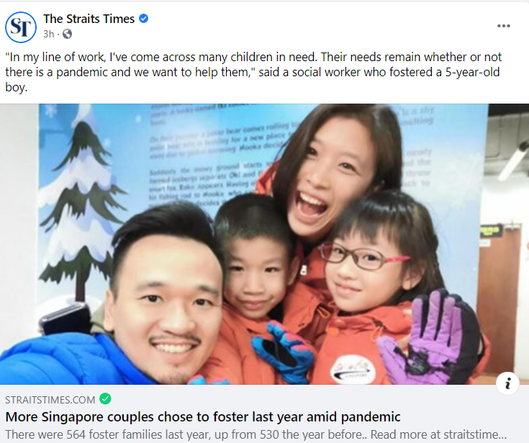
Pope Francis:
"The choice of adoption and foster care expresses a particular kind of fruitfulness in the marriage experience, and not only in cases of infertility. In the light of those situations where a child is desired at any cost, as a right for one’s self-fulfilment, adoption and foster care, correctly understood, manifest an important aspect of parenting and the raising of children. They make people aware that children, whether natural, adoptive or taken in foster care, are persons in their own right who need to be accepted, loved and cared for, and not just brought into this world."
Amoris Laetitia, 180
Notes:
Closer to home, a recent Straits Times report indicated more Singapore couples chose to foster last year amid a pandemic. Pope Francis in Amoris Laetitia 180 stressed that children whether natural, adopted or taken in foster care are persons in their own right who need to be accepted, loved and cared for and not just brought into this world. So when families in a community are able to come together to form a support structure or eco-system, this helps to make for stronger and more resilient marriages and families and provides a safety net to catch those who may have fallen in between the gaps.

Slide 15
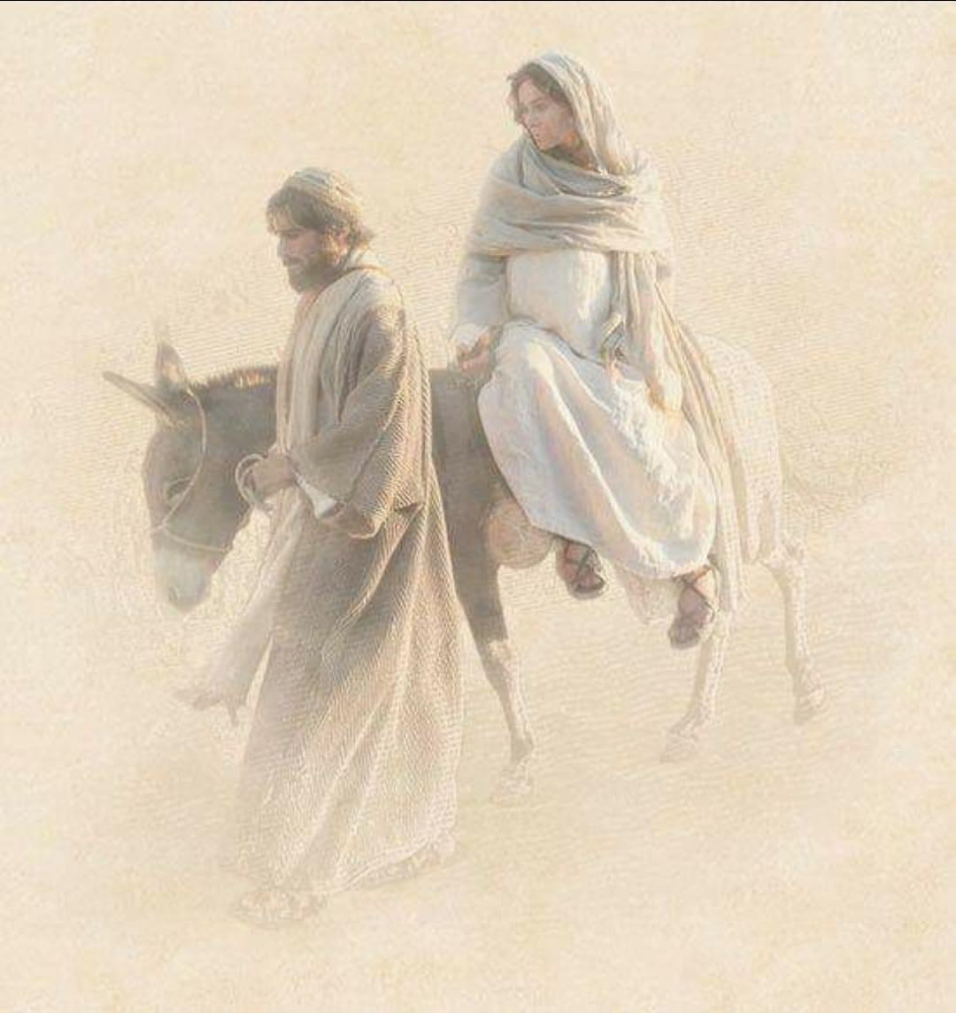
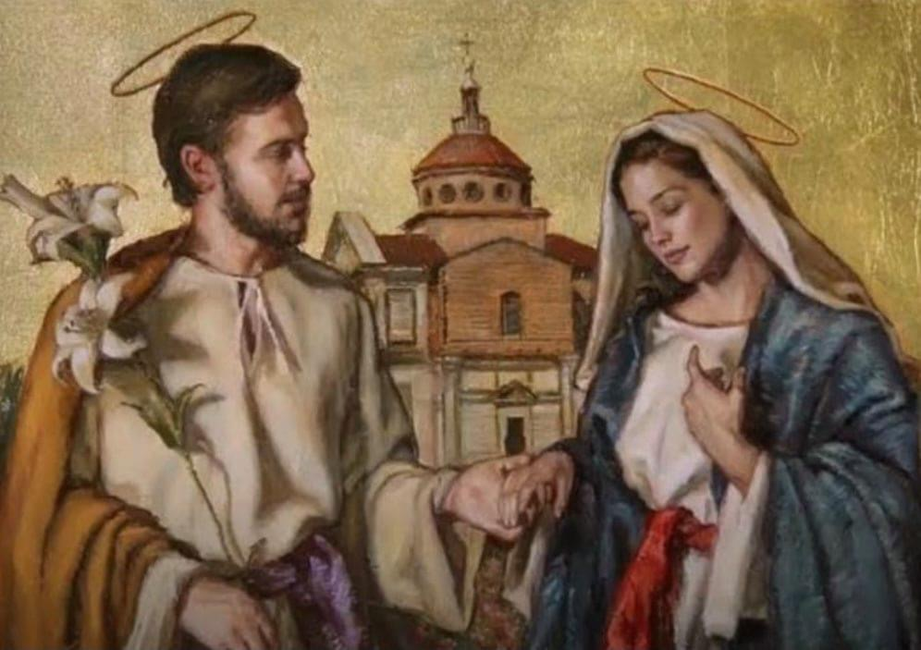
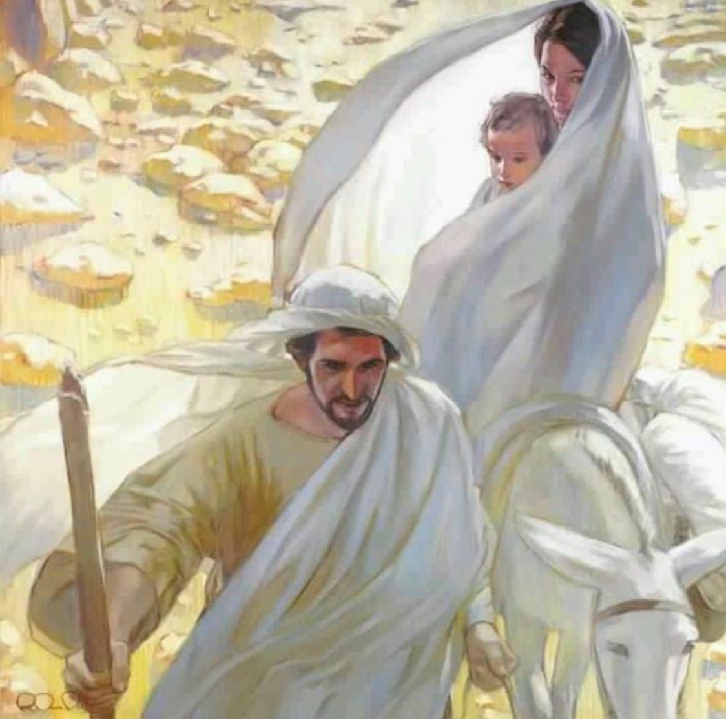
Long before Calvary, when Jesus commanded all of his disciples to take Mary into their hearts
and homes, St Joseph had already taken Mary into his heart and into his home.
When he took Mary’s hand in marriage, he consecrated himself to her and made a promise to treasure her femininity, especially her blessed virginity. He was her beloved provider, protector and servant.
“Joseph – the first consecrated knight of the Holy Queen.”
Notes:
Ok moving on; Joseph is our gallant knight in shinning armour – well not quite in armour and a war horse since he set aside his right to the throne in order to fulfil his mission … so if you wonder why Jesus came into Jerusalem riding on a donkey; besides King Solomon as example, perhaps his own father had shown him the way too; if any body can find me a picture of Joseph riding on a donkey, please share with me! The ones I have all show Joseph on foot with Mary and the child Jesus riding on the donkey! But anyway, as Fr Calloway wrote in his book, long before Calvary, when Jesus … read off the slide
“ … he was her beloved provider, protector and servant. Tradition has it that Mary was a temple maiden, when she learnt that she was to be married, she was dismayed but yet she prayed and continued to trust in God that somehow her vows of chastity and virginity will be preserved. And sure enough God provides!

Slide 16
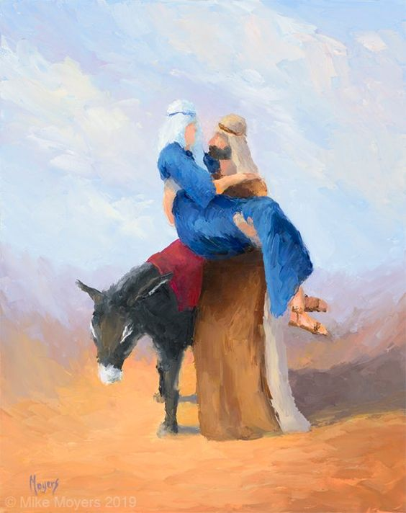
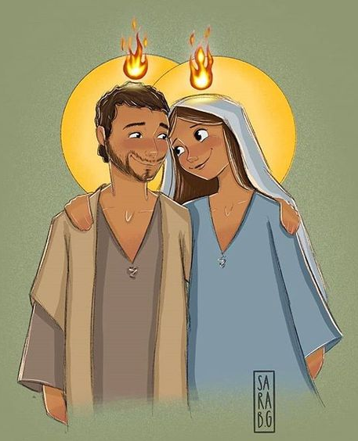
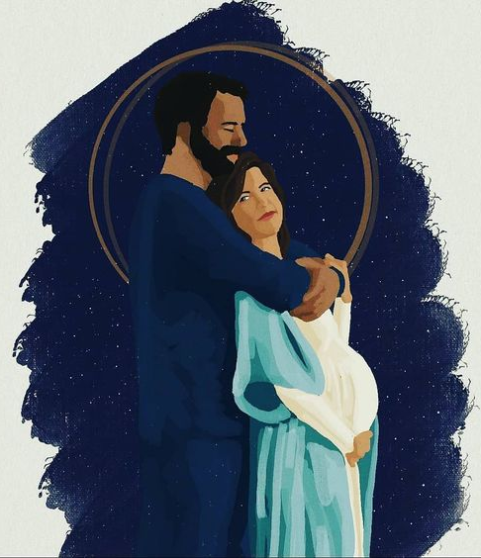
St Joseph is the most Marian of all the saints. He is the model for total consecration to Mary. He is the first human person to have been totally consecrated to the Blessed Virgin Mary.
“Joseph – the greatest knight of Our Lady.”
Notes:
For those of us familiar with the 33-days to Morning Glory, long before St Louis de Montfort, St Maximilian Kolbe, St Mother Teresa or St John Paul II gave themselves totally to Mary, St Joseph already did so … St Joseph is the most Marian of all the saints. He is the model for total consecration to Mary. He is the first human person to have been totally consecrated to the Blessed Virgin Mary.

Slide 17
Of all the saints on the Liturgical Calendar, aside from Jesus and Mary, by far the greatest saint is “Glorious Saint Joseph”. He indeed is in a category by himself! The theologians classify the greatness of those in glory with the following titles: “Latria”, which means adoration that we give to the Blessed Trinity, Father, Son and Holy Spirit. “Hyperdulia” given to the Blessed Virgin Mary means the highest veneration. “Dulia”, given to the saints, implies veneration. Finally, Glorious Saint Joseph is rightly given “Protodulia”, meaning that among the saints he is given first place; “Proto” means first!
Glorious Saint Joseph, First amongst the Saints
Notes:
But again, to reiterate, the hero in our story is Christ Jesus. He is the Messiah and it is only by his name that we are saved. But Joseph was given the privilege to name him. Read off the slide … Of all the saints on the liturgical calendar, aside from Jesus, who is God and Mary who is the Mother of God, by far the greatest saint is Glorious St Joseph …

Slide 18
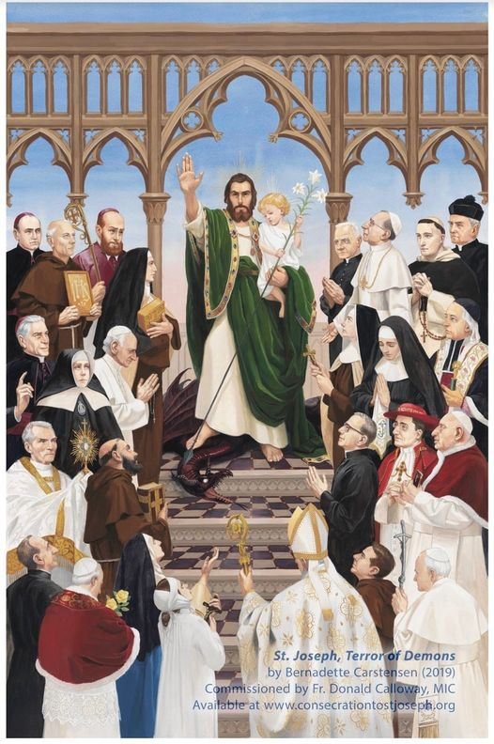
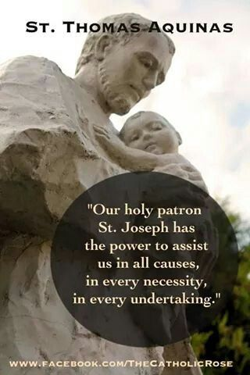
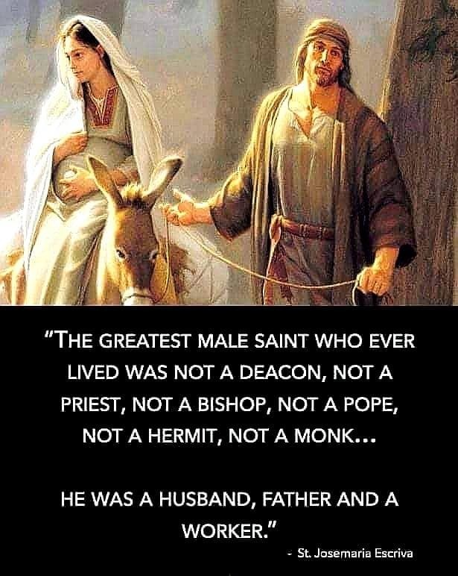
Saint Joseph, the Delight of Saints
Notes:
According to St Thomas Aquinas, … he is the pao-ka-liao saint! The multi-purpose, all-in-one, go-to saint! And I think St Josemaria Escriva said it best when he said…

Slide 19
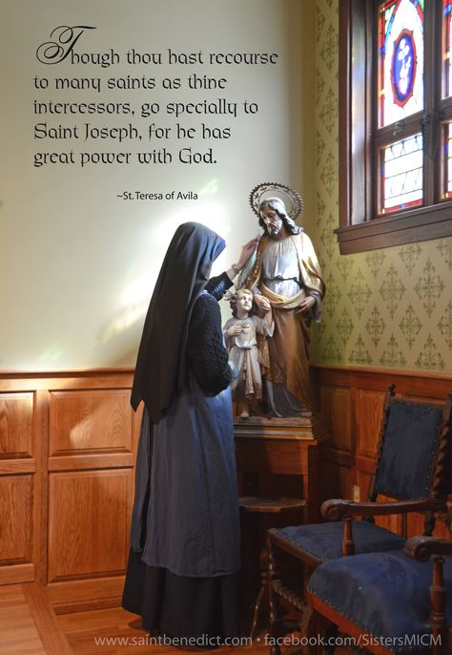
Devotion to Joseph
I took for my advocate and lord the glorious Saint Joseph and commended myself earnestly to him; and I found that…. he gave me greater blessings than I could ask of him. I do not remember even now that I have ever asked anything of him which he has failed to grant…
I wish I could persuade everyone to be devoted to this glorious saint... I have never known anyone to be truly devoted to him and render him particular services who did not notably advance in virtue, for he gives very real help to souls who commend themselves to him.
(Teresa of Avila, Life 6.6-7)10
Saint Joseph, the Delight of Saints
Notes:
St Teresa of Avila is just about the most ardent of St Joseph devotees … She said in her autobiography …

Slide 20
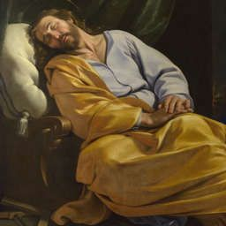
Sleeping St Joseph
St. Joseph wants us to be docile to the direction of the Holy Spirit so that we can be led in the ways of Holiness. For that to happen, we need to spend quiet time in prayer, to connect and to be intimate with God. Through prayer, St Joseph exercised the virtues of faith, hope and charity, as well as the moral virtues of prudence, temperance, justice and fortitude.
Notes:
Sleeping St Joseph … Pope Francis shared his story of Sleeping St Joseph during an address he made at the Meeting with Families in Manila on 2015. The pope spoke of his devotional practice of writing prayer requests on pieces of paper and slipping them under the statue of Sleeping Joseph to invoke St Joseph’s intercession, asking him to sleep over those prayer requests. So even while asleep St Joseph continues to watch over and protect the Holy Church.
Read last portion of the slide

Slide 21
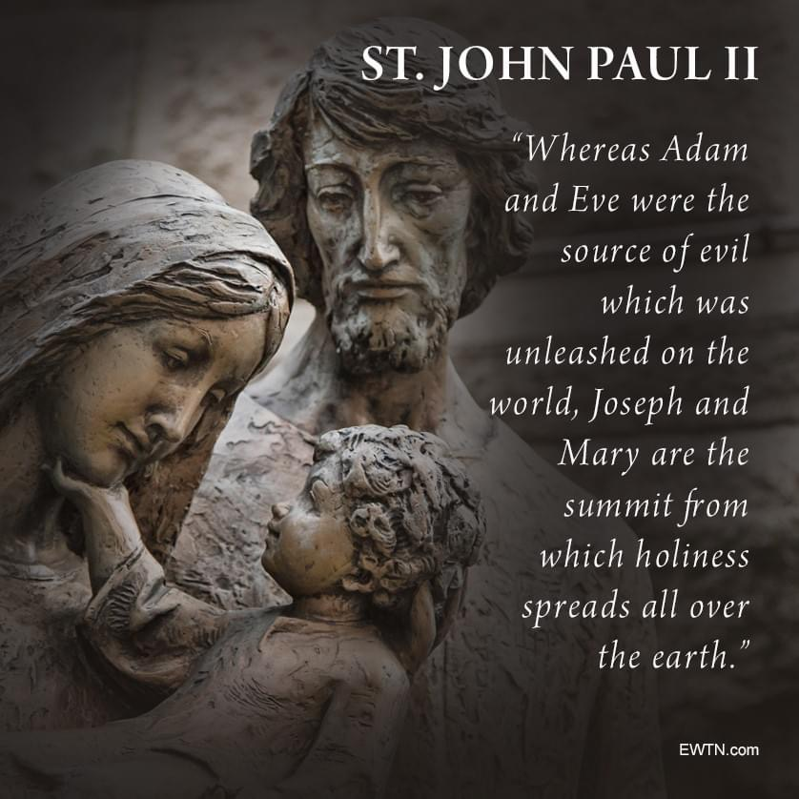
Our first father's disobedience caused the downfall of all creation and kept us from entering heaven. Saint Joseph's fatherhood on the other hand, elevates us and helps us to enter heaven. He brings us to the only path that leads to heaven: Jesus. He will help us acquire the correct attire - virtues and holiness - needed to enter the wedding feast of heaven.
Let’s acquire the right attire – virtues and holiness – needed to enter the wedding feast of heaven
Notes:
Read quote by JPII and the text on the slide

Slide 22
After a week of learning more about St Joseph, is there one trait / virtue / quality that strikes you about St Joseph?
By our baptism we are adopted into the Holy Family, with Jesus as our brother, Mary as our mother and Joseph as our spiritual father; Can you relate to having St Joseph as your spiritual father?
Jesus grew in wisdom and stature and in favour with God and man under the guidance of Joseph. Is there one thing that you would like to bring to St Joseph in prayer? Perhaps at the end of your sharing, within your group, you can pray with and for each other what you want to bring to St Joseph in prayer now.
Group Reflection & Discussion Questions

Slide 23
S | SHARE AUTHENTICALLY Let love be without pretence. – Romans 12:9
A | ACCEPT ONE ANOTHER Therefore accept one another just as Christ also accepted us to the glory of God. – Romans 15:7
F | FIX NOT THY BROTHER
E | ENCOURAGE ONE ANOTHER Therefore encourage one another and build up one another just as you are doing – 1 Thessalonian 5:11
Group Reflection & Discussion Questions

Slide 24
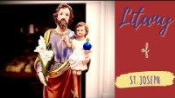
The Litany of Saint Joseph

