Slide 1
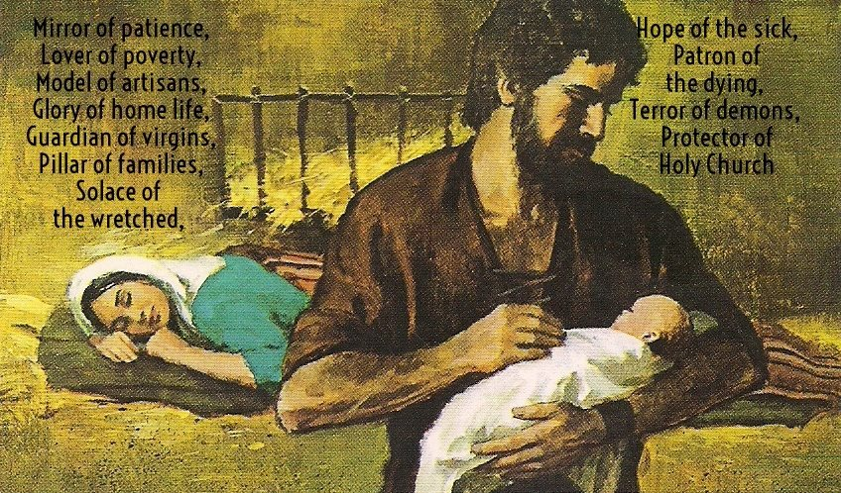
who are you saint joseph?
Notes:
Welcome! Thank you for making the time to come to learn more about Saint Joseph. A most understated and unsung hero and saint. As we wait for more to join in before we start the session, here’s a music prayer to St Joseph by Lorraine Hess, “With a Father’s Heart” to help put us in the mood … this music prayer video is inspired by Pope Francis’ Apostolic Letter Patris Corde With a Father’s Heart as part of the dedication for the Year of St Joseph

Slide 2
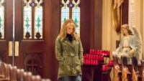
With a father’s heart
Notes:
Music Prayer to St Joseph by Lorraine Hess, “With a Father’s Heart” Inspired by Pope Francis’ Apostolic Letter Patris Corde for the Year of St Joseph

Slide 3
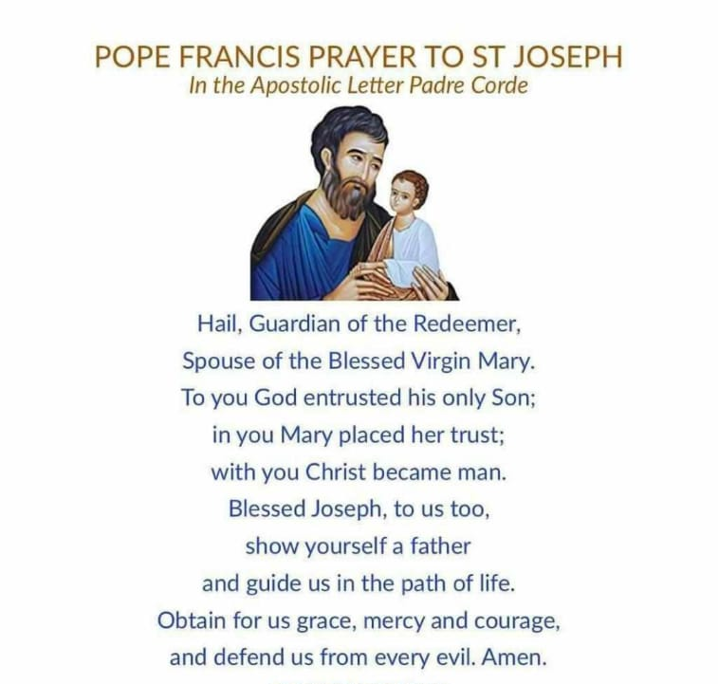
Year of St Joseph. 8th Dec 2020 – 8th Dec 2021
Notes:
Let us begin our session with a prayer written by Pope Francis in his recent apostolic letter Patris Corde “With a Father’s Heart” … Hail, Guardian of the Redeemer, …

Slide 4
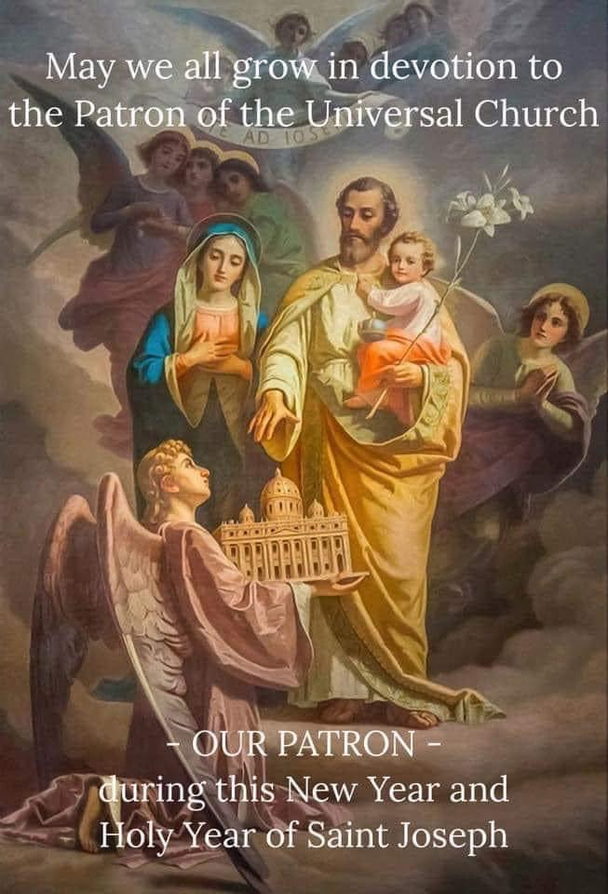
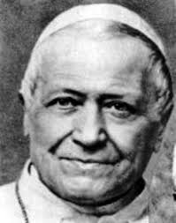
THE POPES AND SAINT JOSEPH
In 1870 blessed pope pius ix declared st joseph the patron of the universal church.
Notes:
So who is Saint Joseph? In centuries past, hardly anything had been written or said about St Joseph; like he had been hidden; and even in scripture you would hardly become aware of St Joseph. It was only in the last 150 years the Fathers of the Church, prompted by the Holy Spirit, had begun to extol the greatness and virtues of St Joseph as our Spiritual Father. In 1870, Blessed Pope Pius IX declared St Joseph the patron of the Universal Church …

Slide 5
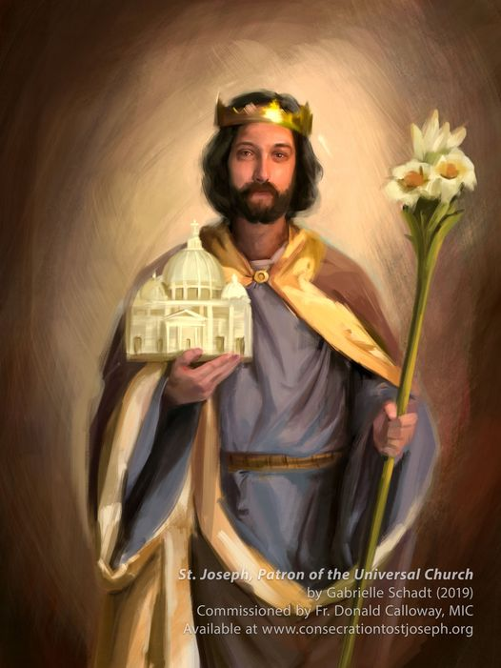
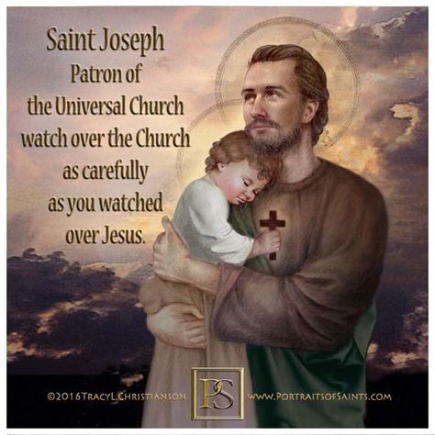
THE POPES AND SAINT JOSEPH
"It is thus fitting and most worthy of Joseph's dignity that, in the same way he once kept unceasing holy watch over the family of Nazareth, so now does he protect and defend with his heavenly patronage the Church of Christ.“
Pope Leo XIII
Joseph, Protector of the Holy Church, Patron of the Universal Church; pray for us.
Notes:
Pope Leo XIII who succeeded Pope Pius IX explained succinctly that “it is thus fitting and most worthy of Joseph’s dignity that, in the same way he once kept unceasing holy watch over the family of Nazareth, so now does he protect and defend with his heavenly patronage the Church of Christ.” Perhaps now more than ever in these dangerous and challenging times God is unveiling His secret weapon St Joseph, Protector of the Holy Church, to watch over the Church as carefully as he had watched over Jesus.

Slide 6
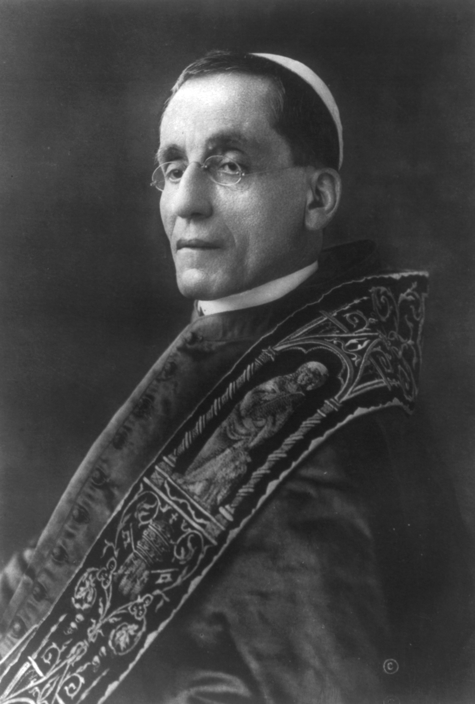
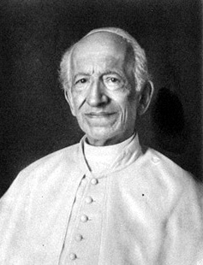
In 1889, Pope Leo XIII issues Encyclical on Devotion to St Joseph (Quamquam Pluries)
In 1921, Pope Benedict XV inserts the phrase
“Blessed be St Joseph, her most chaste spouse into the Divine Praises.
THE POPES AND SAINT JOSEPH
Notes:
Pope Leo XIII himself wrote an encyclical to inspire greater devotion to St Joseph and in 1921, another Church Father, Pope Benedict XV inserted the phrase “Blessed be St Joseph, her most chaste spouse into the Divine Praises.

Slide 7
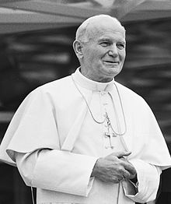
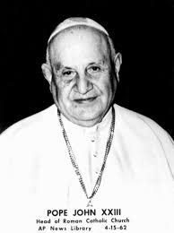
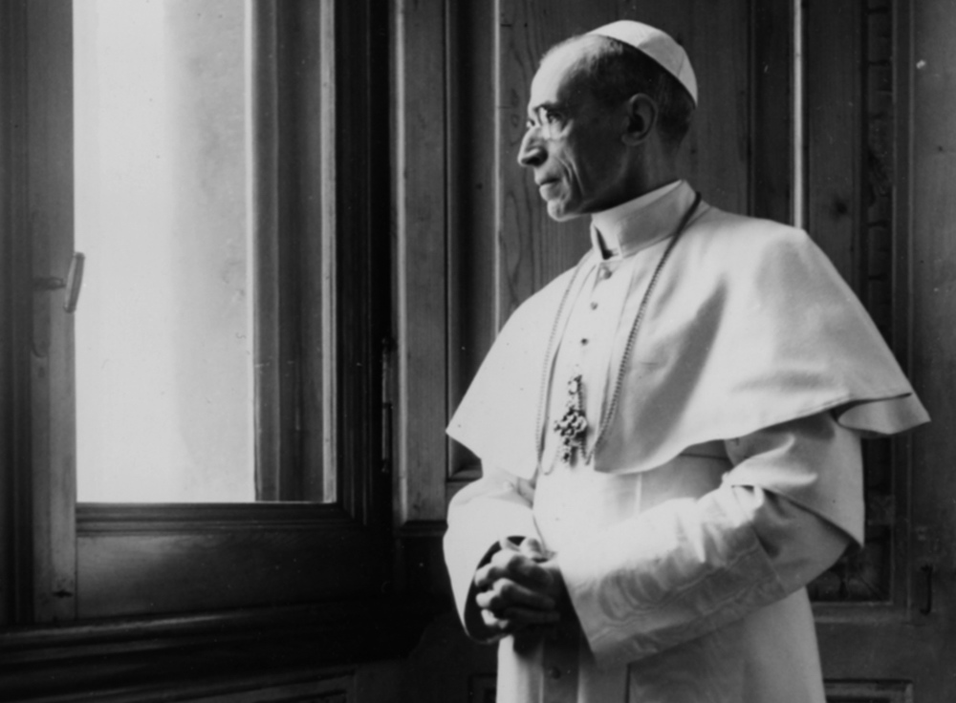
In 1989 Pope John Pope II issued Apostolic Exhortation on St Joseph (Redemptorist Custos)
In 1955, Pope Pius XII instituted
Feast of St Joseph the Worker
In 1962, Pope John XXIII inserted St Joseph’s name into the Roman Canon (Eucharistic Prayer 1)
THE POPES AND SAINT JOSEPH
Notes:
Read off the slide in chronological order … 1955; 1962 and 1989

Slide 8
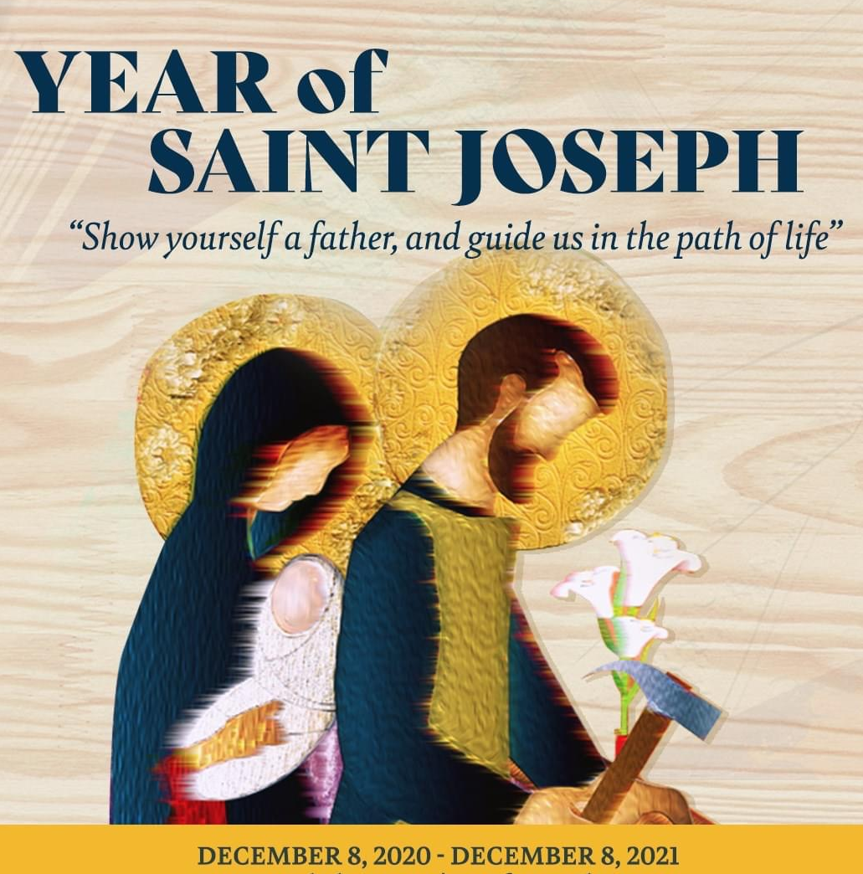
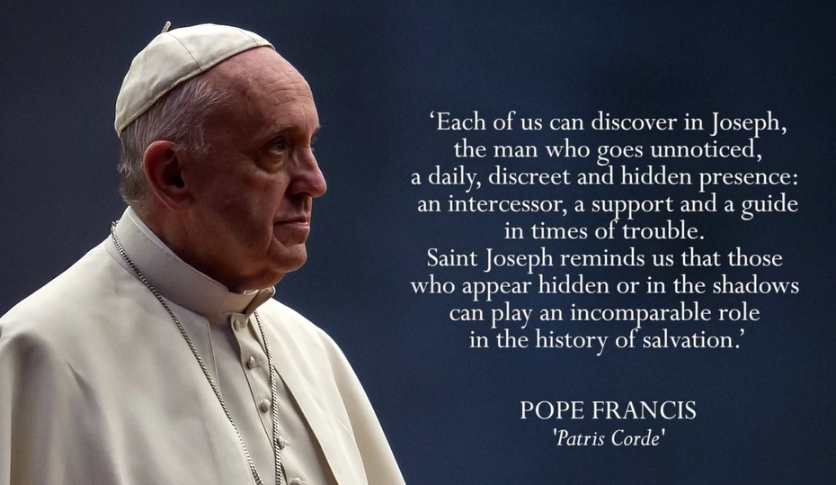
THE POPES AND SAINT JOSEPH
In 2013, Pope Francis inserted St Joseph’s name into all the Eucharistic Prayers (I,II,III,IV)
‘Show your self a father and guide us in the path of life’
Notes:
And in our time, our beloved Pope Francis in 2013 inserted St Joseph’s name into all the Eucharistic Prayers and as you know in celebration of the 150th anniversary of St Joseph being declared Patron of the Universal Church, Pope Francis declared a Year of Saint Joseph from 8 Dec 2020 to 8 Dec 2021.
Particularly during this time when the world got hit and is still coming to grips with the coronavirus pandemic, Pope Francis paid tribute not just to all the frontline healthcare workers who toiled unceasingly and tirelessly attending to all infected by Covid-19 but all those in essential services as well – all those working behind the scenes, minding security, cleaning toilets, sanitising premises, delivering food and essential supplies; reminding him of St Joseph … in his apostolic letter Patris Corde; with a Father’s Heart he said … (read off the slide) Pope Francis wrote …
Indeed we can look within our own domestic family situation or environment; Can we see who has been giving his / her heart, body and soul totally, unreservedly, unceasingly and yet quietly, without complaint, without fanfare, to the marriage, the family, within the community in the best interest of the spousal, parental or community relationship?
In my case, my wife Allyson is the cradle Catholic. I’m a convert. In the early years of our marriage she did not force me to convert. She simply lived and modelled her faith but she did pray hard for 9 years before I became Catholic. [I recently learnt from a good friend that her husband finally signed up for RCIA. She had been praying for 23 years! So don’t ever give up on prayer!] in terms of sacrifices, my wife also gave up her high flying career to be a stay home mum to take care of our girls.

Slide 9
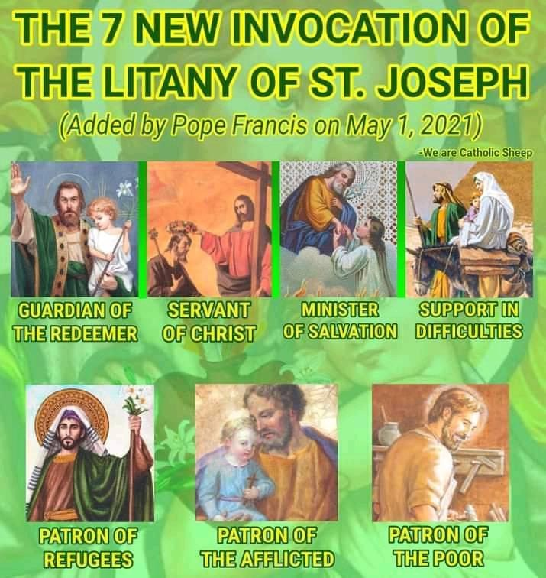
Notes:
Most recently, on May 1st, on the Feast of St Joseph the Worker, Pope Francis expanded on the Litany of St Joseph by adding 7 new invocations.
In these you can clearly see that St Joseph, given the hard life that he had been through, he particularly has a soft spot for the poor, marginalised, migrants and refugees, orphans, single parents, those afflicted and in difficulties.
In the latter chapters of the Consecration to St Joseph book, you’ll come to see how St Joseph encourages us to always look out for those around us who are suffering or in difficulties.
[As a domestic church or as a point of light providing support, encouragement and refuge to troubled marriages and families. The importance of being in community whose members can watch out for one another be they the spouses or the children. For CEP audience]

Slide 10
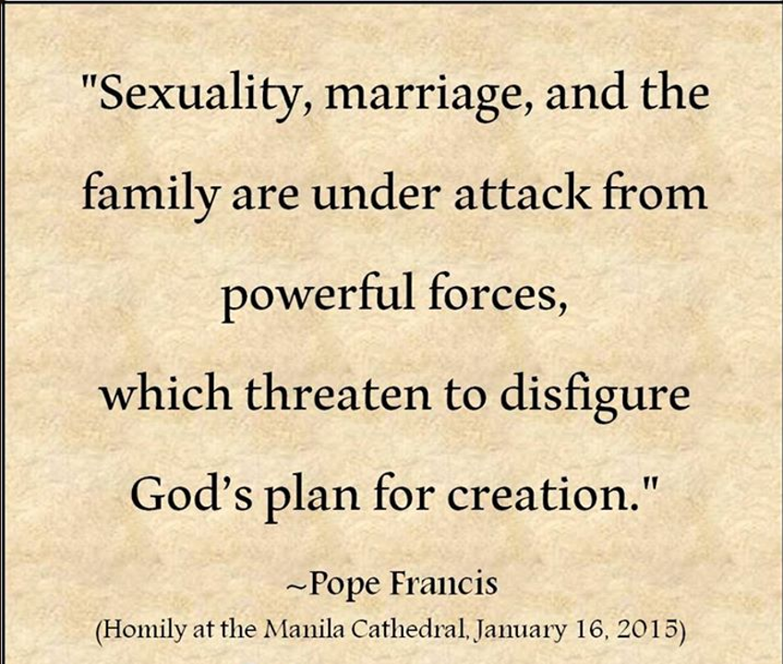
Co-Habitation
De-Factor Partner
Polygamy
Same-Sex Marriage
Divorce
Culture of death
contraceptives
abortion
euthanasia
We need to go back to fundamentals. As God intended marriage and family to be from the beginning
Notes:
And so there’s not a more urgent time than now to call upon St Joseph. It would seem like God has been holding St Joseph in reserve until now to unleash him to the world because now, more than ever, we need St Joseph, our Spiritual Father to help us to preserve and to protect marriage and family, which have continually and increasingly been attacked, redefined and disfigured away from what God meant marriage and family to be from the beginning … we need to go back to fundamentals, to learn and emulate the virtues and example of St Joseph – how he lived a pure and chaste life, how he managed the trials and tribulations of his mission and vocation as husband to Mary and as the legal guardian and foster father of Jesus with fortitude and fidelity.

Slide 11
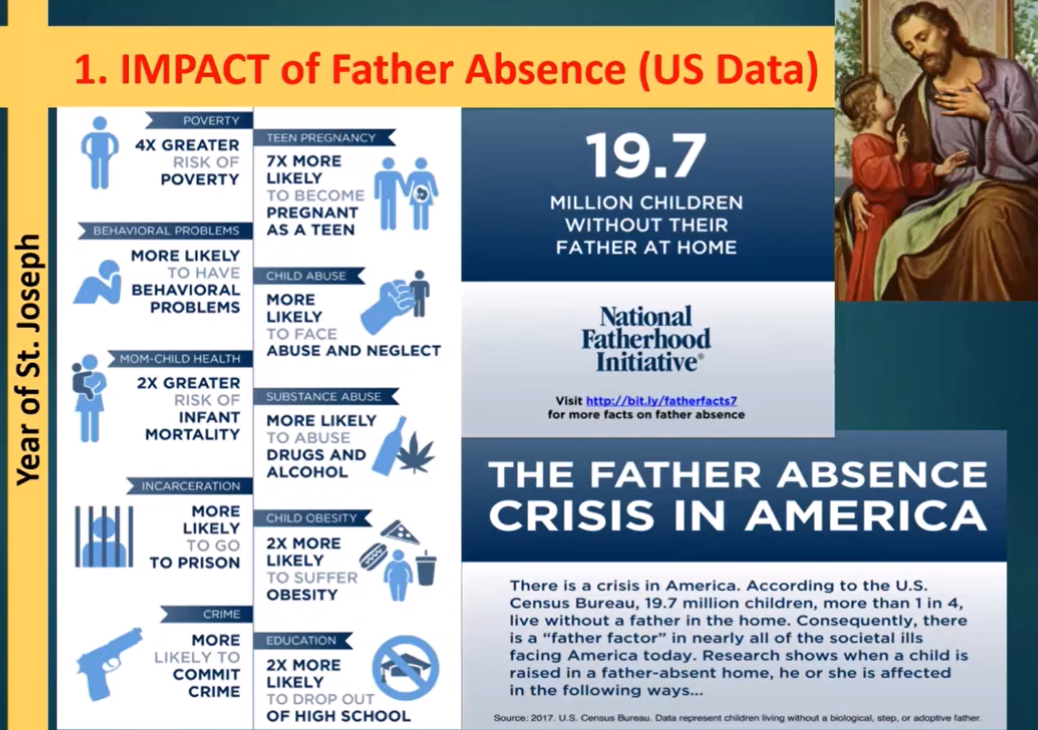
Virtually every major pathology has been linked to fatherlessness. Violent crime, drug and alcohol abuse, teen pregnancy, suicide – all correlate more strongly to fatherlessness than any other single factor.
Stephan Baskerville, Howard University
We need to go back to fundamentals. As God intended marriage and family to be from the beginning
Notes:
It has been well documented in the US and also elsewhere around the world that every major pathology can be linked to fatherlessness. Violent crime, drug and alcohol abuse, teen pregnancy, suicide – all correlate more strongly to fatherlessness than any other single factor.

Slide 12
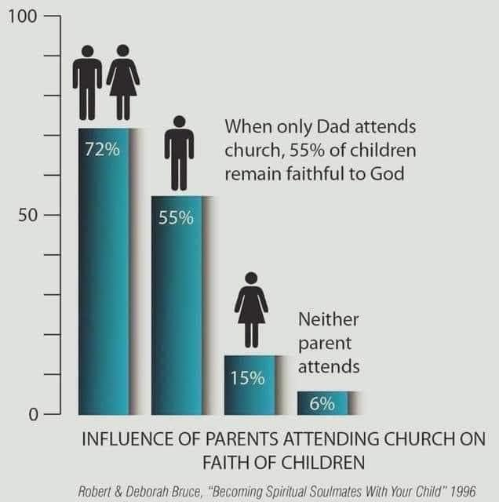
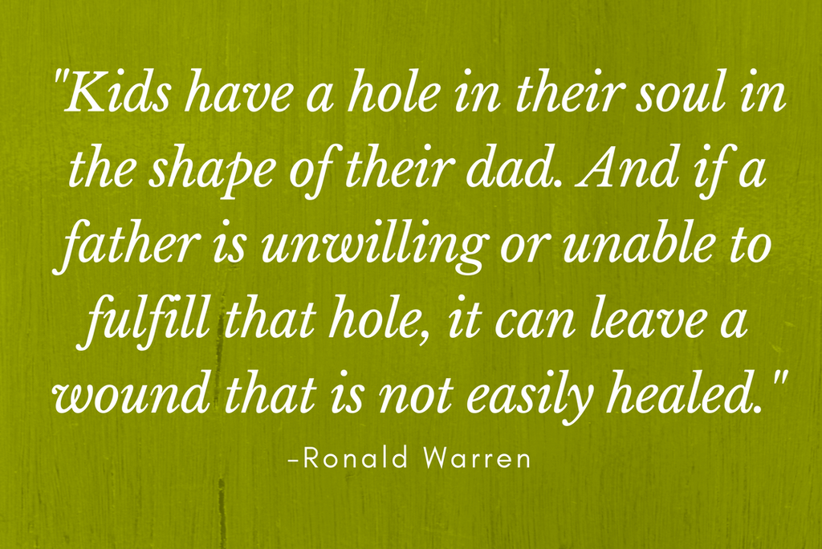
A Father’s Influence
Notes:
Read off the slide and give personal example. It has been said … I can relate to this because when I was a child, I hardly got any attention and affirmation from my dad, That not that he can’t; he cleared favoured my sisters but with me it was always cold and distant. What made matters worst was that his parents, my paternal grandparents ill-treated my mum and my dad didn’t protect nor stood up for my mum. So growing up I had a dim view of authority figures. I grew up being a rebel. It took me almost 50 years before I could unlearn and relearn a new script about what a father’s love, a father’s heart can be.
Explain the research finding of a world-wide study conducted in Switzerland on the impact of fathers on the faith of their children … [ no offense / disrespect to the women-folk ] it is merely to point to the role of the father and a father’s influence on his children, especially in their faith formation … essentially the study pointed out that if dad is the regular church-goer, chances of the children being regular church-goers are higher than compared to mum; …

Slide 13
A Father’s Influence
Notes:
For the dads among us, perhaps it’s a reminder that you are your daughter’s first love and your son’s first hero. But before the women-folk here all start to leave; … It bears reminding that a child has a right to a father and a mother.

Slide 14
A child has a right to a father and a mother
Notes:
It bears reminding that a child has a right to a father and a mother. Both play important, necessary and complementary roles in the upbringing of a child, while we also want to understand the plight of single parents who for whatever the reasons – they end up playing the role of both father and mother. Even Jesus, in growing up, he needed both the paternal and maternal attention and influence of Joseph and Mary in order that he may grow in wisdom and stature before God and men. Remember when God created Man, He said it is not good for Man to be alone. I shall give him a Help-Mate, an ezer – a life partner of equal dignity, for God made Woman not from the Head nor the Foot of the man but from the side near to his heart so that Man & Woman as husband and wife – they complete each other. We will discuss more of the biblical order of the family as we progress on in our study of St Joseph

Slide 15



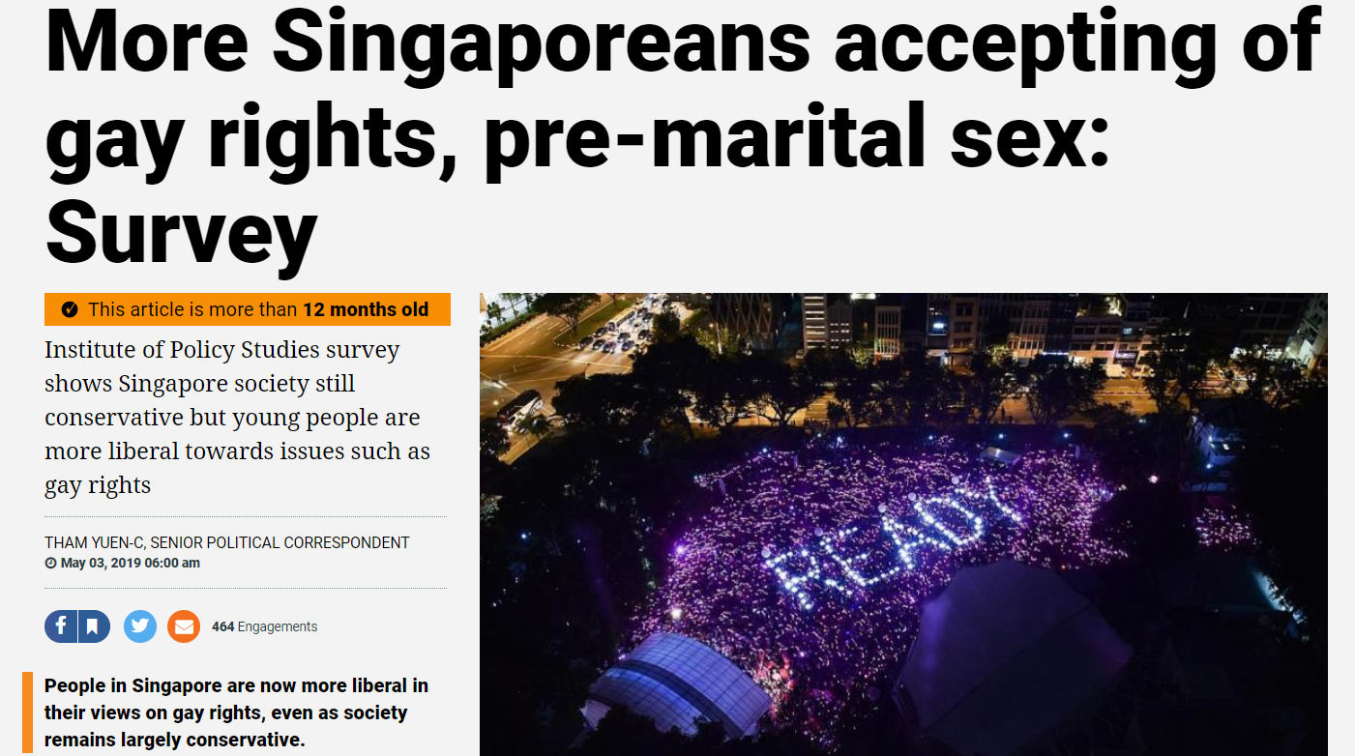
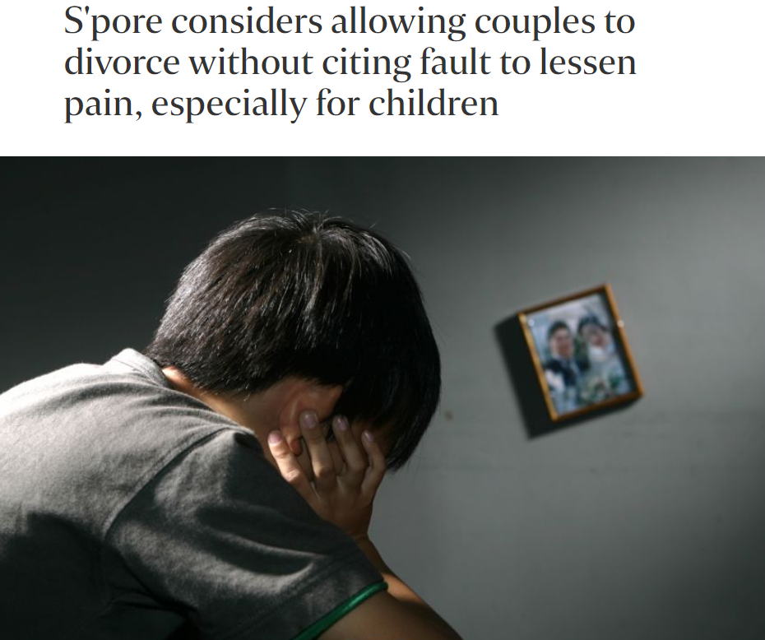
Signs of the times around the world and in Singapore
Notes:
You would have read these in the news; these aren’t just about western culture gone wrong; These issues are right in our back-yard. An Institute of Policy Studies survey shows that while Singapore society is still relatively conservative, our young people are increasingly far more liberal towards issues like gay rights, same-sex marriage, pre-marital sex, etc. School sex education is more about safe sex than it is about the virtues of abstinence. And Singapore’s fertility rate is still well below its replacement rate – seems like we are still hung over from those days when the slogan was Boy of Girl, two is enough. And nowadays, it’s not surprising to hear couples say that no children is fine too!
There are also fewer marriages and when couples do get married, they marry at a later age and increasingly those marriages end in a divorce.

Slide 16

Signs of the times around the world and in Singapore
Notes:
More couples, especially the recently married are getting divorced. 29% of divorces happen between the 5th – 9th year of marriage.

Slide 17

Why Do Couples Get Divorced?
Younger couples are less likely to be bound by traditions
and the idea of lifelong commitment to an individual.
Increase in family stress factors. Couples are also not afraid
to get out of unhappy marriages. This confidence is a significant
contributor to the higher divorce rates in Singapore.
Dual-income couples with more focus on their careers.
Thriving careers and never-ending deadlines have also overpowered marriages. It can eat into the time that couples need to spend with each other. Such couples have limited knowledge about their partners and are less capable at resolving conflicts.
Ending a marriage late also has its own set of challenges like that of children. For many people, the idea of starting afresh at a later stage in their life is discouraging.
Signs of the times around the world and in Singapore
Notes:
Read off the slide … Based on a NUS study, …
Point 4: They can be excellent managers at work but they can’t deal with their own spouse.
Point 5: Better to call it quits early than later.

Slide 18
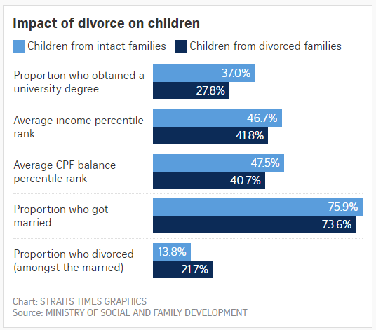
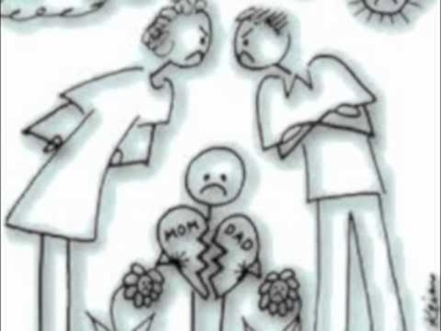
COLLATERAL DAMAGE
Notes:
And not surprisingly the children are most affected by a divorce. See chart from MSF on the impact of divorce on children. Generally speaking, children from intact families fare better than children from divorced families.

Slide 19
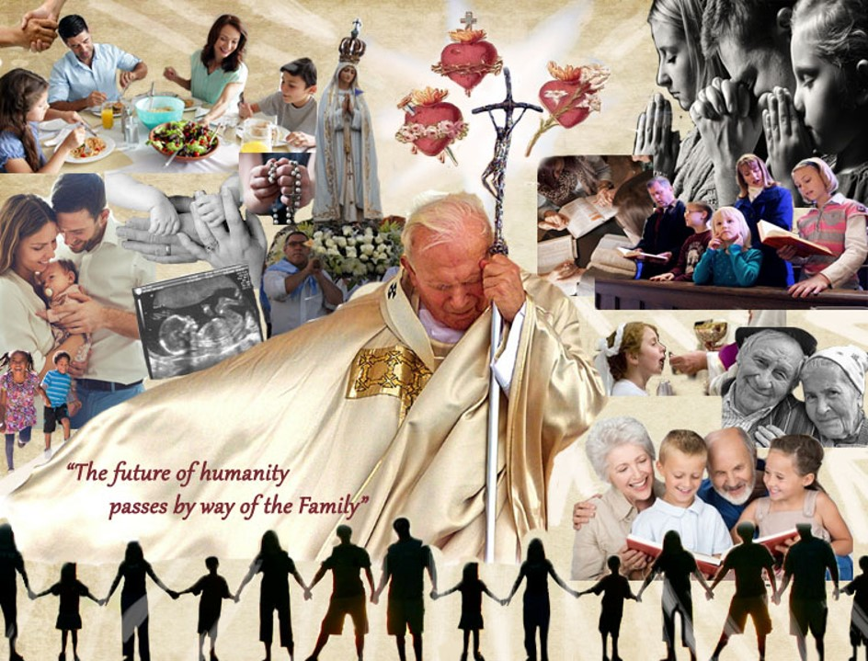
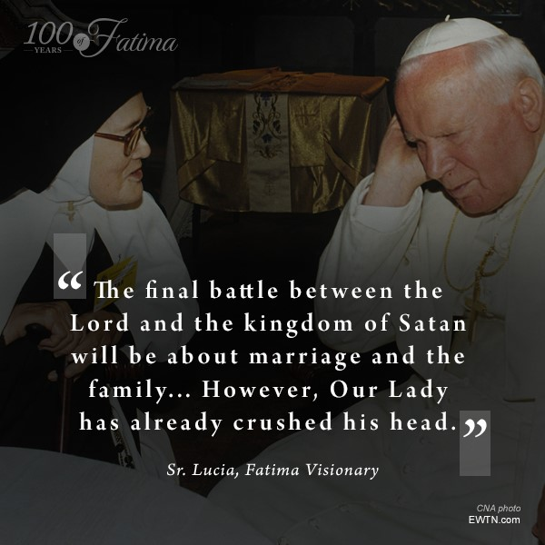
Marriage and Family – the final battleground. The future of humanity passes by way of the Family.
Notes:
St John Paul II was convinced that the well being of both society and the Church depended on the health and strength of the family. Anticipating the coming crisis, he wrote “The future of humanity passes by way of the family. By 1981, John Paul II could see that “the family is the object of numerous forces that seek to destroy it or in some way to deform it.” In a letter to Cardinal Caffarra, Sr Lucia Dos Santos, the Fatima Visionary wrote “The final battle between the Lord and the Reign of Satan will be about marriage and the family.”
I’m not sure if you can see the three hearts of the holy family surrounding the Cross of Christ that SPII is carrying – the scared heart of jesus, the immaculate heart of mary and the chaste heart of joseph

Slide 20
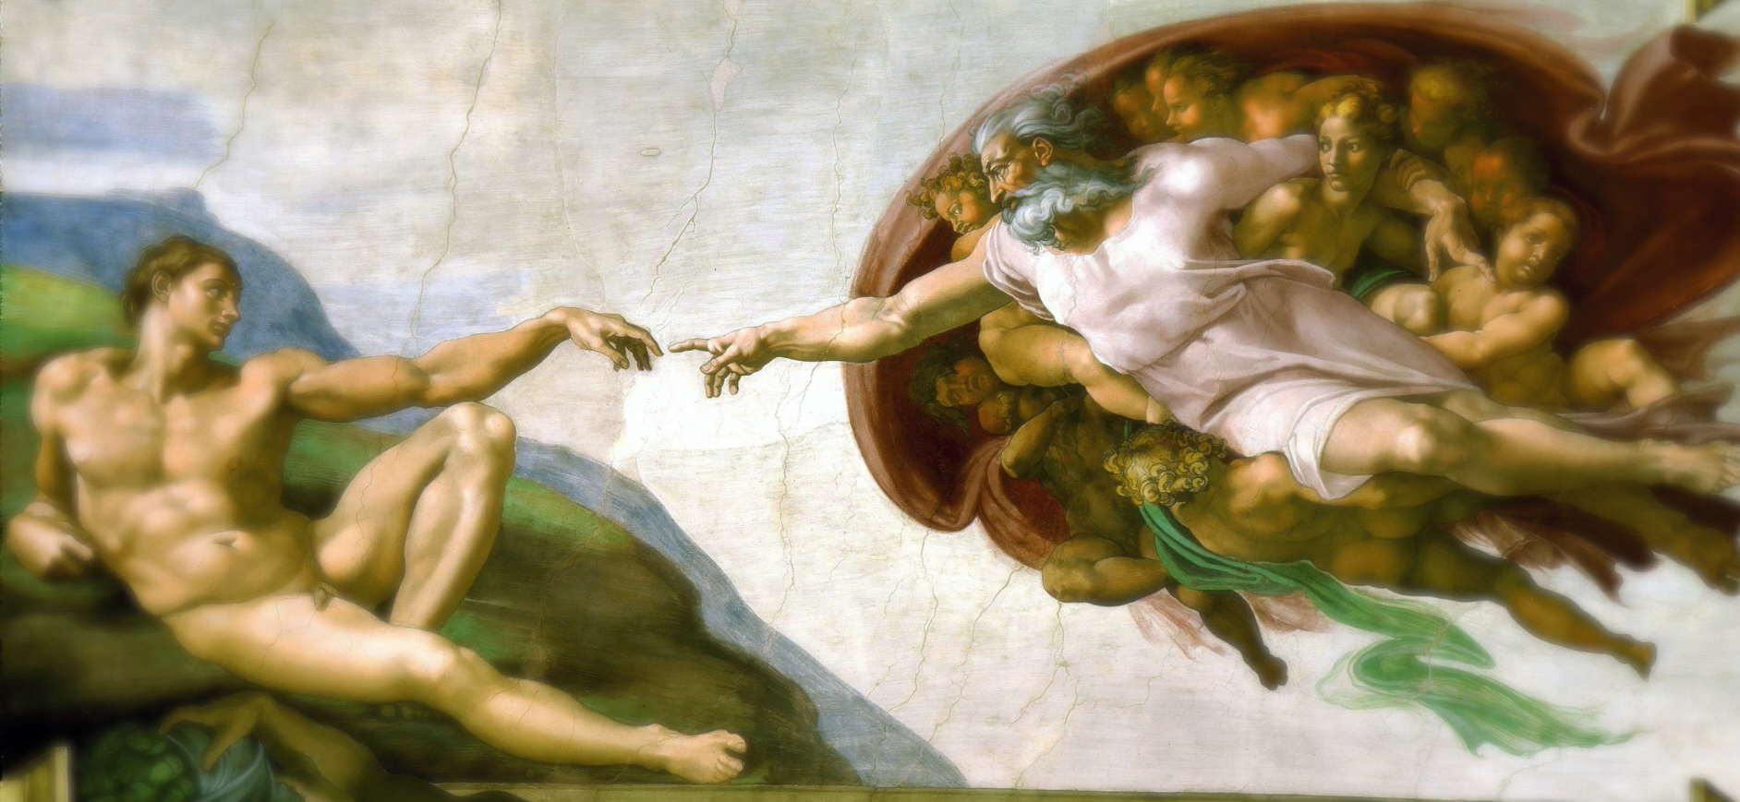
“God is his deepest mystery is not a solitude but a family because he has within himself Fatherhood, Sonship and the essence of the Family, which is Love.” [St Pope John Paul II]
“The family is entrusted to a man, a woman and their children so that they may become a communion of persons in the image of the union of the Father, the Son and the Holy Spirit.” [Pope Francis]
Satan seeks to destroy this union
Notes:
God is Love. And God is Family. He has within himself Fatherhood, Sonship and the essence of the Family, which is Love. The family is entrusted to a man, a woman and their children so that they may become a communion of persons in the image of the union of the Father, the Son and the Holy Spirit. Satan hates that and will go all out to destroy this union that is the very icon of God.

Slide 21
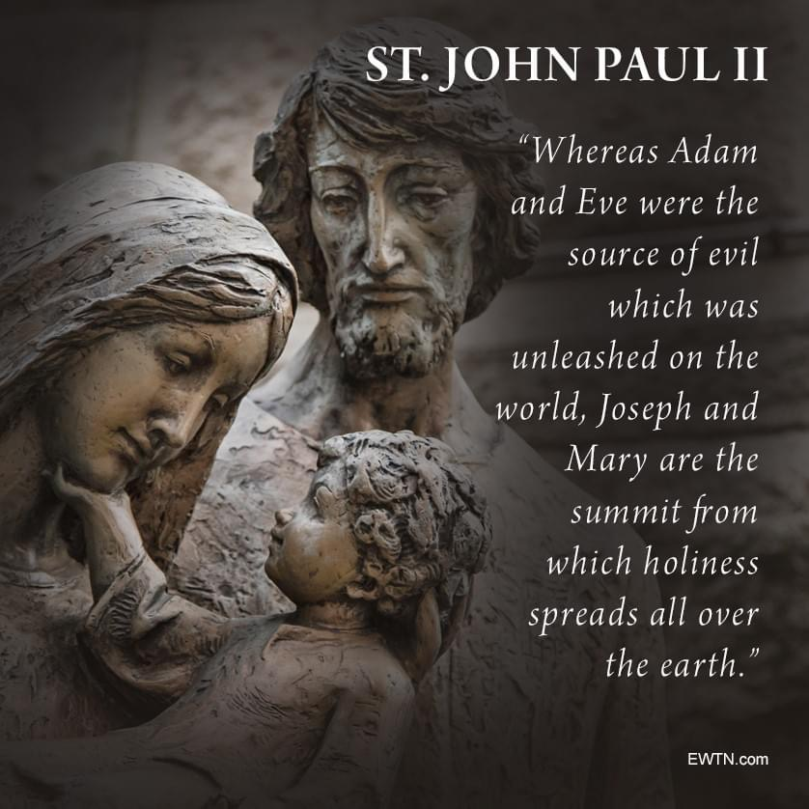
Marriage and Family – the final battleground. It’s time to turn to an unsung hero to help us.
Notes:
He already succeeded in causing the Fall of Adam and Eve. But where Adam and Eve had failed, Joseph and Mary’s fiat and obedience to the Father’s will brought about salvation through Jesus. Truly there’s not a more urgent time as now to turn to an unsung hero to help us. To be consecrated to St Joseph means we acknowledge him as our spiritual father and we seek to be like him in virtue and holiness. We can turn to the chaste heart of Joseph besides the sacred heart of jesus and the immaculate heart of mary.
To quote Fr Calloway in his book he wrote “Now is the time to consecrate yourself to St Joseph! God is telling the Church that in order to defend marriage and the family, elevate morals, recover lost ground and win souls for Jesus Christ, we need to bring St Joseph onto the battlefield. He is the Terror of Demons.* [And we shall see why when we come to that chapter.] * Joseph tricked Satan and hid the virgin birth of Jesus from the Devil; the secret of the incarnation until Jesus’ hour had come. CCC 498: Mary’s virginity and giving birth escaped the notice of the prince / rulers of this age. To the world it was a normal marriage where husband and wife are expected to consummate their marriage and to have children. But Joseph and Mary’s chaste virginal marriage and Jesus’ virginal birth remained hidden and the Devil could not suspect anything. To learn more of this you’ll have to stick around and continue on with this study!

Slide 22
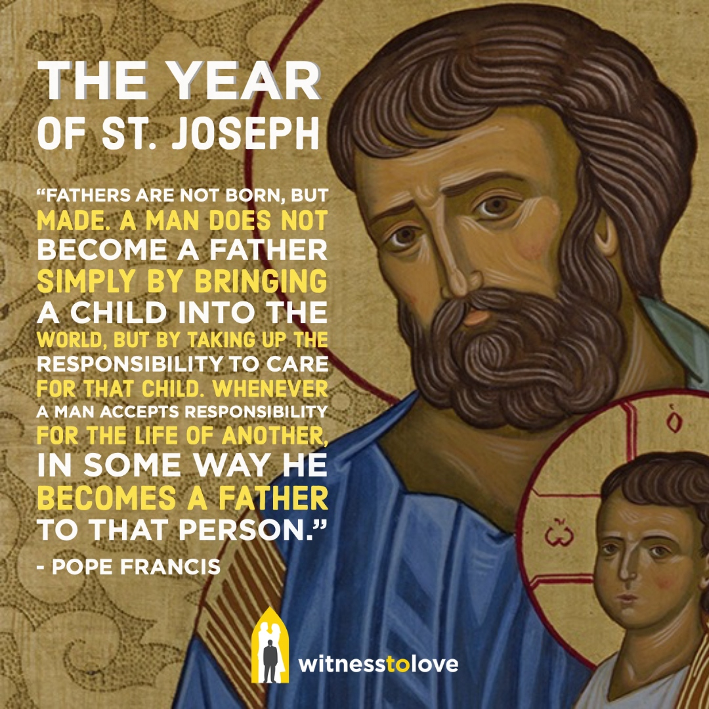
A Father’s Influence
Notes:
So in this year of St Joseph we turn to the just man; not just a man but a man’s man. Even while Jesus is not his son by blood, he loved and raised Jesus as his own. Pope Francis wrote “Fathers are not born but made. A man does not become a father simply by bringing a child into the world but by taking up the responsibility to care for that child.” Admittedly it is easier for men to relate to the virtues and qualities of St Joseph as husband, father, protector and provider. Next to Jesus, he is the perfect model of Christian masculinity. For the women, you might ask: “What is the relevance of St Joseph to me as a Christian woman? It’s much easier to relate to Mary as wife and mother. But if Mary is your mother in the order of grace as the Catholic Church teaches and as Jesus said as he lay dying on the cross: “Behold your Mother!” then wouldn’t you also claim the privilege of having St Joseph as your spiritual father whom you can turn to for guidance and protection?
As mentioned earlier when God created Man, he also gave him a Help-Mate, an ezer – a life partner of equal dignity; You as your husband’s ezer can help, encourage and support him to acquire more of the virtues and attributes of St Joseph. [Which is what my wife Allyson does. Instead of grumbling and pointing fingers – Why can’t you be more like St Joseph? Why can’t you step up? She gently and quietly nudges me to know more about St Joseph so as to acquire more of his traits and virtues. In all of my previous 5 sessions I’ve run she has either been praying hard for me while I’m running a session like now or she is beside me in running a 33-day consecration to St Joseph. And she continues to pray everyday calling out to St Joseph to inspire and guide me in my life coz she knows I can be quite stubborn.
Now we know Joseph has the heart of a servant as he lovingly and faithfully served Mary and Jesus. A prime example of servant leadership. Can we not ask him to teach us to serve in humility and graciousness? St Joseph persevered and endured his trials and challenges stoically; seeking always to fulfil God’s will, even when he does not have the full big picture. He gave himself totally and unreservedly to Mary and Jesus, placing their needs and interests before his; choosing to remain in the background while preparing both Mary and Jesus for the trials that are to come when he can no longer be with them. Scott Hahn uses the analogy of a spousal dance in which the husband leads but he showcases his wife such that she is the center of attention and admiration. Both husband and wife can learn from St Joseph how to be a pure gift to one another.

Slide 23
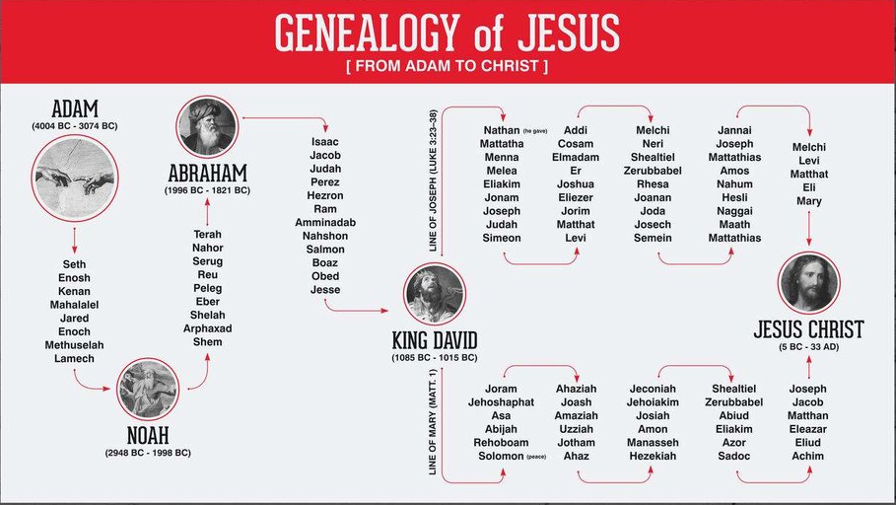
Saint Joseph, Noble Offspring of David
MARY
JOSEPH
The blood of David, of Solomon, and of all the kings of Judah flows in his [Joseph’s] veins. St. Peter Julian Eymard
Notes:
So who is St Joseph? He is the noble offspring of David. The blood of David, of Solomon and of all the kings of Judah flows in his veins. By the time of the birth of Christ, Judea had been lost to the Romans and the descendants of King David had lost their royal birth-right and their place in line for the throne. Herod the Great, who was appointed king of the Jews by the Roman senate, had usurped the throne. But Joseph remained a part of this Davidic lineage and is actually the rightful heir to the throne. Yet for the sake of the mission entrusted on him, he remained hidden and gave up on his right to the throne and instead took on the form of a lowly carpenter. This is to avoid attention coming on to him and thereby endangering the life of the child Jesus. Again, we will get into more details when we come to the chapter on Saint Joseph as the noble offspring of King David.

Slide 24
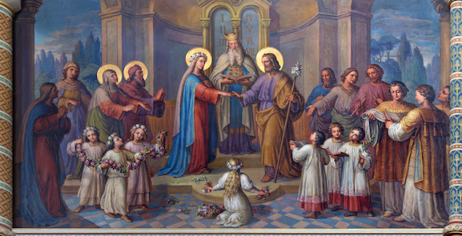
Joseph, the key that closes the Old Testament and opens the New!
And Jacob was the father of Joseph the husband of Mary, of whom Jesus was born, who is called Christ.
Notes:
St Joseph’s mission and his role in salvation history is clearly evident as we read in Matthew’s genealogy of Jesus … “And Jacob was the father of Joseph the husband of Mary of whom Jesus was born who is called Christ.”

Slide 25
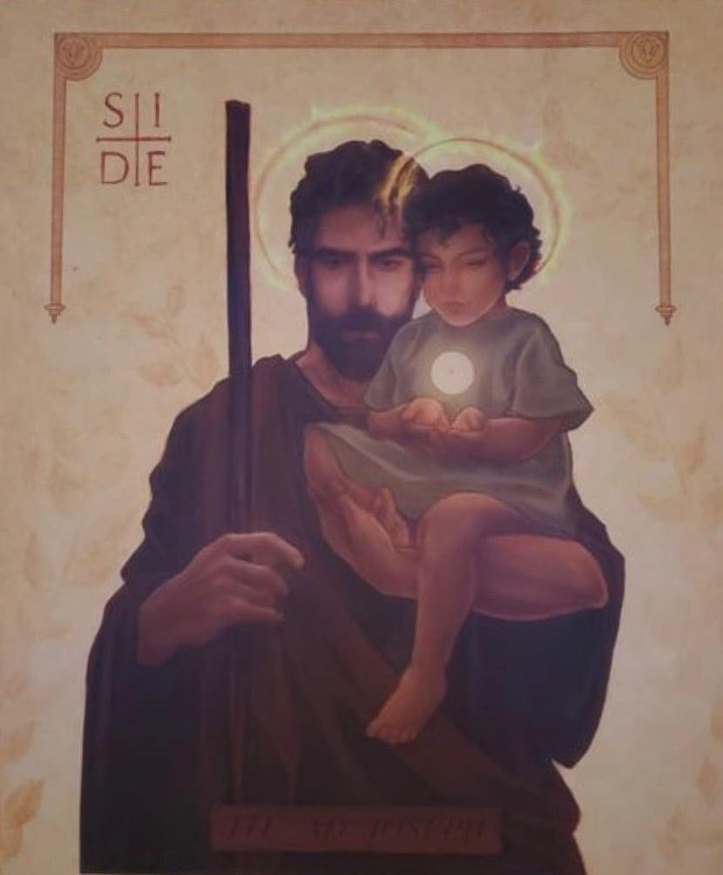

As Almighty God appointed Joseph, son of the patriarch Jacob, over all the land of Egypt to save grain for the people, so when the fullness of time was come and he was about to send on earth his only begotten Son, the Saviour of the world, he chose another Joseph of whom the first had been a type, and made him the lord and chief of his household and possessions, the guardian of his choicest treasures.
Blessed Pope Pius IX
This icon is titled "St. Joseph, Defender of the Eucharist." It is at the Cathedral of Our Lady of Perpetual Help in Rapid City, South Dakota.
Today, there is a worldwide spiritual and moral famine on the earth.
Ite ad loseph! “Go to Joseph and do whatever he tells you!” Genesis 41: 55
Notes:
In the Old Testament we find the story of Joseph the son of the patriarch Jacob who had the ability to interpret dreams. His jealous brothers sold him into slavery. But he rose from imprisonment in Egypt to become the 2nd most powerful man after the Pharoah. He foresaw there would be 7 years of plenty followed by 7 years of severe famine. He was thus able to save Egypt as well as the world from starvation with all the grain he had stored. But the New Testament Joseph did even better. He saved the Living Bread Jesus that gives eternal life. [Read off the top portion of the slide.] Today there is a worldwide spiritual and moral famine on the earth. It is time to go to Joseph.

Slide 26
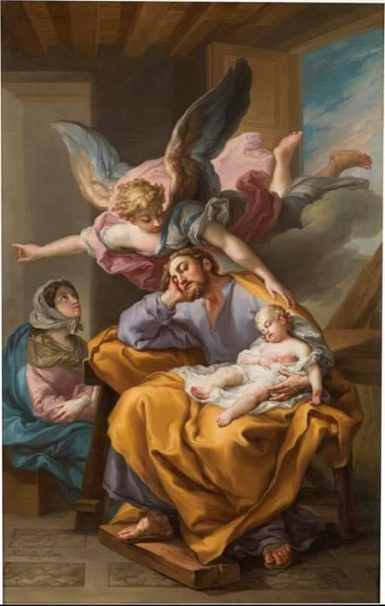
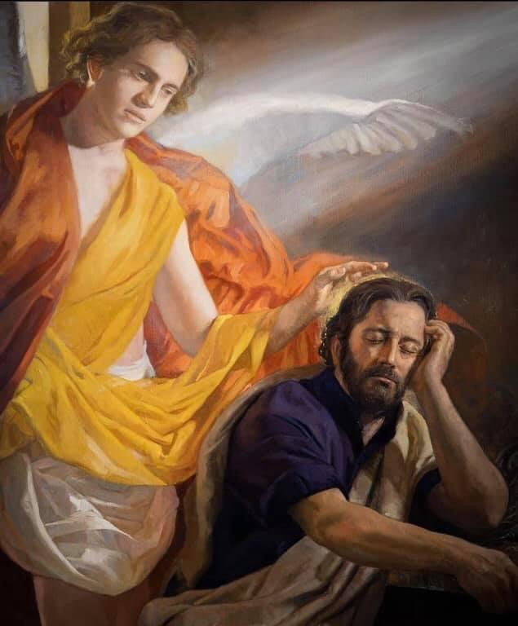
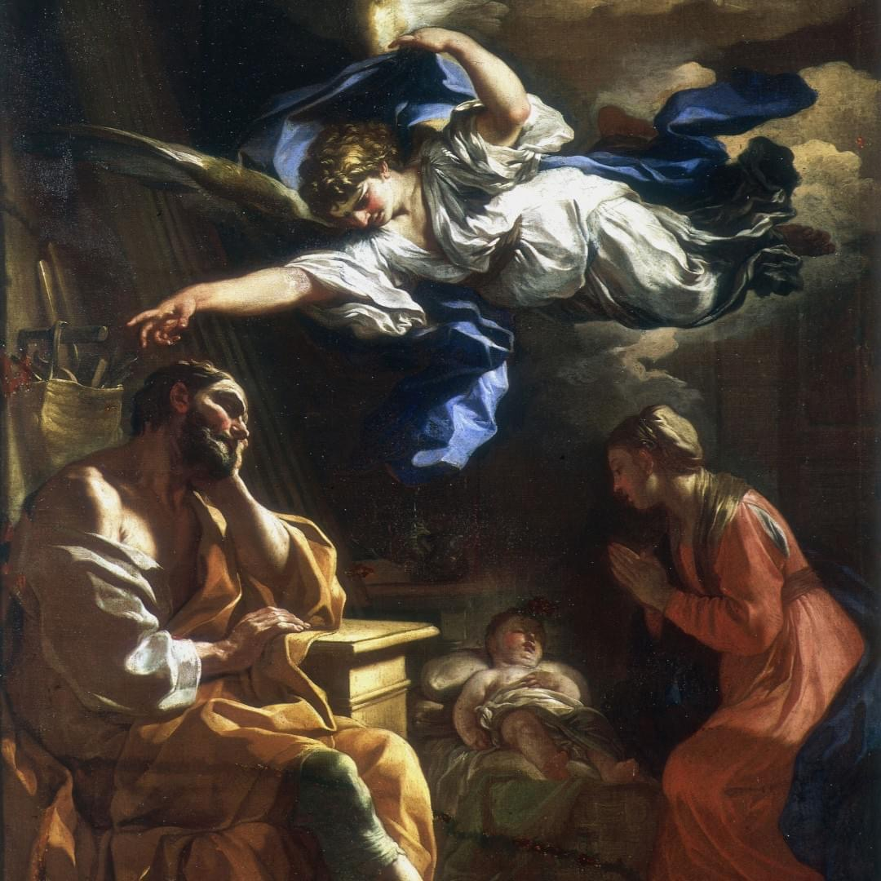
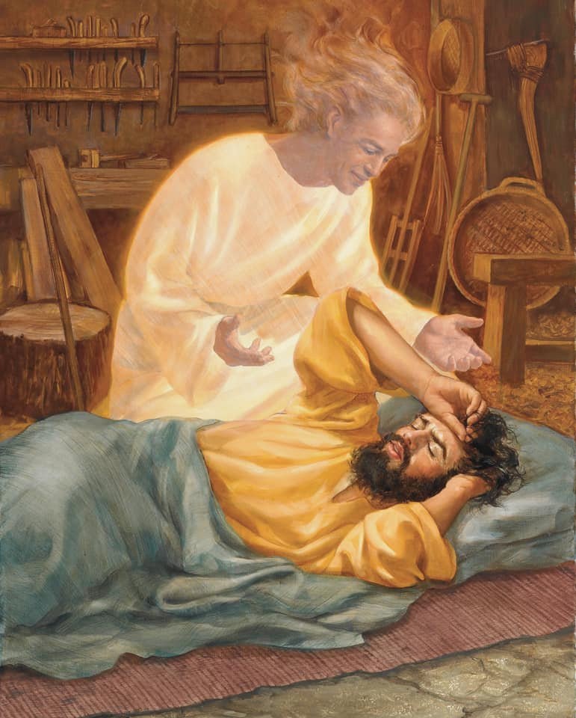
Joseph’s Fiat
Matt 2: 19-21
Matt 2: 22-23
Matt 1: 20-24
Matt 2: 13-15
Saint Joseph’s docility to the Holy Spirit made it possible for him to communicate with God even while he slept!
Notes:
The New Testament Joseph was also a dreamer. God communicated with him through his dreams. Through an angel, he was assured that Mary was with child through the Holy Spirit and he should take her as his wife and name the child Jesus. Later the angel came to warn him that their lives were in danger as King Herod had sent his soldiers out to look for Jesus to kill him. After hiding in Egypt for some time, the angel told Joseph it was safe to bring the Holy Family back to Israel but mid-way, the angel further warned that they should head to Nazareth instead of settling in his ancestral home of Bethlehem. When Joseph awoke from each of these dreams, he wasted no time and acted swiftly and decisively, obeying what the angel had instructed him to do.

Slide 27
Hebrews 1 … “At many moments in the past and by many means, God spoke to our ancestors through the prophets; but in our time, he has spoken to us in the person of his Son, …”
How has God reached out to you? Are you aware of God’s presence and prompting in your life?
What is God calling you to [in this season of your life]?
Something to ponder …
Notes:
So perhaps we paused for a bit and consider this …

Slide 28
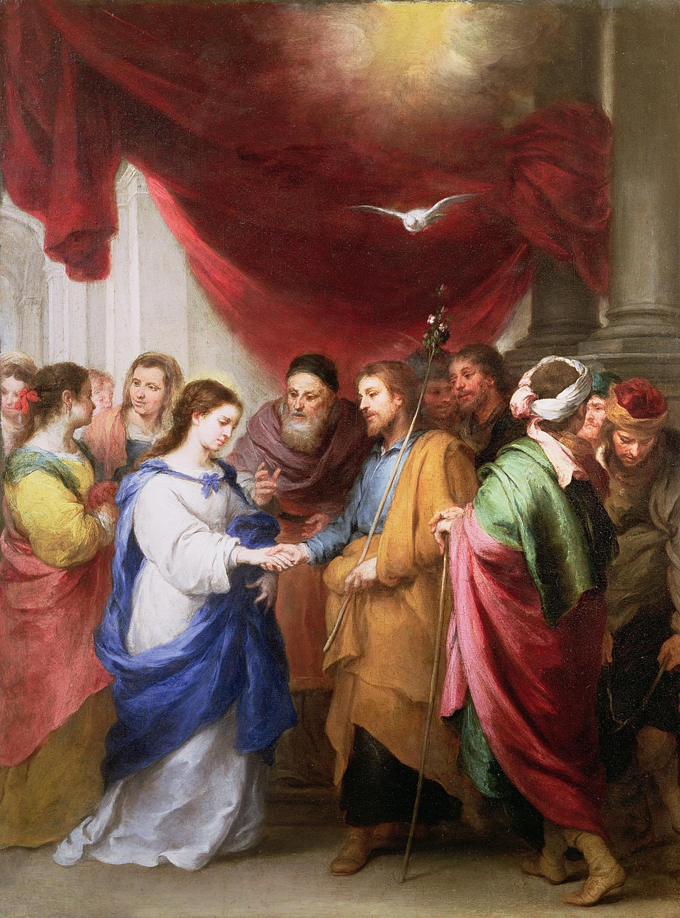
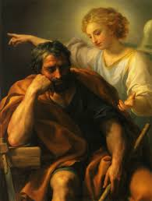
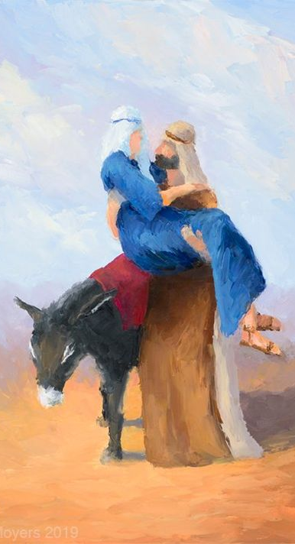
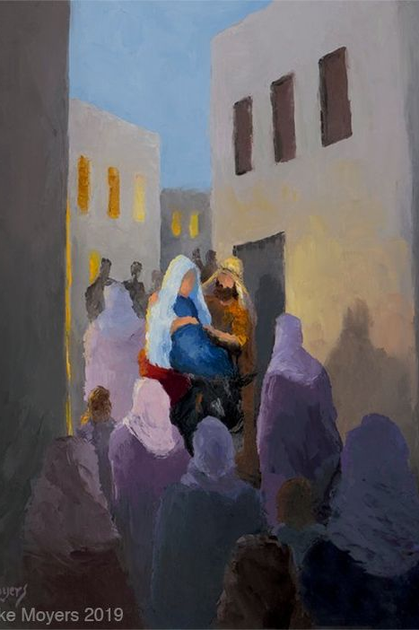
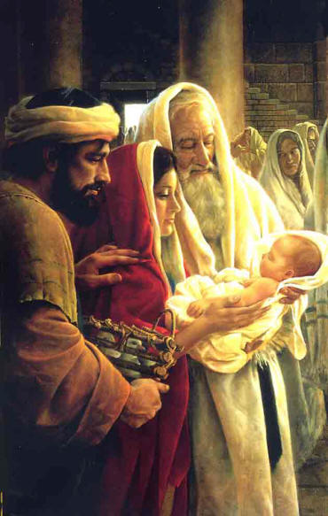
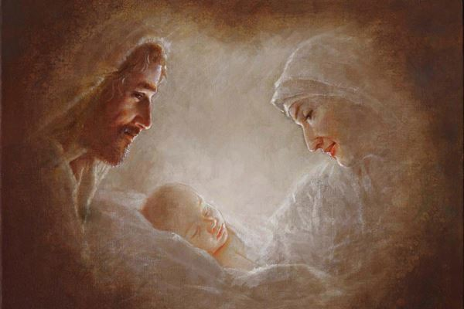
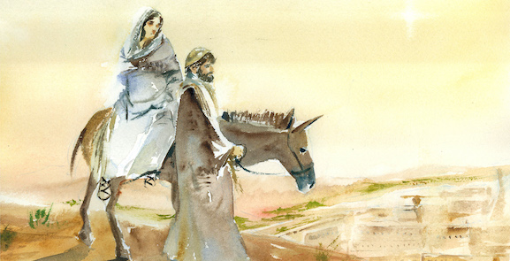
Joseph’s Fiat
These encounters showed Joseph’s total obedience to God.
He protected his family. He was instrumental to God’s plan of salvation.
He participated perfectly in the fulfilment of the scriptures.
Summary from the four dreams
Notes:
We can see from all these encounters that Joseph was completely obedient. He did what he was told to do. He protected his family. He was instrumental to God’s plan of salvation. He participated perfectly in the fulfilment of the scriptures.

Slide 29
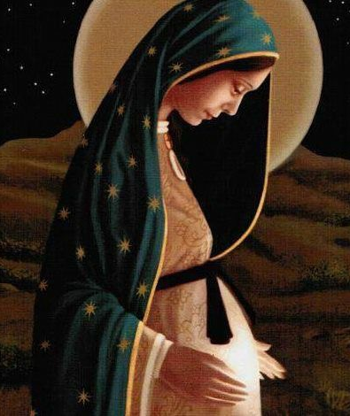
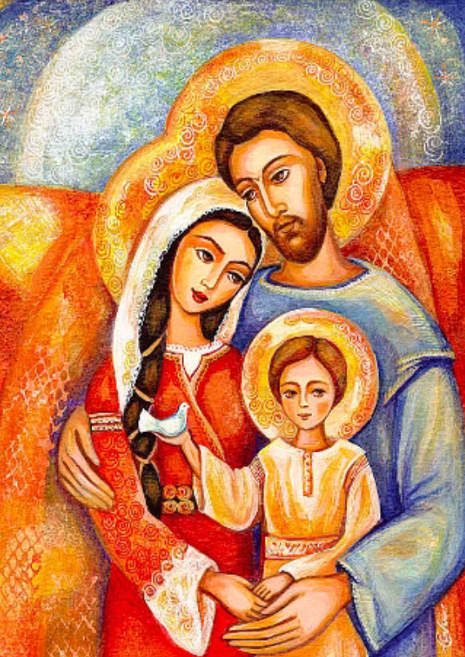
Joseph’s Fiat ensured that
Mary was not stoned.
Jesus was not murdered by Herod.
As God’s chosen earthly representative, he nurtured
Jesus who grew up in wisdom and stature before God and man.
Jesus lived to complete and fulfil his own mission.
Joseph completes the Holy Family and aids in God’s plan of salvation
Notes:
Read off the slide …

Slide 30
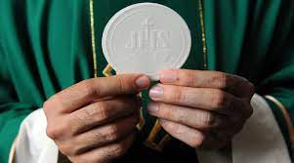
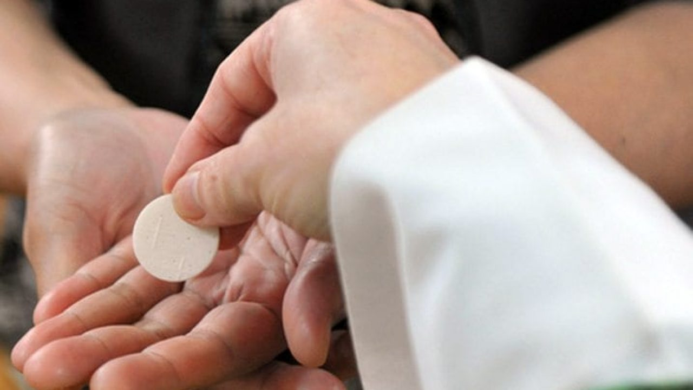
Today we can partake of the Body and Blood of Jesus Christ
because of Joseph’s protection at the beginning.
A far reaching protection
Notes:
Read off the slide … when you next attend Mass and receive the Eucharist, spare a thought for Joseph. Today we can partake of the Body and Blood of Jesus Christ because of Joseph’s protection at the beginning.

Slide 31
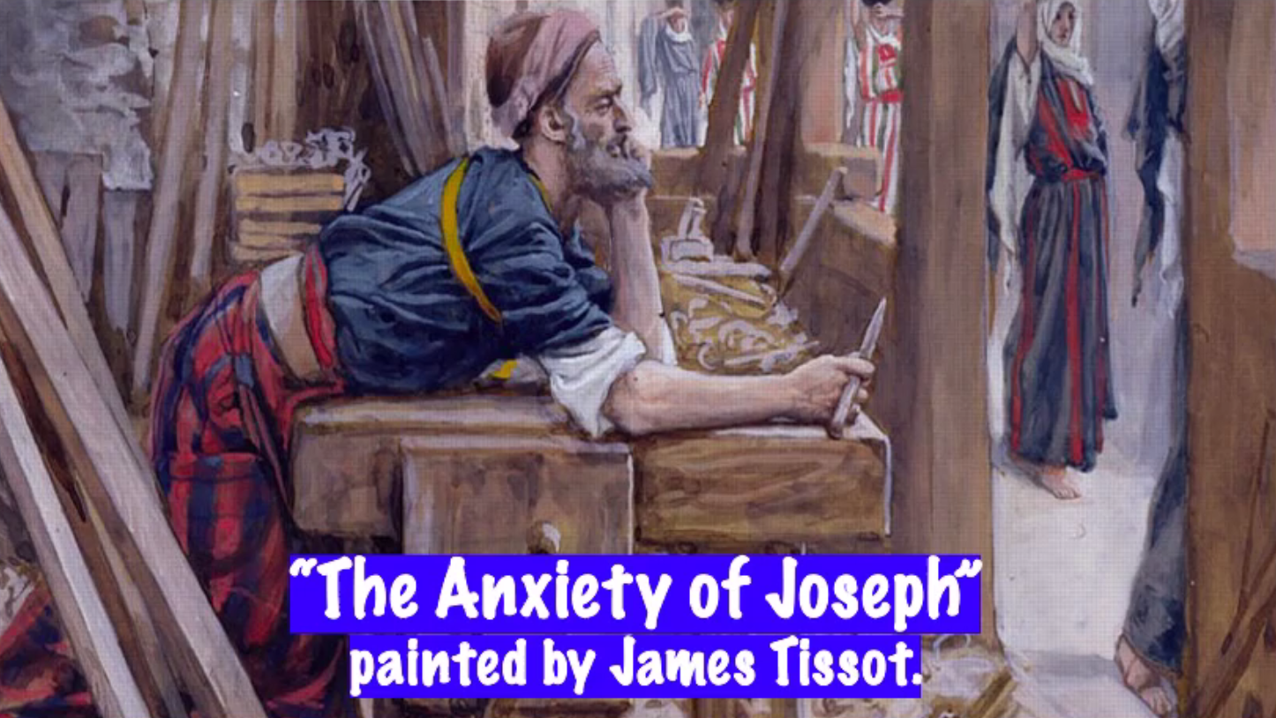
Saint Joseph, your every day man, simple carpenter, average working class Joe
Notes:
Dr Pitre in his talk on the Hidden King of the Jews said that in fulfilment of his mission Joseph gave up his own kingship and chose instead to live the quiet humble life of a carpenter. Hidden from the rulers of the age, he protected the mother and child until it was time for Jesus to begin his public ministry. And like us, Joseph too had his fears and anxieties. [You may recall that during Pentecost before the Holy Spirit descended on the apostles; they were huddled in the Upper Room and they were fearful. Yet they gathered together to pray and God responded by sending forth the Holy Spirit.]

Slide 32
“Even through Joseph’s fears, God’s will, his history and his plan were at work. Joseph, then, teaches us that faith in God includes believing that he can work even through our fears, our frailties and our weaknesses. He also teaches us that amid the tempests of life, we must never be afraid to let the Lord steer our course. At times, we want to be in complete control, yet God always sees the bigger picture.”
Patris Corde – Apostolic letter of Pope Francis on the 150th anniversary of the proclamation
of St Joseph as Patron of the Universal Church.
Notes:
Read off the slide … Joseph too prayed fervently to God. Even through Joseph’s fears …

Slide 33
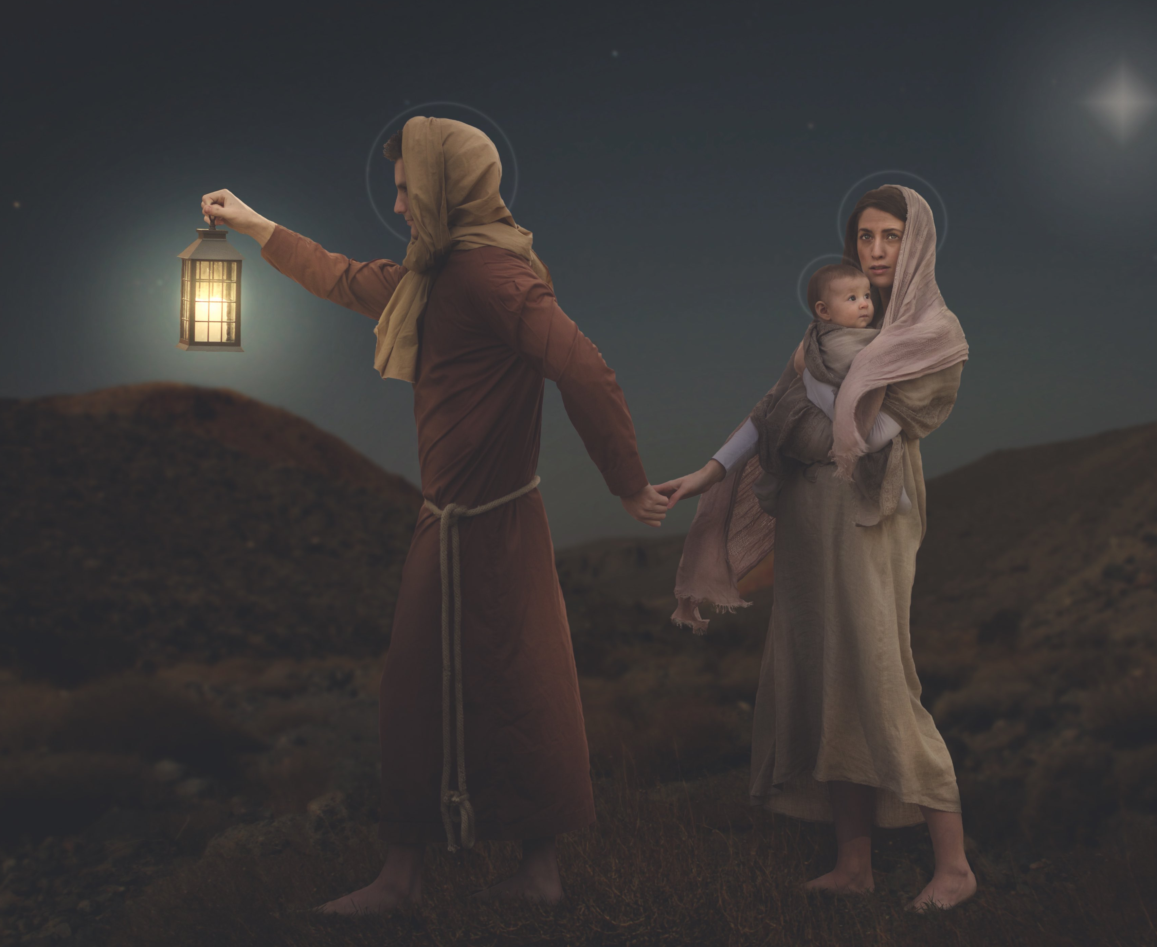
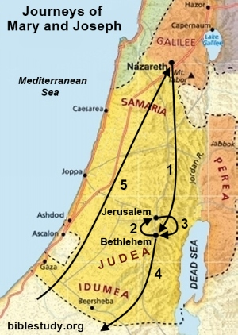
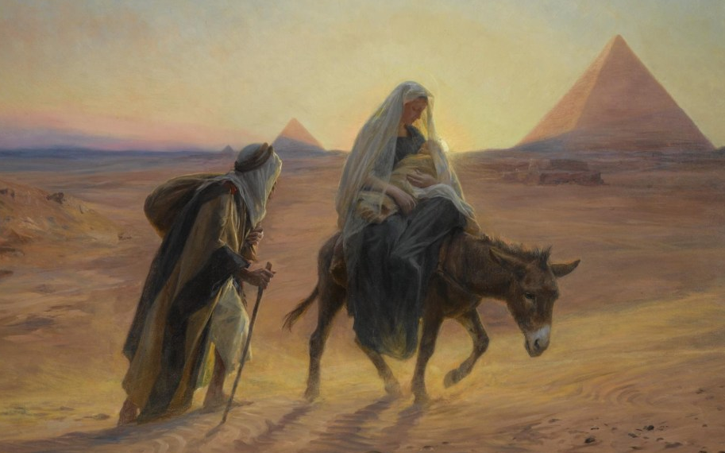

“Just as God told Joseph: “Son of David, do not be afraid!” (Mt 1:20), so he seems to tell us: “Do not be afraid!” We need to set aside all anger and disappointment, and to embrace the way things are, even when they do not turn out as we wish. Not with mere resignation but with hope and courage.”
The Will of God will not take you where the Grace of God will not protect you
Notes:
Read off the slide, … end with “The Will of God will not take you where the Grace of God will not protect you.”

Slide 34




Joseph Most Just, Chaste, Prudent, Courageous, Obedient, Faithful and Patient; Pray for us.
"Saint Joseph was a faithful and just man because of the love that filled his soul and made him love the paths that God’s Providence had marked out for him. With Saint Joseph, the Christian learns what it means to belong to God and to assume one’s place among men, sanctifying the world. Get to know Joseph and you will find Jesus. Talk to Joseph and you will find Mary, who always sheds peace about her in that attractive workshop in Nazareth.”
St Josemaria Escriva
Notes:
Joseph has many virtues we can learn to emulate as we embark on this 33-day consecration. St Josemaria Escriva the founder of Opus Dei tells us that Saint Joseph was … (read off the slide)

Slide 35

Joseph completes the Holy Family
Membership in the Holy Family of Nazareth - Accepting St Joseph as our father, Mary as our mother and Jesus as our brother is the surest, easiest and quickest way of becoming a member of the Trinitarian family in heaven.
“St Joseph is head of the Holy Family, father of the trinity on earth which resembles so closely the Holy Trinity on high.”
St Peter Julian Eymard
We are made for Heaven
Notes:
Indeed if we have so readily consecrated ourselves to Mary and Jesus, then a consecration to St Joseph who is Head of the Holy Family and the Father of the Earthly Trinity, would be a natural choice. Membership in the Holy Family of Nazareth – Accepting St Joseph as our father, Mary as our mother and Jesus as our brother is the surest, easiest and quickest way of becoming a member of the Trinitarian family in heaven. And we are made for Heaven.

Slide 36

Only Jesus can bring us home to our Father in Heaven.
To Jesus; through Mary and Joseph.
Notes:
And we know only Jesus can bring us home to our Father in Heaven.
So everything we learn about St Joseph must first:
1. Lead us to a closer relationship with Jesus and
2. Help us understand more of the nature of God the Father and his plan for the salvation of the world. [If we look too narrowly in our study of St Joseph, invariably we will get uncomfortable and think we are turning St Joseph into a larger hero than he is; which I can tell you, St Joseph himself will not be comfortable for in everything he has placed Jesus and Mary ahead of himself and like John the Baptist, they must increase while he decreases. Joseph did what he did for the love of Abba Father, Jesus & Mary. When one actor's role is done, he must exit the stage. God is the author and script writer. So, in this consecration journey, we must reflect:
As I learn more about St Joseph, can I discover more what's God's plan for me? How can I be more like St Joseph in order that I may walk closer with Christ Jesus?
The hero in our story is Jesus Christ. He is the Messiah and it is only by his name that we are saved. Take this analogy: For sure when you go visit your BFF Jesus, you'll want to say Hello to his parents as well, Uncle Joseph and Aunty Mary. [It’s the polite thing to do, right?] If you can't find Jesus, then you'll want to ask Uncle Joseph and Aunty Mary where's Jesus? Where did he go? His parents will probably tell you: Don’t scared, we'll bring you to him. We lost him once for three days, a long time ago; but not to worry, siah, we won't lose him again. So, if you need to look for Jesus in a hurry, come to us!
To Jesus; through Mary and Joseph.

Slide 37
What has been my experience of St Joseph? How much do I know about him? Has he been a part of my faith journey? What would I like to learn from these 33 days?
In knowing more about Joseph, am I open to letting Joseph lead me closer to Jesus and to learning more about God’s plan for me?
Group Reflection & Discussion Questions
Notes:
And that concludes my presentation for now; … time for the group buzz. The suggested questions are …

Slide 38

S | SHARE AUTHENTICALLY Let love be without pretence. – Romans 12:9
A | ACCEPT ONE ANOTHER Therefore accept one another just as Christ also accepted us to the glory of God. – Romans 15:7
F | FIX NOT THY BROTHER
E | ENCOURAGE ONE ANOTHER Therefore encourage one another and build up one another just as you are doing – 1 Thessalonian 5:11
Group Reflection & Discussion Questions
Notes:
Some simple ground rules - allow everyone a chance to speak. Stick to the subject matter. Listen to, accept and affirm each sharing. We are not here to fix one another but to encourage and support each other in our path to holiness. As the saying in Proverbs goes – iron sharpens iron.

Slide 39


33-Day Consecration to Saint Joseph

Slide 40




While the Church does not consider it obligatory to believe private revelations as a matter of faith, these books all have received an Imprimatur and Nihil Obstat from the Vatican officially declaring them free from doctrinal and moral error.
Servant of God
Mother Cecilia Baij
Venerable Maria de Agreda
Blessed Anne Emmerich
St Bridget of Sweden
Private visions / revelations

Slide 41

Dr Brant Pitre Professor of scripture at the Augustine institute

Slide 42
Start to be familiar with the litany of St Joseph as you will be asked to pray this litany each day of the 33-day consecration.
Read the assigned pages for each day of the journey. As we start today, Day One, read the introduction and the content for Day One. Subsequently, just move on with the readings for each day.
Thereafter, you may wish to view Fr Calloway’s video for each day.
In the consecration chatgroup I will post instructions, share notes and resources, post the daily summary, answer questions and clarifications, remind of the upcoming session, and providing the reflection and discussion questions ahead of our group meetings.
How shall we begin?

Slide 43
Our group meetings via Zoom on Tuesday starting at 8pm are as follows:
20 July: Introduction to Saint Joseph / Day One.
27 July: Covering readings for Days 2-8
3 August: Covering readings for Days 9-15
10 August: Covering readings for Days 16-22
17 August: Covering readings for Days 23-29
20 August: Covering readings for Days 30-33
21 August: Consecration Day – Morning Mass at CDM to be confirmed
Our Group Meetings

Slide 44
Opening song / prayer followed by summary slide presentation of key concepts followed by Q&A to clarify anything we don't understand from our readings.
Then we break up into our respective discussion groups to buzz on a couple of reflection / discussion questions.
Then come back as a collective group to share group summary and end with prayer (Litany of St Joseph).
Structure of the Group Meetings

Slide 45


LITANY OF SAINT JOSEPH

