Slide 1
Family of Origin

Slide 2
OPENING PRAYER
Let us pray…..

Slide 3
Notes:
All 6 sessions are shown here: https://northpoint.org/thrive-online-curriculum
This is session 4 - https://northpoint.org/thrive-online-curriculum-session-4

Slide 4
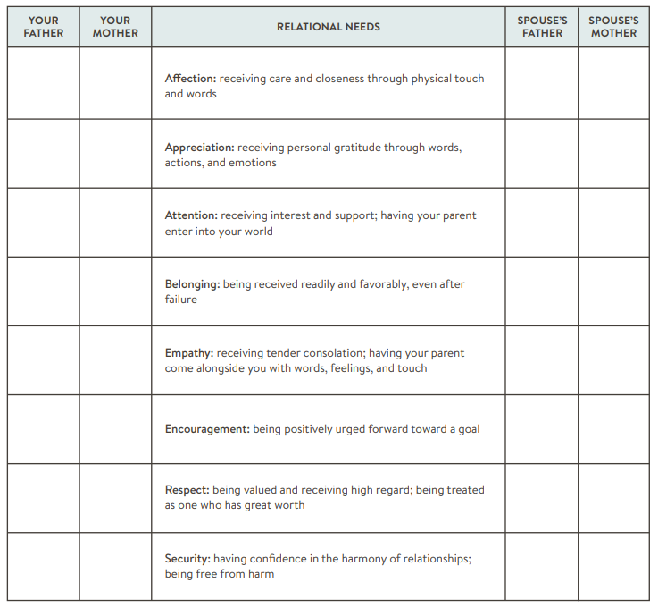
Relational Needs with Family
If a parent regularly met the need, write “yes” in the corresponding box. If a parent very rarely or never met the need, write “no” in the corresponding box. After completing the chart, discuss with your spouse the needs that were left unmet and consider their effects on you.

Slide 5
Closing Prayer
Lord, I pray that You would enable us to let go of our past completely. Deliver us from any hold it has on us. Help us to put off our former conduct and habitual ways of thinking about it and be renewed in our mind and spirit.
Enlarge our understanding to know that You make all things new.
Show us a fresh, Holy Spirit-inspired way of relating to negative things that have happened. Give us the mind of Christ so that we can clearly discern Your voice from the voices of the past.
When we hears those old voices, enable us to rise up and shut them down with the truth of Your Word. Amen

