Slide 1
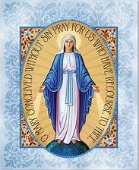
Final week
33 Days of Morning Glory retreat

Slide 2
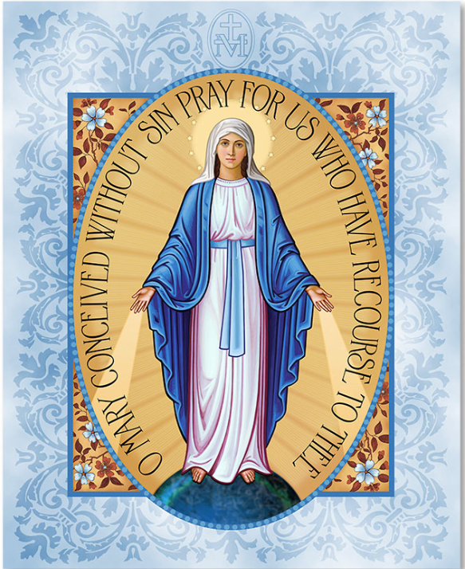
Notes:
Welcome everyone

Slide 3
Notes:
Gerry

Slide 5
Video - Part 1
33 Days of Morning Glory retreat
Week 5

Slide 6
The Litany of Loreto
V. Lord, have mercy. R. Christ have mercy. V. Lord have mercy. Christ hear us. R. Christ graciously hear us. God the Father of heaven, have mercy on us. God the Son, Redeemer of the world, have mercy on us. God the Holy Spirit, have mercy on us. Holy Trinity, one God, have mercy on us.
Holy Mary, pray for us. Holy Mother of God, pray for us. Holy Virgin of Virgins, Mother of Christ, Mother of divine grace, Mother most pure, Mother most chaste, Mother inviolate, Mother undefiled, Mother most amiable, Mother most admirable, Mother of good Counsel, Mother of our Creator, Mother of our Savior, Virgin most prudent, Virgin most venerable, Virgin most renowned,
Virgin most powerful, Virgin most merciful, Virgin most faithful, Mirror of justice, Seat of wisdom, Cause of our joy, Spiritual vessel, Vessel of honor, Singular vessel of devotion, Mystical rose, Tower of David, Tower of ivory, House of gold, Ark of the covenant, Gate of heaven, Morning star, Health of the sick, Refuge of sinners, Comforter of the afflicted, Help of Christians, Queen of Angels, Queen of Patriarchs, Queen of Prophets, Queen of Apostles, Queen of Martyrs, Queen of Confessors, Queen of Virgins, Queen of all Saints,
Queen conceived without original sin, Queen assumed into heaven, Queen of the most holy Rosary, Queen of families, Queen of peace,
V. Lamb of God, Who takest away the sins of the world, R. Spare us, O Lord. V. Lamb of God, Who takest away the sins of the world, R. Graciously hear us, O Lord. V. Lamb of God, Who takest away the sins of the world, Have mercy on us.
V. Pray for us, O holy Mother of God. R. That we may be made worthy of the promises of Christ.
Let us pray. Grant, we beseech Thee, O Lord God, that we thy servants may enjoy perpetual health of mind and body, and by the glorious intercession of blessed Mary, ever Virgin, may we be freed from present sorrow, and rejoice in eternal happiness. Through Christ our Lord. R. Amen.
V. Thou gavest birth without loss of thy virginity. R. Intercede for us, O holy Mother of God.
Let us pray. O God, Who by the fruitful virginity of blessed Mary hast offered unto the human race the rewards of eternal salvation, grant, we beseech thee, that we may know the effects of her intercession, through whom we have deserved to receive the author of life, our Lord Jesus Christ, Thy Son.
R. Amen.
Notes:
Elena & Ivan???

Slide 7
Come, Holy Spirit, and be with us. Help us to see in a single gaze of faith all we’ve learned about Marian consecration to Jesus, and prepare our hearts to live out our consecration to the full. Amen

Slide 8
Video - Part 2
33 Days of Morning Glory retreat
Week 5

Slide 10
Notes:
Elena & Ivan / Marcus & Jolene ?

