Slide 1
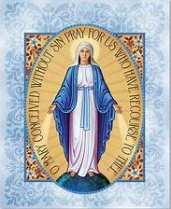
Week 3 (service team)
33 Days of Morning Glory retreat

Slide 3
Time | Activity
8.45pm | Protection prayer (service team come together to say the prayer)
8.55pm | Welcome everyone & Play song (6 mins)
9.02pm | Opening prayer (3 min) & video part 1 (6 min)
9.10pm | Say group prayer from retreat companion
9.15pm | Breakout rooms: Groups to share the reflection questions (35 min)
9.50pm | Video part 2 (33mins)
10.23pm | Main group: Sharing about video 2 that you have watched (10 min)
10.33pm | Closing prayer & End session (5 mins)
10.38pm | Cutting off prayer (service team will stay back to say the prayer)

Slide 4
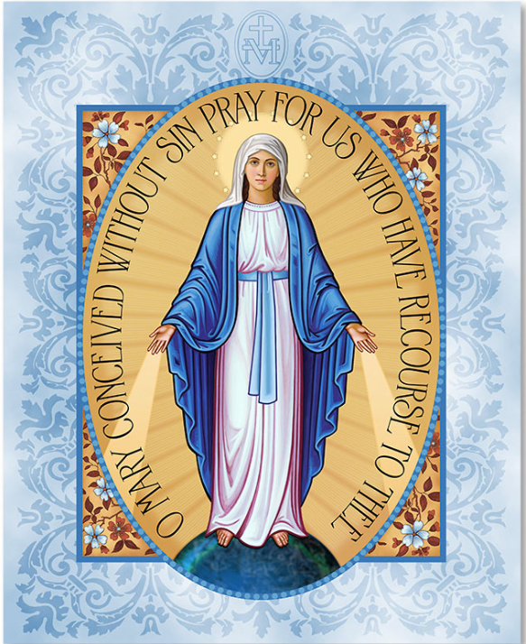

Slide 5
33 Days of Morning Glory retreat
https://www.youtube.com/watch?v=f0YWKLNhTvE

Slide 6
Week 3
33 Days of Morning Glory retreat

Slide 7
Opening prayer
33 Days of Morning Glory retreat
Week 3
Notes:
I would like to invite Belle to start with an opening prayer

Slide 8
Video - Part 1
33 Days of Morning Glory retreat
Week 2

Slide 9
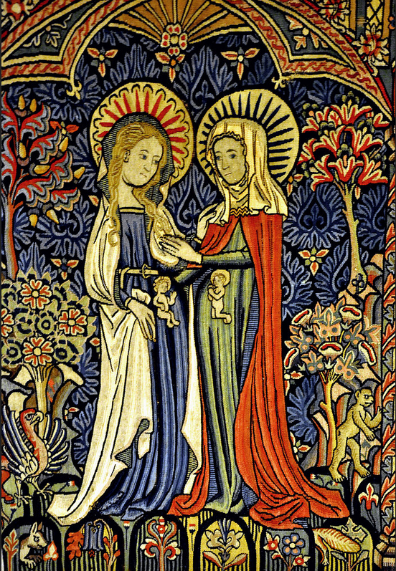
Magnificat prayer
My soul proclaims the greatness of the Lord,
my spirit rejoices in God my Savior,
for he has looked with favour on his lowly servant.
From this day all generations will call me blessed:
the Almighty has done great things for me, and holy is his Name.
He has mercy on those who fear him
in every generation.
He has shown the strength of his arm,
he has scattered the proud in their conceit.
He has cast down the mighty from their thrones,
and has lifted up the lowly.
He has filled the hungry with good things,
and the rich he has sent away empty.
He has come to the help of his servant Israel
for he has remembered his promise of mercy,
the promise he made to our fathers,
to Abraham and his children forever.
Amen.

Slide 10
Come, Holy Spirit, and be with us.
We wish to contemplate the mysteries of Jesus and Mary in our lives, as we prepare for consecration to Jesus through Mary.
Amen.

Slide 11
Breakout rooms
33 Days of Morning Glory retreat
Week 3

Slide 12
Video - Part 2
33 Days of Morning Glory retreat
Week 3

Slide 13
Main group sharing
33 Days of Morning Glory retreat
Week 3

Slide 14
Notes:
Please encourage the retreatants to write their own consecration prayer

Slide 15
Consecration Details
Date: 1st Jan 2021 (FRI) Time: 9.30am to 11.45am (Live Mass via zoom)
Celebrant: Fr. Derrick Yap
9.30am - mass cum consecration
10.30am Post video on consecration
11. 15am Meetup with group mates and
share about the consecration journey

Slide 16
Closing prayer
Dear Papa Lord, We give praise to your most holy name and we give you thanks for this retreat. We unite our prayers with your heavenly angels and saints in praying for the Maris Stella parent support community and our CEP community.
Jesus, cover us with your love and your precious blood. Protect all of us retreatants, service teams, prayer warriors and all of our family members from harm and illness. May our eyes and hearts be open to hear your gentle promptings and our hearts be pliable to your moulding and pruning.
Mama Mary, lend us your heart, teach us to love our family members with your tenderness. Please cover us in your mantle, as we offer ourselves for God’s Glory
Come Holy Spirit, give us a steadfast faith and all the graces that we need. Holy Spirit renew us, we give you the permission to change us to be the saints God wants us to become, for His Glory
St. Joseph, protector of families, please pray for us
Glory be to the Father…

Slide 17
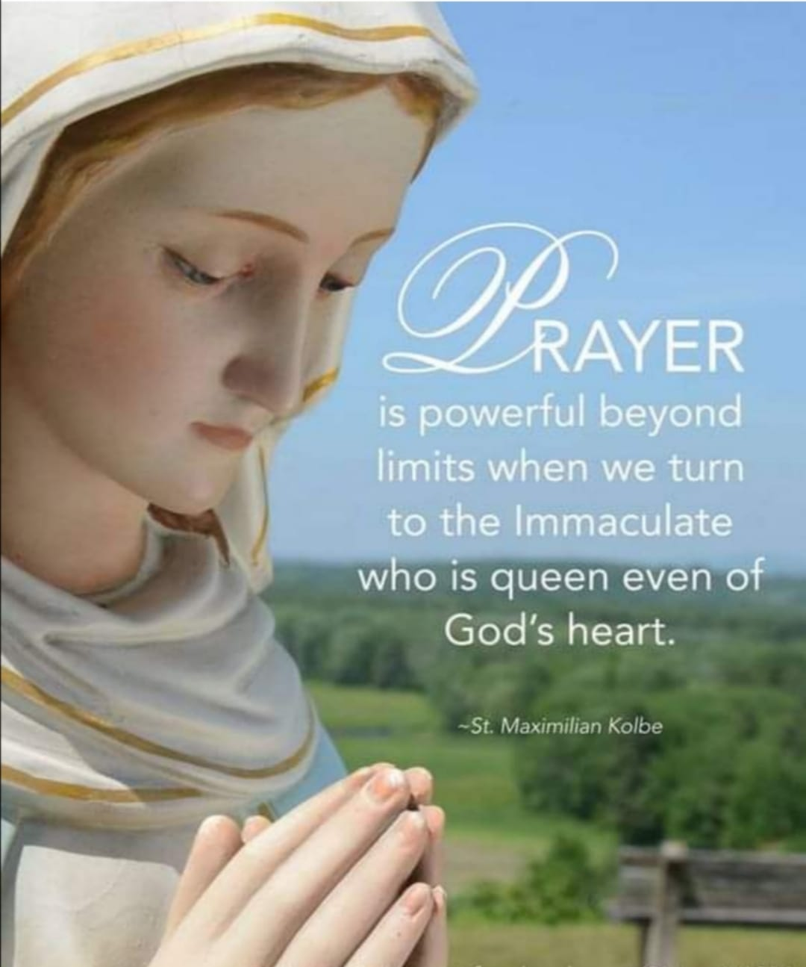
Rosary session via zoom
Rosary 1st and 3rd Sunday of the month
Jan 3 and 17 at 9pm.

Slide 18
Renewal of consecration cum meetup
(TBC)
Date: 13 March (SAT) / 15 March 2021 (MON) 2021 -TBC Time: 9pm - 10.30pm Group meetup, Rosary, renewal of consecration

Slide 22
Be still
And know I am God
Oh be still
And know I am God
Sometimes I wonder why
Some things happen to me
Why some things…
That everywhere I go
I live my life as if he doesn't know best
But only in the lord is my soul at rest
Still its easier said than done
Just to Be still
And know He is God
Oh be still
And know He is God
Be still and know He is God
Oh Be still and know He is God
Be Still by Luke Spehar
Everywhere I go
I see people running
Running from their own minds
From something they won't see
And everywhere I go
I see unanswered questions
Pry apart their convictions
And cause them to fall down
And it surprises me to know
That he answers all questions
Just by softly saying
Be still
And know I am God
Oh be still
And know I am God
Everywhere I go
I find myself running
Mindlessly in circles
From the doubts in my head
And everywhere I go
I wonder where I going
I wonder if I'm showing
Everything that must be seen
And it surprises me to know
That he answers all my questions
Just by strongly saying to me

