Slide 1
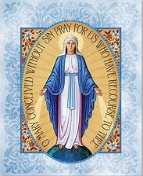
Week 3
33 Days of Morning Glory retreat

Slide 3
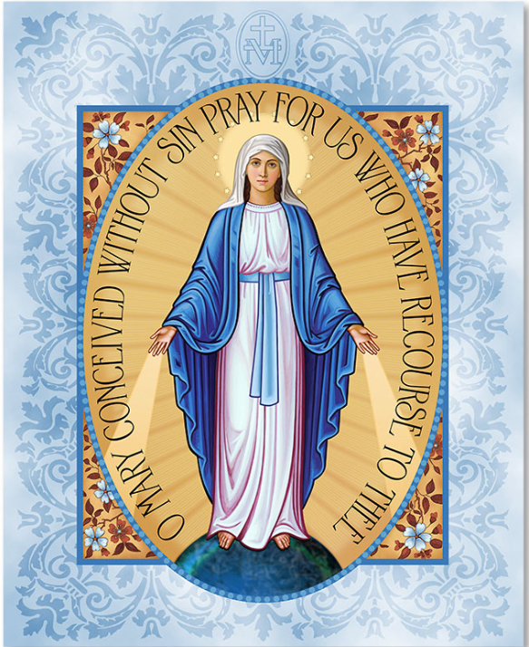

Slide 4
33 Days of Morning Glory retreat
https://www.youtube.com/watch?v=StFAiPzHflY&feature=youtu.be

Slide 5
Week 3
33 Days of Morning Glory retreat

Slide 6
Opening prayer
33 Days of Morning Glory retreat
Week 3
Notes:
I would like to invite Belle to start with an opening prayer

Slide 7
Video - Part 1
33 Days of Morning Glory retreat
Week 3

Slide 9
Come, Holy Spirit, and be with us.
We wish to contemplate the mysteries of Jesus and Mary in our lives, as we prepare for consecration to Jesus through Mary.
Amen.

Slide 10
Breakout rooms
33 Days of Morning Glory retreat
Week 3

Slide 11
Video - Part 2
33 Days of Morning Glory retreat
Week 3

Slide 12
Main group sharing
33 Days of Morning Glory retreat
Week 3

Slide 13
Notes:
Please encourage the retreatants to write their own consecration prayer

Slide 14
Closing prayer

Slide 15
Consecration Details
Date: 11th Feb 2021 (THUR) Time: 7.45am Paraliturgy by Fr. Derrick Yap

Slide 16
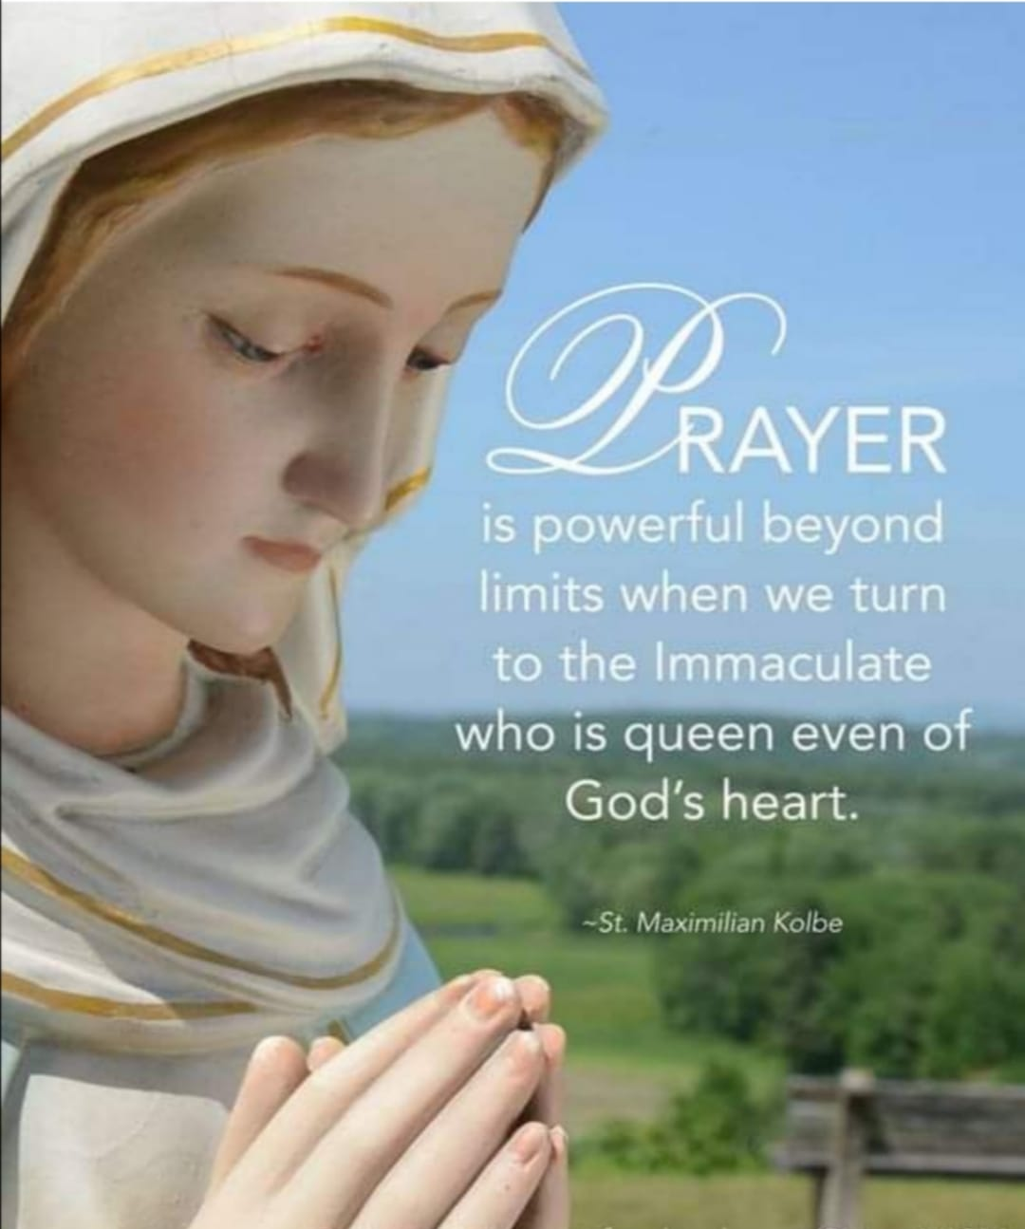
Rosary session via zoom
Rosary 1st and 3rd Sunday of the month

Slide 18
Renewal of consecration cum meetup
(TBC)
Date: 13 March (SAT) / 15 March 2021 (MON) 2021 -TBC Time: 9pm - 10.30pm Group meetup, Rosary, renewal of consecration

Slide 21
Be still
And know I am God
Oh be still
And know I am God
Sometimes I wonder why
Some things happen to me
Why some things…
That everywhere I go
I live my life as if he doesn't know best
But only in the lord is my soul at rest
Still its easier said than done
Just to Be still
And know He is God
Oh be still
And know He is God
Be still and know He is God
Oh Be still and know He is God
Be Still by Luke Spehar
Everywhere I go
I see people running
Running from their own minds
From something they won't see
And everywhere I go
I see unanswered questions
Pry apart their convictions
And cause them to fall down
And it surprises me to know
That he answers all questions
Just by softly saying
Be still
And know I am God
Oh be still
And know I am God
Everywhere I go
I find myself running
Mindlessly in circles
From the doubts in my head
And everywhere I go
I wonder where I going
I wonder if I'm showing
Everything that must be seen
And it surprises me to know
That he answers all my questions
Just by strongly saying to me

