Slide 1
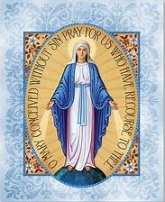
Week 1
33 Days of Morning Glory retreat

Slide 2
Time | Activity
7.45am | Opening prayer & video part 1 (5 min)
7.50am | Say group prayer from retreat companion (5min)
7.55am | Breakout rooms: Groups to share the reflection questions (25 min)
8.20pm | Video part 2 (35 mins)
8.50pm | Main group: Sharing about video 2 that you have watched (10 min)
9am | Closing prayer & End session (5 mins)

Slide 4
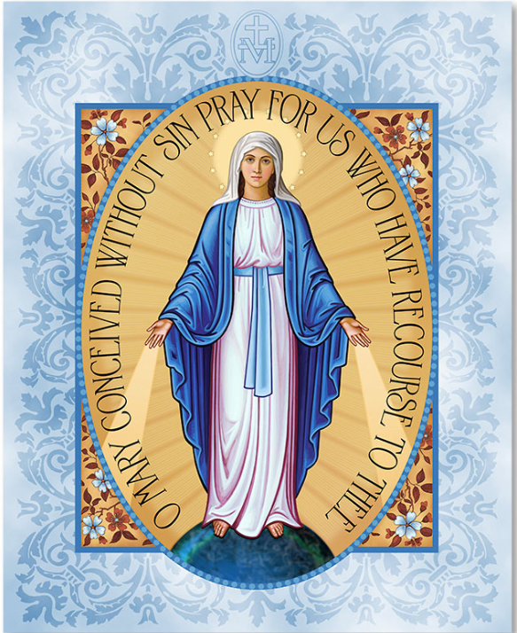

Slide 5
Week 1
33 Days of Morning Glory retreat

Slide 6
Opening prayer
33 Days of Morning Glory retreat
Week 1
Notes:
I would like to invite Belle to start with an opening prayer

Slide 7
Video - Part 1
33 Days of Morning Glory retreat
Week 1

Slide 9
Come, Holy Spirit, and be with us.
We wish to contemplate the mysteries of Jesus and Mary in our lives, as we prepare for consecration to Jesus through Mary.
Amen.

Slide 10
Group sharing
33 Days of Morning Glory retreat
Week 1

Slide 11
Video 2
33 Days of Morning Glory retreat
Week 1

Slide 12
Group sharing (10 min)
33 Days of Morning Glory retreat
Week 1

Slide 13
Closing prayer

