Slide 1
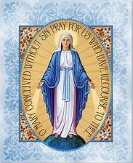
Week 2 (service team)
33 Days of Morning Glory retreat

Slide 2
Time | Activity
8.45pm | Protection prayer (service team come together to say the prayer)
8.55pm | Welcome everyone & Play song (6 mins)
9.02pm | Opening prayer (3 min) & video part 1 (6 min)
9.10pm | Say group prayer from retreat companion
9.15pm | Breakout rooms: Groups to share the reflection questions (35 min)
9.50pm | Main group sharing (5 mins) & Video part 2 (30 mins)
10.25pm | Main group: Sharing about video 2 that you have watched (10 min)
10.35pm | Closing prayer & End session (5 mins)
10.40pm | Cutting off prayer (service team will stay back to say the prayer)

Slide 4
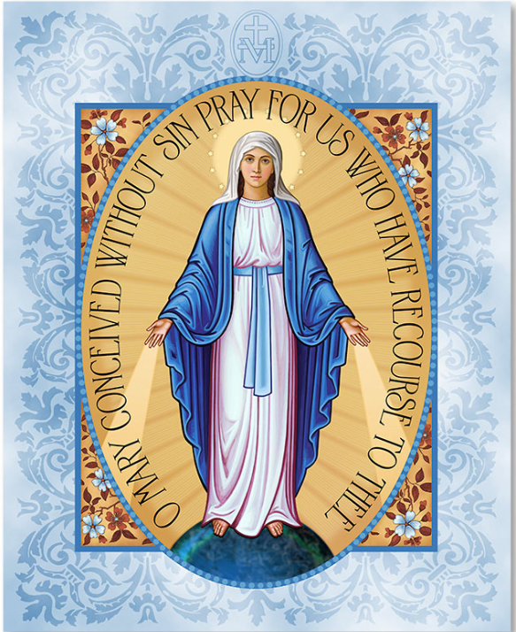

Slide 5
As I kneel before You As I kneel before You
As I bow my head in prayer
Take this day, make it Yours
And fill me with Your love
Ave Maria
Gratia plena
Dominus tecum
Benedicta tu
All I have, I give You
Every dream and wish are Yours
Mother of Christ
Mother of mine,
present them to my Lord
Ave Maria
Gratia plena
Dominus tecum
Benedicta tu
As I kneel before You
And I see Your smiling face
Every thought, every word
Is lost in Your embrace
Ave Maria
Gratia plena
Dominus tecum
Benedicta tu
Ave Maria
Gratia plena
Dominus tecum
Benedicta tu

Slide 6
Week 2
33 Days of Morning Glory retreat

Slide 7
Opening prayer
33 Days of Morning Glory retreat
Week 2
Notes:
I would like to invite Belle to start with an opening prayer

Slide 8
Video - Part 1
33 Days of Morning Glory retreat
Week 2

Slide 9
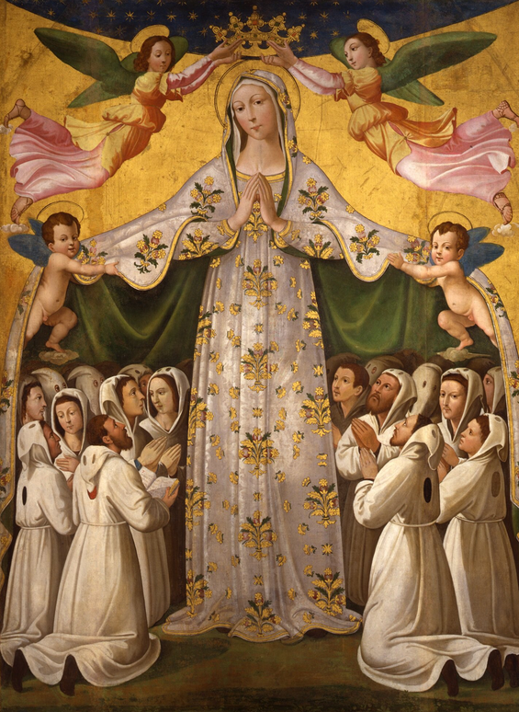
Sub Tuum Praesidium
( oldest prayer to the Blessed Virgin Mary)
We fly to thy protection,
O holy Mother of God.
Despise not our petitions in our necessities,
but deliver us always from all dangers,
O glorious and blessed Virgin.
Amen

Slide 10
Come, Holy Spirit, and be with us.
We wish to contemplate the mysteries of Jesus and Mary in our lives, as we prepare for consecration to Jesus through Mary.
Amen.

Slide 11
Breakout rooms
33 Days of Morning Glory retreat
Week 2

Slide 12
Video - Part 2
33 Days of Morning Glory retreat
Week 2
Main group sharing (5 mins)

Slide 13
Main group sharing
(10 mins)
33 Days of Morning Glory retreat
Week 2

Slide 14
Closing prayer
Dear Papa Lord, We give praise to your most holy name and we give you thanks for this retreat. We unite our prayers with your heavenly angels and saints in praying for the Maris Stella parent support community and our CEP community.
Jesus, cover us with your love and your precious blood. Protect all of us retreatants, service teams, prayer warriors and all of our family members from harm and illness. May our eyes and hearts be open to hear your gentle promptings and our hearts be pliable to your moulding and pruning.
Mama Mary, lend us your heart, teach us to love our family members with your tenderness. Please cover us in your mantle, as we offer ourselves for God’s Glory
Come Holy Spirit, give us a steadfast faith and all the graces that we need. Holy Spirit renew us, we give you the permission to change us to be the saints God wants us to become, for His Glory
St. Joseph, protector of families, please pray for us
Glory be to the Father…

Slide 15
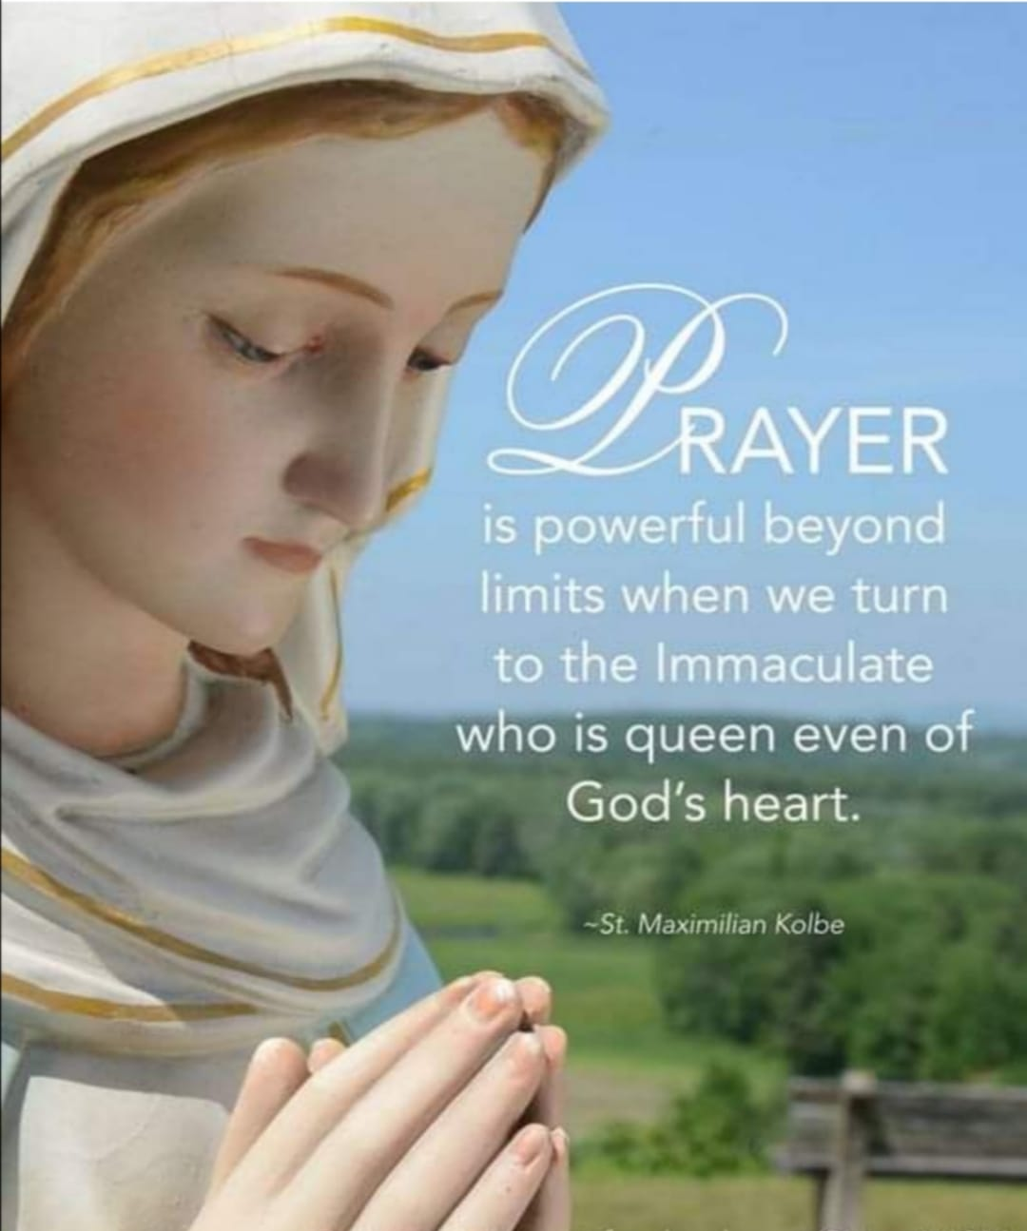
Rosary session via zoom
Rosary 1st and 3rd Sunday of the month
Dec 20th
at 9pm.

Slide 19
Holy Spirit, You are welcome here
There is nothing worth more
That will ever come close
No thing can compare
You're our living hope
Your presence Lord
I've tasted and seen
Of the sweetest of Love
When my heart becomes free
And my shame is undone
Your presence Lord
Holy spirit, You are welcome here
Come flood this place and fill the atmosphere
Your glory, God, is what our hearts long for
To be overcome by Your presence, Lord
Holy spirit, You are welcome here
Come flood this place and fill the atmosphere
Your glory, God, is what our hearts long for
To be overcome by Your presence, Lord
Let us become more aware of Your presence
Let us experience the glory of Your goodness
(Repeat)
Holy spirit, You are welcome here
Come flood this place and fill the atmosphere
Your glory, God, is what our hearts long for
To be overcome by Your presence, Lord
(Repeat)
Let us become more aware of Your presence
Let us experience the glory of Your goodness
(Repeat)
There is nothing worth more
That will ever come close
No thing can compare
You're our living hope
Your presence Lord
I've tasted and seen
Of the sweetest of love
When my heart becomes free
And my shame is undone
Your presence Lord
Holy spirit, You are welcome here
Come flood this place and fill the atmosphere
Your glory, God, is what our hearts long for
To be overcome by Your presence, Lord

Slide 20
Be still
And know I am God
Oh be still
And know I am God
Sometimes I wonder why
Some things happen to me
Why some things…
That everywhere I go
I live my life as if he doesn't know best
But only in the lord is my soul at rest
Still its easier said than done
Just to Be still
And know He is God
Oh be still
And know He is God
Be still and know He is God
Oh Be still and know He is God
Be Still by Luke Spehar
Everywhere I go
I see people running
Running from their own minds
From something they won't see
And everywhere I go
I see unanswered questions
Pry apart their convictions
And cause them to fall down
And it surprises me to know
That he answers all questions
Just by softly saying
Be still
And know I am God
Oh be still
And know I am God
Everywhere I go
I find myself running
Mindlessly in circles
From the doubts in my head
And everywhere I go
I wonder where I going
I wonder if I'm showing
Everything that must be seen
And it surprises me to know
That he answers all my questions
Just by strongly saying to me

